Slide 1

Desired Results for Children and Families
A project of the California Department of Education,
Early Education and Support Division
with
Desired Results Training & Technical Assistance Project
Notes:
1
Display the title screen to let participants know that they are in the correct location for the Desired Results training.

Slide 2

Desired Results Day 6
Welcome Back
Notes:
Welcome back participants.

Slide 3

Welcome!
Who’s on the Web conference today?
Only the presenter’s voice can be heard during the conference.
All participants are encouraged to submit questions and contribute to the discussion through text chat.

Slide 4
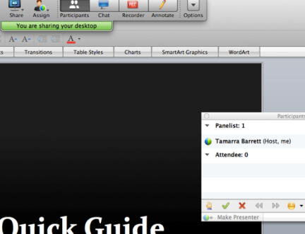
Quick Guide
To see participant list, go to green bar at top of screen and drop down bar appears.
Click on participants.

Slide 5
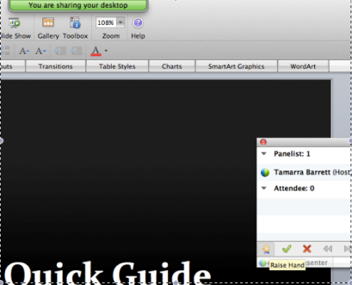
Quick Guide
To raise a hand, use participant box and click on small hand.
To put hand down, click hand again.

Slide 6
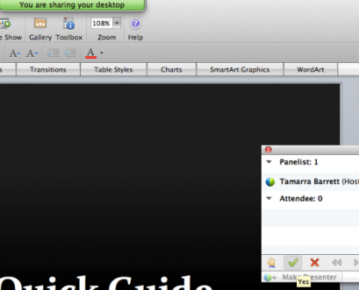
Quick Guide
To answer YES to a question:
From participant box, click on green check mark.
To clear check mark, click again.

Slide 7
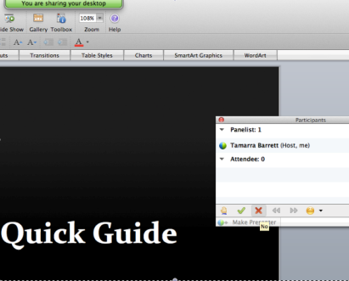
Quick Guide
To answer NO to a question:
From participant box, click on red x.
To clear red x, click again.
Notes:
Desired Results training is the result of a desire on the part of the California Department of Education, Early Education and Support Division to improve and standardize program quality across the state.
In Session I, an overview of the system’s components will provide preliminary information on the Desired Results for Children and Families system’s goals and structure.
Later, additional details and information will be provided to give participants knowledge about each element of the DR system.

Slide 8

Quick Guide
To open Chat Box:
Go to green bar at top of screen, drop down menu appears.
Click on chat.
Type comment into lower box.
Assign a sender and
click enter.

Slide 9

Chat Box
Please use the chat box for general comments.

Slide 10
Agenda
Welcome
Program Self-Evaluation
  Updates to the 2014/2015 process
  Summary of Findings/Program Action Plans
Taking It Back to the Agency
Question and Answer
Notes:
Describe the day’s training plans.
Read the agenda from the slide.
Refer participants to the handouts in the folder.

Slide 11

Intent of Webinar
Understand what is new in 2014/2015 Program Self-Evaluation (PSE) Process
Notes:
• This Webinar will explain what is new in the process and what needs to be sent June 1st.

Slide 12
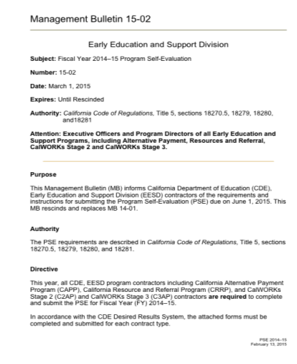
Management Bulletin

Slide 13
Available Information from Early Education and Support Division
Management Bulletin (MB) 15-02 from the Early Education and Support Division (EESD) was released in March 2015 detailing required Program Self Evaluation forms.
Notes:
The forms discussed today are needed for the Program Self Evaluation.
Trainer note: Remind participants to register to receive management bulletin emails.

Slide 14
EESD Mailing List
http://www.cde.ca.gov/sp/cd/ci/progspeclist.asp
Please use the link to join the EESD mailing list and receive management bulletins.

Slide 15
The Program Self-Evaluation (PSE) requires that the Desired Results system data be compiled and summarized for the:
DRDP
DR Parent Survey
Environment Rating Scale
Program Review Instrument
NEW!
Notes:
The PSE requires data be compiled and summarized.

Slide 16
Program Self Evaluation (PSE)
Guides programs by examining all three components of the Desired Results system
Determines program strengths
Determines areas of improvement
Establishes program goals for the upcoming year
Notes:
This process allows programs to reflect on progress over the year, and make a plan for ongoing improvement. The plan developed now is for next contract year.

Slide 17
The PSE requires completion of:
Due to EESD by June 1st at 5:00 pm
EESD Program Review Instrument (EESD 4001)
DR Program Action Plan-Reflection on Action Plan (EESD 4002)
DRDP Summary of Findings and Program Action Plan (EESD 4003)
ERS Summary of Findings (EESD)
Parent Survey Summary of Findings (EESD)
Program Self Evaluation Cover Page (EESD 4000)
Notes:
This year all contractors (reference directions of EESD 4001) are to complete the Program Review Instrument. (CAPP, CMAP, C2AP C3AP, CRRP are included
This year all contractors that completed the PSE last year, need to complete the EESD 4002, this form reflects on your goals from last year. For contractors that are completing PSE this year ( but did not last year) the reflection sheet is not required this year, but heads up it will need to be completed next year.
This year all contractors complete the DRDP Summary of Findings and Program Action Plan, it looks a little different from previous years but this form is still used to
This year all contractors are to complete the Cover page ( 1 cover page) per agency
This year ERS and Parent Survey Summary of Findings must be completed, but are not mailed in to EESD.
*Remind participants to read the directions on the forms.

Slide 18

PSE Forms
Each EESD form has a sheet of instructions.
Please read the instructions on each form.

Slide 19
Programs are to…
NEW!
Complete the Program Review Instrument
Consider Contractor Requirements:
  Review all categories that apply
  Provide description of findings
Complete one EESD 4001 form for each contract type
Notes:
Trainer note: Have participants review how they have met their fiscal and program requirements and provide a description of the findings for the different categories.
CAPP, CMAP, C2AP, C3AP, CRRP must also complete this form.

Slide 20
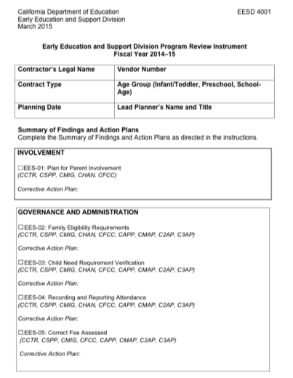
Program Review Instrument (EESD 4001)
NEW!
Notes:
This form is a new requirement for the PSE process. More information and details about the Program Review Instrument and requirements are available on the cde.ca.gov Web site.

Slide 21
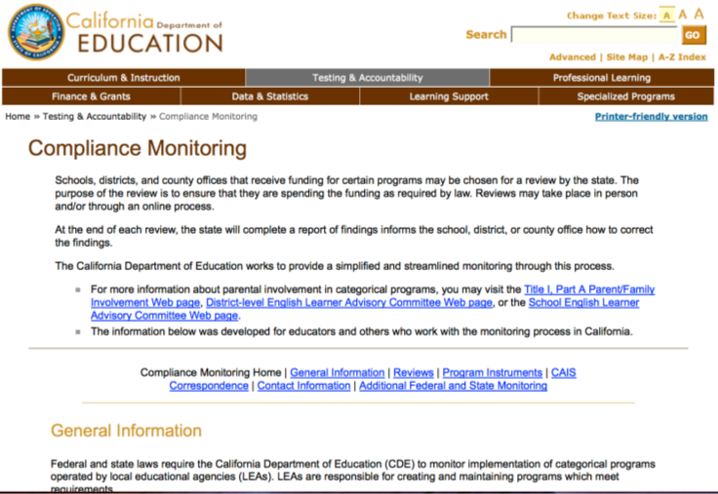
http://www.cde.ca.gov/ta/cr/

Slide 22
Programs are to…
Reflect on the 2014 Action Plan being implemented this contract year
Consider educational goals:
  Identify what went well
  Identify what still needs improvement
Complete one EESD 4002 form for each contract type by age group
Notes:
Trainer note: Have participants use their program action plans from 2014 (last year) to reflect on their progress.
CAPP, CMAP, C2AP, C3AP, CRRP will not be completing reflection sheet this year, but they will complete it next year.

Slide 23
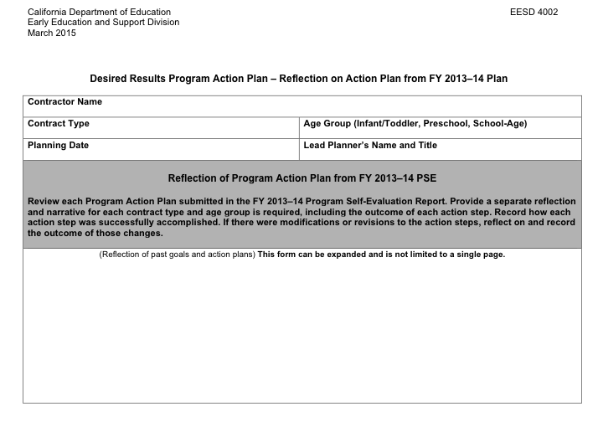
Reflection on Action Steps EESD 4002
Notes:
Agencies are to provide a brief narrative reflecting on action steps from FY2013/2014 Program Action Plan (CD 4001A) to the form Reflection on Action Plan (EESD 4002).
CAPP, CMAP, C2AP, C3AP, CRRP will not be completing reflection sheet this year, but they will complete it next year.
This reflective process will help contractors identify accomplishments and lessons learned to use in future planning for program quality.
Use the EESD 4002 form to describe the successful implementation of each action step and/or modifications to the action steps. Explain how the action step was revised and the outcome of the modification.

Slide 24
Reflection
Reflect on last year
Consider educational goals
Identify what went well
Identify what still needs improvement
Complete one EESD 4002 form for each contract type by age group
Notes:
Have participants use their program action plans from last year to reflect on their progress. The action steps would be different or unique to the contract type and age group. A separate reflection and narrative for each is required.

Slide 25
The PSE requires all teachers to:
Complete the DRDP for each child twice a year
Summarize classroom data
Complete classroom Summary of Findings (EESD 3900)
Notes:
Trainer note: Refer to form EESD 3900 (used to be CD 4001b). Have participants read first three paragraphs. Highlight when the CD3900 dated March 2015 is to be completed.
Although this is not a required form, as it states in the instructions, alternate forms must include all the same information (key findings, action steps, completion date and person responsible, follow up and reflection). Please realize that at any time a EESD consultant may request this information.

Slide 26
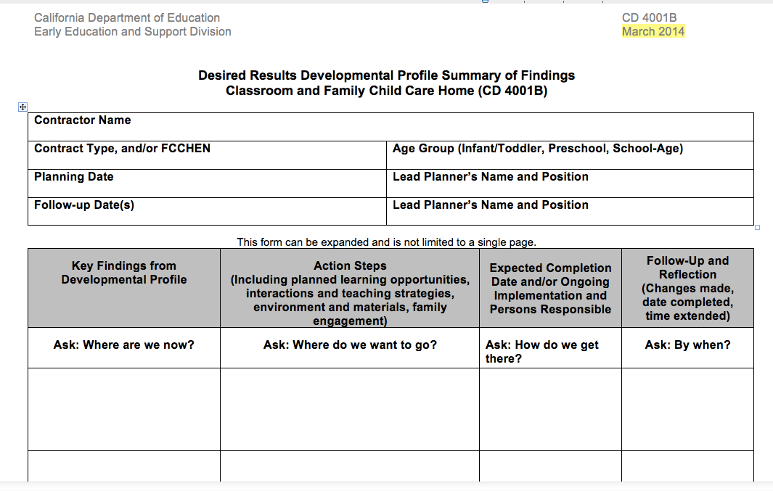
CD 4001B
Follow up
Notes:
Early Education and Support Division (EESD) has added questions under each column to help teachers in their reflection process, and to help them understand the content needed for each column.
Remember the teachers have already completed this form. And now based on the 2nd data collection period, they are reflecting on how the planning went and if any modifications are needed to support their current group of students.
The form for 2015/2016 is dated March 2015.
The CD4001B is from the first data collection period.

Slide 27
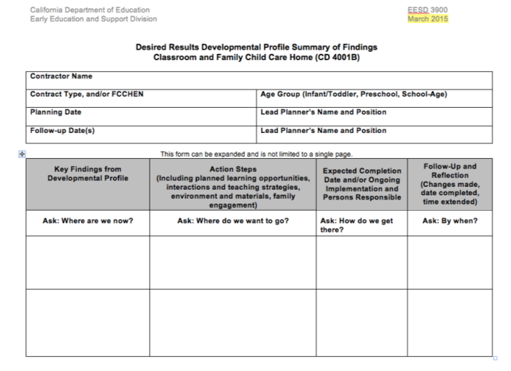
EESD 3900

Slide 28
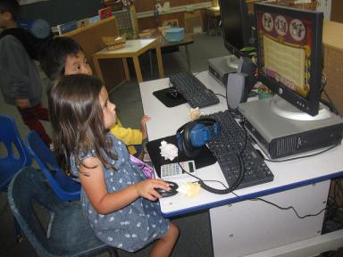

The PSE requires programs to compile data for analysis
Notes:
After completing each child’s DRDP, receiving completed Parent Surveys, and evaluating classrooms and FCC homes using ERS, the next task is to compile the data.
Data is compiled in order to analyze and make programmatic decisions.
Data is compiled to know what went well and what still needs to be addressed.

Slide 29

Data is compiled to assist programs in building a clear picture of group strengths and areas for improvement.
Notes:
The compiling of data provides programs with an OVERVIEW of the program strengths and areas for improvement. It is an important step in the self-evaluation process. Since teachers compile data or write classroom summaries of findings, they should be familiar with the process.

Slide 30
Group data is compiled to inform:
Professional Development
Curriculum/Materials Required
Staff or Program Schedules
Child-Staff Interactions
Parent Education/Community Outreach
Program or Classroom Use of Space
Notes:
When planning action steps for the Program Action Plan, consider these areas of growth for the entire program.

Slide 31
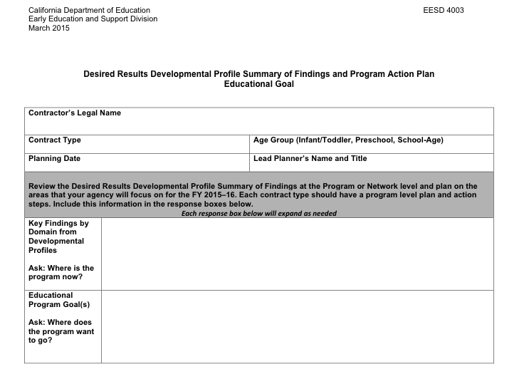
DRDP Summary of Findings/Program Action Plan
Notes:
After the 6 month follow up assessment period, compile the information from all of the individual classroom of family child care home DRDPs. First compile information at site level, then at program level.
Look for trends or patterns in the DRDP data to identify overall strengths and areas needing improvement at the domain level. Write at least one key finding.
There is an additional column (educational goals). In this column, define at least one goal at the domain level to address the identified key finding.
The new form is EESD 4003 (used to be CD 4001a).
You will notice some changes to the layout of the form to help write more information. As the form states, this is the PROGRAM action plan.
Similar to the classroom summary of findings, there are guiding questions for each area.

Slide 32
Comparison of Forms
EESD 4003 vs. EESD 3900
4003
Teachers complete
3900
Program Action Plan
Action steps geared towards teaching staff to impact children
Educational goal
Classroom Summary of Findings
Action steps geared towards direct impact on children
Follow up section
Notes:
Trainer note: Ask participants to highlight the differences.

Slide 33


DRDP data is compiled…
… by site,
…by program,
…by age group,
…by contract
Notes:
Trainer note: Refer to EESD 4003. Allow participants 3-5 minutes to read instructions.
Each teacher compiled classroom data and completed a Summary of Findings (CD 4001B)-last year. Now we are looking at the program level. Programs are required to take all of the classroom data and compile by age group it at the site level or FCCHEN designated teachers case load, and then compile the data at the program level by age group and contract.

Slide 34

Suggested ways to summarize the data include…
Using DRDPtech©
Using a tally sheet
Using a computer spreadsheet (Excel)
Using a commercial software program
Notes:
• There are several suggested ways that programs may summarize the information. Each agency may experiment with the method. However, the number of classrooms, sites, and program types, as well as technical resources, will likely contribute to the method agencies decide works best.
• The Desired Results Web site offers tools to do a tally or use the Excel files for DRDP age levels and Parent Surveys.

Slide 35
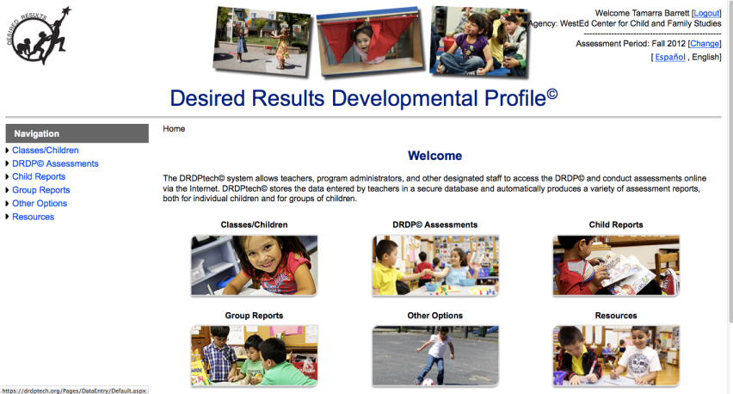
DRDPtech©
Notes:
DRDPtech is free of charge for EESD-funded programs, California Head Start programs, California tribal CCDF and Head Start programs, and for California K-12 school districts.

Slide 36
DRDPtech©
Notes:
DRDPtech allows programs to go paperless when completing and storing their DRDP data. Within DRDPtech programs can pull different level reports. Reports for individual children, groups of children and the entire agency. These reports are helpful for planning curriculum and meeting professional development goals.

Slide 37


ERS data is compiled at the …
…classroom/family child home
…site
…contract
Notes:
Trainer note: Refer to instructions EESD. Allow participants 3-5 minutes to read and highlight important information.
No matter the size of a program or agency, data is compiled at the classroom level for the Environment Rating Scale. Each program is responsible for the ERS data to be grouped by:
1st – classroom/ FFCHEN home
2nd – site / FFCHEN home
3rd - program or agency compiled by age group and contract. Compile all of the ITERS, ECERS, FCCERS and SACERS.Write a Summary of Findings for each one or write it by type on one sheet of paper.)

Slide 38
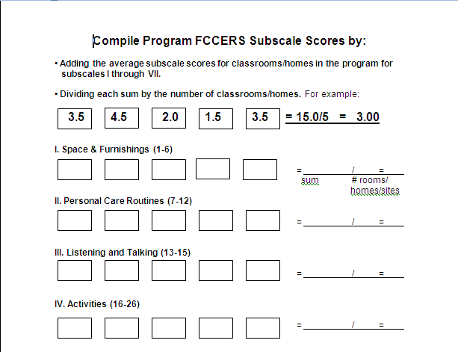
To compute ERS contract average subscale: Add each classroom average and divide by the number of classrooms
Notes:
• AGENCY average subscale scores are computed by adding up each classroom/home average subscale scores together and dividing that sum by the number of classrooms/homes.
• All subscale score AVERAGES below “5” must be listed on the AGENCY ERS Summary of Findings, in the subscales listed in the instructions for form EESD. Although action steps must be completed by a date determined by the agency, items that involve the immediate safety of children should be addressed as soon as possible.

Slide 39
Parent Survey data is compiled…
…by site (recommended)
…by contract
Notes:
Trainer note: Refer to EESD. Allow participants 3-5 minutes to read instructions and highlight important information.
No matter the size of a program or agency, Parent Surveys are summarized at the contract level, although agencies may choose to compile it at the site level. Agencies group the data by:
1st - site (ONLY a recommendation; site summary is not required.)
2nd - program or agency
This data will be used to write Summaries of Findings which will be analyzed again to determine a COMPREHENSIVE Program Action Plan for the agency.

Slide 40

Suggested ways to summarize Parent Survey data include…
Hand using a tally sheet
Using a computer spreadsheet - Excel file
Using commercial software program
Notes:
Parent surveys are compiled in a similar way to the DRDP with the addition of available space to record the comments parents make on the survey form.
No matter the size of a program or agency, parent surveys are summarized at the contract level, although agencies may choose to compile it at the site level. Agencies group the data by:
1st - site (ONLY a recommendation; site summary is not required.)
2nd - program or agency
This data will be used to write summaries of findings which will be analyzed again to determine a COMPREHENSIVE program action plan for the agency.

Slide 41
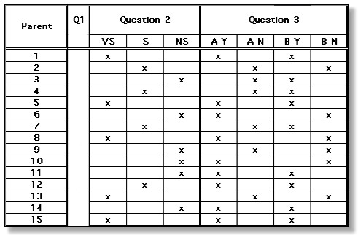
Parent Survey
Group Data Summary Excel File
Notes:
There is also an Excel file for compiling parent survey data. This file follows the format of the Parent Survey:
VS is very satisfied
S is satisfied
NS is not satisfied
On question segment:
The Y is equal to a Yes
The N is equal to No

Slide 42
Programs are ready to compile data when:
Teachers/FCC network managers have completed a DRDP for each child
or
Parent Surveys have been distributed and returned
or
Each classroom/FCC home has completed an ERS Profile
Notes:
10
Explain that compiling data begins when all assessments have been completed: a DRDP on all children, Parent Surveys, and all classroom/FCC homes have been assessed with the appropriate ERS.
Remember, the DRDP has to be done twice, within 60 days and then every six months thereafter. Teachers will have already compiled this data once, as well as the agency this year.
If the center-based contractor has multiple sites, first compile the information by site, and then at the program level.
If the education network has more than one designated teacher, collect information from each family child care home, and first compile the information by each designated teacher’s case load assignment (which would be similar to a center-based “site”) and then complete the information at the program level.

Slide 43
Use the appropriate DRDP Group Data reports within DRDPtech©:
Infant/Toddler DRDP – Birth-35 months
Preschool DRDP – 36 months-Kindergarten
School Readiness – Transitional Kindergarten
School age DRDP – Kindergarten-12 years
Notes:
DRDPtech provides online data entry of all age instruments.

Slide 44
After compiling the data during the appropriate time periods for the:
DRDP
Parent Surveys
ERS
You are ready to complete the Summary of Findings and Program Action Plan.
Notes:
Data is now compiled.
Trainer note: Discuss how to complete the Summary of Findings.

Slide 45


Writing a Summary of Findings
  and a Program Action Plan!

Slide 46
A Summary of Findings...
Identifies the Key Findings based on the data
Describes Action Steps to address Key Findings
Identifies who will complete the Action Steps and completion dates
Describes follow up as needed
Notes:
8
The process is the same for all Summary of Findings (Parent Surveys and ERS).

Slide 47
Purpose of Agency
Summary of Findings
The Summary of Findings identify the what, how, who, and when that will be addressed in the agency.
This process:
  assists programs in supporting children’s development
  provides easier-to-access data for reflection and planning to improve programs
Notes:
Share the slide.
Some of the purposes of completing a Summary of Findings include ongoing continuous quality improvement. The summary helps to see what programs are doing well and where they can implement strategies to do better.

Slide 48

Step 1
Identifying
Key Findings
Notes:
When writing the key finding, programs may ask themselves, “Where are we now?” The key findings are trends that show up in the data that identify strengths and areas needing improvement.

Slide 49
Key Findings are the trends or important information found when analyzing data from the assessment tools on the previous page.
These findings are used to improve the quality of the program resulting in better outcomes for children and families.
Notes:
Read slide.
The key findings are those trends or patterns identified when analyzing the data, from DRDPs, Parent Surveys and ERS
These findings are important enough to write action steps about.
These findings will make an impact on children and families in the program.

Slide 50
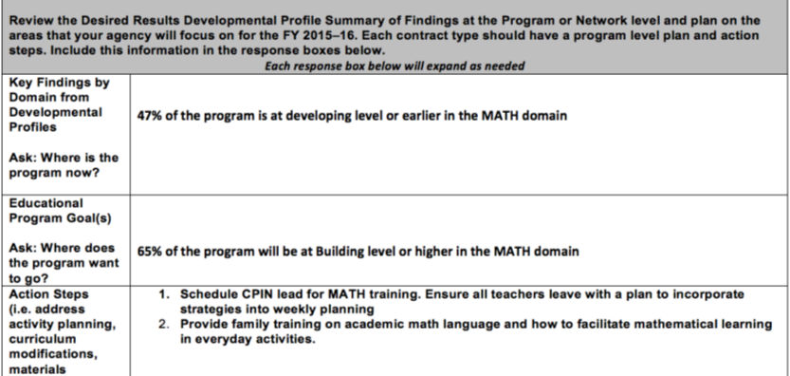
DRDP Summary of Findings/Program Action Plan
Provide Key Findings in percentages.
You have identified a finding.
What educational goal for children
could you add?
Notes:
Trainer note: Share slide. Direct participants to sample of DRDP Summary of Findings/Program Action Plan, provided by Field Service Office. Point out the focus of Action Steps.
In completing the DRDP Summary of Findings/Program Action Plan for the program by age and by contract, consider professional development and curriculum that the children needed support in the mathematical domain.
They had experience and knowledge about math for early learners, but wondered where to access research and guidance in planning the action steps for the Summary of Findings and the agency Program Action Plan.

Slide 51
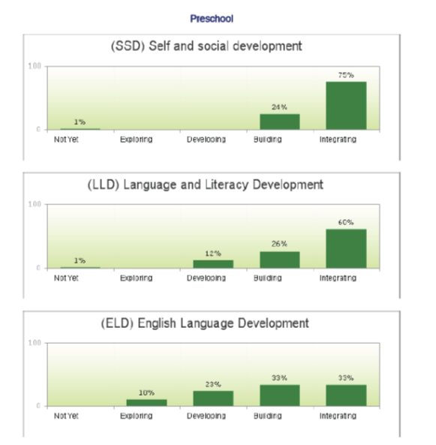
Notes:
Analyze this spring group report and type a key finding at the domain level into the chat box.

Slide 52
Educational Program Goals...
Address important issues regarding the educational needs of children identified in the program findings
Are based upon the DRDP findings
Choose only one or two goals per age group.
Notes:
The second box of the EESD 4003, is for the Programs Educational Goal. Based on your key finding from the DRDP, what are your goals for the next coming year?
Remember to write attainable goals.

Slide 53



Write Key Findings and an Educational Goal for each age group in your program
Infant/Toddler
Preschool
School-age
Notes:
Key findings and educational goals must be written for each age group.

Slide 54
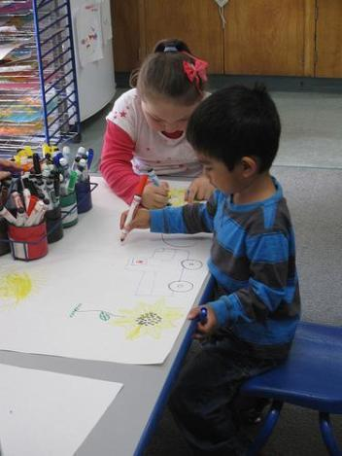
Step 2
Writing Action Steps
Notes:
We know the action steps are a way to focus efforts to improve outcomes for children and families.

Slide 55
Action Steps
Are the what and the how
May include resources
May address how parents will be involved in reaching the program goal
Be specific and outline all steps
Notes:
Develop and write attainable action steps to achieve the program’s goals. Think about the possible actions to take that support children’s development in this area. Think about professional development, parent materials, supervision, environment and materials.

Slide 56
Consider a variety of strategies including:
Curriculum modifications
Professional development
Activity Planning
Materials required
Staff or program schedules
Child-staff interactions
Program or classroom use of space
Parent education, or community outreach
Suggested resources
Notes:
These categories have been updated on your new form. These are the things you are to address. These categories are listed under Action Steps on the sample Summary of Findings/Program Action Plan.

Slide 57




Use frameworks as a resource
School-age frameworks available on CDE Web site
Notes:
Note to trainer:
The curriculum framework chapters provide information to support children's learning in the areas described in the California Infant/Toddler Curriculum Framework, California Preschool Learning Foundations, Volumes 1- 3 and school age frameworks are available on the CDE Web site.
Trainer Notes:
Identify what domain each icon represents.
Volume 1 contains the first four domains (the first four icons reading from the top of the page). Volume 2 contains the next three domains (visual/performing arts, physical development, and health), and Volume 3 will contain the last two domains (history/social science and science).
The icons and their colors are used to identify domain sections inside of the book. We will look at the sections of the book on the next slide.

Slide 58
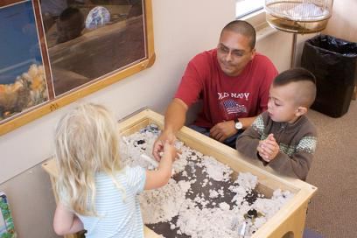
What do the frameworks do?
Frameworks present strategies and information to enrich learning and development opportunities for all of California’s children.
Notes:
All of the frameworks were developed to support implementation of foundations for infants, toddlers and preschoolers and standards for K-12.

Slide 59

What’s in the frameworks?
Guiding Principles
Environments and Materials
Summary of the Strands and Substrands
Notes:
The frameworks all have Guiding Principles that are grounded in research and practice.
In Environment and Materials, there are strategies for setting up a rich and stimulating physical space that is conducive to children's learning.
The Summary of the Strands and Substrands are the foundations or standards.

Slide 60

Discover ideas for:
Environments
Building on children’s play
Materials
Teacher-guided learning activities
Notes:
Click to reveal each in turn:
Setting up environments,
Encouraging and building on child's self-initiated play,
Selecting appropriate materials, and
Planning and implementing teacher-guided learning activities.

Slide 61

The I/T and Preschool Curriculum Framework strategies are:
Developmentally appropriate
Reflective of thoughtful observation and intentional planning
Individually and culturally meaningful
Inclusive of children with disabilities and other special needs
Notes:
Click to reveal each in turn.

Slide 62


Curriculum Framework in CECO
Notes:
For more information about the framework, visit California Early Childhood Online. There are modules for each of the domains. The actual curriculum framework can be downloaded for free from the CDE Web site.

Slide 63

Step 3: Completion Date and Person Responsible
Notes:
Record any follow up needed to complete the action step. This would take place after the next data collection.

Slide 64
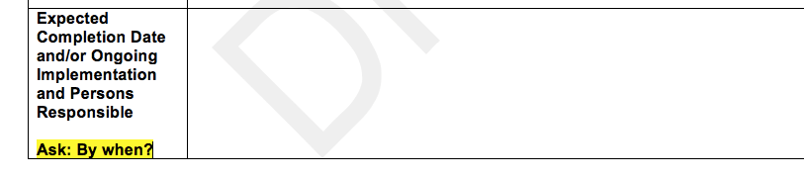
Completion Dates and Person Responsible
When
Who
Notes:
Step 3:
• Expected Completion Date column - List the when and who takes on responsibility for completing the action steps.
Be specific when listing the WHO. Give an actual name. This person is responsible to make sure that as a team/program the action steps are followed through This person is not solely responsible for making sure the action steps happen.

Slide 65

Step 4: Follow up and Reflection

Slide 66
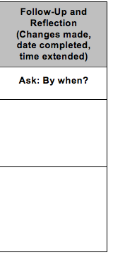
Follow Up and Reflection
Modifications?
What worked?
Notes:
Record any follow up needed to complete the action step on the Summary of Findings for Parent Surveys and ERS. It remains blank for now.
Follow Up column – At the second assessment next contract year, review collected data and determine if the action steps taken resulted in improvements in the Parent Survey findings, and ERS scores. Add any new action steps to take or extended time needed. Remember the follow up column will be blank when it is sent to EESD June 1st.
For the DRDP Summary of Findings/Program Action Plan, the follow up section has been removed. Complete form EESD 4002 Reflection Plan at this time next year.

Slide 67
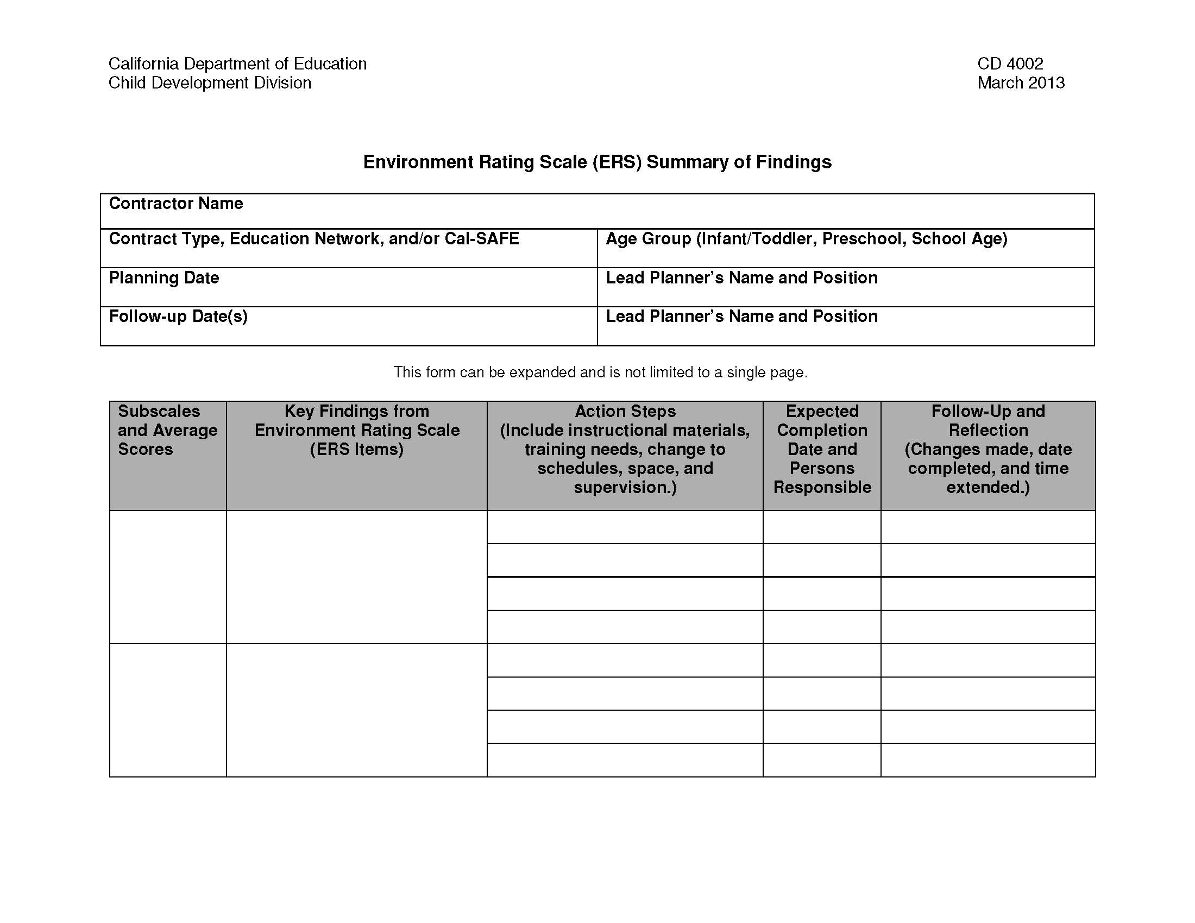
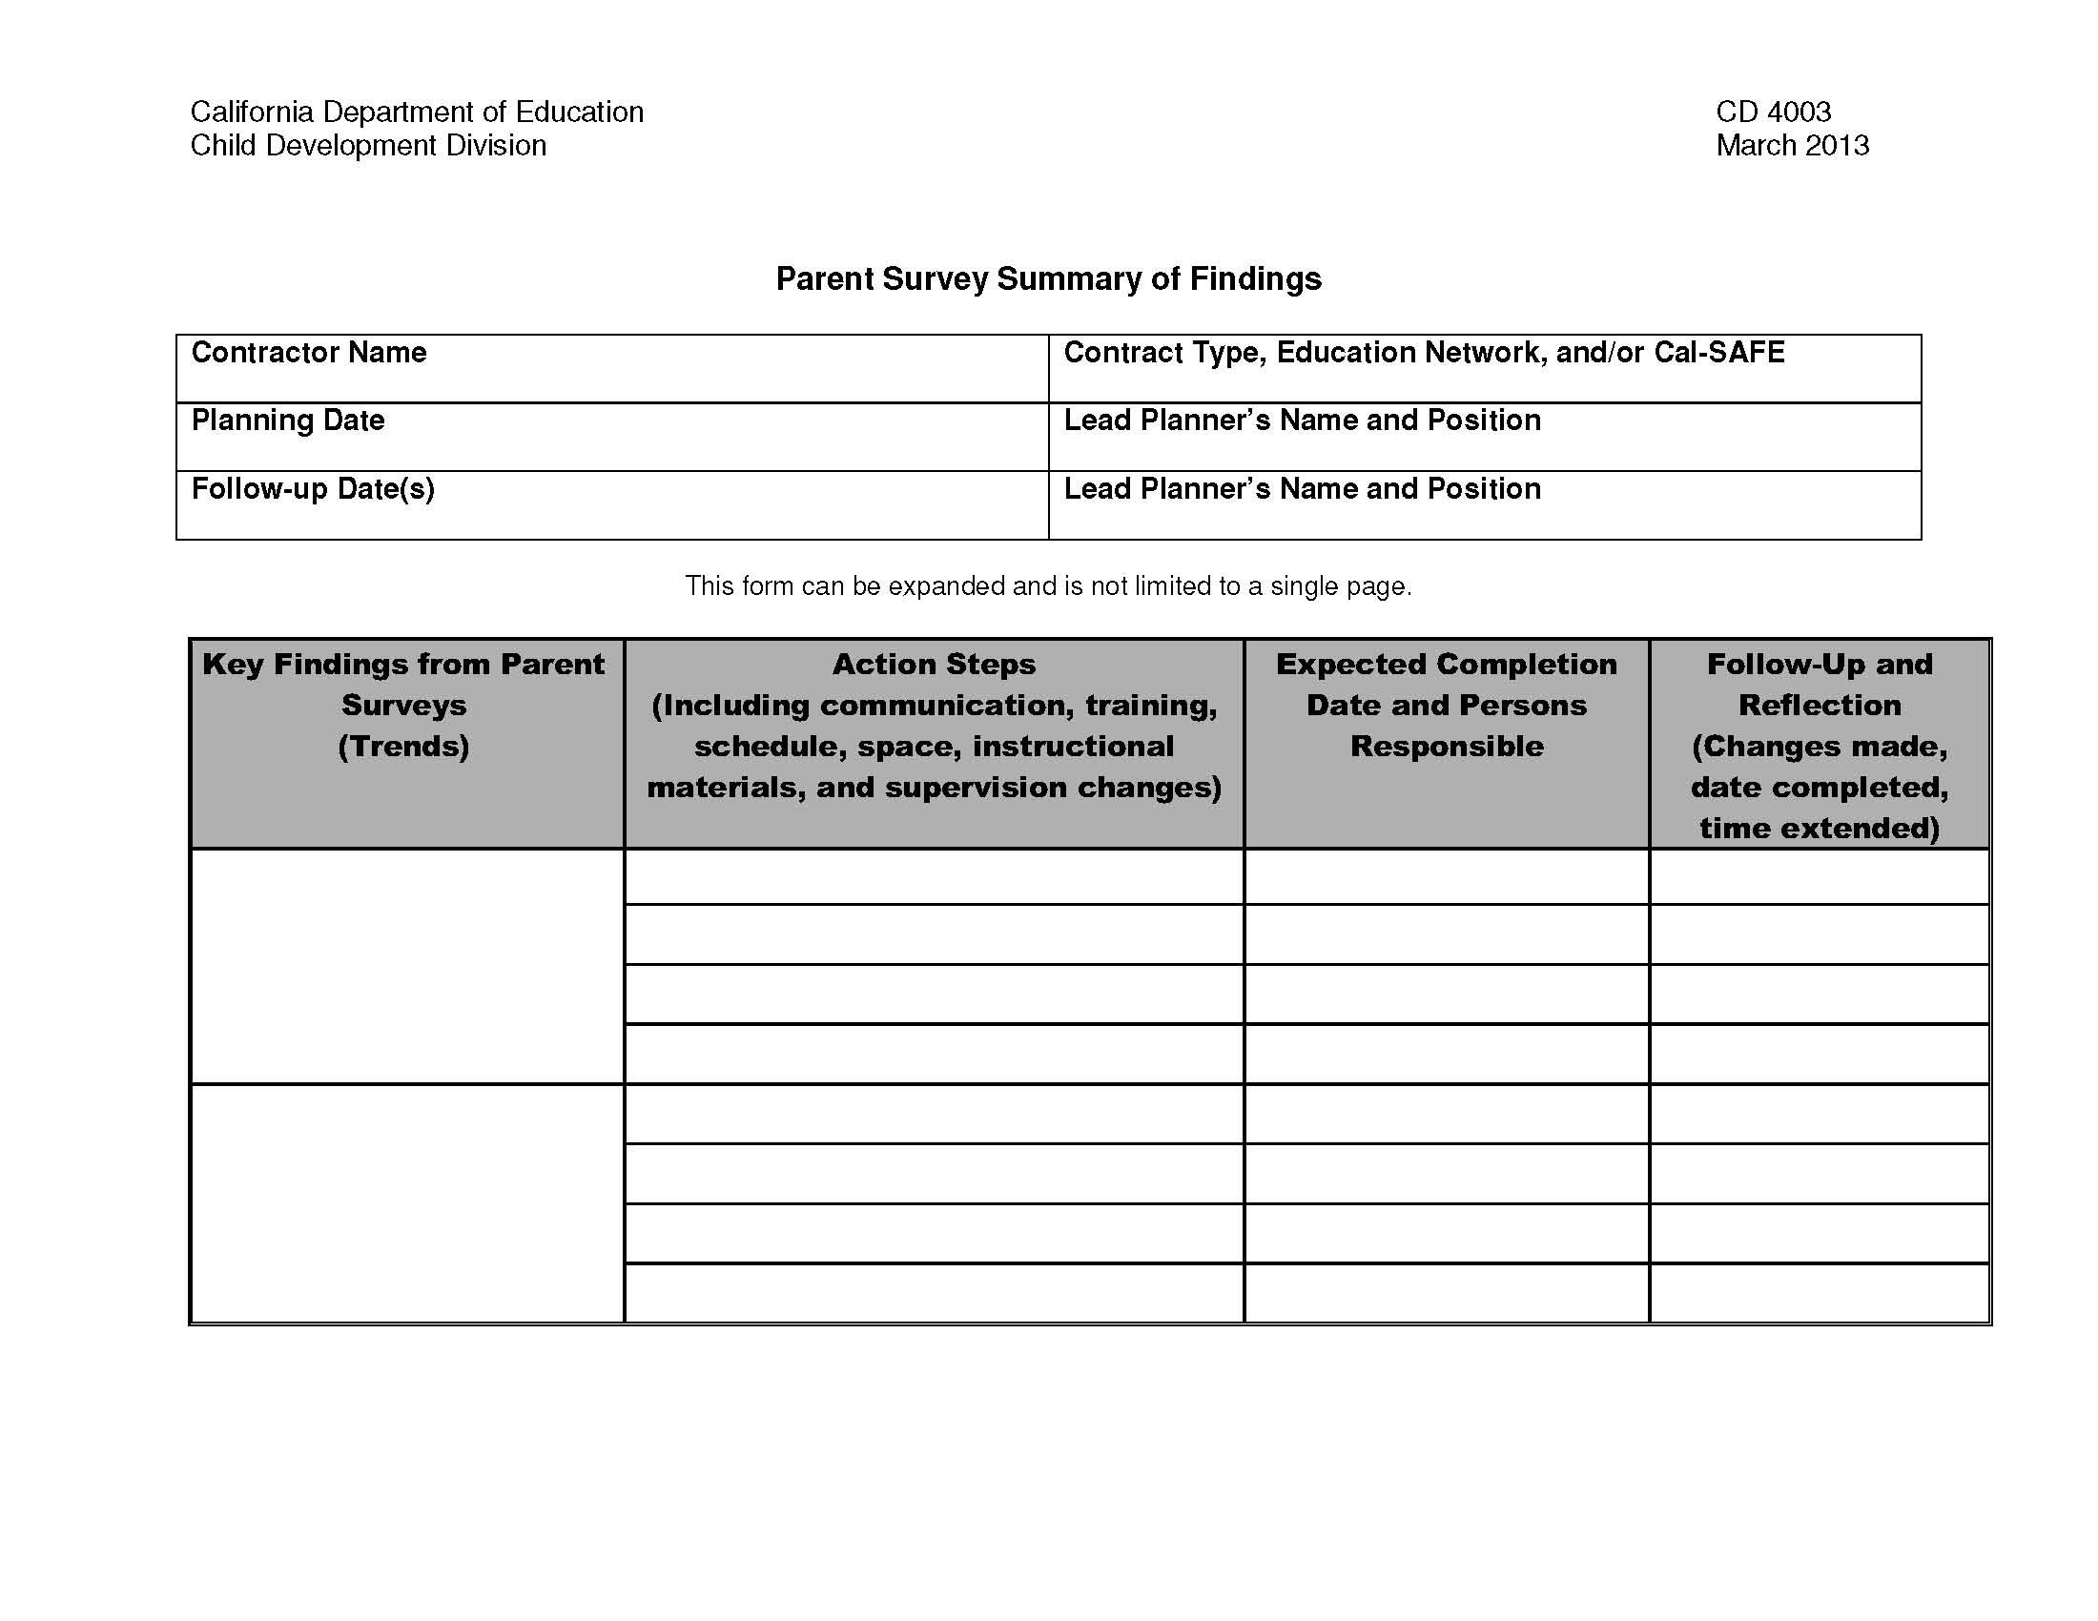

Summary of Findings
Notes:
Program Self Evaluation (PSE) requires completion of all three Summary of Findings, but only the DRDP Summary of Findings and Program Action Plan are to be turned in on June 1st.
Remember the follow up sections are on ERS, Parent Survey and DR classroom Summary of Findings.

Slide 68
The PSE requires completion of:
Due to EESD by June 1st at 5:00 pm
EESD Program Review Instrument (EESD 4001)
DR Program Action Plan-Reflection on Action Plan (EESD 4002)
DRDP Summary of Findings and Program Action Plan (EESD 4003)
ERS Summary of Findings (EESD)
Parent Survey Summary of Findings (EESD)
Program Self Evaluation Cover Page (EESD 4000)
Notes:
This year all contractors (reference directions of EESD 4001) are to submit the Program Review Instrument. (CAPP, CMAP, C2AP C3AP, CRRP, CCTR, CSPP are included.) Although not submitted, all contractors should have completed this the Program Review Instrument. It is not a new requirement to complete-just a new requirement to submit it.
All contractors that completed the PSE last year, need to complete the EESD 4002 this year. This form reflects on your goals from last year. For contractors that are completing PSE this year, but did not last year, the reflection sheet is not required this year. But heads up! It will need to be completed next year.
This year all contractors complete the DRDP Summary of Findings and Program Action Plan. It looks a little different from previous years.
This year all contractors are to complete the cover page (1 cover page) per agency.
This year ERS and Parent Survey Summary of Findings must be completed, but are not mailed in to EESD.
*Remind participants to read the directions on the forms.

Slide 69
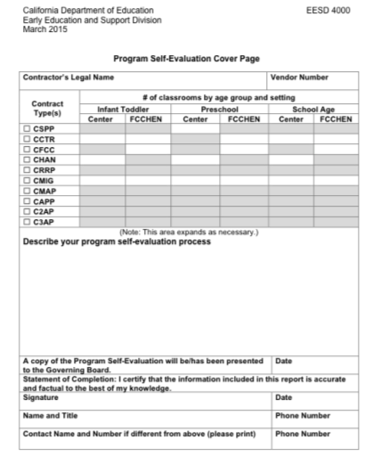
Program Self Evaluation Cover Page EESD 4000
Notes:
Submit one Program Self-Evaluation (PSE) Cover Page (EESD 4000).

Slide 70
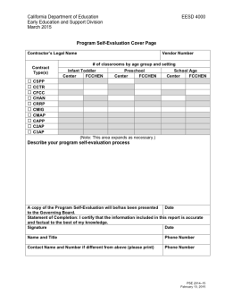

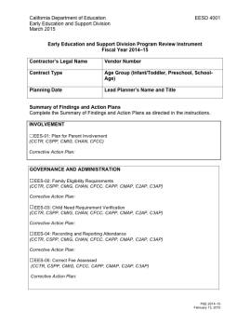
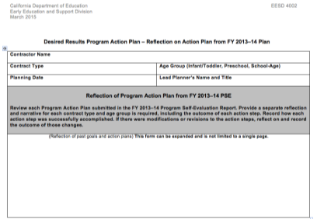
What needs to be sent to
EESD by June 1st?
Notes:
The entire Program Self Evaluation must be completed, but only the three documents mentioned need to be sent. The rest should be on file.
PSE Cover Page (EESD 4000)
Program Review Instrument (EESD 4001)
Desired Results Program Action Plan-Reflection on Action Steps (EESD 4002)
DRDP Summary of Findings and Program Action Plan (EESD 4003) by age and contract

Slide 71
Keep it Alive!
Keep up the continuous improvement process and implement the plan.
Keep families involved and aware!!!
Make sure teachers know the plan and continue to reflect and refine. They will make it happen.

Slide 72
Old Forms vs. New Forms
CD 3900---------------EESD 4002
CD4001A--------------EESD4003
CD4001B--------------EESD3900
CD4000----------------EESD4000
EESD4001

Slide 73




DRDP (2015)
Notes:
The three current DRDP instruments are being replaced by the DRDP (2015) effective fiscal year 2015. Check the Web site for face to face teacher trainings, admin webinars, and online modules.

Slide 74


DRDP (2015): A Full Continuum Instrument
The DRDP (2015) represents a full continuum instrument to assess all children from early infancy to kindergarten entry including children with Individual Family Service Plans and Individualized Education Programs.
Notes:
The instrument consists of a full continuum representing development from early infancy to early kindergarten. There is one instrument, but there are two views of the instrument: PS view which has all of the measures and the IT view which has measures specific to infant/toddler development.

Slide 75

Resources
Notes:
The Desired Results Web site has a wealth of observation resources and training opportunities. There is more detailed information about DRDP (2015) on the Web site.

Slide 76

DRDP (2015) Module
Notes:
There is a DRDP (2015) module available with more detailed information under the DRDP (2015) link.

Slide 77
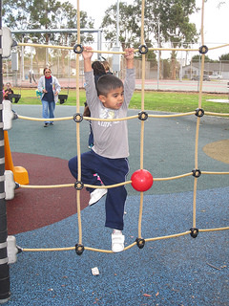
Training Opportunities
CECO Online Modules
Interactive Modules
Face to Face Training
Recorded Webinars
Certified Trainers Institutes

Slide 78

Questions??

Slide 79

Becoming better is not a destination it is a spirit
of continuous improvement - Unknown

Slide 80
Contact Information
Desired Results Training & Technical Assistance Project
333 North Lantana Street, Suite #277
Camarillo, CA 93010
800-770-6339
www.desiredresults.us
desiredresults@wested.org
Notes:
DRT&TA project members are happy to address questions and concerns. Reach us by phone or email.

Slide 81
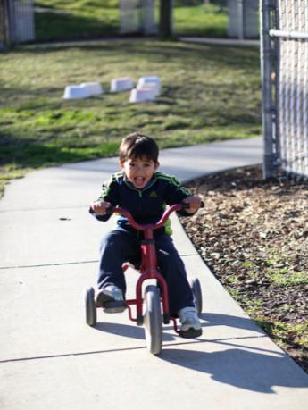
Thank you for your participation!
Notes:
Thank the audience for their attention and participation during the training.

