Slide 1
DRDP (2015) What’s It All About?
Notes:
Welcome to the DRDP (2015) session.
You will be introduced to the new DRDP (2015).
Have everyone get handouts as they enter.

Slide 2
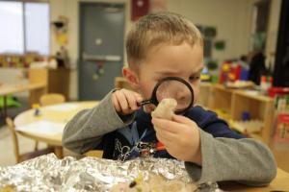
Agenda
Overview of the DRDP
DRDP (2015): What’s the same/What’s new?
Professional Development and Resources Available
Notes:
Go over the agenda.

Slide 3
Outcomes
Learn about the DRDP (2015) including identify similarities and differences between the DRDP (2010) and DRDP (2015).
Learn about DRDPtech and how the results can be used for planning purposes.
Identify online resources to support implementing DRDP (2015).

Slide 4
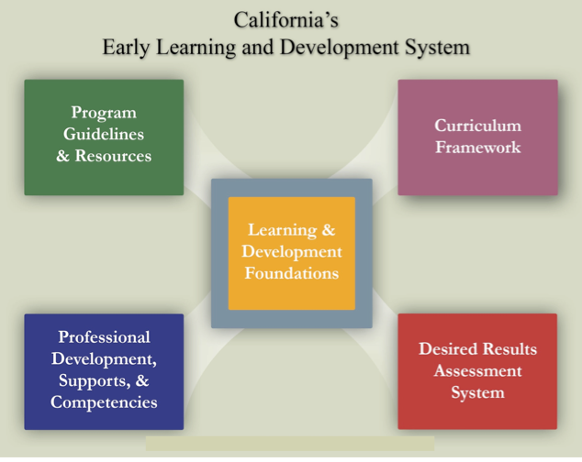
2010 © California Department of Education
Desired Results T & TA Project
4
Notes:
4
HO: CAELDS AND IMPLEMENTATION GUIDE
This is the CAELDS. We are familiar with how all the components fit together and support what we know is appropriate for early childhood.
As an administrator, are you able to find all the resources needed within each component?
Let us start with the DR assessment system. There is an implementation guide in your folder (it can also be found on the Web site) to help administrators and their staff embed the DR system in to their programs.
On the DR Web site, there are resources for administrators to use with their staff. Under the regional training link http://www.desiredresults.us/trainings_regional.htm, there are activities to conduct with your staff as you train them on observation an the DR process.
We will talk more about resources as we go throughout the day

Slide 5
Overview of DRDP (2015)
Notes:
This presentation will be posted on the Desired Results Web site as a resource for administrators to train their staff on the DRDP (2015) at the end of April 2015
Ask your staff:
What do they already know about DRDP 2015?
What do they want to know?
You can chart these responses

Slide 6
What is the DRDP?
Individual child assessment
Observation-based assessment tool
Based in developmental research and theory
Includes developmental sequences of behavior
Based on ongoing activities and routines in the early care and education setting with familiar adults
Notes:
Observation is the foundation of the DRDP (2015) assessment instrument.
It is NOT a test.
Not a checklist
Not a right or wrong list
Authentic assessment is a recommended practice and includes the ongoing documentation of what children are able to accomplish. California has consistently pulled researchers together to write what typical development looks like based on the research, then complete research studies to ensure the instrument reflects development and get feedback from teachers.This is a very stringent process that California has followed to ensure a quality instrument that is valid and reliable.

Slide 7
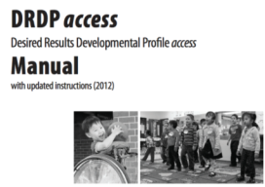
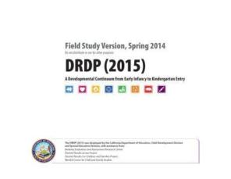
DRDP (2015) Implementation in 2015
Notes:
Currently there are three assessments used for children before kindergarten entry.
The DRDP-IT and the DRDP-PS are aligned to the Early Learning and Development System. Children with IEPs receive two assessments the ACCESS and the age appropriate instrument.
The DRDP 2015 replaces these three instruments.
.
Effective fall of 2015, the DRDP 2015 is required of all EESD programs and Special Education Programs and it is required for all children with an IFSPs and IEPS. (new contract year 2015-16).

Slide 8
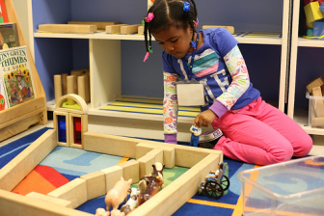
DRDP (2015): A Full Continuum Instrument
The DRDP (2015) represents a full continuum instrument to assess all children from early infancy to kindergarten entry including children with Individual Family Service Plans and Individualized Education Programs.
Notes:
The instrument consists of a full continuum representing development from early infancy to early kindergarten. There is also the DRDP-K for children in transitional kindergarten or kindergarten.

Slide 9
The DRDP (2015) Instrument
Create a single DRDP instrument for all children infancy to kindergarten entry — typically developing and special needs
Add domains for all of the Early Learning Foundations (I/T & Preschool Vol. 1 – 3 )
Comply with federal reporting requirements for the Special Education Division
Align to Head Start Early Learning Framework
Notes:
Purpose behind DRDP (2015):
The DRDP (2015) represents a full continuum instrument to assess all children from early infancy to kindergarten entry including children with Individual Family Service Plans (IFSP) and Individualized Education Programs (IEP).
The DRDP (2015) provides one single instrument in place of the three. It is aligned to infant toddler foundations, preschool foundations, Common Core and Head Start Early Learning Framework.

Slide 10
Accommodating the Range of Abilities
Accommodate the development of almost all children in the age range:
Each measure was created to prevent ceiling or floor effects.
Preventing a floor effect: The earliest level of development on the continuum begins a little earlier than what would be expected for most children assessed by the instrument.
Preventing a ceiling effect: In the developmental continuum, the latest level is beyond the development of what would be expect of most children assessed by the instrument.
Notes:
The DRDP has been created to prevent both the floor and the ceiling effect. In other words, all infants are not expected to be at Responding Earlier and all preschoolers are not expected to be at Integrating Earlier. It depends on each individual child and the teacher must review and reflect on their documentation before rating a measure.

Slide 11
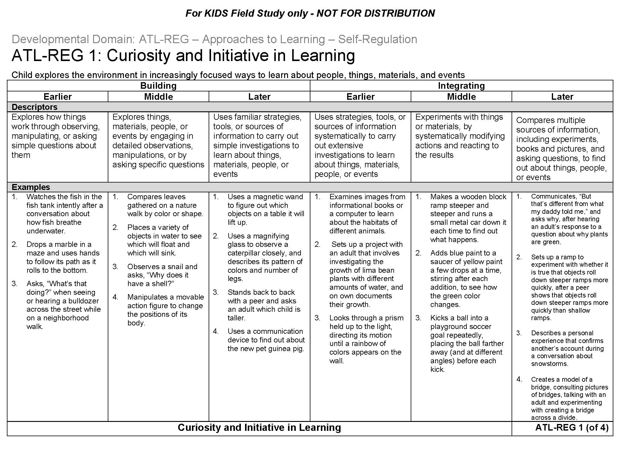
2 new levels span into first grade to avoid a ceiling effect
4 levels overlap with DRDP (2015) full continuum to avoid floor effect
Notes:
The descriptors of the later levels of the DRDP (2015) (full continuum measures) are early kindergarten skills and behaviors. These last four levels of the DRDP 2015 full continuum assessment over lap with the first 4 levels of the DRDP-K.
This avoids the ceiling affect. All preschool age children are not expected to be at the last developmental level of the assessment at the end of their preschool years. These skills at Integrating Earlier are early kindergarten skills.

Slide 12
Notes:
The DRDP aligns with the:
Infant and Toddler Early Learning and Development Foundations
Preschool Learning Foundations, Volumes 1-3
Common Core Standards
Head Start Child Development and Early Learning Framework
Now let’s look at the instrument in more detail…

Slide 13
DRDP (2015)
Notes:
There is one assessment, but two ways to view the one assessment. The infant/toddler view and the preschool view. The infant/toddler view has measures used to assess infants and toddler, and the preschool view has measures used to assessed preschool aged children.

Slide 14
DRDP 2015 Table of Contents
Notes:
Now lets take a look at the Table of Contents inside of the instrument on p. i
Please highlight iv, All about the Measures and xiv Measures at a Glance. The pages iii-xiii is the Front Matter. We recommend reading this with your staff. You can do a jigsaw activity where each person reads a specific part and shares out something they read. Another option is to do a Dear Abbey where you formulate questions with which your staff may need more support. They must find the answer. This activity can be found on the admin training sheet we looked at earlier.

Slide 15
Ask Siri……
What is the important note on page xiii?
Do I need to see a child do all of the examples before rating a developmental level as mastered?
What dos the ;and mean?
Notes:
ACTIVITY: Ask Siri
Participants will use their DRDP and the chart paper to answer the Ask Siri questions.

Slide 16
What’s new in the DRDP (2015) ?
Domains
Developmental levels
Measure names
Number of measures completed for each age group
Notes:
The DRDP (2015) includes new domains not previously assessed.
Given the continuum from birth through age five, new developmental levels have been added.
New measures have been developed both in the new domains and the existing domains.
The number of measures will differ from the existing DRDP instruments due to the new domains and the developmental continuum.
There are more changes for special education assessor, e.g., the page orientation is now horizontal, and the developmental levels are named and not numbered.
Trainer note: Participants are familiar with these terms, but there are additions to each category. The number of measures completed depends on the age of the child being assessed.

Slide 17
DRDP (2015) Navigation Map
Domain
17
Developmental Level
Definition
Measure
Descriptor
Example
Notes:
This navigation map of one measure covers the full developmental continuum of early infancy through five years of age.
Domain: The domain is listed at the top left and bottom right. A domain represents an essential area of learning and development for young children.
Measure: A measure describes a specific competency along a continuum of developmental levels. Each domain consists of a set of measures. ( in DRDP 2015 the measures are numbered within the domain)
Definition: The definition of a measure specifies the aspects of development being observed.
Developmental Level: Each developmental level specifies a point along the continuum that ranges from earlier to later levels of development. (the number of developmental level depend on that specific measure)
Descriptor: Each descriptor identifies knowledge, skills, or behaviors that are observed at a specific developmental level along the continuum.
Example: Examples illustrate the descriptors. An example is one of many possible ways a child might demonstrate knowledge, skills, or behaviors.

Slide 18
DRDP (2015) Domains
Approaches to Learning—Self-Regulation*
Social and Emotional Development*
Language and Literacy Development*
English Language Development
Cognition, Including Math and Science*
Physical Development—Health*
History—Social Science
Visual and Performing Arts
Notes:
These are the domains of the DRDP (2015). There are some new domains, such as Approaches to Learning--Self-regulation.
Some of the domain names have changed slightly, and some have been combined. The DRDP (2015) for use with infants and toddlers includes only the domains listed with an asterisk.
Preschool teachers will notice that there are two additional domains from Volume 3 of the California Preschool Learning Foundations --Visual and Performing Arts and History-Social Science.
The measures in the Visual and Performing Arts, History-Social Science, and the English Language Development domains pertain to preschool aged children.

Slide 19
Developmental Levels
The full-range of developmental levels on the DRDP (2015) includes the following:
Responding (Earlier, Later): Generally, knowledge, skills, or behaviors observed during early infancy
Exploring (Earlier, Middle, Later): Generally, knowledge, skills, or behaviors observed in later infancy, toddlerhood, and early preschool
Exploring Later/Building Earlier: Generally, knowledge, skills, or behaviors observed in later toddlerhood and early preschool
Building (Earlier, Middle, Later): Generally, knowledge, skills, or behaviors observed in preschool
Integrating Earlier: Generally, knowledge, skills, or behaviors observed in late preschool and early kindergarten
Notes:
All infants will not be at Responding Earlier, but this chart gives a gauge of each developmental level and the age range it may cover. This can also be found inside your DRDP on page iv.

Slide 20
DRDP (2015) Continuum of Developmental Levels
Continuum from earlier to later levels of development
Notes:
The full range of developmental levels on the DRDP (2015) goes from responding to integrating. Throughout the instrument, the number of levels for each measure can vary depending on the competencies that are appropriate for that measure.

Slide 21
DRDP (2010) and DRDP access – DRDP (2015)
DRDP (2010):
Infant/Toddler
35 measures in 5 domains
Preschool
43 measures in 7 domains
DRDP (2015):
Infant/Toddler
29 measures in 5 domains
Preschool
56 measures in 8 domains
DRDP access:
Birth to Five
48 Measures in 10 domains
Notes:
Ask the audience, “How many know the amount of measures and domains currently in the DRDP for infant and toddlers? How about preschool?”
Here is a comparison chart of the Current (DRDP) 2010 to the (DRDP) 2015 calibration study.
Two measures were added to the infant toddler view in February 2015. Cog 10 and Cog 12. (Have participants pull out these handouts.)
They are not new measures to the instrument because they were in the preschool view as later development. During the calibration study, they became full continuum.They are expanded measures.

Slide 22
Notes:
Effective February 2015, there are two more measures in the infant/toddler view of the DRDP (2015). These are COG 10 and COG 12. Please check the Web site for the most up to date version of the instrument.

Slide 23
Notes:
This is the Measures at-a-Glance page from the instrument. Teachers are able to see which measures carried over from the DRDP (2010) and which new measures for which they may need to be more intentional about collecting documentation.
COG 10 and COG 12 have been expanded to full continuum measures. Please make sure to check the Web site for the most recent version of the assessment.

Slide 24
Three Types of Measures
Full Continuum Measures consist of 7-9 levels that describe development from early infancy to early kindergarten.
Earlier Development Measures consist of 5-6 levels that describe development that typically occurs in the infant/toddler and early preschool years.
Later Development Measures consist of 6 levels that describe development that typically occurs in the preschool years and early kindergarten.
Notes:
There are three types of measures. This is a new part of the DRDP 2015.
Full continuum measures are in both views of the assessment.
Earlier Development measures are in both views of the assessment.
Later Development measures are only in the preschool view of the assessment.
Let’s look at the different types.

Slide 25
Full Continuum Measures
Notes:
Have participants turn to PD HLTH 1.
This is a full continuum measure. Full continuum measures provide behaviors and skills on a continuum from early infancy to kindergarten entry and it is inclusive of children with special needs.
In the preschool view all of the developmental levels are an option for rating.

Slide 26
Full Continuum Measures Continued…
Notes:
This is the full continuum measure in the infant/toddler view. The last few developmental levels are not a rating option in the infant/toddler view. The last few developmental levels are late preschool to early kinder skills so they do not apply to infant and toddlers.

Slide 27
Earlier Development Measures
Notes:
Participants turn to ATL REG 1
The earlier development measures consist of 5-6 levels that describe development that typically occurs in the infant/toddler and early preschool years. There are no later levels for this measure because the developmental continuum does not extend further. If a preschool-aged child is beyond the latest developmental level on this measure, there is an opportunity to mark that when rating. These measures are aligned to the Infant toddler foundations. However preschool teachers may very well have a preschool aged child that is still working in the skills in these measures.
There are 4 earlier development measures:
Attention Maintenance
Self-comforting
Spatial relationships
Imitation

Slide 28
Later Development Measures
Notes:
Participants turn to ATL REG 5
The later development measures consist of six levels that describe development that typically occurs in preschool years and early kindergarten. The reason there are no earlier levels for this measure is because the developmental continuum does not begin any earlier. However preschool teachers who have children who are not at the earliest developmental level on this measure will have the option to mark child is not at the earliest developmental level on this measure.
Later development measures are only in the preschool view of the assessment. There are no later development measures in the infant toddler view.

Slide 29
Sample of the ATL-REG Domain
Domain | For Field Study | Measures Coded in IT Domain | Measures Coded in PS Domain
ATL/ REG | ATL/REG 1 | Attention maintenance
 | ATL/REG 2 | Self comforting
 | ATL/REG 3 | Curiosity and initiative in learning | Curiosity and initiative in learning
 | ATL/REG 4 | Self-control of feelings and behavior | Self-control of feelings and behavior
 | ATL/REG 5 |  | Engagement and persistence
 | ATL/REG 6 |  | Shared use of space and materials
 |  | Number of ALT/REG measures at IT: 4 (2 ED; 2 Full Continuum) | Number of ALT/REG measures at PS: 4 (2 Full Continuum; 2 LD)
Notes:
Lets now look at one of the new domains, Approaches to Learning–Self-regulation. This is a sample of the measures within this domain.
Two of the measures are early development ATL REG1 and ATL REG2.
Two of the measures are Full continuum, ATLREG 3 and ATL REG 4.
Two of the measures are Later development ATL REG 5 and ATL REG 6. (These two measures are not in the infant toddler view.)

Slide 30
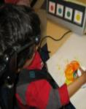
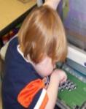
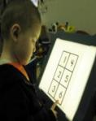
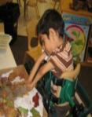
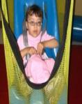
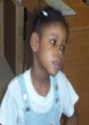
Using Adaptations
For more information:
http://draccess.org/training/learningmodules.html
Notes:
The system of adaptations currently used with the DRDP access will be available to children with and without disabilities.

Slide 31
Adaptations
Are changes in the environment or differences in observed behavior that enable children with IFSPs and IEPS to be most accurately assessed in their typical settings
Used throughout the day to allow children more control in their environment
May be appropriate for other children in the classroom
Notes:
Use interactive strategy

Slide 32
DRDP Adaptations
1. Augmentative or alternative communication system
2. Alternative mode for written language
3. Visual support
4. Assistive equipment or device
5. Functional positioning
6. Sensory support
7. Alternative response mode
Notes:
These are the seven broad categories of adaptations. Encourage your staff to go into the assessment as much as possible, have them break into pairs. Each pair reads about an adaptation and shares out tot the group. Many specific examples exist within each. To view the descriptions of each, and numerous examples, visit the Desired Results access Project’s Web site at draccess.org

Slide 33
The System of Adaptations
A set of adaptations was developed to use with the DRDP access, based on research and recommend practice.
The same set of adaptations will be integrated into the DRDP (2015).
Notes:
Implementing a system of adaptations is a key opportunity for collaboration and an important part of including children with disabilities in the preschool classroom.

Slide 34
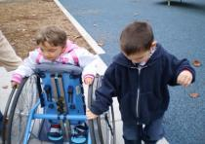
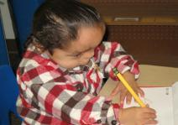
Why use adaptations?
To ensure that the DRDP instruments measure ability, rather than disability
Notes:
Sometimes the presence of a disability prevents children from demonstrating particular skills.
Adaptations used for the DRDP assessment are those typically present throughout the child’s day.
This is the end of the 1st ppt

Slide 35
Resources
Notes:
The Desired Results Web site has a wealth of observation resources and training opportunities. There is more detailed information about DRDP (2015) on the Web site.
This is the end of the 1st ppt

Slide 36
DRDP (2015) Module
http://www.desiredresults.us/training_drdp2015.html
Notes:
There is a DRDP (2015) module available with more detailed information under the DRDP (2015) link. http://www.desiredresults.us/training_drdp2015.html
Administrators are encouraged to visit this module with their staff and go through it together.
Activities for the module include
Have DRDP handy and circle and highlight in the descriptors
Chart Responses for Math video
Partner read the Assessing Dual Language Handout

Slide 37
Completing the Assessment
Gather evidence
Review and reflect
Determine mastery
Select developmental level
Notes:
The steps for completing the assessment remain the same in the DRDP (2015) version.
You still:
Gather evidence.. Pictures, notes, work samples
Review and reflect all of the evidence you have on a child
Determine mastery as overtime and in different settings
Select the highest developmental level mastered for the skill.

Slide 38
Working with Special Education
With the DRDP (2015), assessments can be completed collaboratively.
Observations may be shared.
Conversations about ratings and results can lead to joint planning and ongoing communication.
Special educators will continue to submit data to the Special Education Division.
Notes:
Special education providers will continue to submit the DRDP to meet the SED reporting requirements.
Early childhood teachers should collaborate with special educators.
Best practice is to share observations, complete instrument and talk together on how to implement plans resulting from reports.

Slide 39
DRDPtech
Notes:
DRDPtech is an online data entry system. It is free to EESD contractors, LEAs, Tribal CCDF, CA Head Start programs. For more information on DRDPtech, sign up for the free Webinars.

Slide 40
DRDPtech Resources
DRDPtech Webinars are provided twice a month for free.
http://www.desiredresults.us/trainings_opp_teacher.html
Notes:
This is the end of the 2nd ppt

Slide 41
Putting It All Together
Notes:
This is the beginning of the 3rd PPT.

Slide 42
Use Frameworks as a Resource
All frameworks including school-age are available on CDE Web site
Notes:
Note to trainer:
The curriculum framework chapters provide information to support children's learning in the areas described in the California Infant/Toddler Curriculum Framework, California Preschool Learning Foundations, Volumes 1- 3 and school age frameworks are available on the CDE web site.

Slide 43
Curriculum Framework in CECO
http://www.caearlychildhoodonline.org/
Notes:
For more information about the framework, visit California Early Childhood Online. There are modules for each of the domains. The actual curriculum framework can be downloaded for free from the CDE Web site.

Slide 44
Language and Literacy
“Children learn more when adults model language and literacy as well as provide playful, purposeful instruction. Play spaces with literacy props (e.g., signs, lists) allow children to congregate and to make choices that foster rich language and literacy experiences.”
California Preschool Curriculum Framework, p. 103
Notes:
In The California Preschool Framework Volume 1, under the domain of Language and Literacy, there are suggestions on appropriate materials to support a curriculum rich in content. This section also discusses how to create a stimulating environment that promotes language and literacy.

Slide 45
According to Our Data
Notes:
DRDP (2015) Scale level reports will be ready in the FALL of 2015.

Slide 46
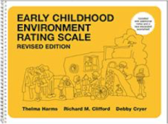
Putting It All Together
Let’s take a look at:
California Preschool Framework, Volume 1 for some ideas on strategies to implement
The ECERS item 15, for quality items and appropriate practice that support language and literacy
Notes:
Activity: Putting It All Together (20 min)
Handouts needed (classroom data, CA framework , ERS, Venn Diagram)
In this activity participants will analyze their classroom data. After choosing a domain that needs support they will examine domains from the California framework ( IT or PS) and specific Items in the ERS (IT or EC) for connections on strategies and best practice.
www.caearlychildhoodonline.org
ERS modules are a great resource. Use this resource now, it is free until the end of 2015...Big thanks to CA First 5.

Slide 47
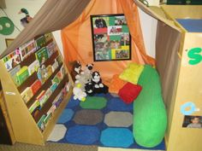
Some of the ideas include…
Create a place to display family items
Create a cozy library or book area
Centers or Interest areas
Blocks
Art
Writing
Make thoughts explicit, think out loud
Culturally sensitive environment
Notes:
California Preschool Curriculum Framework, p.102-104 Let us consider how these ideas connect to Environment Rating Scales.

Slide 48
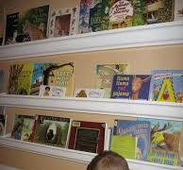
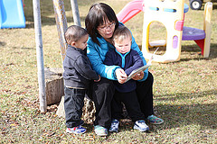
Environment Rating Scale
Item 15 Books and Pictures
A wide selection of books
Staff read books to children informally
Books are organized in a reading center
Notes:
Use this resource now, it is free until the end of 2015. Big thanks to CA First 5.

Slide 49
When Observing in the Classroom
ERS
Organized books
Wide selection
Frameworks
Create centers
Create cozy library area
What can you observe?
Notes:
Have participants pull out Venn Diagram handout and Activity Sheet.
Have them write strategies from the framework into the framework circle and indicators from ERS item 15.
Also what skills are they able to observe for and support in the classroom based on providing strategies from the Framework and best practices according to the ECERS?
Have participants write what they can observe in the middle of both circles.
This activity can also be done using large chart paper.

Slide 50
Resources

Slide 51
California Early Childhood Online (CECO)
Notes:
The courses provided on the California Early Childhood Online (CECO) Web site enable teachers to increase content knowledge and ability to provide developmentally appropriate experiences for children in their care.
Meeting the developmental needs of young children and their families requires a comprehensive approach.
CECO provides access to comprehensive resources and courses in one centralized location to meet the ever-changing needs of the early childhood field.
Use CECO ERS module
Use this resource now, it is free until the end of 2015. Big thanks to CA First 5.
www.caearlychildhoodonline.org

Slide 52
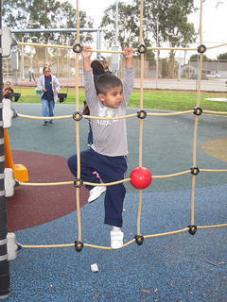
Training Opportunities
CECO Online Modules
Interactive Modules
Face to Face Training
Live Web Conferences
Certified Trainers Institutes (for EESD programs)
Train-the Trainer Institutes (for SED programs)

Slide 53
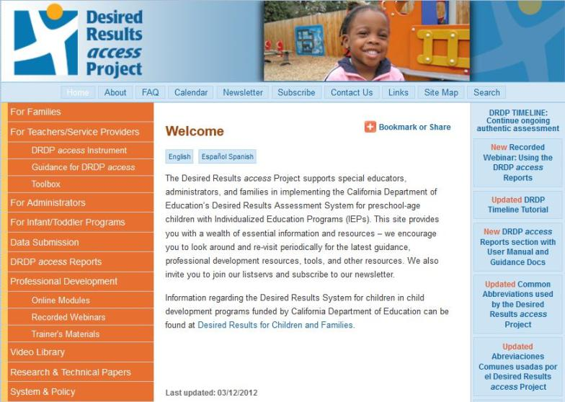
Visit draccess.org – for Special Education Information and Resources

Slide 54
Collaborative Team
UC Berkeley – BEAR Center
California Department of Education, Early Education and Support Division and Special Education Division
Notes:
This slide serves as an acknowledgement to our collaborators.
WestEd is working with UC BEAR (UC Berkeley Evaluation and Assessment Research Center). The work we are doing to develop this instrument is sponsored by the California Department of Education, Early Education and Support Division and Special Education Division.

Slide 55
Questions??

Slide 56
Thank you!!

