Slide 1
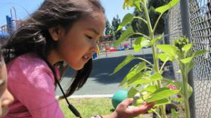
Desired Results for Children and Families
A Project of the California Department of Social Services with the Desired Results Training & Technical Assistance Project
Notes:
Trainer note: Introduce yourself, co-trainers, and special guests.
Participants will learn about why the Desired Results system was developed and how it can be used to improve quality services to children and families. Participants should write ONLY on the colored pages in the binders. The white pages can be used as handout masters when they return to their agencies to train others.

Slide 2
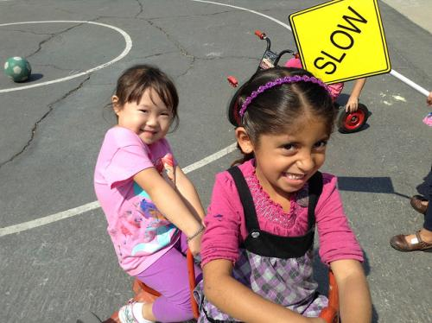
Welcome to Desired Results Overview Training

Slide 3

Parking Lot
Write questions on post-its and place on Parking Lot chart paper.
Notes:
Slide optional: Place two Parking Lot posters in the room.
Participants may post questions in the Parking Lot. Note that facilitators will try to answer as many questions as possible during the training.
Let group know that questions for which you do not have answers will be researched for the next training.
NOTE TO TRAINER: Call the Desired Results Project during a session break or lunch for answers to unanswered questions (800-770-6339).

Slide 4
Agenda
Introduction/Overview of the Desired Results System
Early Learning and Development System
Desired Results Developmental Profile (DRDP)
Environment Rating Scales
Parent Survey
Continuous Improvement Process
Notes:
Trainer note: Share the training outcomes.
The training will focus on methods within the Desired Results system that will improve services to children resulting in overall program improvement.
The secondary focus will be to provide training for using the tools that will support program improvement.
This training will help participants use the Desired Results tools to demonstrate program accountability.

Slide 5
Session I: Overview
Notes:
Desired Results training is the result of a desire on the part of the California Department of Education, Early Education Division to improve and standardize program quality across the state.
In Session I, an overview of the system’s components will provide preliminary information on the Desired Results for Children and Families system’s goals and structure.
Later, additional details and information will be provided to give participants knowledge about each element of the Desired Results system.

Slide 6
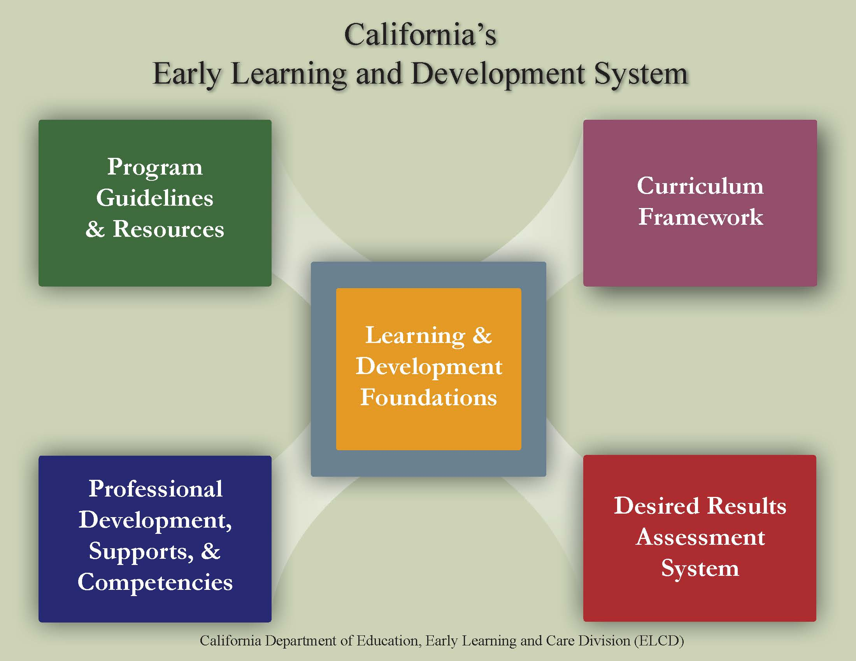
CA Early Learning and Development System
Notes:
This information is included in the online overview of the system. Today we are focusing on the Desired Results assessment system. This handout is in the binder and contains information for each of the elements on the back side. You will be able to write in the resources available for each component.
Trainer note: Direct participants to use a highlighter to highlight key words as the elements are discussed. Instruct participants to keep this handout available.

Slide 7




Learning Foundations
What Children Know and Are Able to Do
CPIN offers training
CECO modules
Notes:
At the center of the system are the Learning and Development Foundations, which describe the learning and development preschool children typically demonstrate with appropriate support.
The Infant/Toddler Learning & Development Foundations describe what children know and are able to do at around 8 months, 18 months, and 36 months.
The Preschool Learning Foundations describe what children know and are able to do at around 48 months and 60 months when in a high-quality program.
Early learning foundations are also known by the terms “early learning standards” in other states.
Early Learning Foundations are what teachers should know coming into a classroom. The background knowledge of child development assists teachers in making appropriate classroom decisions.

Slide 8






Program Guidelines
CPIN
DLL link
Notes:
The guidelines bring together information that program administrators and teaching staff can use to prepare appropriate learning environments for children.
Ask teachers, to look through the Inclusion Works and the Preschool English Learner Guides to become familiar with the resources.

Slide 9




Curriculum Frameworks
CPIN offers training
CECO modules
Notes:
Another element of the system includes the Curriculum Frameworks. The Framework offers guidance on how programs and teachers can support the learning and development that are described in the foundations through environments and experiences that are linguistically and developmentally appropriate, as well as individually and culturally meaningful and connected.

Slide 10







Professional Development Supports & Competencies
Notes:
The above resources assist California’s workforce is being prepared, professional and aware of early childhood trends. Use your device to search one of these resources and tell the group one new thing you have learned.

Slide 11
Professional Development, Supports & Competencies
California Early Childhood Online
Program for English Learner Training
Family Child Care at Its Best
ECE Mentor Program
The Child Development Training Consortium
Notes:
Refer to Handout - California Department of Education Early Education Division (CDE/EED) Professional Development Resources
The Program for Infant Toddler Care (PITC) seeks to ensure that America's infants get a safe, healthy, emotionally secure, and intellectually rich start in life. http://www.pitc.org/
California Preschool Instructional Network (CPIN) provides professional development and technical assistance to preschool teachers and administrators to ensure preschool children are ready for school. http://www.cpin.us/
The Preschool English Learner Training provides teaching strategies, materials, and training to individuals interested in achieving optimal educational outcomes for children who attend public preschool programs and speak a language other than English. http://www.cpin.us/p/pel/
California School-Age Consortium (CalSAC) - CalSAC’s mission is to enhance the performance of California out-of-school program providers by building connections, competence, and community. http://www.calsac.org/
Family Child Care at Its Best provides high-quality, university-based child development education to thousands of licensed and license-exempt family childcare providers throughout California. http://humanservices.ucdavis.edu/ChildDev/Programs/FamilyChildCare.aspx?unit=CHLDEV
Desired Results Training and Technical Assistance Project provides training and technical assistance in implementing the Desired Results system, including assessing children with the Desired Results Developmental Profile©. http://www.desiredresults.us
The California Early Childhood Mentor Program provides resources and support to aspiring and experienced teachers and administrators in programs serving children from birth to five and before- and after-school programs. http://www.ecementor.org/
The Child Development Training Consortium promotes high-quality early education to California’s children and families by providing financial and technical assistance to child development students and professionals. http://www.childdevelopment.org

Slide 12


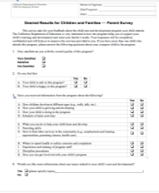
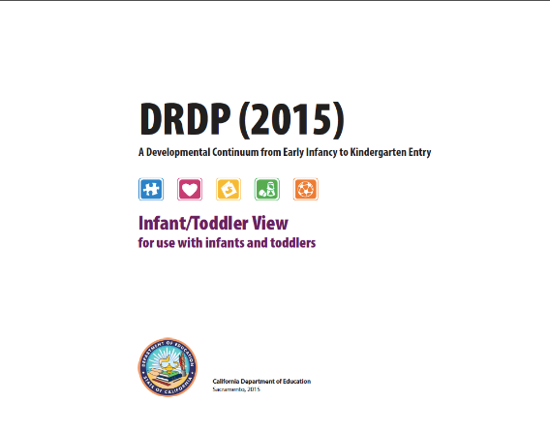
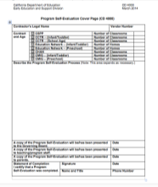

Desired Results Assessment System
Notes:
The DR Assessment system includes the DRDP assessment, the ERS, parent surveys and Program Self Evaluation. All of these elements work together in an effort to support ongoing program improvement.

Slide 13
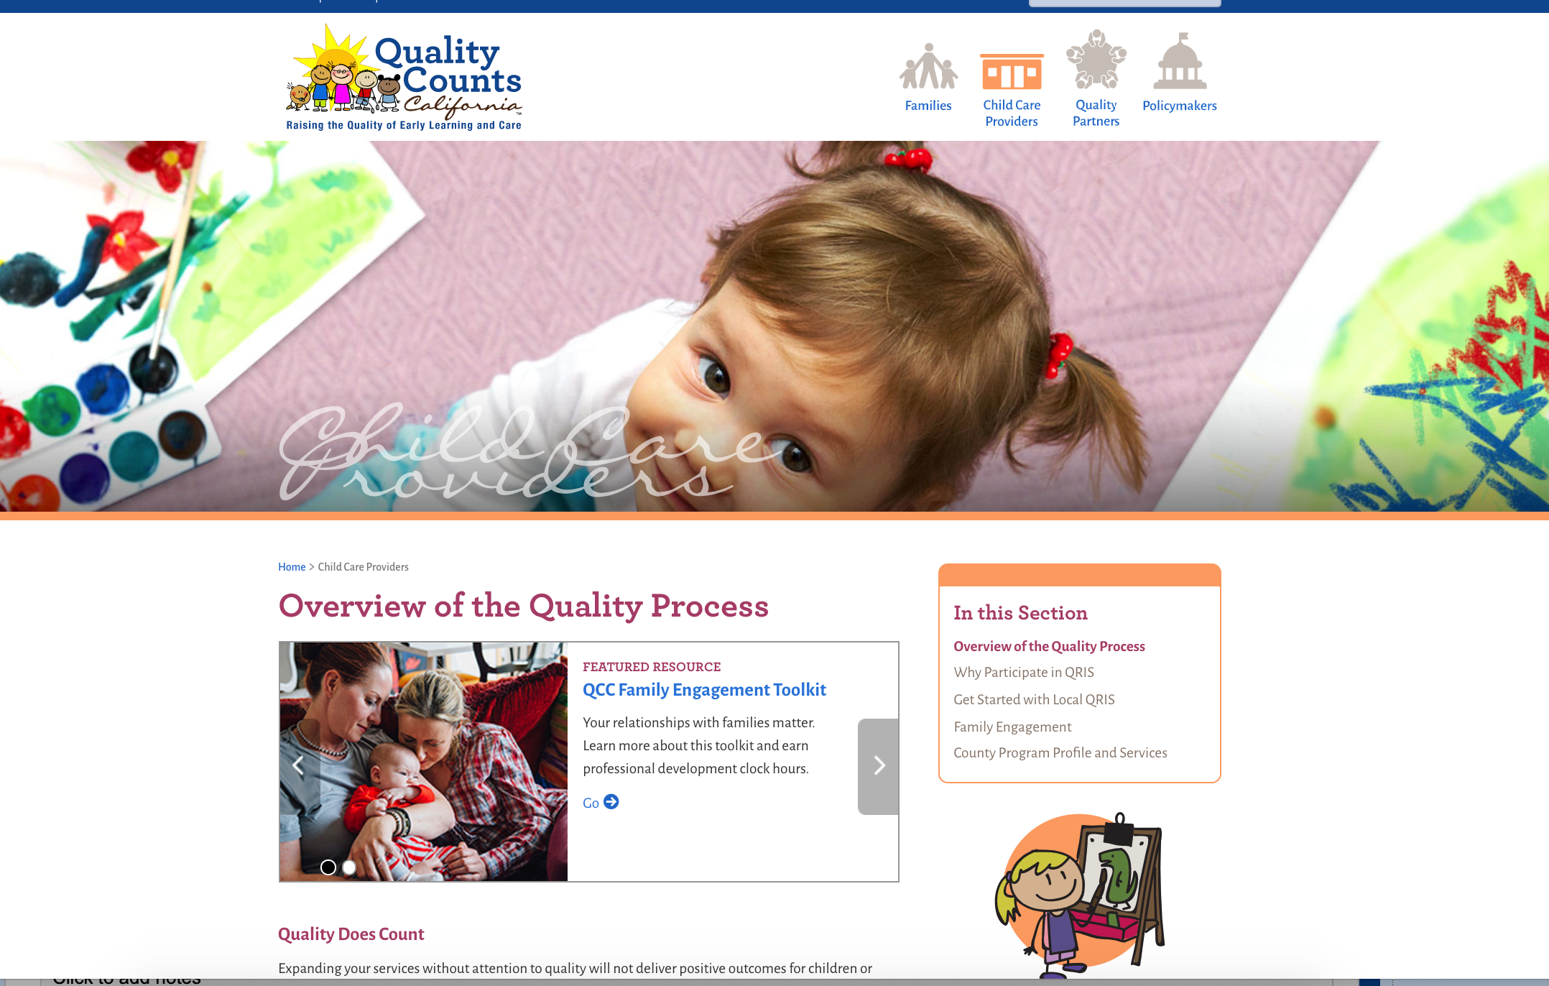
Quality Counts California
Notes:
The DRDP, The ERS and the act of using data to plan are also a part of the Quality Counts California system. More information can be found on their site.
https://www.qualitycountsca.net/
https://www.cde.ca.gov/sp/cd/rt/californiaqris.asp

Slide 14

What are your desired results?
DIRECTIONS:
Introduce yourself to others.
Reflect on the meaning of desired results.
Discuss your desired results.
Take out three sticky notes.
Notes:
Activity: Opening Activity
Get three sticky notes from your table. On the first note, write down what you already know about the Desired Results system.
On the second sticky note, write down what you want to know about the desired results system.
On the third sticky note write down the letter “L” at the top.

Slide 15

What are your desired results? (2)
On the first note, write down what you already know about the Desired Results system.
On the second note, write what you want to know about the desired results system.
On the third note, write the letter “L” at the top.
Notes:
Activity: Opening Activity- KWL
Get three sticky notes from your table.
On the first note, write down what you already know about the Desired Results system.
On the second sticky note, write down what you want to know about the desired results system.
On the third sticky note, write down the letter “L” at the top. ( Participants will use this note at the end of the day to write two things they learned and how they will take it back to their programs.)
When you are done. please take your sticky to the appropriate charts.
There is a K chart for what you know. Place your first sticky note there.
There is a W chart for what you want to know. Place your second sticky there.
Please keep your third sticky for the end of the day.

Slide 16
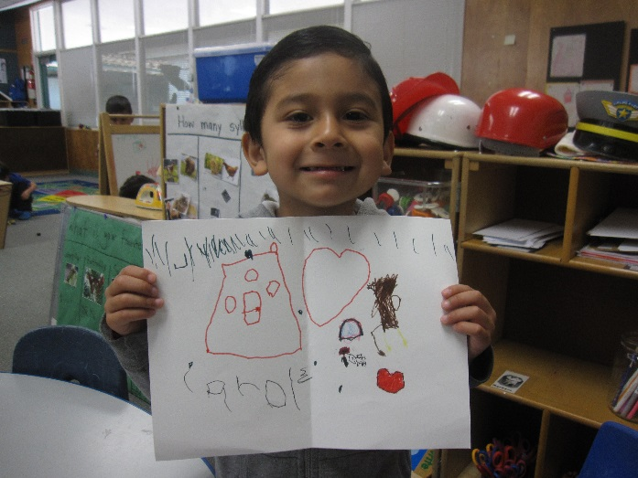
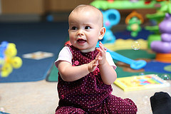
Desired Results for Children
Children are personally and socially competent.
Children are effective learners.
Children show physical and motor competence.
Children are safe and healthy.
Notes:
Review the four (4) desired results for children. These are the overarching goals for children.

Slide 17
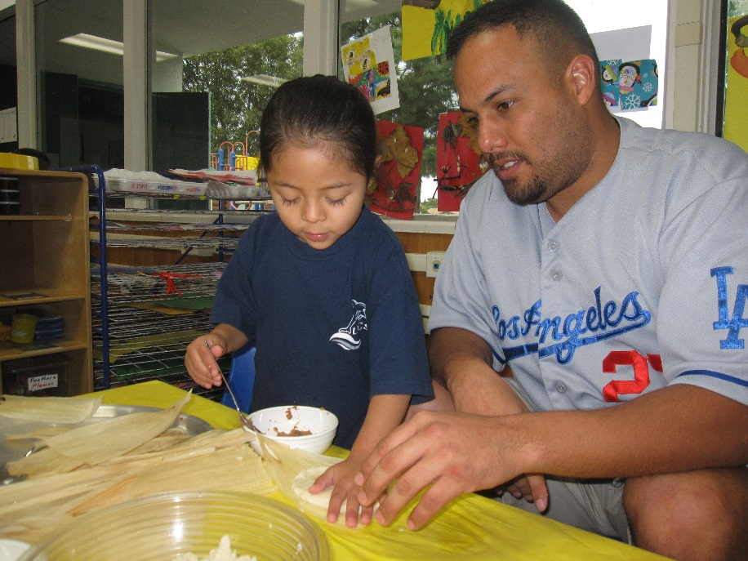
Desired Results for Families
Families achieve their goals.
Families support their children’s learning and development.
Notes:
Trainer note: Introduce the two (2) desired results for families.
The Parent Survey will help determine the achievement of these results. Parents will be supported in their role as their child’s first and most important teacher.

Slide 18
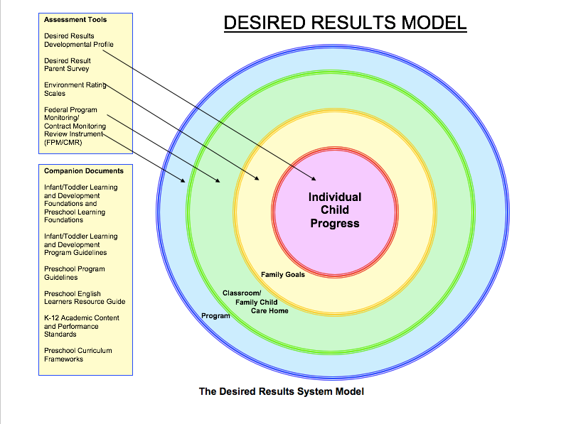
Desired Results model
Notes:
This model is a graphic organizer of the DR. Each of the circles connects to an element from the Desired Results Assessment System.

Slide 19
Foundations and the DRDP
Foundations
DRDP
A guide and teaching tool
At around 8, 18 & 36 months for I/T
At around 48 months and 60 months for PS
For all children, including English language learners and children with disabilities
An observational assessment tool
Developmental continuum
For all children, including English language learners and children with disabilities
Notes:
It is important to understand that the foundations describe the knowledge and skills that all young children typically exhibit:
at about 8, 18, and 36 months for infants and toddlers
at about 48 months and about 60 months of age for preschool children
as they complete their first or second year of preschool;
with appropriate support; and
when attending a high-quality preschool program.
The DRDP is the child observational assessment tool that is used by teachers to record a child’s progress on a developmental continuum.

Slide 20
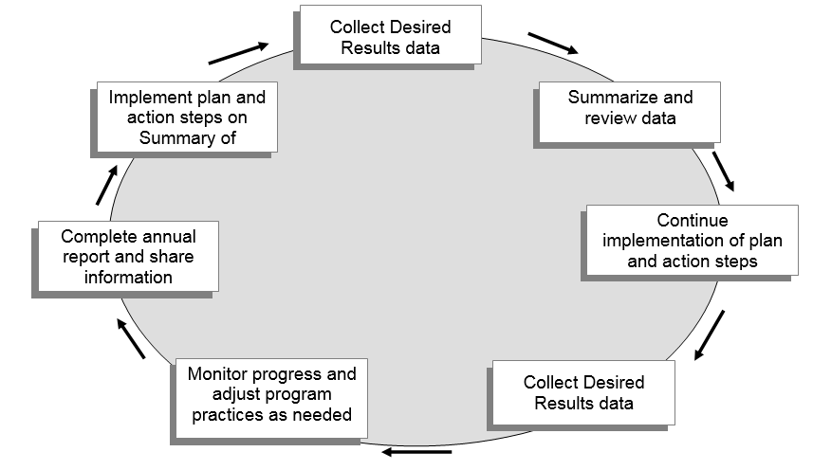
Desired Results System Process for Continuous Improvement
Notes:
Trainer note: Ask participants to follow along on the DR System Process for Continuous Improvement handout.
In this diagram, programs begin at the top left box of the cycle, with implementing the Program Quality Dimensions and moving clock-wise around the cycle each program year. After adjustments have been made, administrators analyze and evaluate the progress to determine what subsequent actions should be taken to ensure continued progress.

Slide 21

Desired Results Developmental Profile
Notes:
Trainer note: Briefly ask how many people have used the DRDP to assess children.
The DRDP serves as a framework for documenting the progress children demonstrate over time.
The DRDP provides teachers with concrete information that will help them tailor their curriculum to meet the needs of the children.

Slide 22



Program Guideline Publications
Notes:
There are three program guideline publications from the California Department of Education
The Guidelines for Early Learning in Child Care Home Settings
Infant/Toddler Learning and Development Program Guidelines
California Preschool Program Guidelines
(This section is for training your site administrators, not teachers.)

Slide 23

Parent Survey
All About Young Children
Notes:
The Parent Survey is the questionnaire to evaluate parents’ satisfaction with programs.
The Parent Survey:
Gives programs access to information from parents to improve program quality
Determines parent satisfaction with their child’s program
Is conducted at least once per year

Slide 24
Environment Rating Scales
Notes:
The Environment Rating Scales allow programs to assess their learning environments.
Research projects have discovered a meaningful relationship between ERS scores and child outcome measures, as well as between ERS scores and teacher characteristics, teacher behaviors, and compensation.
The Environment Rating Scale is used to measure implementation of Program Quality Dimensions.
Each classroom, family childcare home, and school age facility must be assessed at least once per program year.

Slide 25
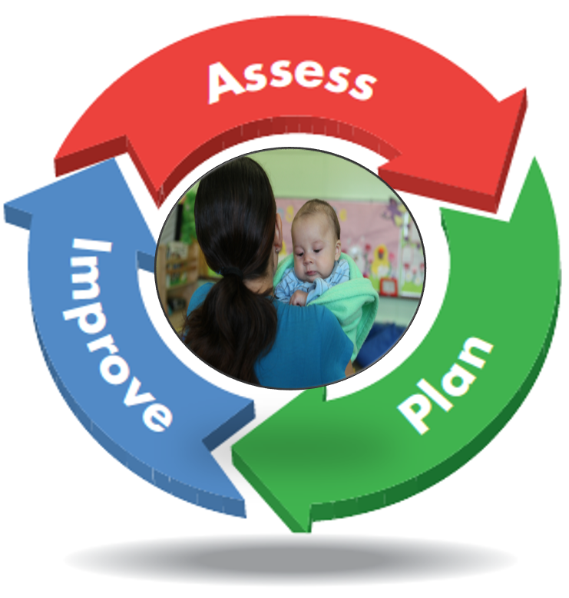
Program Self-Evaluation
Notes:
The program self-evaluation process gives agencies an opportunity to recognize their strengths and areas that require improvements.

Slide 26
Program self-evaluation requirements by contract are based upon…
DRDP Summary of Findings and Program Action Plan
Agency FPM/CMR Summary of Findings
Agency Annual Report
Notes:
Review the Agency Annual Report requirements.
Agency FPM/CMR - Federal Program Monitoring/Contract Monitoring Review
These forms will be described in more detail during online webinars.

Slide 27
Program Self-Evaluation and Compliance Review
Review materials and procedures
Implement Desired Results System
Review and complete Agency Annual Report
Send Annual Report to CDSS by June 1
Notes:
The Desired Results system will document the progress made by children and families in achieving desired results. It will also provide information to help practitioners improve their child care and development services.

Slide 28
In Summary
The Desired Results system is used to:
Increase program quality for children and families.
Measure the developmental progress of children and families in achieving desired results.
Identify program strengths, as well as areas that may need improvement.
Provide a results-based accountability system that is measurable.

Slide 29


Break

