Slide 1

CDSS Attribution
This training is funded by the California Department of Social Services (CDSS). The materials included in this training are developed in part or wholly by the California Department of Education (CDE) and produced by CDSS.
Notes:
This training is funded by the California Department of Social Services (CDSS). The materials included in this training are developed in part or wholly by the California Department of Education (CDE) and produced by CDSS.

Slide 2
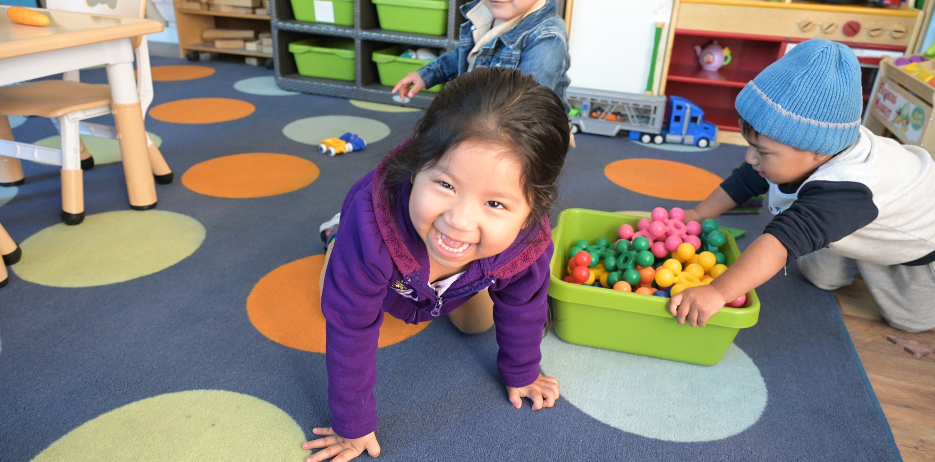
Desired Results for Children and Families
Desired Results System Overview for New Administrators
A Project of the California Department of Social Services with the Desired Results Training & Technical Assistance Project
Notes:
Trainer note: Please introduce yourself, your co-trainers, and any special guests.
Participants will learn about the development of the Desired Results system and how it can be used to improve quality services for children and families. Participants should write ONLY on the colored pages in the binders. The white pages can be used as handout masters when they return to their agencies to train others.

Slide 3
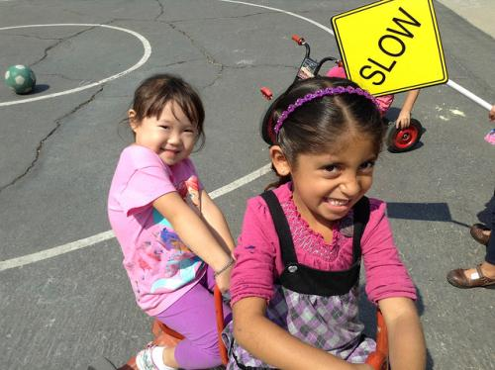
Welcome to Desired Results Overview Training

Slide 4

Parking Lot
Write questions on post-its and place them on the Parking Lot chart paper.
Notes:
Slide optional: Place two Parking Lot posters in the room.
Participants may post questions in the Parking Lot. Please note that facilitators will do their best to answer as many questions as possible during the training.
Let the group know that questions for which you do not have answers will be researched for the next training.
NOTE TO TRAINER: Call the Desired Results Project during a session break or lunch for answers to unanswered questions (800-770-6339).

Slide 5
Agenda
Introduction/Overview of the Desired Results System
Early Learning and Development System
Desired Results Developmental Profile (DRDP)
Environment Rating Scales
Parent Survey
Continuous Improvement Process
Notes:
Trainer note: Share the training outcomes.
The training will focus on methods within the Desired Results system that enhance services to children, leading to overall program improvement.
The secondary focus will be to provide training for using the tools that will support program improvement.
This training will help participants use the Desired Results tools to demonstrate program accountability.

Slide 6
Session I: Overview
Notes:
Desired Results training is the result of a desire on the part of the California Department of Education, Early Education Division, to improve and standardize program quality across the state.
In Session I, an overview of the system’s components will provide preliminary information on the Desired Results for Children and Families system’s goals and structure.
Later, additional details and information will be provided to give participants knowledge about each element of the Desired Results system.

Slide 7
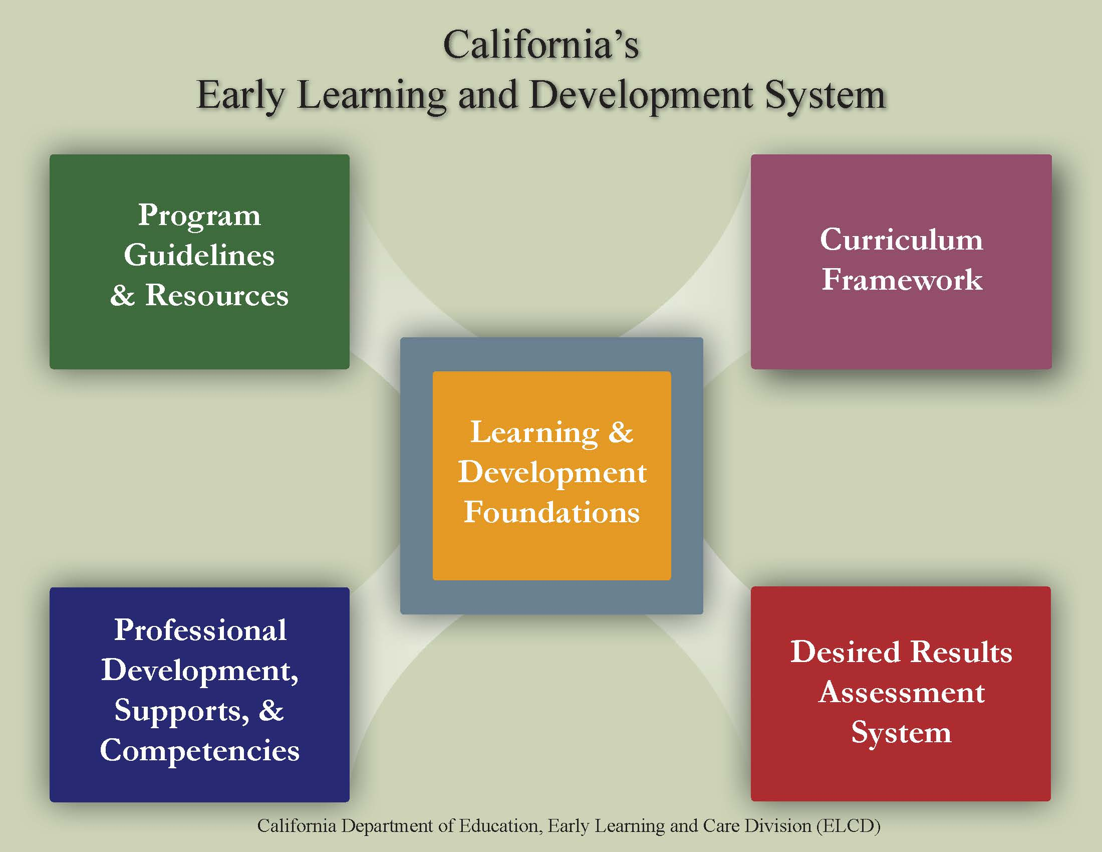
CA Early Learning and Development System
Notes:
This information is included in the online overview of the system. Today, we are focusing on the Desired Results assessment system. This handout, located in the binder, contains information for each of the elements on the back side. You will be able to write in the resources available for each component.
Trainer note: Direct participants to use a highlighter to highlight key words as the elements are discussed. Instruct participants to keep this handout available.

Slide 8




Learning Foundations What Children Know and Are Able to Do
CPIN offers training
CECO modules
Notes:
At the center of the system are the Learning and Development Foundations, which describe the learning and development that preschool children typically demonstrate with appropriate support.
The ITLD Foundations show how development unfolds across three age periods: 4 through 11 months, 11 through 23 months, and 23 through 36 months. For each foundation age period, indicators describe knowledge, skills, and behaviors that show the developmental progression across the age periods.
The Preschool TK Learning Foundations were released in July 2024.
The California Preschool/Transitional Kindergarten Learning Foundations (PTKLF) describe the learning and development of most children ages three to five and a half years old in high-quality early education programs.
The foundations can provide all educators, family childcare providers, parents, and the public with a clear understanding of the wide range of knowledge and skills that children typically acquire when given the benefits of a high-quality early childhood program, whether it is in center-based, home-based, or TK settings.
(https://www.cde.ca.gov/sp/cd/re/psfoundations.asp)
The IT foundations are available in 4 languages on the CDSS website
Pre-recorded presentations that provide an overview of each PTKLF domain can be found on the CDE YouTube channel.
In the chat box, type Foundations= AGE. Encourage your staff to reference the Foundations when reviewing age-appropriate skills.

Slide 9






Program Guidelines
Notes:
The guidelines bring together information that program administrators and teaching staff can use to prepare appropriate learning environments for children.
Ask teachers to look through the Inclusion Works and the Preschool English Learner Guides to become familiar with the resources.

Slide 10




Curriculum Frameworks
CECO modules
CPIN offers training
Notes:
Another element of the system includes the Curriculum Frameworks. The Framework provides guidance on how programs and teachers can support the learning and development described in the foundations through environments and experiences that are linguistically and developmentally appropriate, as well as individually and culturally meaningful and connected.

Slide 11







Professional Development Supports & Competencies
Notes:
The above resources help prepare California’s workforce to be professional and aware of early childhood trends. Use your device to search for one of these resources and share with the group one new thing you have learned.
Place a star on the resource you have used or encouraged your staff to use.
Is there a resource on this slide that you would like more information about? Please type it into the chat box.
On the resource section of the Google doc https://drive.google.com/file/d/1Nx8TXgqrcLIkOFb6uB9N2Zjy7aN5hFoz/view
You will find a resource document that looks like this.
Please take a look and mark two of them that you are interested in knowing more about.

Slide 12
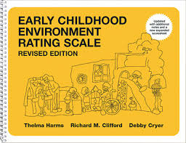
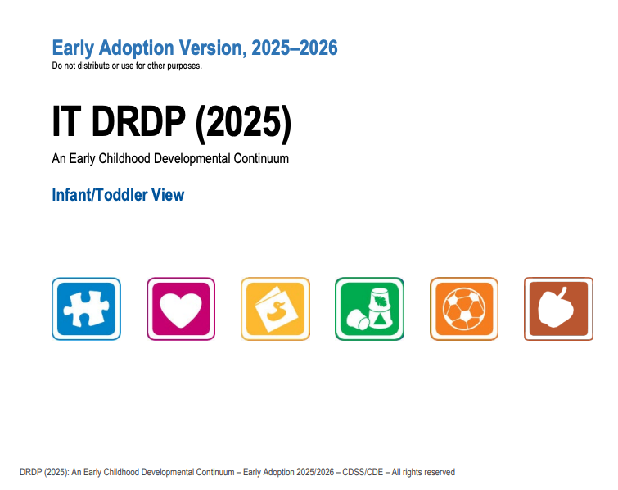
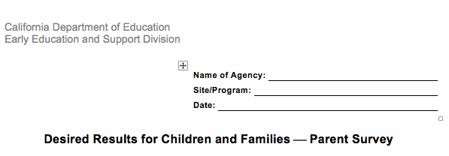
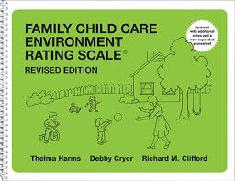
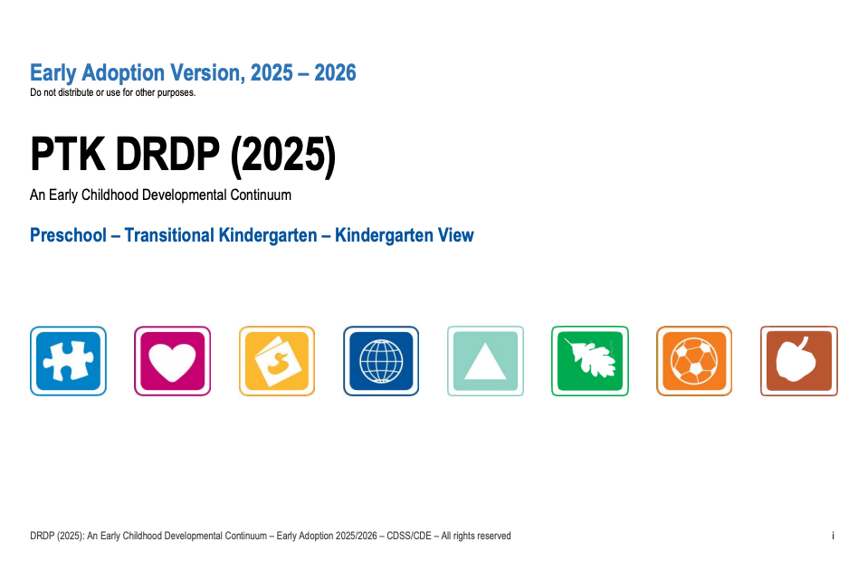
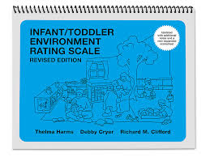
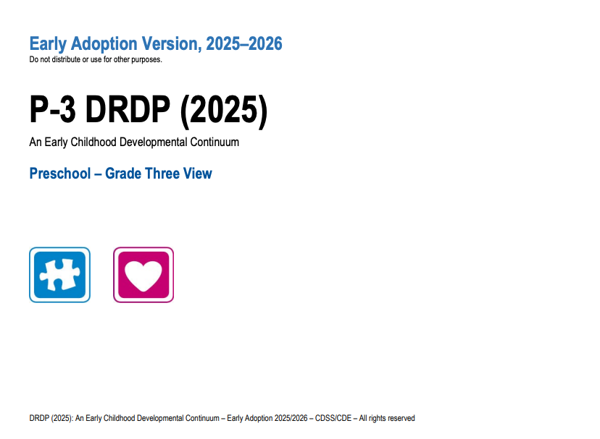

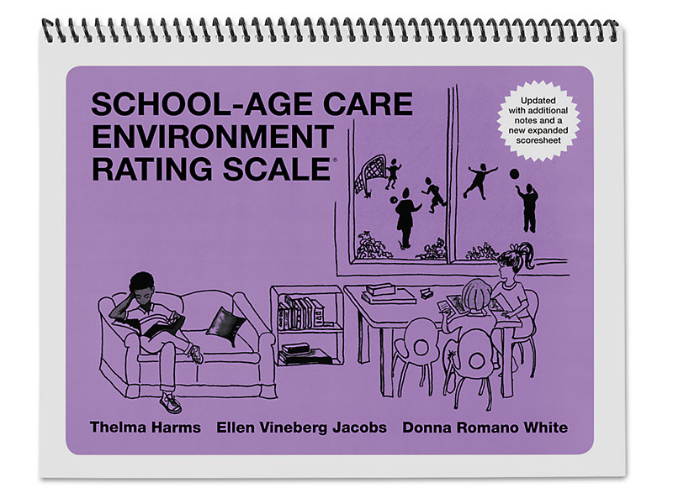
Desired Results Assessment System
Notes:
The DR Assessment system comprises the DRDP assessment, the ERS, parent surveys, and the Program Self-Evaluation. All of these elements work together in an effort to support ongoing program improvement

Slide 13

Quality Counts California
Notes:
Quality Counts California ensures that young children have access to high-quality early learning environments by rating program quality, supporting continuous improvement, and engaging families and communities. The ultimate goal is to foster children's development and school readiness through improved standards and support for ECE providers.
The DRDP and the act of using data to plan are also a part of the Quality Counts California system. For more information, please visit their website.
https://www.qualitycountsca.net/
https://www.cdss.ca.gov/inforesources/child-care-and-development/quality-improvement-initiatives
https://www.cde.ca.gov/sp/cd/rt/californiaqris.asp

Slide 14

What are your desired results?
DIRECTIONS:
Introduce yourself to others.
Reflect on the meaning of desired results.
Discuss your desired results.
Take out three sticky notes.
Notes:
Activity: Opening Activity
Get three sticky notes from your table. On the first note, write down what you already know about the Desired Results system.
On the second sticky note, write down what you want to know about the desired results system.
On the third sticky note, write down the letter “L” at the top.

Slide 15
What are your desired results? (2)
On the first note, write down what you already know about the Desired Results system.
On the second note, write what you want to know about the desired results system.
On the third note, write the letter “L” at the top.
K
What I already know
W
What I want to know
L
What I learned
Notes:
Activity: Opening Activity- KWL
Get three sticky notes from your table.
On the first note, write down what you already know about the Desired Results system.
On the second sticky note, write down what you want to know about the desired results system.
On the third sticky note, write down the letter “L” at the top. (Participants will use this note at the end of the day to write two things they learned and how they will take them back to their programs.)
When you are done. please take your sticky to the appropriate charts.
There is a K chart for what you know. Place your first sticky note there.
There is a W chart for what you want to know. Place your second sticky there.
Please keep your third sticky for the end of the day.

Slide 16
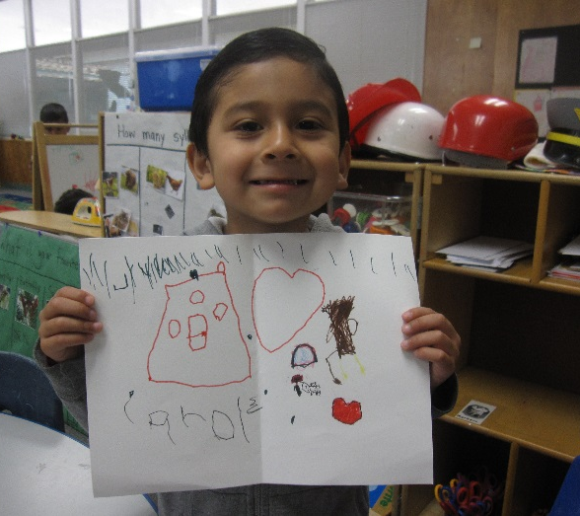
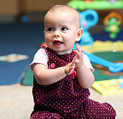
Desired Results for Children
Children are personally and socially competent.
Children are effective learners.
Children show physical and motor competence.
Children are safe and healthy.
Notes:
Review the four (4) desired results for children. These are the overarching goals for children.

Slide 17
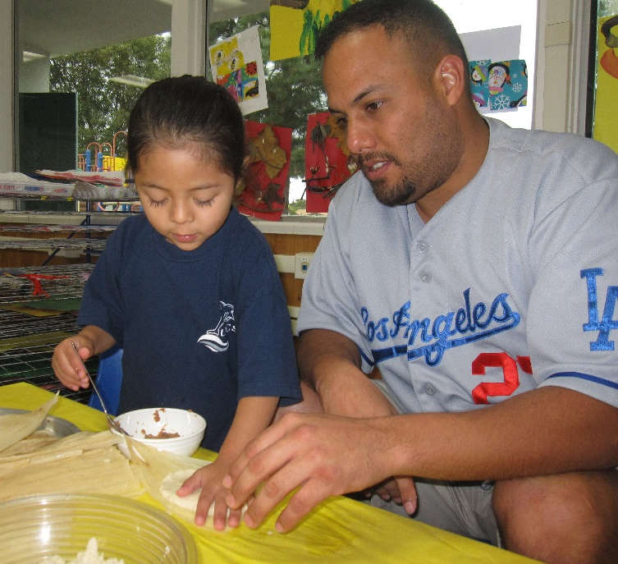
Desired Results for Families
Families achieve their goals.
Families support their children’s learning and development.
Notes:
Trainer note: Introduce the two (2) desired results for families.
The Parent Survey will help determine the achievement of these results. Parents will be supported in their role as their child’s first and most important teacher.

Slide 18
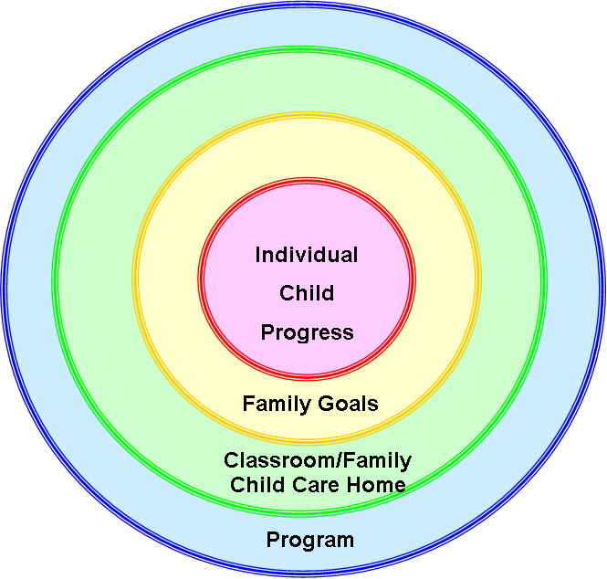
Desired Results Model
Assessment Tools
Desired Results Developmental Profile
Desired Result
Parent Survey
Environment Rating
Scales
Federal Program Monitoring/Contract Monitoring Review Instrument
Companion Documents
Infant/Toddler Learning and Development Foundations and Preschool/Transitional Kindergarten Learning Foundations
Infant/Toddler Learning and Development Program Guidelines
Prekindergarten Learning and Development Guidelines
Preschool English Learners Resource Guide
K-12 Academic Content and Performance Standards
Preschool Curriculum Frameworks
Notes:
This model is a graphic organizer of the DR. Each of the circles connects to an element from the Desired Results Assessment System.

Slide 19
Foundations and the DRDP
Foundations
DRDP
A guide and teaching tool
At around 8, 18 & 36 months for I/T
Ages 3- 5.5 for preschool and TK
For all children, including English language learners and children with disabilities
An observational assessment tool
Developmental continuum
For all children, including English language learners and children with disabilities
Notes:
It is important to understand that the foundations describe the knowledge and skills that all young children typically exhibit:
at about 8, 18, and 36 months for infants and toddlers
Ages 3- 5.5 for Preschool and TK
as they complete their first or second year of preschool;
with appropriate support; and
when attending a high-quality preschool program.
The DRDP is a child observational assessment tool used by teachers to record a child’s progress on a developmental continuum.

Slide 20
Desired Results System Process for Continuous Improvement
Collect Desired Results data
Summarize and review data
Continue implementation of plan and action steps
Complete annual report and share information
Implement plan and action steps on the Summary of Findings
Monitor progress and adjust the program as needed
Collect Desired Results data
Notes:
Trainer note: Ask participants to follow along on the DR System Process for Continuous Improvement handout.
In this diagram, programs begin at the top-left box of the cycle by implementing the Program Quality Dimensions and moving clockwise around the cycle each program year. After adjustments have been made, administrators analyze and evaluate the progress to determine what subsequent actions should be taken to ensure continued progress.

Slide 21
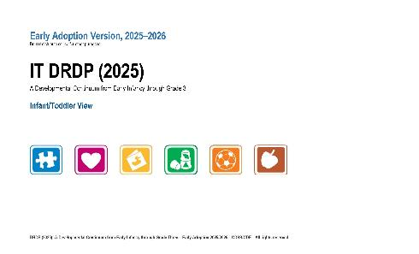
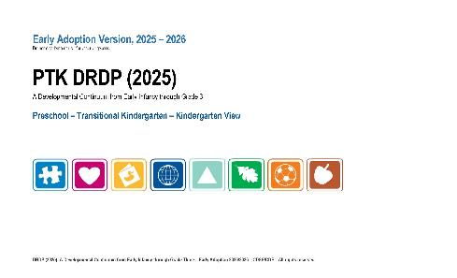
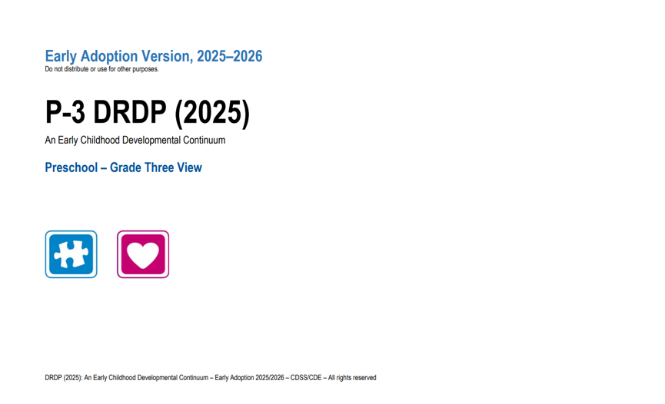

Desired Results Developmental Profile
CECO modules
Notes:
The DRDP 2025 is a single instrument with four views for children aged 0-12. The DRDP (2025) is a full continuum instrument used for all children from infancy through kindergarten entry, including children with special needs
The DRDP serves as a framework for documenting the progress children demonstrate over time.
The DRDP provides teachers with concrete information that will help them tailor their curriculum to meet the needs of the children.
The DRDP is a full continuum assessment. The same assessment is used for all children, including children with IFSPs and IEPs. There is one assessment, and it has five views. The measures, however, are the same. This means that ATL-REG 1 is the same measure in all views. The difference is the number of measures in the different views.
The DRDP (2025) for infants and toddlers has six domains and 25 measures.
The DRDP (2025) for PTK has eight domains and 35 measures.
The DRDP (2025) for P3 has two domains and nine measures

Slide 22



Program Guideline Publications
Notes:
There are three program guideline publications from the California Department of Education
The Guidelines for Early Learning in Child Care Home Settings
Infant/Toddler Learning and Development Program Guidelines
California Preschool Program Guidelines
(This section is for training your site administrators, not teachers.)

Slide 23

Parent Survey
All About Young Children
Notes:
The Parent Survey is a questionnaire to evaluate parents’ satisfaction with programs.
The Parent Survey:
Gives programs access to information from parents to improve program quality
Determines parent satisfaction with their child’s program
Is conducted at least once per year

Slide 24
Environment Rating Scales
a required tool for the Program Self-Evaluation and the ongoing continuous improvement process.
Notes:
The Environment Rating Scales allow programs to assess their learning environments.
Research projects have discovered a meaningful relationship between ERS scores and child outcome measures, as well as between ERS scores and teacher characteristics, teacher behaviors, and compensation.
The Environment Rating Scale is used to measure implementation of Program Quality Dimensions.
Each classroom, family childcare home, and school-age facility must be assessed at least once per program year.

Slide 25
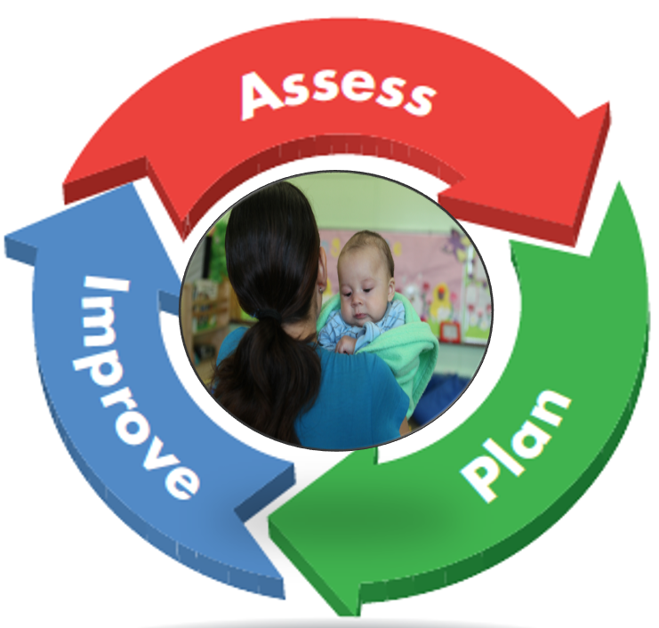
Program Self-Evaluation
Notes:
The program self-evaluation process offers agencies the opportunity to identify their strengths and areas that require improvement.

Slide 26
Program self-evaluation requirements by contract are based upon…
DRDP Summary of Findings and Program Action Plan
Agency Summary of Findings
Agency Program Self Evaluation
Notes:
Review the Agency Annual Report requirements.
Agency FPM/CMR - Federal Program Monitoring/Contract Monitoring Review
These forms will be described in more detail during online webinars.

Slide 27
Program Self-Evaluation and Compliance Review
Review materials and procedures
Implement Desired Results System
Review and complete Program Self Evaluation
Send Program Self Evaluation to CDSS by June 1
Notes:
The Desired Results system documents the progress made by children and families in achieving desired results. It also provides information to help practitioners improve their child care and development services.

Slide 28
In Summary
The Desired Results system is used to:
Increase program quality for children and families.
Measure the developmental progress of children and families in achieving desired results.
Identify program strengths, as well as areas that may need improvement.
Provide a results-based accountability system that is measurable.
Notes:
The Desired Results system is used to:
Increase program quality for children and families.
Measure the developmental progress of children and families in achieving desired results.
Identify program strengths, as well as areas that may need improvement.
Provide a results-based accountability system that is measurable.

Slide 29
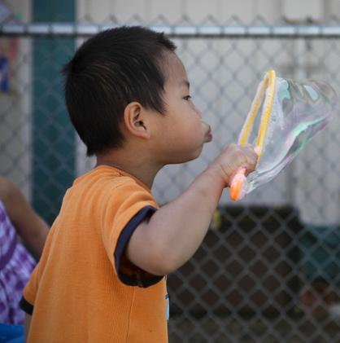
Break
The wider the range of possibilities we offer children, the more intense will be their motivations and the richer their experiences.
-Loris Malaguzzi

