Slide 1

CDSS Attribution
This training is funded by the California Department of Social Services (CDSS). The materials included in this training were developed in part or wholly by the California Department of Education (CDE) and produced by CDSS.
State of California Department of Social Services, Copyright (2026)
Notes:
This training is funded by the California Department of Social Services (CDSS). The materials included in this training were developed in part or wholly by the California Department of Education (CDE) and produced by CDSS (State of California Department of Social Services, Copyright [2025]).
None

Slide 2
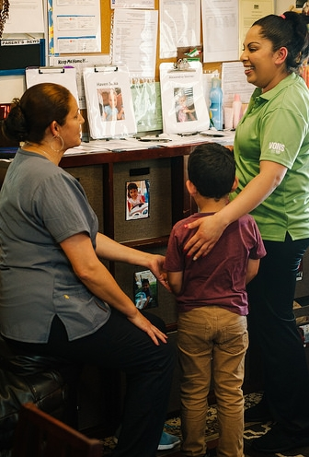
Session IV: Desired Results Parent Survey
Notes:
In this session, participants will learn about the Parent Survey form. They will also learn how to summarize the data from the surveys.
None

Slide 3
Agenda
Family Partnerships and Supporting Family Culture
Parent Survey Summary of Findings
Notes:
Good morning, everyone.
Today, we will explore and connect family partnerships and Parent Survey Summary of Findings and how to use that data to support strong family partnerships.
Completing the Parent Survey Summary of Findings is the same as the DRDP. You gather your data, analyze it, and write an action plan for how you will make that data visible in the classroom and throughout your program. The slides for today are available on the Desired Results website and your Google Doc.
We will also post a recording on the DRDP YouTube Channel.

Slide 4
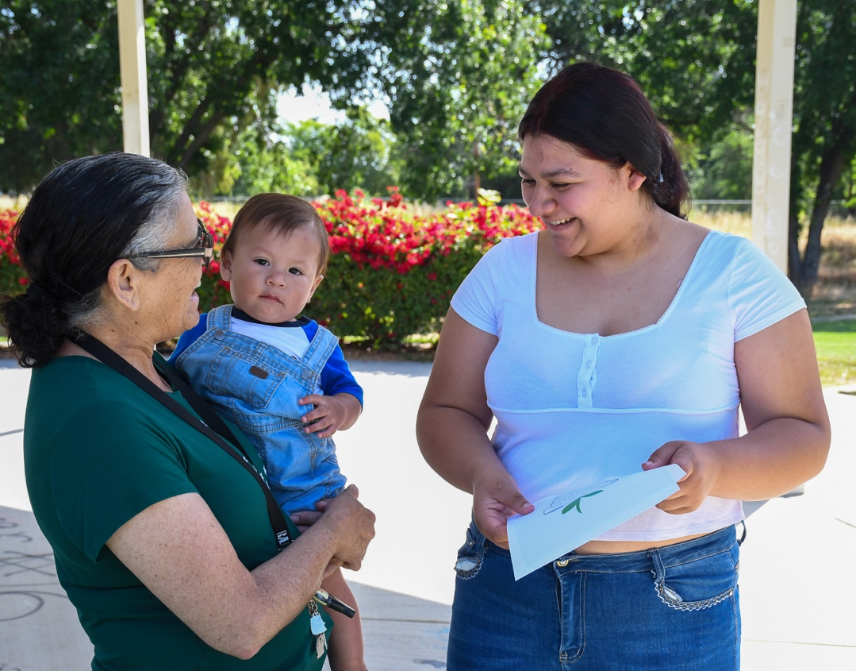
Outcomes
Understand the importance of building strong relationships and trust within families
Gain practical strategies for distributing and collecting parent survey data and using it to inform program improvement.
Notes:
These are the outcomes for today’s session:
Understand the importance of building strong relationships and trust within families
Gain practical strategies for distributing and collecting parent survey data and using it to inform program improvement.

Slide 5
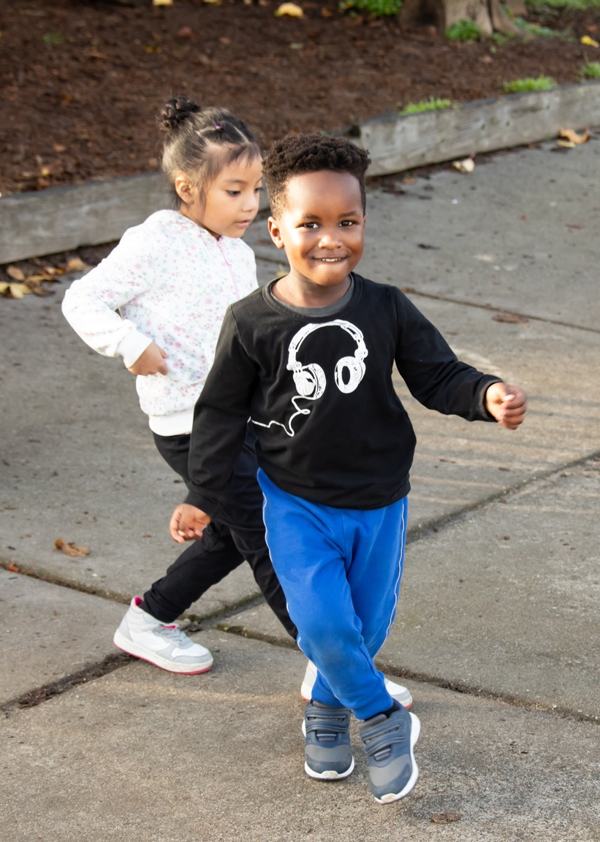
Stop and Reflect
How comfortable are you with interacting with families?
Are any barriers preventing you from building relationships with the families in your classroom or program? If so, what are they?
What steps can you take to overcome these barriers?
What does “partnership” mean to you when working with families?
Notes:
We will spend the next 12 minutes in break-out rooms, where you will be placed in groups of three. Choose two of these questions to respond to. Each person will have about two minutes to share their thoughts, ideas, wonderings, or feelings. It's important to listen with your whole heart as others share. Remember, you can pass your turn if you wish. Please keep track of the time while sharing to ensure everyone has a chance to speak.
Send participants to break-out rooms—ideally with 3-4 people.
Share the slide in the Zoom break-out rooms.
When participants return, ask 1-3 people to share. This final step is essential as it connects them to the larger group.
Slide text: How comfortable are you with interacting with families?
Are any barriers preventing you from building relationships with the families in your classroom or program? If so, what are they?
What steps can you take to overcome these barriers?
What does “partnership” mean to you in the context of working with families?

Slide 6
Desired Results Parent Survey
Notes:
In this session, participants will learn about the Parent Survey form. They will also learn how to group the survey data in a summary.
Trainer Note:
From the Google Doc, open the first handout, Parent Survey--Developing Family Partnerships binder pages, and view the Table of Contents.
Use annotate to star the most useful activities for your staff.
This section will review the parent survey requirements and the importance of family partnerships and relationships.

Slide 7

Purpose of the Parent Survey
Determines parent satisfaction with their child’s program
Provides information about how parents are achieving their goals
Gives programs access to information from parents to use to improve program quality
Is conducted at least once per year
Notes:
The Parent Survey was designed to collect information on how well each program supports the following two desired results for families:
Families support their children’s learning and development.
Families achieve their goals.
The Parent Survey provides a uniform procedure for getting information on the same set of issues from parents. It also gives programs new insights that can be used for improving program quality.
Have you already distributed your parent surveys?
Yes
We are working on it
I did not know we had to do them this year.
Slide text: The Desired Results Parent Survey
Determines parent satisfaction with their child’s program
Provides information about how parents are achieving their goals
Gives programs access to information from parents to use to improve program quality
Is conducted at least once per year
None

Slide 8
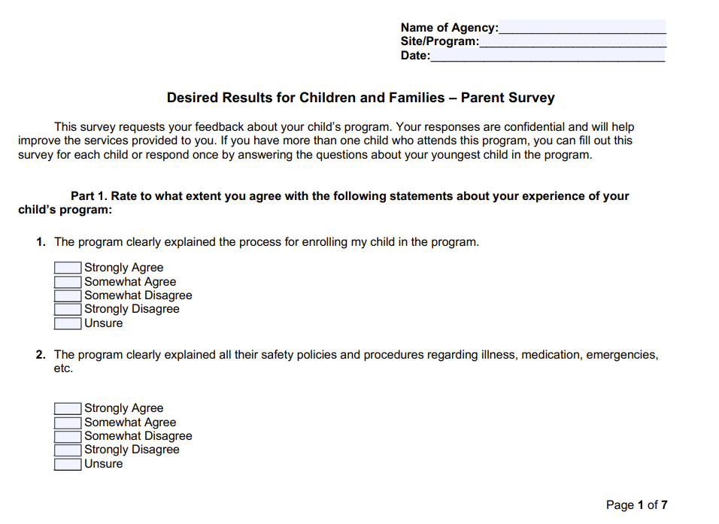
Desired Results for Children and Families Parent Survey
Notes:
The Parent Survey has been updated and now includes 21 questions applicable to all children, along with two additional questions specifically for children who have an Individualized Family Service Plan (IFSP) or an Individualized Education Program (IEP). In addition, two open-ended questions allow families to express what they appreciate about the program and suggest any improvements they would like to see.
The Parent Survey is available on the DR website in Arabic, English, Farsi/Persian, Hindi, Hmong, Korean, Russian, Simplified Chinese, Spanish, Tagalog, and Vietnamese.
Parent surveys are confidential.
It is distributed once a year, but can be done twice if desired.
None

Slide 9
Taking a Look at the Parent Survey
😀 | This makes sense to me.
😦 | This surprises me.
🧐 | I have questions about this.
Notes:
The first activity in the binder will help staff become familiar with the survey. They are asked to rate the questions. This activity determines whether they understand the parent survey or if they have any questions.
Activity Option One (1) – Becoming Familiar with the Parent Survey
Participants form small groups of 10-12 people to review and discuss the Parent Survey.
Participants read the Parent Survey and then discuss how the responses might benefit their program.
Ask participants to complete the Parent Survey form. Have participants take on the role of a parent evaluating an imagined program.
None

Slide 10
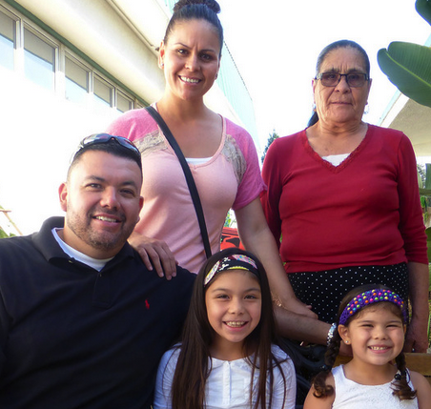
Data from Parent Surveys Is…
Compiled by contract
Analyzed to identify key findings
Used to write the Parent Survey Summary of Findings
How do you gather parent survey data?
Notes:
No matter the size of a program or agency, Parent Surveys are summarized at the contract level, although agencies may choose to compile them at the site level. Agencies group the data by:
1st – site (ONLY a recommendation; site summary is not required.)
2nd – program or agency
This data will be used to write Summaries of Findings, which will be analyzed again to determine a COMPREHENSIVE Program Action Plan for the agency.
None

Slide 11




Online Survey Software
Notes:
There are many online software programs available for collecting and compiling data. Many are free, and others have a fee depending on features and the number of participants.
How many of you are using or have used online software for your parent surveys?
https://www.jotform.com/blog/best-survey-tools/
Slide text:
Online Survey Software
Google Forms
SurveyMonkey
Zoho
Surveyplanet
None

Slide 12
Resources
Find forms on the Desired Results website www.desiredresults.us to assist in compiling data.
Parent Survey Group Data Summary
Up to 30 parent surveys
Up to 100 parent surveys
Notes:
If an administrator would prefer to use an Excel sheet to compile their data, resources are available on the Desired Results website
The Parent Survey Group Data Summary includes two (2) worksheets: the Input Data sheet and the Overview sheet. It provides numbers and percentages for the possible response options.
None

Slide 13
Desired Results Parent Survey Return
CDSS and CDE require the Parent Survey to be distributed once a year.
Getting parents to return surveys is important.
Good strategies for getting surveys back do NOT include punishing children for parents not returning the survey.
Notes:
See Activity Sheet—Parent Survey Returns
The Parent Survey is distributed to gather feedback on how they feel about our program. The data is then collected to inform the Summary of Findings.
Share that children do not have control over their families and should not be punished for their actions.
Remind them that their strategies should NOT include punishing children, e.g., child gets a sticker if the survey is returned, child gets a prize if the survey is returned, etc.
Having a positive relationship with parents will increase the odds of your getting a survey back.
None

Slide 14

Provide this…and they will return!
With the participants in your group, assign a recorder and a reporter.
With your group, write down your successful strategies for collecting parent surveys.
Be prepared to share your top three.
Notes:
Slide introduction: “Getting Parent Surveys returned can be tricky, but I also know the answer is typically in the room! Now we are going to work smarter, not harder, and take this opportunity to share some of our most successful strategies for collecting Parent Surveys.”
I am going to place you into breakout rooms for 8 minutes, and you will share the strategies that have worked for you. We will share when we return.
Were there any ideas on how to increase parent survey return?
Trainer note: This can be a group activity.
Provide participants with 3 x 5 index cards. Write one idea per card.
Give participants time to share their top three.
None

Slide 15
Motivating Parents to Return the Survey
Review the Parent Survey with families at a parent meeting prior to giving it to families.
Host a “Just for the Fun of It” night periodically.
Provide a comfortable space to complete the survey.
Provide a small reward such as a raffle ticket, prize, etc.
Notes:
Trainer note: Go through each bullet point that the group has not already addressed.
To ensure family members have a clear understanding of the Parent Survey’s purpose and contents, many sites review the survey during a parent meeting and have families fill it out during or after the review.
“Just for the Fun of It Night” might include a movie, a potluck dinner, or a game night. Families are more apt to come out if it involves fun, family, and food!
See the handout with other strategies.
Providing a comfortable space to fill out the survey could be a treat for busy families. Provide adult-size chairs, soft music, and refreshments such as coffee, tea, and muffins, or a bowl of treats.
Suggestion for gift: one program took a photo of each child and put it in a frame from the dollar store. Local stores or other community organizations might donate a raffle prize.
None

Slide 16
Completing the Parent Survey Summary of Findings
Desired Results for Children and Families – Parent Survey
This survey requests your feedback about your child’s program. Your responses are confidential and will help improve the services provided to you. If you have more than one child in this program, you can fill out this survey for each child, or respond once by answering the questions about your youngest child.
Part 1. Rate to what extent you agree with the following statements about your experience of your child’s program:
1. The program clearly explained the process for enrolling my child in the program.
Strongly Agree
Somewhat Agree
Somewhat Disagree
Strongly Disagree
Unsure
Notes:
After the data has been compiled, the program needs to write a Parent Survey Summary of Findings. There is an activity for your staff in the binder pages of the Google Doc.
If you have written one of these before, type “ME” in the chat. If this is your first time seeing this document, type “first time.”
Trainer: Pull up the activity from the binder pages. We have provided sample data for your staff to analyze and discuss how the program can address the concerns from the parent survey.
Activity: Completing the Parent Survey Summary of Findings and Exploring the Action Step Further
Activity (30 minutes)
After collecting the Parent Surveys, compile the data and use that data to write a Summary of Findings.
Find the Summary of Findings in the handouts.
Walk through the handout.
The process is the same for each Summary of Findings completed, i.e., the DRDP and the ERS.
None

Slide 17
Action Steps
Parent Survey Summary of Findings
Contractor Legal Name: Growing Wings
Center-based and/or Family Child Care Home Education Network: CSPP and CCTR
Planning Date: January 13, 2026
Lead Planner Name and Position: Ms. Osborne - Director
Follow-up Date(s): February 2026, March 2026, April 2026
Follow-up Lead Planner Name and Position: Ms. Ramos – Site Administrator
Key Findings from Parent Survey:
69% of our families responded that they did not receive information on the curriculum and learning activities from our program
51% of our families responded that they did not receive information from our program on current suspension and expulsion policies and procedures
Action Steps (Including communication, training, schedule, space, instructional materials, and supervision change[s])
Post updated lesson plans, photos, and learning objectives at classroom entrances for families to view during drop-off and pick-up.
Notes:
We provide a sample summary of findings that models clear, specific action steps.
Be specific when writing action steps. For example, instead of saying “Send home monthly newsletter,” try “Send home newsletter that includes a section, family events, parent committees, opportunities to volunteer, and other family engagement opportunities.” Using the language from the survey may be helpful.
Also, brainstorm some out-of-the-box ideas, things that are new to your program.
None

Slide 18
Expand Your Understanding of Families
6+3=9,
But so does 5+4.
The way you do things is not always the only way to do them.
Respect other people's way of thinking.
Notes:
As a program or as an administrator, you may feel that you have provided information to families (family handbooks, family meetings, etc.), even though they say they did not receive it; however, everyone does not see everything the same way. Families may not have realized that the family meeting was a way to get involved with the program; for them, it may have just been a meet-and-greet. Being respectful of others’ way of thinking is how we can all get to the same answer or conclusion.
Slide Text:
Expand Your Understanding of Families
6+3=9, but so does 5+4.
The way you do things is not always the only way to do them.
Respect other people's way of thinking.
None

Slide 19
Things to Consider
Is the written information sent in the parents’ home language?
Has the information been offered in multiple ways (e.g., a parent night, follow-up newsletter, personal note home, social media)?
Are parent tips feasible? Do they have the resources?
Do you request acknowledgment (e.g., that an activity for families is sent home and the family shares feedback with the teacher)?
Notes:
Here are some items to consider as you analyze the parent survey data.
Slide text:
Is the written information sent in the parents’ home language?
Has the information been offered in multiple ways (e.g., a parent night, a follow-up newsletter, a personal note home, a recorded presentation)?
Are parent tips feasible? Do they have the resources?
Do you request acknowledgment (e.g., that an activity for families is sent home and the family shares feedback with the teacher)?

Slide 20


Important Publications
Notes:
Now, we will look at strategies to share with your staff to help them develop partnerships with families. Two important publications with free companion CECO modules are available to everyone.
1. The Best Practices for Planning Curriculum for Young Children: Family Partnership and Culture. A big part of building long-lasting family partnerships is tapping into the family as a primary resource.
“This publication promotes understanding of children’s cultural or multicultural experiences at home and helps teachers use those experiences as building blocks for teaching and learning in early education settings” (Family Partnership and Culture, p. v).
2. Responsive Early Education for Families Experiencing Homelessness contains “…essential factual information and resources about the extent of early childhood homelessness in addition to concrete research-based strategies teachers can implement that benefit all of the children in their care and are essential for young children and their families impacted by homelessness.” (CDE, 2019, viii).”
In the following few slides, we will share and discuss strategies and information from these two publications to help administrators prepare ECE staff to understand the shared responsibility we have to ensure that all children have opportunities to participate in early learning environments that promote their well-being, optimal development, and educational success.
Developing positive, strength-based relationships with the parents and families is most likely to happen when there is a trusting relationship, and teachers listen to and learn from families about the experiences they face.
Another resource is - https://qualitycountsca.net/early-educators/family-engagement/family-engagement-toolkit/
None

Slide 21
Most Important Protective Factor
“The most important protective factor that supports young children to develop resilience in the face of sustained stress and trauma is experiencing a consistent relationship with a supportive caregiver who is responsive to the child’s needs” (Responsive Early Education for Young Children and Families Experiencing Homelessness, p. 74).
What are some strategies to creating responsive caregiving?
Notes:
Teachers may use various strategies to create responsive, strength-based relationships with families. Here are a few strategies to try:
Learn how to initiate respectful discussions with families about their housing situation, understanding that families may not self-identify as homeless if they are doubling up.
Understand the difference between cohousing arrangements made by choice and reflect family cultural traditions and values versus doubling-up situations in which families have no other housing options.
It is important to note that this is not an exhaustive list but rather a sampling of effective strategies. More strategies are listed in the Responsive Early Education for Young Children and Families Experiencing Homelessness publication.

Slide 22

Important: Strategies to Try
Use person-first language.
Place informational posters about services in visible areas.
Invite families to share their stories.
Notes:
Trainer note:
Teachers may use a variety of strategies to create responsive, strength-based relationships with families. Here are a few strategies to try:
Use person-first language and avoid referring to families as “homeless” on school forms or in conversation with families.
Communicate messages of inclusion. Place informational posters about services (e.g., California Department of Education’s Homeless Education Program poster) in visible areas where families will see them and post them online. https://www.cde.ca.gov/sp/hs/cy/documents/homelesspostereng.pdf
School House Connection. works to overcome homelessness. The website has videos, tipsheets, and other resources. https://docs.google.com/document/d/1OKy9Q3IQ16aDXfFlvS9ij2L9O6MXnYg1-hACkDfevWE/edit?tab=t.0
Invite families to share their stories to shed light on the complex circumstances that lead parents to experience homelessness.

Slide 23
Reflective Practice
“Reflective practice allows teachers to think about their practice. Critical reflection is a combination of reflection and an explicit examination of the role of equity and power in teaching practice” (Responsive Early Education for Young Children and Families Experiencing Homelessness, p. 83).
How can teachers strengthen their self-awareness about the beliefs, or assumptions, they have about children and families experiencing homelessness?
Notes:
How can teachers strengthen their self-awareness about the beliefs, assumptions, or potential biases they have about children and families experiencing homelessness?
Reflective practice allows teachers to think about their practice. Critical reflection is a combination of reflection and an explicit examination of the role of equity and power in teaching practice (Sensoy and DiAngelo 2017)” (Responsive Early Education for Young Children and Families Experiencing Homelessness, p. 83).

Slide 24
Building Successful Relationships With Families
What does it take to build successful relationships?
Mutual trust and respect
Environments that give positive messages to families, like “You belong here.”
Supportive communication
Recognition of working with families as partners
What else does it take?
Notes:
Activity Sheet #2 –Building Successful Relationships with Families (15 minutes)
Mutual trust and respect– Families feel like they are heard and that their opinion matters.
Environments convey that families are essential by reflecting their culture and ethnicity; they are welcome in the classroom.
Communication is regular and supportive, such as contacting the family with positive information about their child before something negative occurs.
Letting parents know that you want to work as a partner and that the parent is the child’s first teacher.

Slide 25

Strategies for Building Relationships
Learn first, teach second.
Participate in community cultural gatherings that are open to the public.
Source: Best Practices: Family Partnerships and Culture
Notes:
These are examples of strategies to start the lines of communication with families.
Participate in community cultural gatherings that are open to the public. If you are invited, your attendance at cultural celebrations may provide an opportunity to foster relationships with the children and families.
Take a moment and turn to Family Partnerships and Culture [CDE], pp 8-9, now to see more strategies you can use.
Debrief: Remind participants that “Mistakes will certainly be made and are part of the learning process. Although cultural responsiveness may be challenging, it can ultimately be a source of deep joy and meaningful relationships” (Family Partnerships and Culture [CDE], p. 98).
None

Slide 26

Family Values
How does our program…
Value families and their contribution to children’s learning?
Approach cultural variation with an open mind?
Apply knowledge gained about families, including their values and beliefs, to teaching and learning?
Notes:
How does our program…
Value families and their contribution to children’s learning?
Approach cultural diversity with an open mind?
Apply knowledge gained about families, including their values and beliefs, to teaching and learning?
Families have valuable information necessary to understand the children you serve. “To develop a partnership and to tap into the family as a primary resource, teachers and program staff must reach out to families, learn about them, and develop strong partnerships with them. This process requires openness to learning and an effort to understand the individuality of each family and the diversity of the families from which the children come.”( Family partnership and Culture p. x)
Trainer note:
Before this activity, have three chart papers posted, each with the question written on it. Post them throughout the room.
Have teachers write a response to each question on a sticky note and post it on the appropriate chart paper.

Slide 27

Q and A
Notes:
Now that we are coming to the end. Please share questions or thoughts about the topic or resources we shared today.
While you type the questions – Maria will call a raffle winner.
None

Slide 28
Resources that Support Family Partnerships
DRDP Online
Curriculum Frameworks
All About Young Children
California Early Childhood Online (CECO)
Best Practices Family Partnerships and Culture
HeadStart.gov website
Notes:
Curriculum Frameworks: The California Early Learning and Development System includes several components related to the Early Learning Foundations. The foundations are about the child and explain what a child may be able to do at different developmental milestones. They are similar to early learning standards in other states. The companion document to the foundations is the Curriculum Frameworks, which provides teachers with information on how to support children’s learning and development, as well as information for them to share with families.
All About Young Children: As with the rest of the field, the CDE acknowledges families’ central role in child development. It became clear that families must be able to access the information in the foundations. So, with WestEd, CDE created a tool to help families use the learning foundations. In creating this resource, of course, the diverse needs of families were identified. Instead of making a publication, the team decided it needed to be a living, breathing resource that changes just like families. An interactive website was developed that can be viewed in seven languages, focused on five learning domains, and spanning five age ranges to meet families’ interests and needs.
Best Practices in Partnering with Families: It is not just the information that families need to participate in and lead their child’s education. It is also necessary to build relationships with their education centers and teachers so that they can share the information that they bring to the table, and teachers can learn about the family and use this information with the family to support the child.
DRDP: The Desired Results Developmental Profile is an observational assessment aligned with the Foundations that provides information to teachers and families.
California Early Childhood Online (CECO) has online training to support teachers, staff, and caregivers. There are many courses, including Strengthening Families. Strengthening Families is a national movement, and this online course is A Resource for Action: Implementing the Strengthening Families Protective Factors Framework. In addition to strengthening families, many other courses on CECO may include content on partnering with families. For example, there are courses on each of the foundation’s domains, including sections of the Framework Engaging Families and courses on effectively utilizing the DRDP, which supports partnering with families.
Headstart.gov: Head Start offers online resources to build strong, effective partnerships that help parents and children thrive. Some valuable resources include courses on Building Partnerships with Families, Strategies for Family Engagement: Attitudes and Practices, Family Engagement and Cultural Perspectives: Applying Strengths-based Attitudes, and Partnering with Families of Children who are Dual Language Learners. There are also guidance resources for supervisory administrators to help their staff use a strengths-based approach in their work with families.
(https://headstart.gov/family-engagement/article/building-partnerships-families-series)

Slide 29
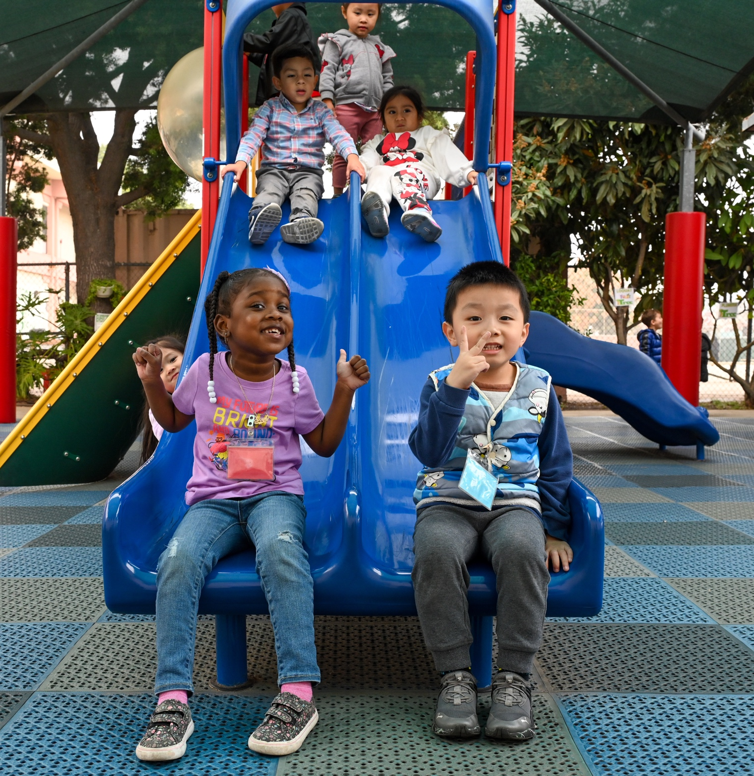
Thank You!
Notes:
Thank you!

