Slide 1

Desired Results for Children and Families
A Project of the California Department of Education, Early Education and Support Division with the Desired Results Training &Technical Assistance Project

Slide 2

Welcome to Experienced Administrators Webinar

Slide 3
Agenda
Welcome
Desired Results Components
Program Self-Evaluation
  Updates to the 2017/2018 process
Question and Answer

Slide 4
Training Outcomes
Participants will learn:
To focus on achieving desired results for children and families
About program improvement through the use of the Desired Results system
Updated information new in 2017/2018 Program Self-Evaluation (PSE) Process
Notes:
This training will focus on methods within the Desired Results system that improve services to children resulting in overall program improvement.
The secondary focus is on using the tools to support program improvement.
This training will help you use the Desired Results tools to demonstrate program accountability.
Trainer Notes:
Share the training outcomes.

Slide 5
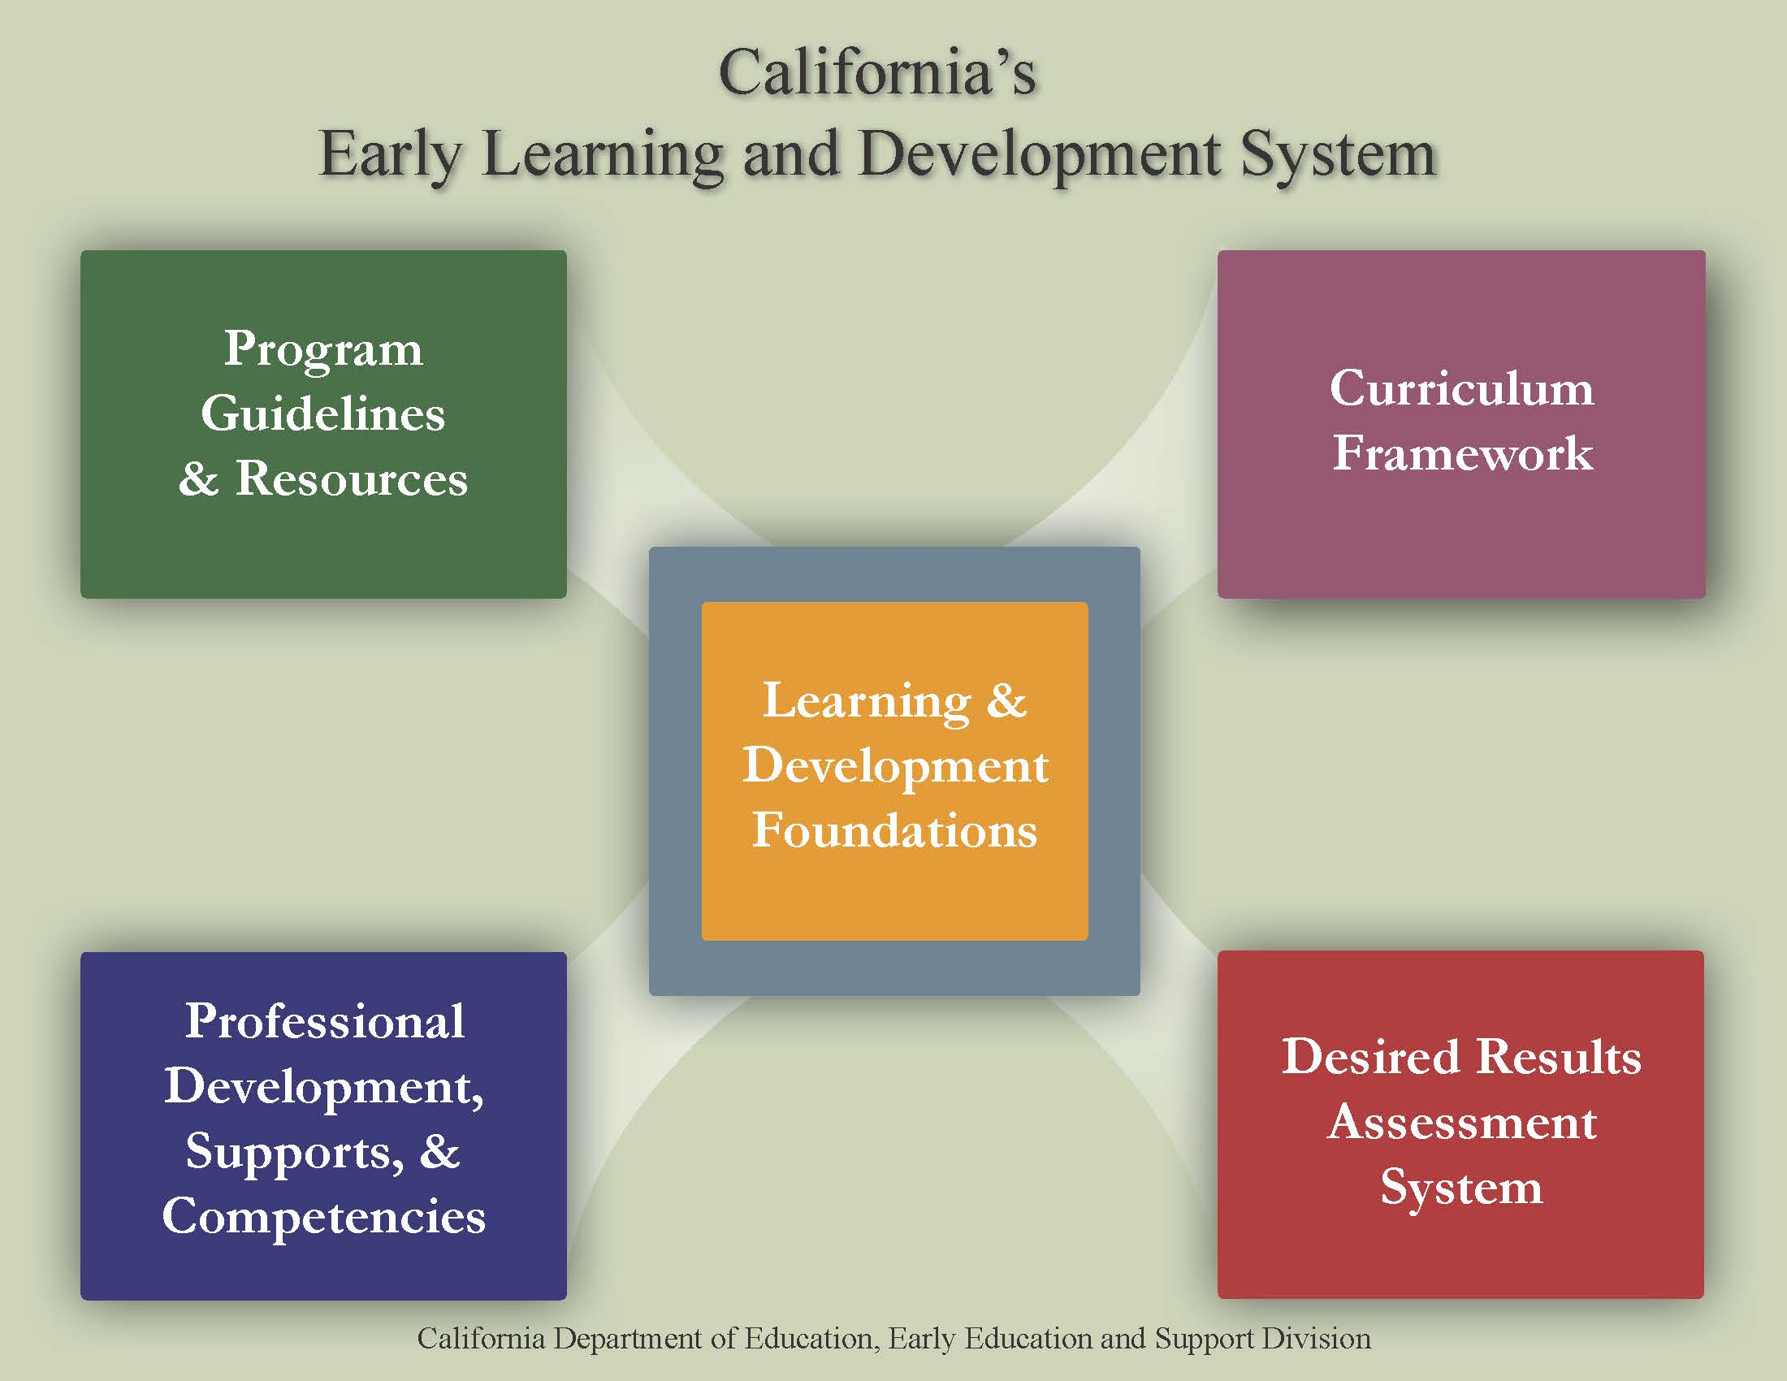
ELDS

Slide 6






Program Guidelines
CPIN
DLL link
Modules now available

Slide 7


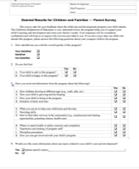



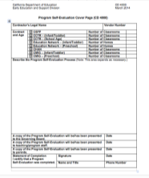


Desired Results Assessment System
Notes:
The system includes the DRDP assessment, the Environment Rating Survey (ERS), parent surveys and Program Self Evaluation.

Slide 8

Resources
Which resource is new to you?
Can you use it as an action plan for your Program Self Evaluation?

Slide 9


Program Self-Evaluation (PSE)
Notes:
The program self-evaluation process gives agencies an opportunity to recognize their strengths and areas that require improvements.

Slide 10
PSE Requirements
The Program Self-Evaluation (PSE) requires that the Desired Results system data be compiled and summarized for the:
  DRDP
  DR Parent Survey
  Environment Rating Scale
  Program Review Instrument
Notes:
The PSE requires data be compiled and summarized.
Contractors with Alternative Payment and/or Resource and Referral Programs are required to complete the Program Instrument (Form 4001) and the Desired Results Parent Survey (Form 4003).

Slide 11
PSE and Compliance Review
Review materials and procedures.
Implement Desired Results System.
Review and complete Agency Annual Report.
Send Annual Report to EESD by June 1st.
Notes:
The Desired Results system documents the progress made by children and families in achieving desired results. It also provides information to help practitioners improve their child care and development services.

Slide 12
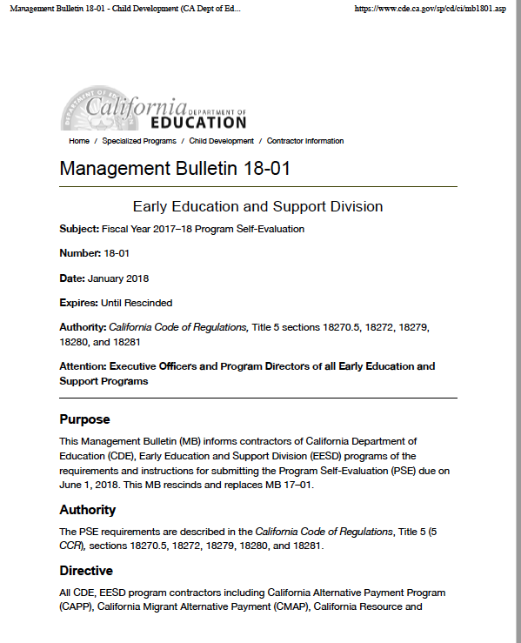
Management Bulletin 18-01
Notes:
Management Bulletin (MB)18-01 from the Early Education and Support Division (EESD) was released in March 2018 detailing required Program Self Evaluation forms.
https://www.cde.ca.gov/sp/cd/ci/mb1801.asp

Slide 13
EESD Mailing List
Join the EESD mailing list and receive management bulletins.
(http://www.cde.ca.gov/sp/cd/ci/progspeclist.asp)

Slide 14
Purpose of the PSE
Guides programs by examining all three components of the Desired Results system
Determines program strengths
Determines areas of improvement
Establishes program goals for the upcoming year
Notes:
This process allows programs to reflect on progress over the year and make a plan for ongoing improvement. Contractors are required to analyze findings from the self-evaluation and develop both a written list of tasks to modify the program for all areas needing improvement and procedures for ongoing monitoring to assure that areas that are satisfactory continue to meet standards. The plan developed now is for next contract year.

Slide 15
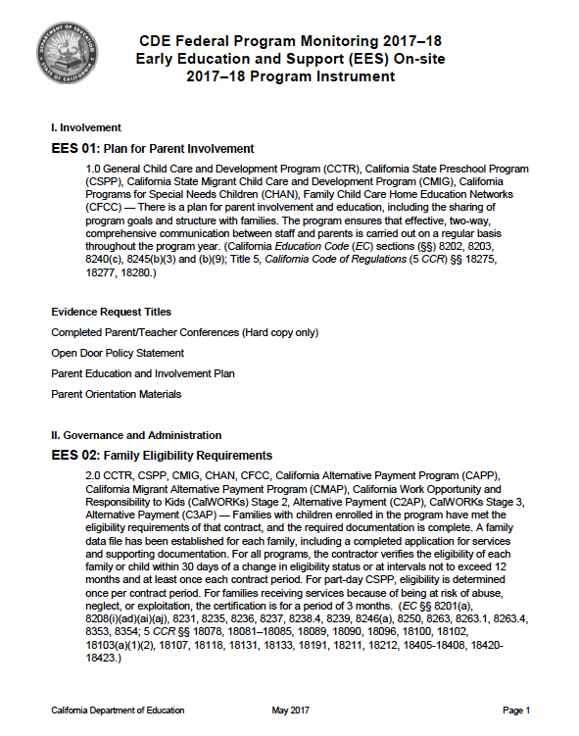
CDE Federal Program Monitoring Program Instrument

Slide 16
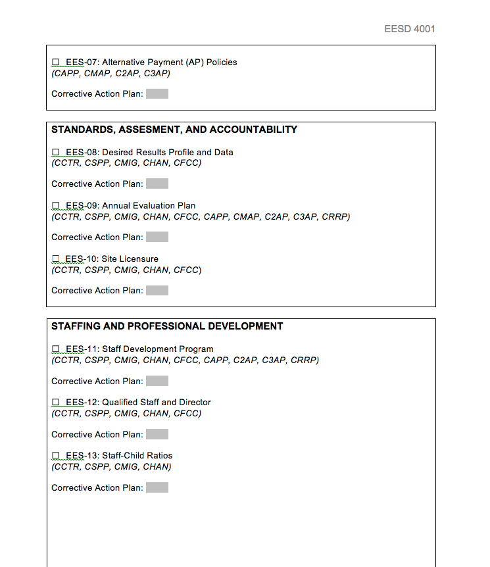
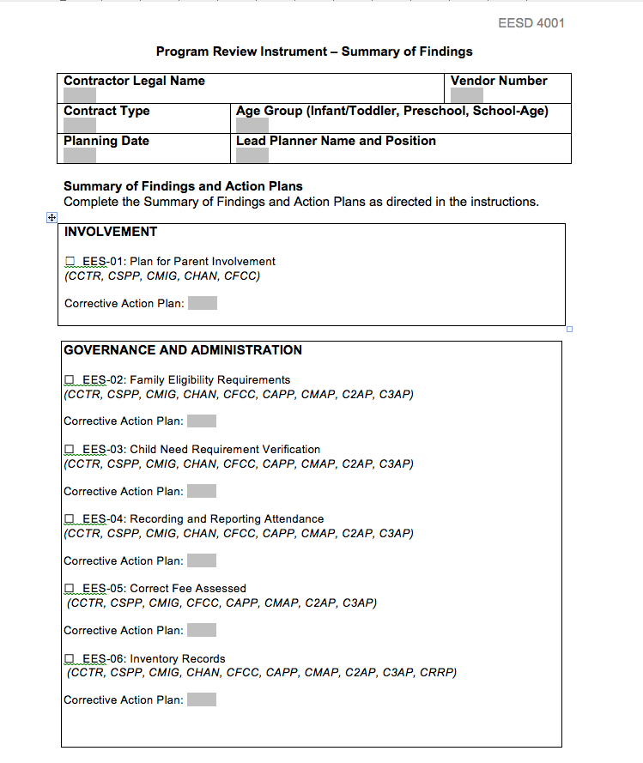
EESD 4001
Notes:
EESD 4001 and the Program Review instrument (SOF) are in your folder. There are 20 categories to review, and some categories apply to some contracts.
Please go through the categories and circle the ones that pertain to the programs you support.

Slide 17
Programs are required to…
Complete the Program Review Instrument.
Consider Contractor Requirements.
  Review all categories that apply.
  Provide description of findings.
Respond for all contract types, held by contractor
Notes:
Trainer Notes:
Have participants review how they have met their fiscal and program requirements and provide a description of the findings for the different categories.
CAPP, CMAP, C2AP, C3AP, CRRP must also complete this form.

Slide 18

Compiling Data
Data is compiled to assist programs in building a clear picture of group strengths and areas for improvement.
Notes:
The compiling of data provides programs with an OVERVIEW of the program strengths and areas for improvement. It is an important step in the self-evaluation process. Data is compiled in order to analyze and make programmatic decisions.
Data is compiled to know what went well and what still needs to be addressed.

Slide 19
Programs are ready to compile data when:
Teachers/FCC network managers have completed a DRDP for each child.
or
Parent Surveys have been distributed and returned.
or
Each classroom/FCC home has completed an ERS Profile.
Notes:
Compiling data begins when all assessments have been completed: a DRDP on all children, Parent Surveys, and all classroom/FCC homes have been assessed with the appropriate ERS.
Remember, the DRDP has to be done twice, within 60 days and then every six months thereafter. Teachers will have already compiled this data once, as well as the agency this year.
If the center-based contractor has multiple sites, first compile the information by site, and then at the program level.
If the education network has more than one designated teacher, collect information from each family child care home, and first compile the information by each designated teacher’s case load assignment (which would be similar to a center-based “site”) and then complete the information at the program level.

Slide 20


DRDP data is compiled…
… by site
…by program
…by age group
…by contract
Notes:
Each teacher compiled classroom data and completed a Summary of Findings EESD 3900 (Fall of 2017). Now we are looking at the program level. Programs are required to take all of the classroom data and compile by age group and at the site level or FCCHEN designated teachers case load, and then compile the data at the program level by age group and contract.
Trainer Notes:
Refer to EESD 4004..

Slide 21
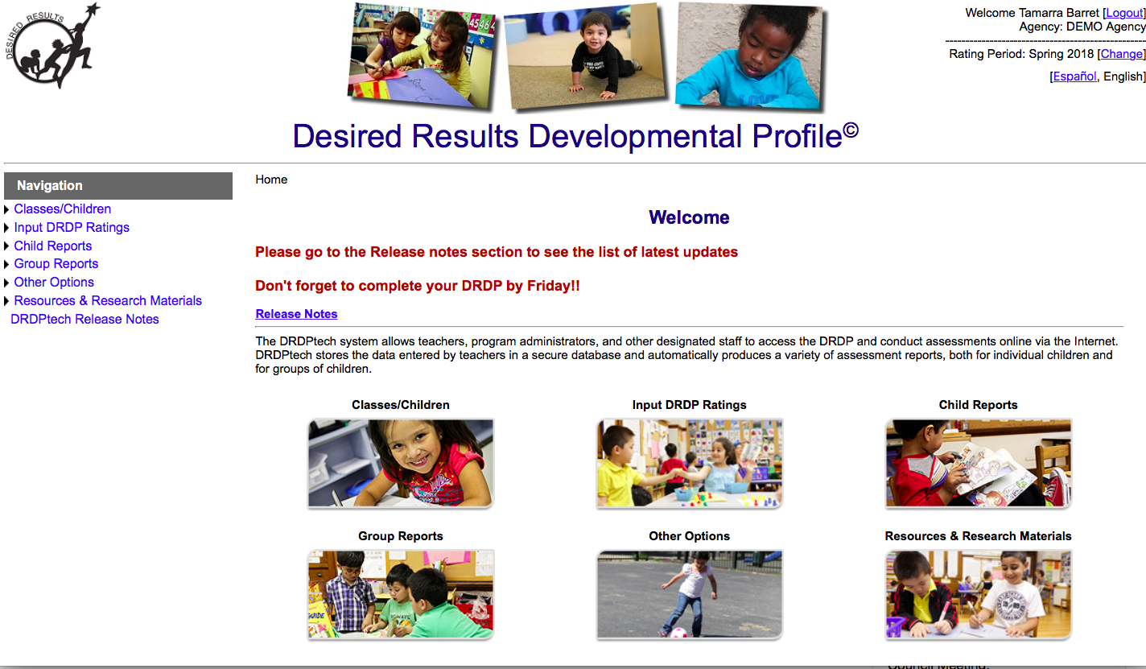
DRDPtech©
Notes:
DRDPtech is available free of charge for agencies funded by CDE’s Early Education & Support Division (EESD), California Head Start programs, California tribal CCDF and Head Start programs, California K-12 school districts, California Community Colleges, California State Universities, University of California campuses and for any family child care home or agency, public or private, involved in the QRIS Quality Counts California.

Slide 22
Use the appropriate DRDP Group Data Reports within DRDPtech
DRDP 2015 (IT)–Birth-35 months
DRDP 2015 (PS)–36 months-Kindergarten
DRDP-K–Transitional Kindergarten
DRDP (SA)–Kindergarten-12 years
Notes:
DRDPtech provides online data entry of all age instruments. DRDPtech also provides for that data to be aggregated as needed for the program.

Slide 23
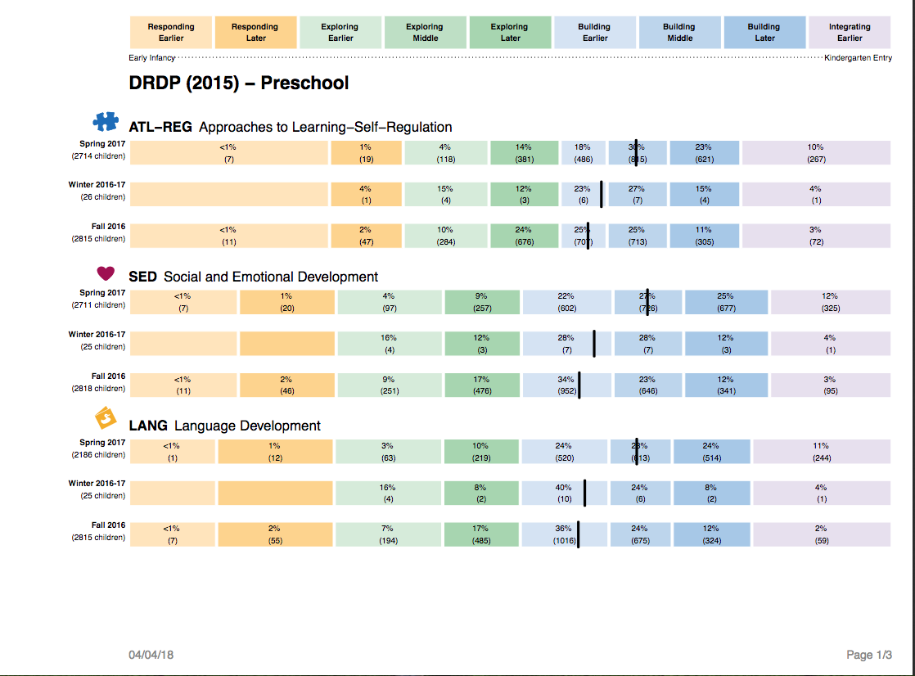
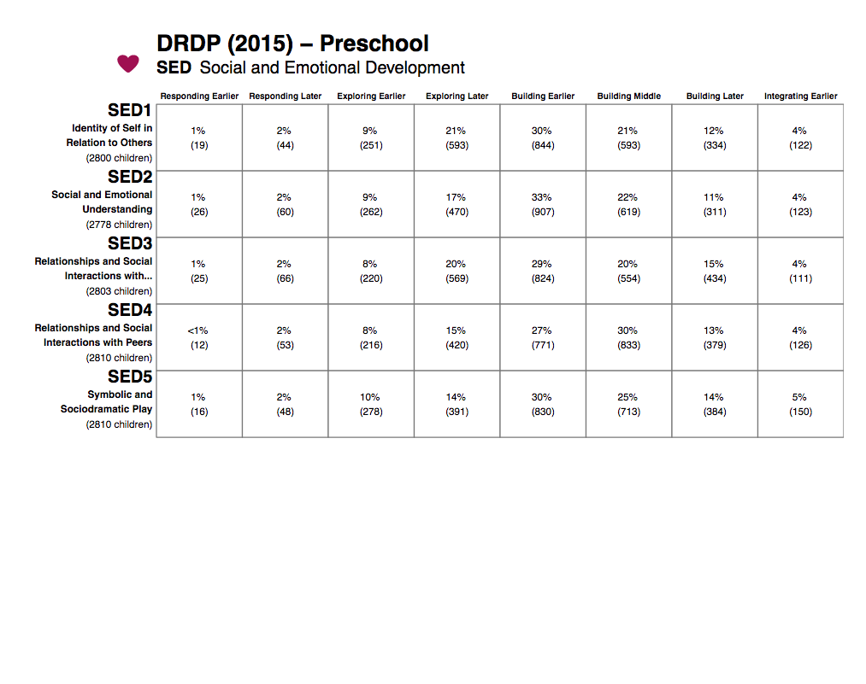
Analyzing Group Data
Use the data provided from DRDPtech to discover more about your program.
Notes:
In the Spring DRDP data is pulled at the program level ( all sites, all classrooms, all children). This data is then analyzed to make programmatic changes for the next year. The changes being suggested and implemented should be within the sphere of influence of the program. All teachers and staff need to be aware of the action plan.

Slide 24
Questions to Ask About the Data
?
What does the data show?
What areas of strength can be seen?
What areas need more support?
What strategies were used?
Do I need to make changes in the environment?
What should I do next?
Notes:
When analyzing data take into account all factors about your specific program. Ask questions about the data:
Who are the families that we serve?
Do we have a large dual language learner community?
What have we already implemented as an agency? Is that evident in the data?
This will help in the discovery of the key finding. This will assure that where you are putting your resources and time will be beneficial for your specific program.

Slide 25
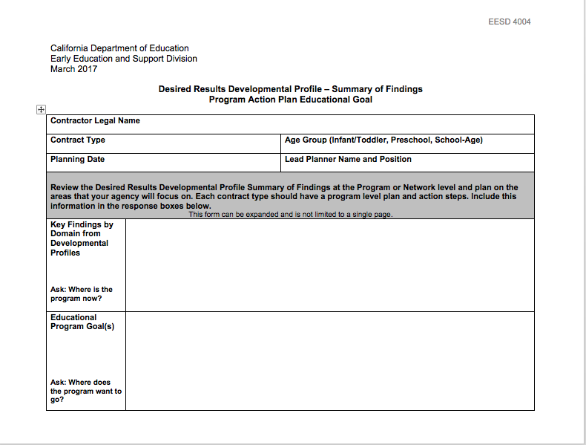
DRDP Summary of Findings Program Action Plan
Notes:
EESD 4004 is the DRDP Summary of Findings and Program Action Plan This form is a place to document how the data was analyzed, what the conclusion was and how the key finding will be addressed throughout your program/ agency.
Label your key finding by domain
Write a specific educational goal for the next year ( what percentage of children, are expected to be at which level in which domain)
Write specific action steps that are in the sphere of influence of the program/ agency and include accountability

Slide 26
Group data is compiled and analyzed to inform:
Professional Development
Curriculum/Materials Required
Staff or Program Schedules
Child-Staff Interactions
Parent Education/Community Outreach
Program or Classroom Use of Space
Notes:
When planning action steps for the Program Action Plan, consider these areas of growth for the entire program.
Make sure your goals and your action steps are the sphere of influence for the PROGRAM. Think about programmatic changes that can be lasting and woven into the fabric of your agency.
While EESD 4004 is not required to be submitted for the Program Self Evaluation, the form does need to be filed away at the program/ agency. Early Education and Support Division is requiring everyone to verify the collection, analysis, and integration of each assessment data toward ongoing program improvement for all applicable contract types.

Slide 27
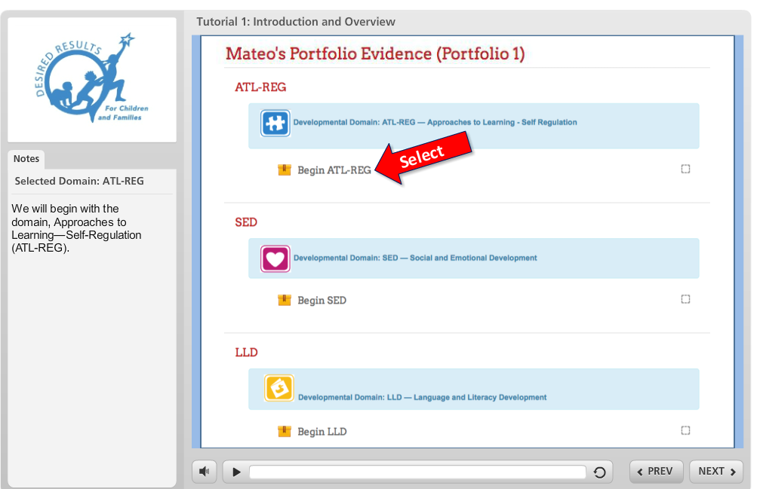
Rater Certification Module
Notes:
One of the newest resources available to aide with teachers being reliable with the completion of the DRDP are the rater certification modules available inside of California Early Childhood Online (CECO).
These modules provide the opportunity for a person to become rater certified. Please go to CECO for more information.

Slide 28


ERS data is compiled at the …
…classroom/family child home
…site
…contract
Notes:
No matter the size of a program or agency, data is compiled at the classroom level for the Environment Rating Scale. Each program is responsible for the ERS data to be grouped by:
1st – classroom/ FFCHEN home
2nd – site / FFCHEN home
3rd - program or agency compiled by age group and contract.
Compile all of the ITERS, ECERS, FCCERS and SACERS. Write a Summary of Findings for each one.
Refer to instructions EESD 4002.

Slide 29
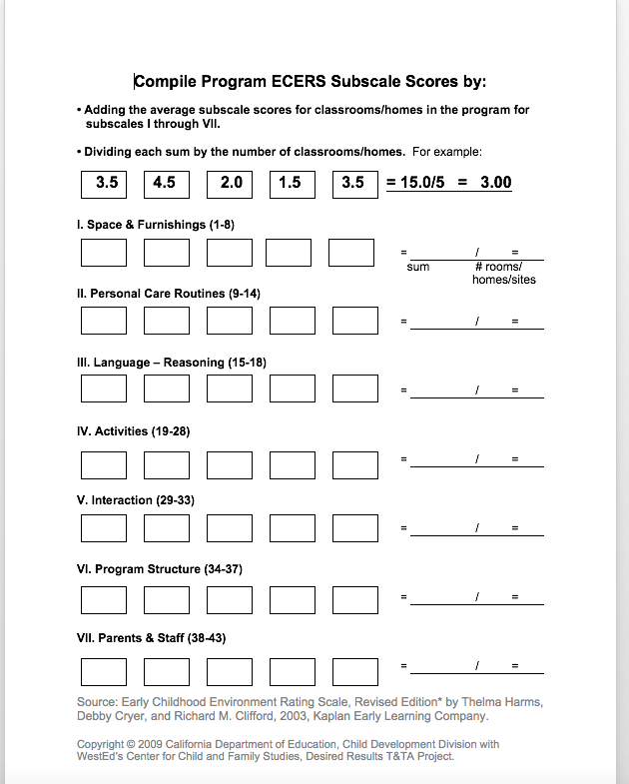
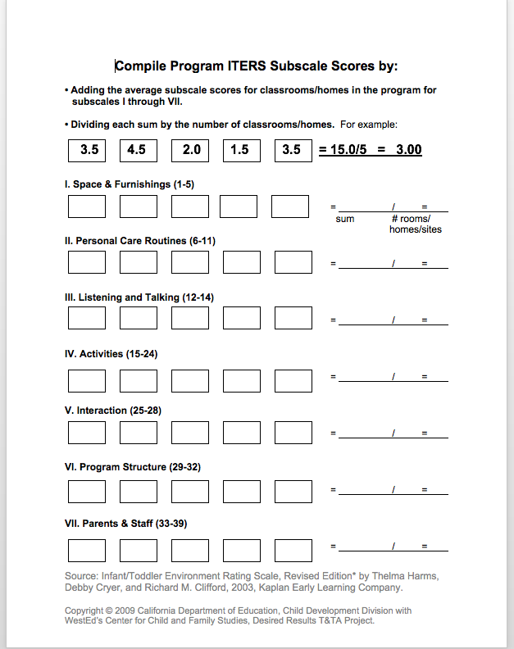
ERS

Slide 30
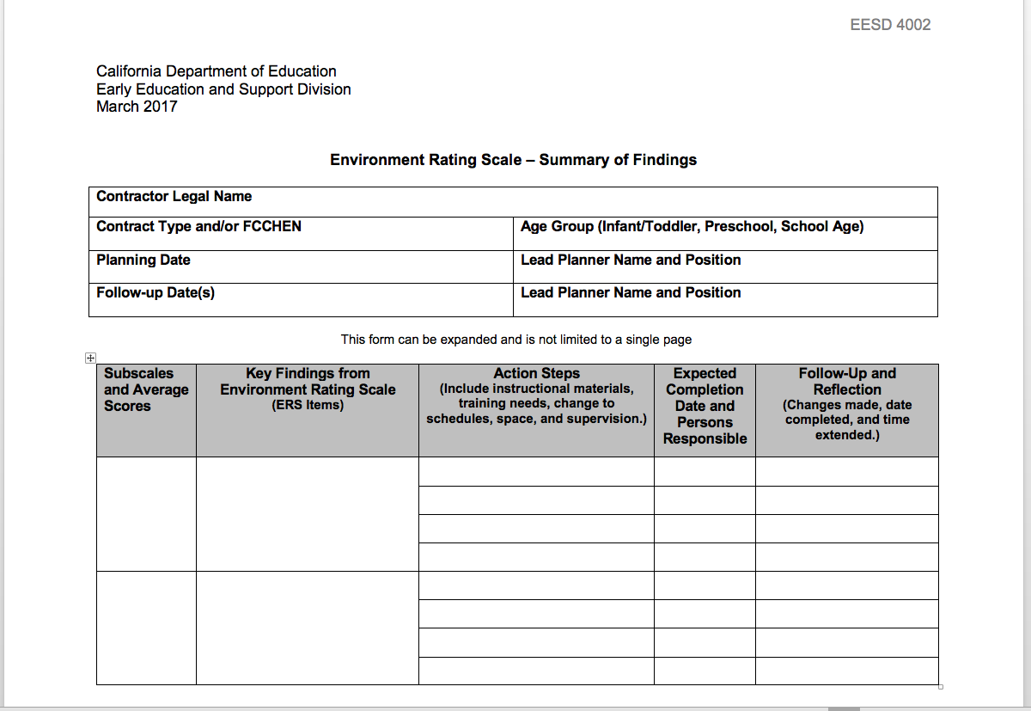
EESD 4002
ERS Summary of Findings
Administrators:
List subscale names and scores for averages below 5.0
Notes:
If as an agency/ program there are no subscales below a 5, select the two lowest scores and make a plan for improvement for those subscales. While EESD 4002 is not required to be submitted for the Program Self Evaluation, the form does need to be filed away at the program/ agency

Slide 31

Look at your data
Strength/ Finding
Choose ERS findings from your data
AND
Choose strengths from your ERS data

Slide 32
Parent Survey data is compiled…
…by site (recommended)
…by contract
Notes:
No matter the size of a program or agency, Parent Surveys are summarized at the contract level, although agencies may choose to compile it at the site level. Agencies group the data by:
1st - site (ONLY a recommendation; site summary is not required.)
2nd - program or agency
This data will be used to write Summaries of Findings which will be analyzed again to determine a COMPREHENSIVE Program Action Plan for the agency.
Trainer Notes:
Refer to EESD 4003. Allow participants 3-5 minutes to read instructions and highlight important information.

Slide 33
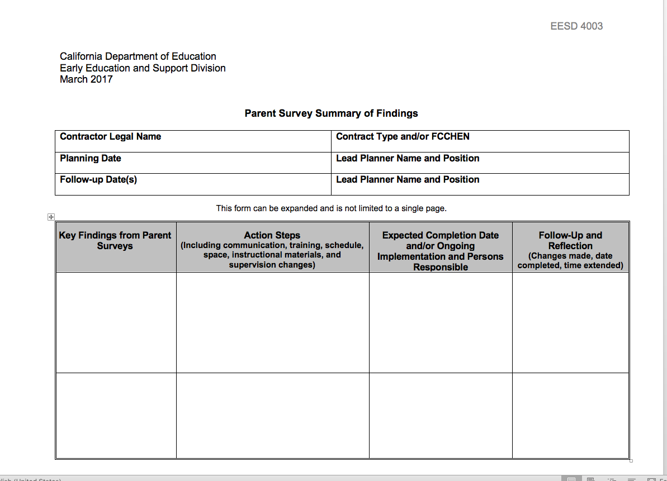
EESD 4003
Parent Survey Summary of Finding
Notes:
As an agency compile the data from families and decide where there is a need for improvement. While EESD 4003 is not required to be submitted for the Program Self Evaluation, the form does need to be filed away at the program/ agency

Slide 34
Look at your data
Strength/ Finding
Choose Parent Survey findings from your data
AND
Choose strengths from your Parent Survey data

Slide 35
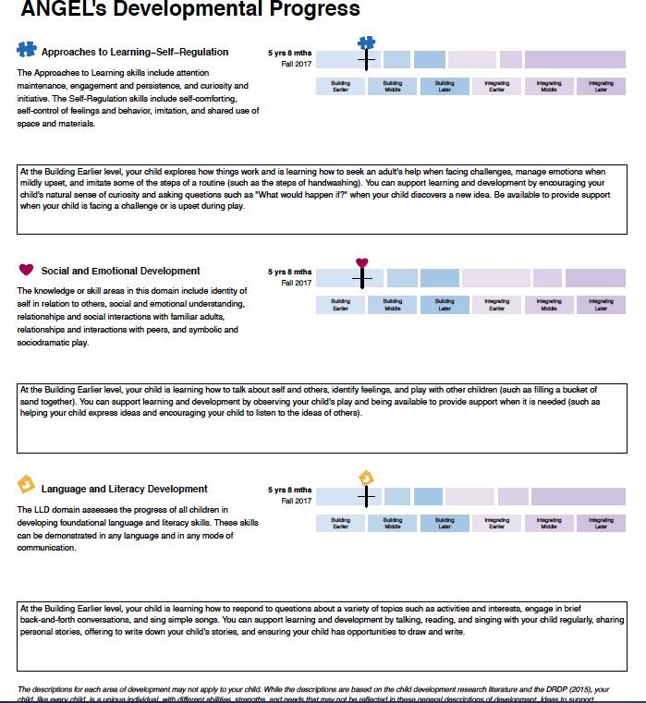
Resources
All About Young Children
DRDPtech Parent Report
Notes:
The All About Young Children website and the DRDPtech Parent Repots are wonderful resources that can be used to address parent survey data findings.

Slide 36
PSE Requirement
Due to EESD by June 1st at 5:00 pm
All contractors are required to complete and submit one (1) EESD 4000.
Programs must be able to verify the collection, analysis, and integration of each assessment data toward ongoing program improvement for all applicable contract types.
Notes:
Now, you have all this wonderful, useful, meaningful data. And as a program you need to reflect on it.
The requirement this year is to complete EESD 4000 as your reflection form and program wide action plan.

Slide 37
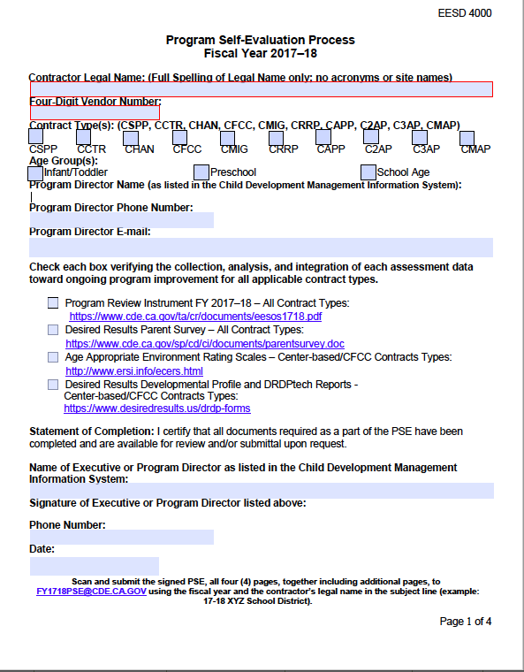
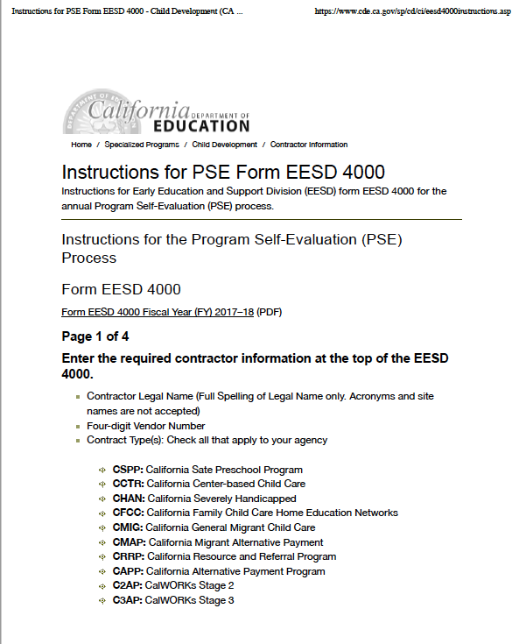
PSE Instructions

Slide 38
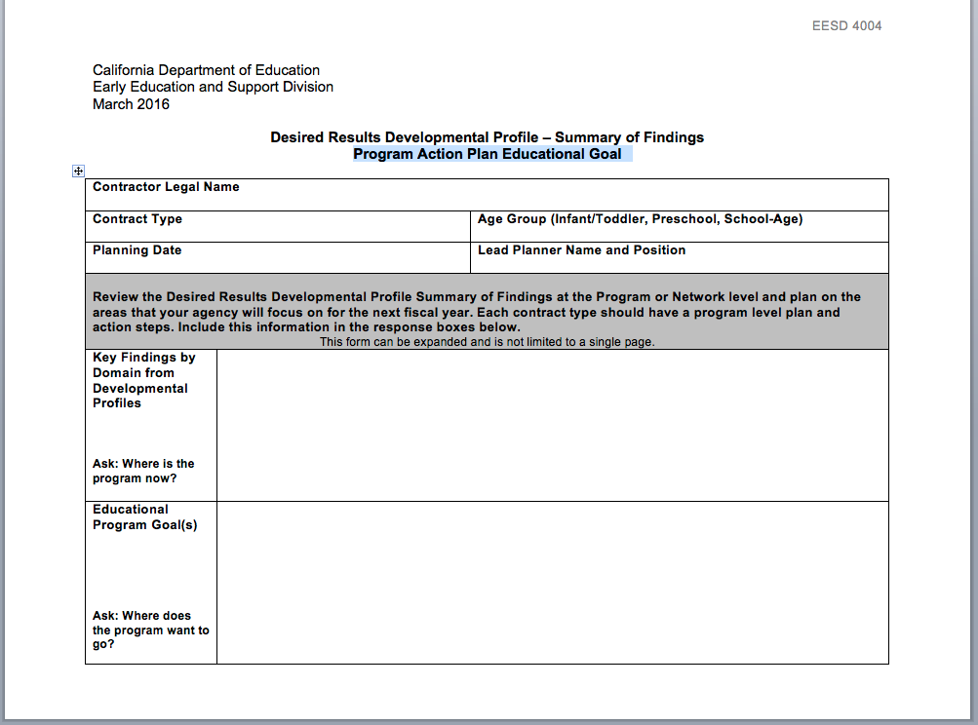
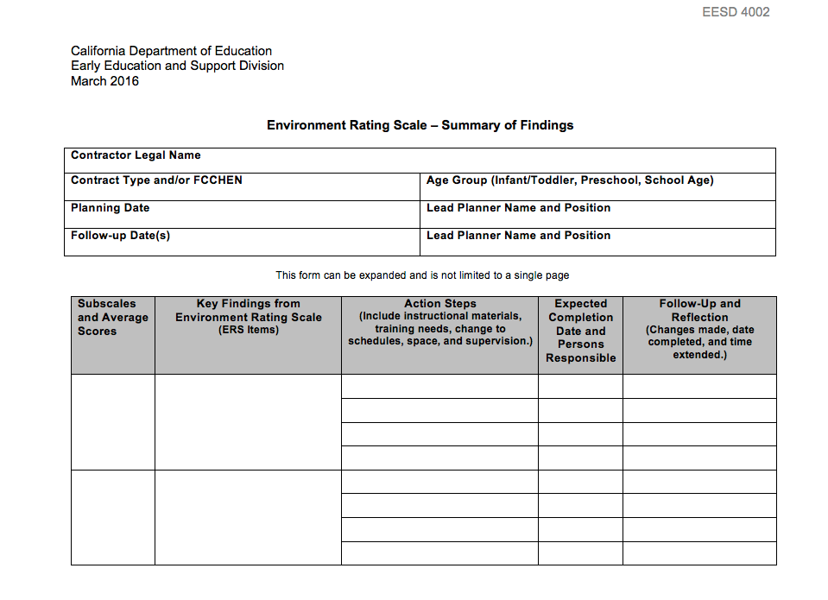
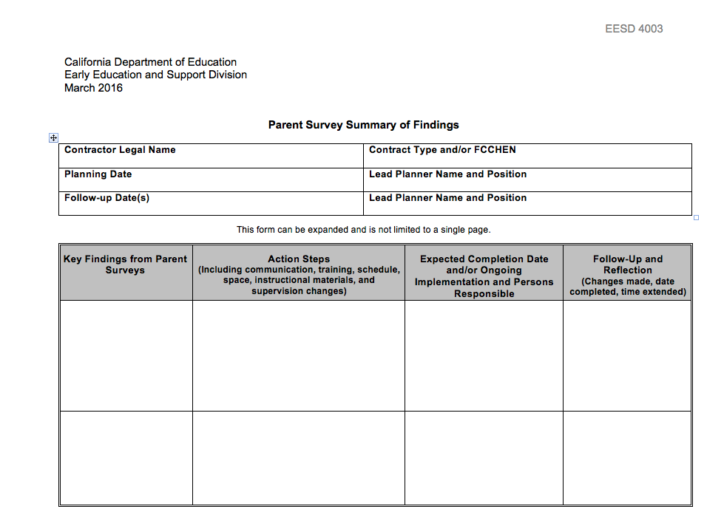
Completing 4000
Notes:
There is a Summary of Findings (SOF) for all the assessments.
Summary of Findings are recommended forms to assist teachers and providers in the planning process. Regardless of whether this resource is used, or the program develops their own form, the written process must be completed and include all information from those forms.
To complete the EESD 4000:
you will pull information from the Program Review Instrument (EESD 4001),
DRDP Program Summary of Finding (EESD 4004),
ERS Summary of Finding ( EESD 4002) and
Parent Survey Summary of Findings (EESD 4003).

Slide 39
PSE Analysis
The PSE requires analysis of findings from self evaluation and development of both a written list of tasks to modify the program for all areas needing improvement and procedures for ongoing monitoring to assure that areas that are satisfactory continue.

Slide 40
What needs to be sent to
EESD by June 1?
One per AGENCY Required
Notes:
All contractors are required to complete one (1) EESD 4000 per contractor.
Scan and submit the signed EESD 4000 four (4) pages including any additional sheets as necessary from pages two (2) through four (4) together electronically in PDF format to FY1718PSE@CDE.CA.GOV using the fiscal year and the legal contractor name in the subject line (example: 17-18 XYZ School District).
All other documents/instruments (i.e., EESD 3900, EESD 4001 – 4004) must be kept on-site, are not included with the submission of the EESD 4000, and are available for review and/or submittal to the CDE/EESD upon request.

Slide 41
Submitting Forms
The PSE must be submitted electronically.
Scan and submit the signed EESD 4000 to FY1718PSE@CDE.CA.GOV using the fiscal year and the legal contractor name in the subject line (example: 17-18 XYZ School District).
Notes:
This year the PSE is submitted electronically only.

Slide 42
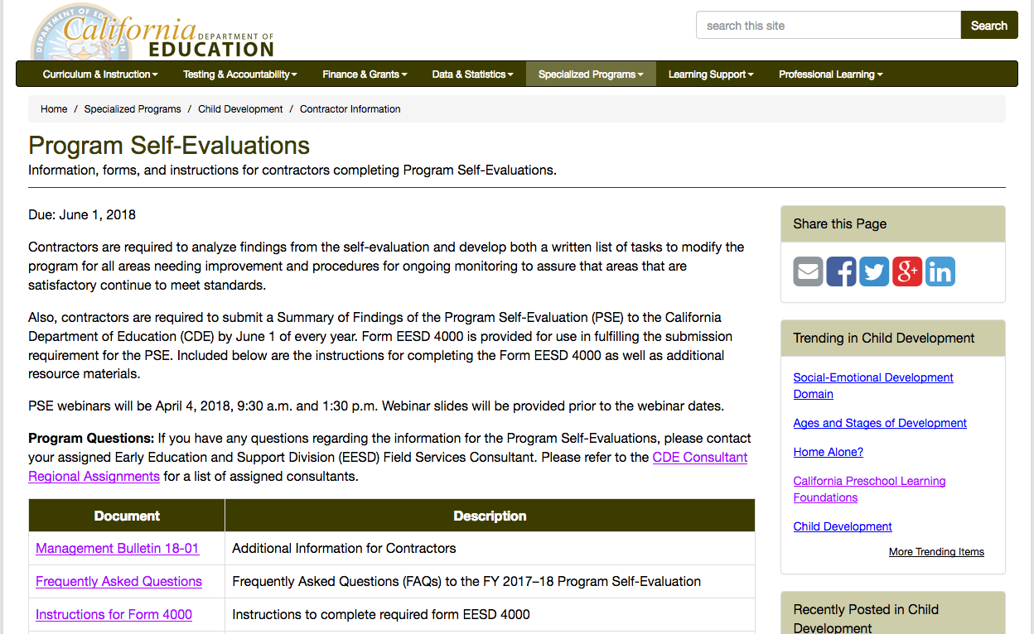
PSE on CDE Web Site

Slide 43
Keep it Alive!
Keep up the continuous improvement process and implement the plan.
Keep families involved and aware!!!
Make sure teachers know the plan and continue to reflect and refine. They will make it happen.

Slide 44

DRDP Resources
Notes:
Transition slide
Trainer Notes:
Become familiar with resources on the DR Web site.

Slide 45


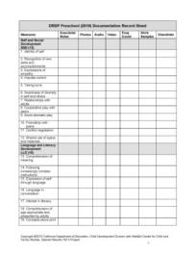
The Desired Results Web Site
Resources
Tools
Forms
Samples

Slide 46
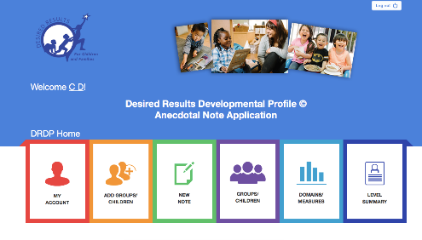
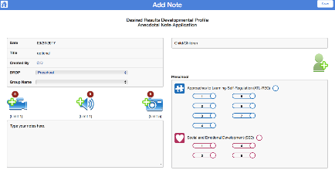
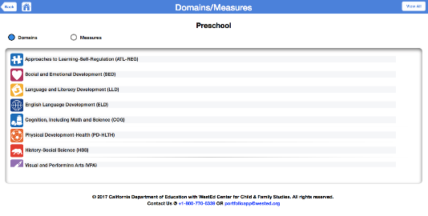
DRDP Portfolio App
Notes:
The app is now available in Web version.
Features of the app include:
Assigning measures to each piece of evidence
Sharing children’s portfolios with families
Assigning one piece of evidence to more than one child at the push of a button

Slide 47
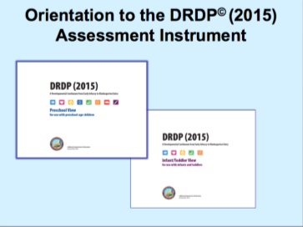
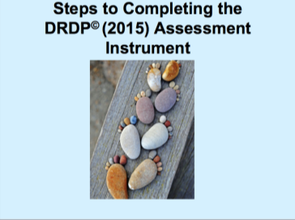

DRDP (2015) Tutorials
Notes:
Learn more about the DRDP (2015) by using the simple-to-use online tutorials. They are very short PowerPoints with a voice narration.

Slide 48



Support Materials for Implementation of DRDP
Getting to Know You Through Observation VHS/ DVD (Training and Guided Practice on Observation Skills)
Getting to Know you Through Observation Trainer’s Guide and Workbook
Getting to Know You Through Observation Trainer’s Guide and Workbook (12 training activities)
Getting to Know you Through Observation Trainer’s Guide and Workbook
Notes:
These are other support materials. Order forms are available on the Resources page of the DR Web site.
Trainer Notes:
Have materials on gallery table.
Watch DVD or look at Trainer workbook so you can talk about these things from personal experience or how you have used them.
If you will be offering Meaningful Observation training, let them know about it.

Slide 49

California Early Childhood Online (CECO)
Notes:
The courses provided on the California Early Childhood Online (CECO) Web site are FREE and enable teachers to increase content knowledge and ability to provide developmentally appropriate experiences for children in their care.
Meeting the developmental needs of young children and their families requires a comprehensive approach.
CECO provides access to comprehensive resources and courses in one centralized location to meet the ever-changing needs of the early childhood field.
After completing a module, you receive a certificate that is good for professional growth hours.

Slide 50

CompSAT
Notes:
This is another helpful website for your professional growth.
CompSAT helps early childhood professionals reflect on their everyday practice and examine what they know and are able to do. There are 12 competencies that are considered.
You are able to learn and grow at your own pace.
The Web site has interactive, multimedia tools, that enhance learning, and identify strengths and needs.
CompSAT is the companion guide to the ECE Competencies.

Slide 51

All About Young Children
Notes:
The All About Young Children Web site provides resources for families based on the California Infant/Toddler Learning & Development Foundations and the California Preschool Learning Foundations.
Parents and family members can find out what skills help children from birth to five learn including how they learn language, how they learn about feelings and relationships, how they learn about numbers, and how they become skillful at moving their bodies.
The site offers video clips of children's activities followed by parents' discussion, print materials of five domains in five age groups, audio files, and downloadable materials.
This Web site provides resources in eight different languages and for different age levels.

Slide 52
Contact Information
Desired Results Training & Technical Assistance Project
333 North Lantana Street, Suite #277
Camarillo, CA 93010
800-770-6339
www.desiredresults.us
desiredresults@wested.org
Notes:
DRT&TA project members are happy to address questions and concerns. Reach us by phone or email.

Slide 53

Becoming better is not a destination, it is a spirit of continuous improvement.
- Unknown

Slide 54

Thank you for your participation!

