Slide 1
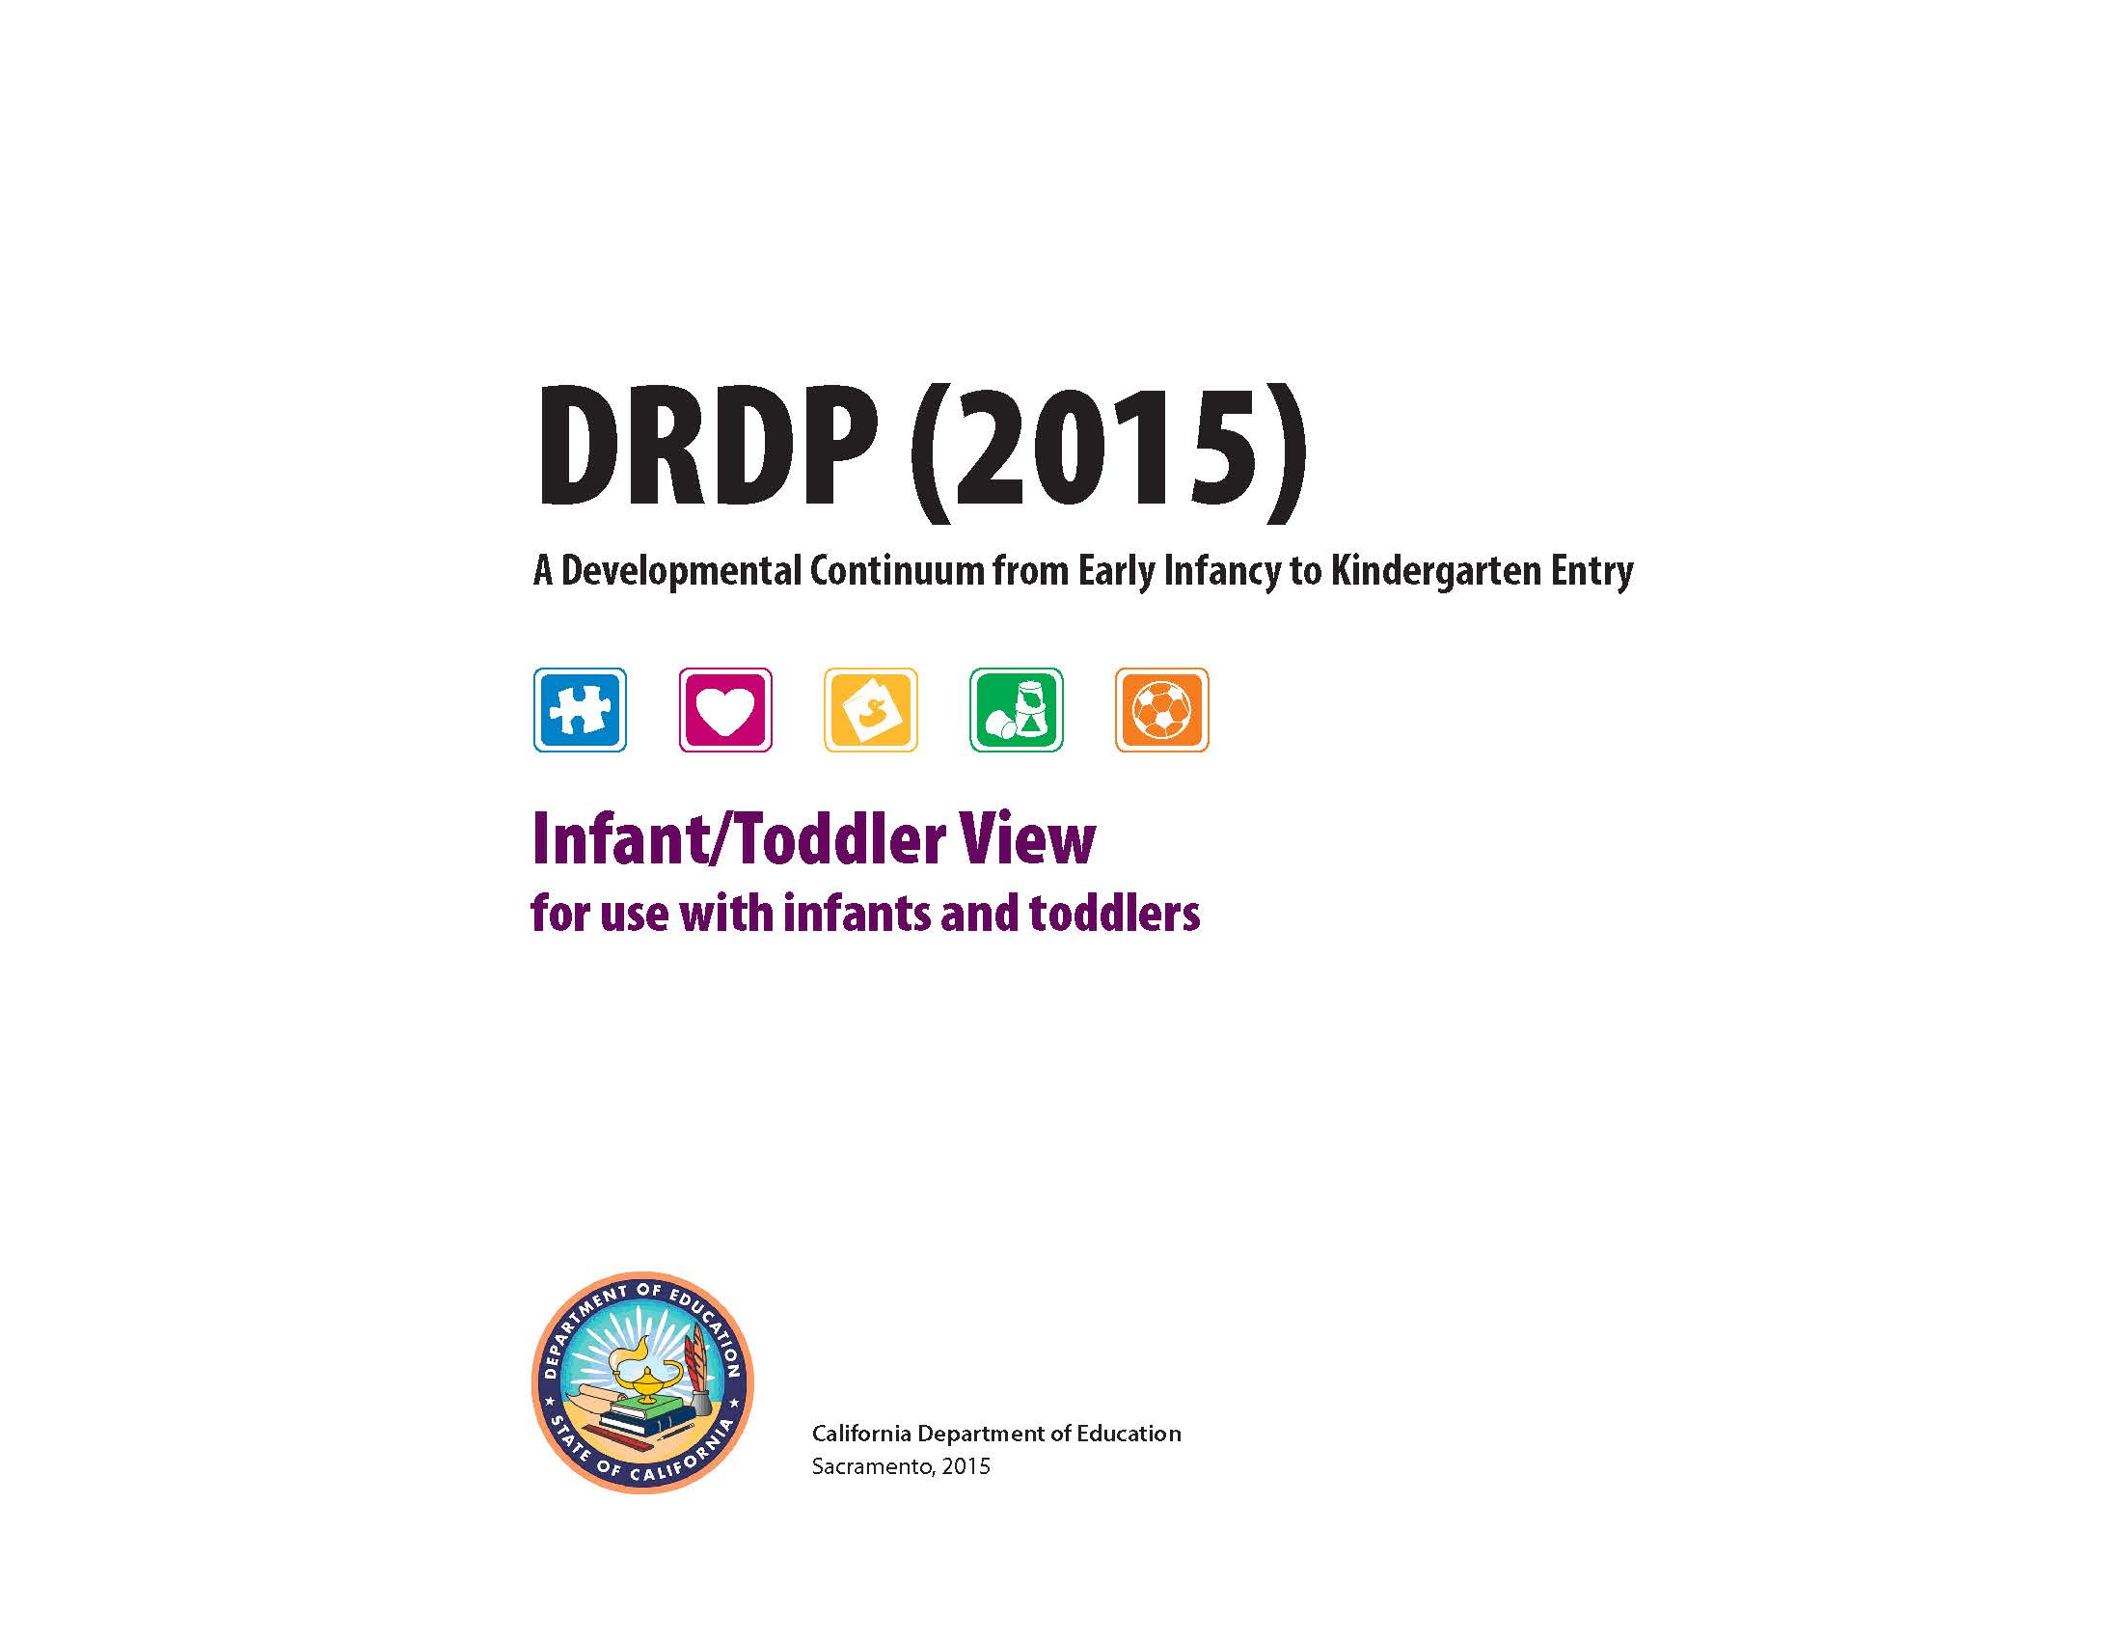

Session III
Desired Results Developmental Profile© (DRDP)
Observation Assessment Instrument
Notes:
Script:
In this session, participants will learn about the Desired Results Developmental Profile (DRDP).
We will focus on observation skills, rating the DRDP, collecting the DRDP data, the Summary of Findings, and the Child’s Developmental Progress form.

Slide 2


We observe…
As each child interacts with other children, adults, and environment
In the natural program setting
Notes:
Script:
Teachers observe children in their natural, daily activities. Agencies will be able to describe children’s achievements in learning and development to advocate the strengths and benefits of the program to families and the larger community.

Slide 3
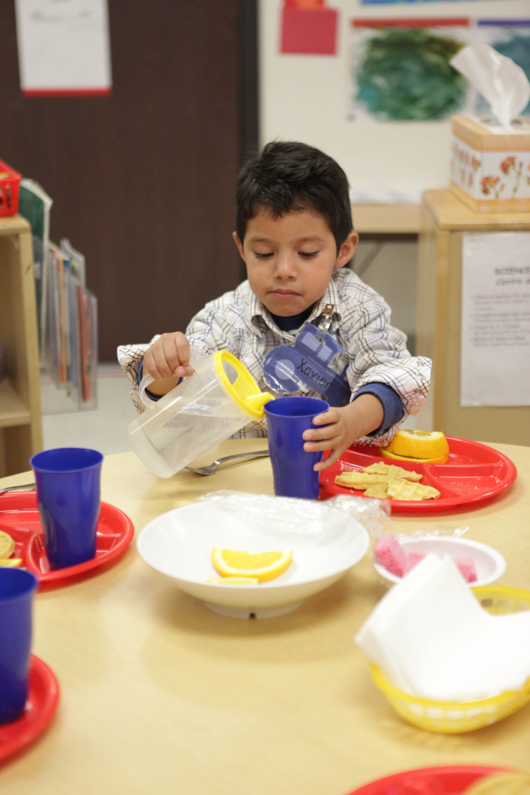
As children participate in the typical daily program
Notes:
Script:
Good observation and recording methods over time are the cornerstones for using the DRDP effectively. The DRDP is not a test, but an observation based assessment for children.
The person who is the designated teacher should complete the DRDP. Assistants, parents, and other staff should contribute observations.
Note: Family Child Care Networks have a “teacher identified” person complete the DRDP. This person may be the case manager who oversees the network care providers. The case manager consults with care providers and parents in completing the DRDP.

Slide 4


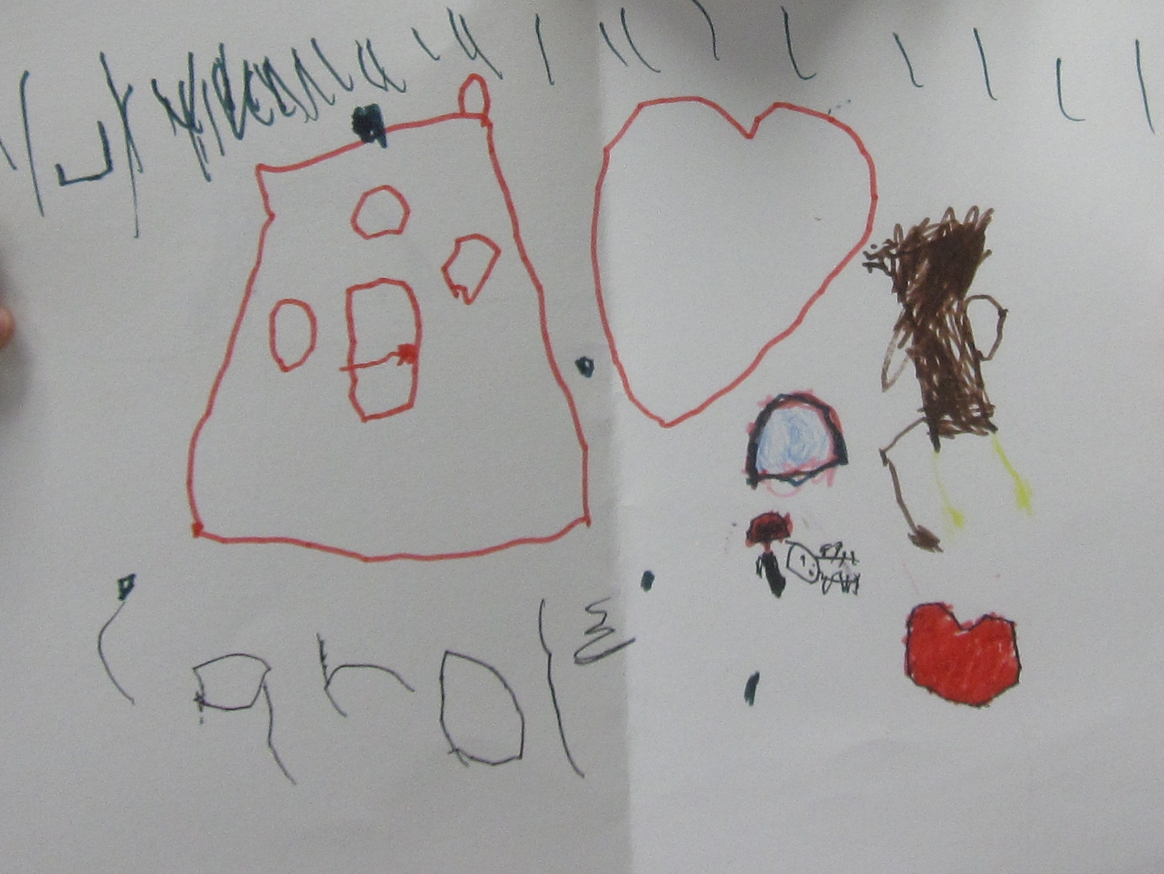

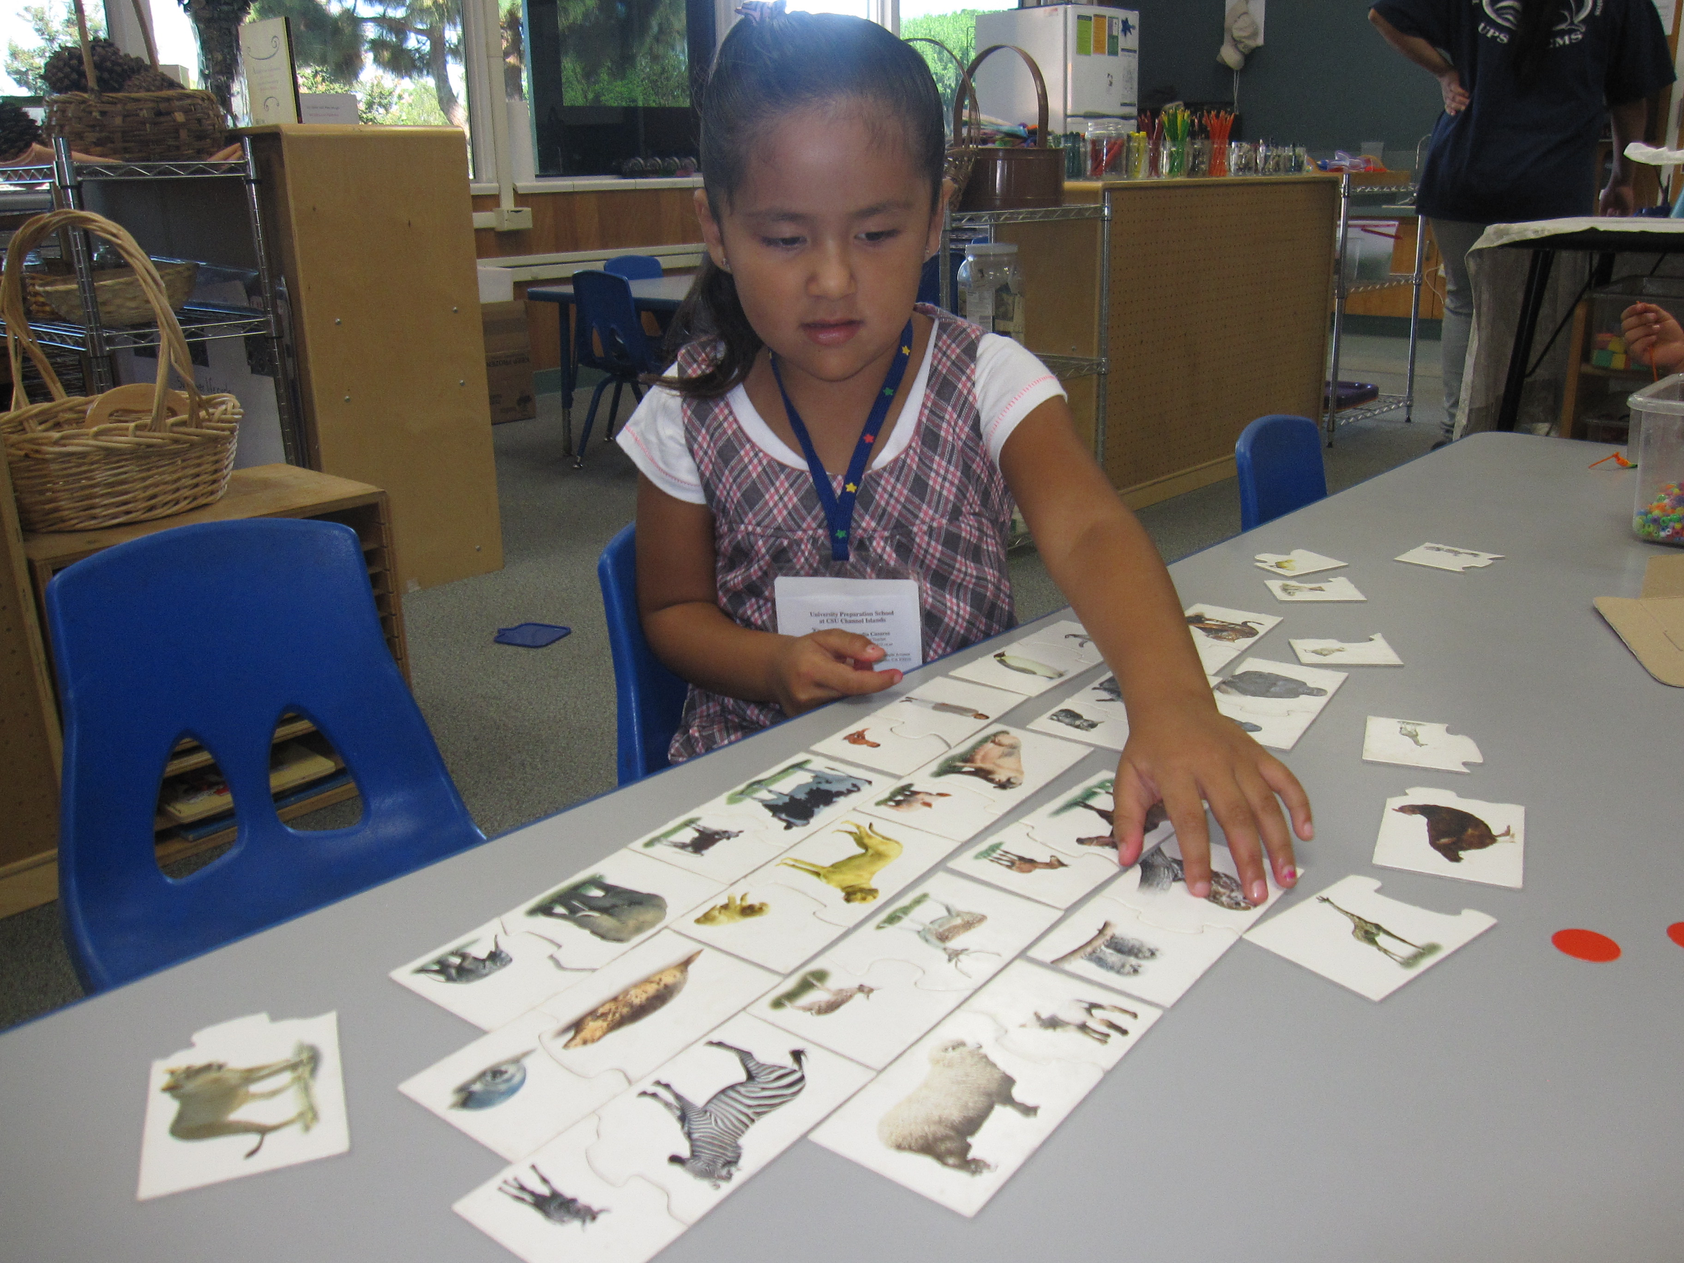
Collected documentation includes:
Anecdotal notes
Photos
Work samples
Other evidence of knowledge and behaviors
Notes:
Script:
Teachers collect a substantial number of anecdotal notes, photos, work samples, and other pieces of documentation from family members and other staff, that demonstrate the children’s mastered developmental levels. The organization of collected documentation can be achieved through “portfolios.”

Slide 5
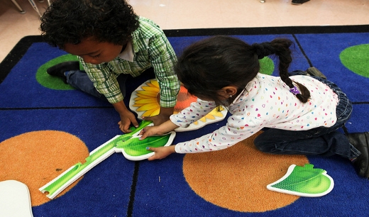
DRDP serves as a way to…
determine how children are benefiting from programs.
Notes:
Script:
The DRDP findings provide information for agencies to use to improve programs.
Information is shared with families during parent conferences to support parents in supporting the child’s progress.
Information can also be shared with the community to demonstrate how children benefit from involvement in the program.

Slide 6
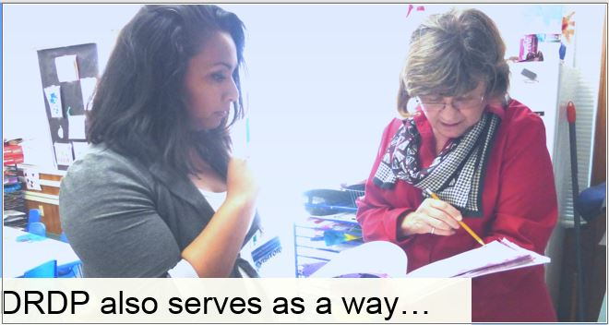
to assist providers in meeting each child’s developmental needs in each classroom or family child care home.
Notes:
Script:
The DRDP documents the kind of work that quality programs are already doing every day.
As teachers learn more about the children in their care, the DRDP information assists them in adapting and modifying curriculum plans and activities for the individual child, as well as activities for small and large groups.

Slide 7

DRDP provides…
a “snapshot” of the child’s development.
Notes:
Script:
Children grow and change quickly, so a completed DRDP is a “snapshot” (i.e., a representative moment in time) of a child’s development.
All succeeding observations will document changes that result from growth and progress.

Slide 8
The DRDP provides a
framework for showing children’s progress over time
Notes:
Script:
There is a suite of DRDP instruments, and each age-level instrument within the suite provides a framework that serves in monitoring children’s progress throughout the program year.
The DRDP (2015) is a full continuum instrument used for all children from early infancy through kindergarten entry, including children with special needs. The DRDP (2015) is one instrument with five views.
There are three preschool views that are used to assess children from preschool-age through kindergarten entry:
DRDP (2015) Preschool© Comprehensive View (56 measures)
DRDP (2015) Preschool© Fundamental View (43 measures)
DRDP (2015) Preschool© Essential View (29 measures)
There are two infant/toddler views that are used to assess children from infancy up to 36 months:
DRDP (2015) Infant/Toddler© Comprehensive View (29 measures)
DRDP (2015) Infant/Toddler© Essential View (21 measures)
Agencies choose which view will be used to assess infant/toddler and preschool age children.
The DRDP-SA© has two versions to choose from:
DRDP-SA© (2011) Complete Version (35 measures)
DRDP-SA© (2010) Simplified Version (2 domains with 13 measures)
The DRDP-SA© (2010) was simplified because other domains/areas were already being assessed during the school day (e.g., reading, math, etc.). The Early Education and Support Division (EESD) felt it was important to continue to assess Self and Social Development as well as Heath and Safety.
Each profile provides guidance in documenting observations that reflect the developmental growth for each age group.

Slide 9
CDE Guidance
Management Bulletin June 2015
Effective Fall 2015, the DRDP (2015) is required for all EESD programs that provide early education and care for children ages early infancy to kindergarten entry. It is also required for all preschool children with IEPs and for all infants and toddlers with IFSPs.
https://www.cde.ca.gov/sp/cd/ci/progspeclist.asp
Notes:
Script:
(Reference management Bulletin 15-03)
If you are providing services to children with Individualized Education Programs (IEPs) or Individualized Family Service Plans (IFSPs), you are encouraged to visit the desired results access website to get additional information about training and specific requirements.

Slide 10
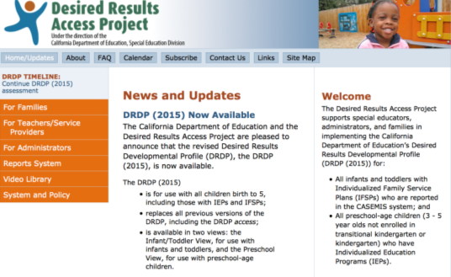
Desired Results Access Project:
For more information:
http://www.draccess.org
:
Notes:
Trainer note:
Participants may have additional questions about DRDP Access. They are encouraged to visit the website listed on the screen for additional information.

Slide 11
CDE Guidance
Management Bulletin June 2015
When children are served by both EESD and SED programs, the teachers and specialists are to collaborate on one assessment following the more stringent timeline, and handle DRDP data according to the requirements of each division.
Notes:
Script:
More details can be found on Management Bulletin 15-03.

Slide 12
CDE Guidance
Management Bulletin June 2015
The management bulletin can be downloaded from the EESD website at:
http:www.cde.ca.gov/sp/cd/ci/mb1004.asp
Take five minutes to read the bulletin and use the highlighter as you read.
Notes:
Script:
The entire bulletin provides information on collaboration between ECE staff and the special education provider. It also gives the requirement of using DRDP Online for all EESD programs. Take five minutes to read the bulletin. We recommend that you provide this bulletin to your staff or share it at a staff meeting.
Trainer note:
Direct participants to read the bulletin and use a highlighter as they read.

Slide 13

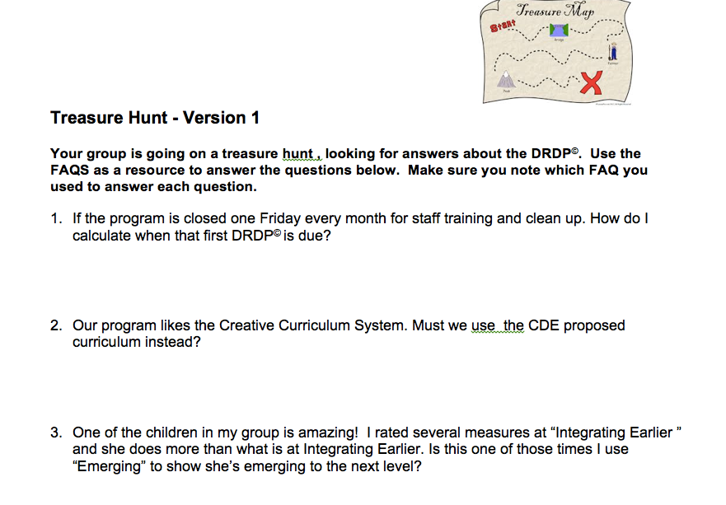
Treasure Hunt - Version 1
Notes:
Activity: Treasure Hunt

Slide 14

DRDP Guidelines
An age-appropriate version of the DRDP must be completed within 60 calendar days of the child’s enrollment and every six months thereafter.
60 calendar days and every 6 months thereafter
60 days
Notes:
Script:
An age-appropriate version of the DRDP must be completed for all children enrolled in a CDE/EESD funded center or family child care home network.
Trainer Note:
Clarify how often and when DRDPs are required to be completed. Emphasize 60 calendar days from the enrollment date of children. Enrollment is typically determined to be the first date the child receives care.

Slide 15
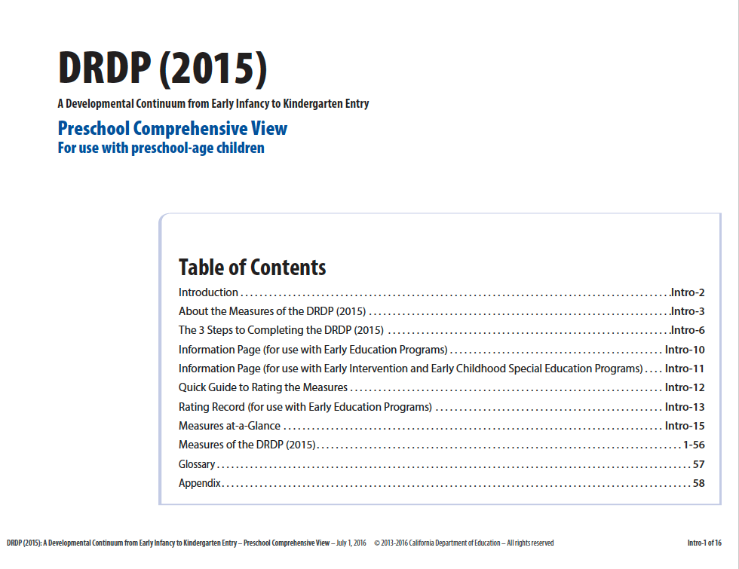
Teachers and staff need to become familiar with the DRDP
Notes:
Script:
Get to know the Desired Results, developmental domains, measures, definitions, developmental levels, and descriptors. Read through the introduction and appendices of the assessment for clarification.
The DRDP tool kit ideas, such as the mini-measures, are on the Desired Results website and are helpful in becoming familiar with the DRDP.

Slide 16
The DRDP was developed by the:
California Department of Education, Child Development Division- (now Early Education and Support Division)
WestEd Center for Child and Family Studies
University of California, BEAR Center
With valuable input from teachers and directors who participated in the research study
Notes:
Script:
WestEd and BEAR aligned the instruments and developed new measures.
BEAR provided overall direction for the study and summarized the data.
BEAR is the Berkeley Evaluation and Assessment Research Center.

Slide 17





Notes:
Script:
The DRDP aligns with the:
Infant and Toddler Early Learning and Development Foundations
Preschool Learning Foundations, Volumes 1-3
Common Core Standards
Head Start Child Development and Early Learning Framework
Now let’s look at the instrument in more detail…

Slide 18
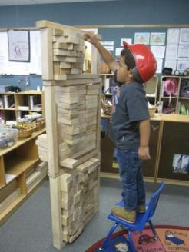
Build A Tower
Use the items on your table.
As a group, build a tower.
You have five minutes.
Notes:
Script:
Refer to DR-2015 Activity Sheet #3 – Build a Tower.
Have participants build a tower using any accessible material (cups, blocks, paper, etc.).

Slide 19
Key Points
What was your first step?
How did you know to start there?
What does this have to do with children’s learning?
Notes:
Script:
(This is the debrief slide.)
The purpose of the activity is to make a connection between having a foundation in order to support a structure. For us that structure is children’s learning. Our foundation is our California Preschool and Infant Toddler Learning and Development Foundations. These are important first steps in understanding child development and understanding the skills that children are capable of.

Slide 20

Why was it important to align the DRDP to the foundations?
To ensure we assess what we want
children to learn and that it is aligned to
what is appropriate for children of this age.
Notes:
Script:
The state has taken care to build a cohesive system.
The foundations describe children’s learning and development.
Thus it is important that we are assessing what we want children to learn, and that we align it to what is appropriate for children of this age.

Slide 21
What is the relationship between the DRDP and the foundations?
The foundations tell us how children, with adequate support, typically learn and develop.
The DRDP provides a structure and a tool for recording an individual child’s development and documenting progress.
All volumes of the California Learning and Development Foundations provide the research backing for the DRDP (2015).
Notes:
Script:
The developmental domains work in an integrated fashion to support all four Desired Results. Ways to use the foundations and DRDP together:
Read foundations at the beginning of the school year to understand development in a general way.
Complete the DRDP twice each year to see children’s progress.
Foundations provide the overall developmental landscape or backdrop. The DRDP helps determine where an individual child is on that backdrop.

Slide 22
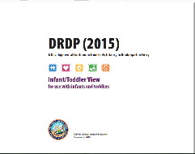
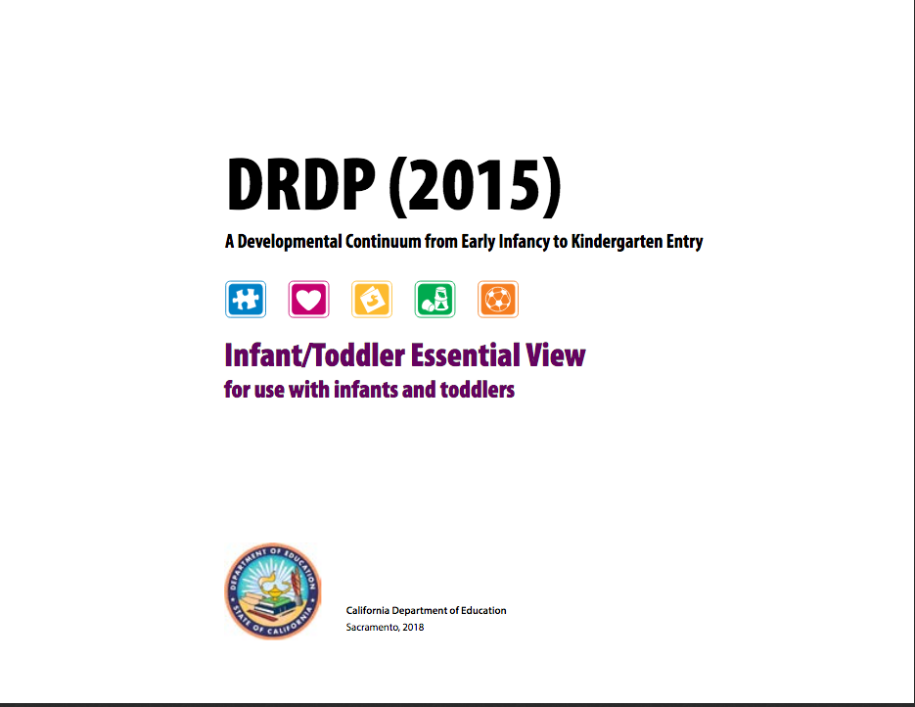
DRDP- Infant Toddler
5 domains
29 measures
5 domains
21 measures
Notes:
Script:
The DRDP (2015) is a full continuum assessment. The same assessment is used for all children, including children with IFSP’s and IEP’s.
There are two infant/toddler views of the DRDP (2015) assessment:
DRDP (2015) Infant/Toddler Comprehensive View
DRDP (2015) Infant/Toddler Essential View
The CDE/EESD recognizes that, while programs have communicated that the information from the Comprehensive View gives a complete picture of a child’s developing knowledge and skills, some are finding it challenging to complete. In response, the CDE/EESD has developed the DRDP (2015) Infant/Toddler Essential View. The Essential View includes a limited number of selected measures from the domains of Approaches to Learning (ATL-REG), Social Emotional Development (SED), Language and Literacy Development (LLD), Cognition - Math (COG-MATH) and Physical Development (PD).
The announcement regarding the DRDP (2015) Infant/Toddler Essential View was released August 2018.

Slide 23
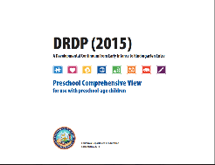


DRDP- Preschool
8 Domains
56 Measures
10 Conditional Measures
6 Domains
43 Measures
13 Conditional Measures
5 Sub-Domains
29 Measures
Notes:
Script:
There are three preschool views of the DRDP (2015) assessment. The difference between each view is the number of measures. The content of the measures are the same across views. This means that ATL-REG 1 is the same measure in all views.
The DRDP (2015) Preschool Comprehensive View has 8 domains and 56 measures. Ten of those measures are conditional.
The DRDP (2015) Preschool Fundamental View has 6 domains with 43 measures. Thirteen of those measures are conditional.
The DRDP (2015) Preschool Essential View has 5 sub domains and 29 measures.
The CDE/EESD recognizes that, while programs have communicated that the information from the Comprehensive View gives a complete picture of a child’s developing knowledge and skills, some are finding it challenging to complete. In response, the CDE/EESD has developed fundamental and essential views for preschool. The fundamental and essential views includes a limited number of selected measures from the domains of Approaches to Learning (ATL-REG), Social Emotional Development (SED), Language and Literacy Development (LLD), Cognition - Math (COG-MATH) and Physical Development (PD).
For preschool age children with an IEP, the Essential View is not an option because it does not meet Office of Special Education Programs (OSEP) requirements. For preschool age children with IEPs, the early development and physical development conditional measures must be completed. Teachers should complete any conditional measures as needed. To learn more about what adaptations a child with an IFSP or IEP needs, please collaborate with the child’s service providers.

Slide 24

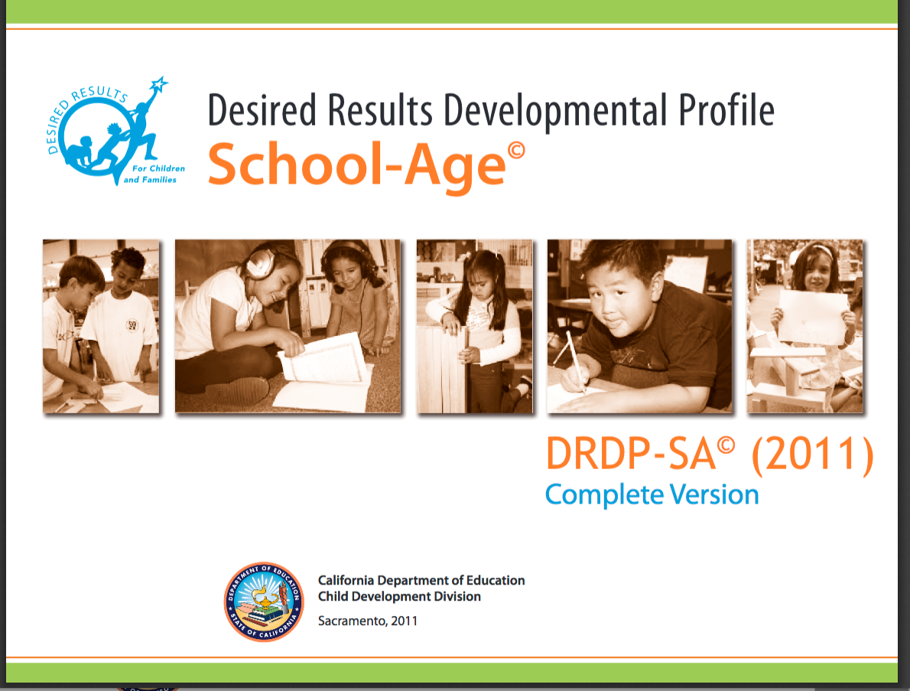
DRDP- School-Age
2 domains
13 measures
6 domains
31 measures
Notes:
Script:
Teachers of school-age children from kindergarten through 12 years of age, including those children with an IEP, may use either the DRDP-SA (2011) Complete Version or the DRDP-SA (2010) Simplified Version.

Slide 25
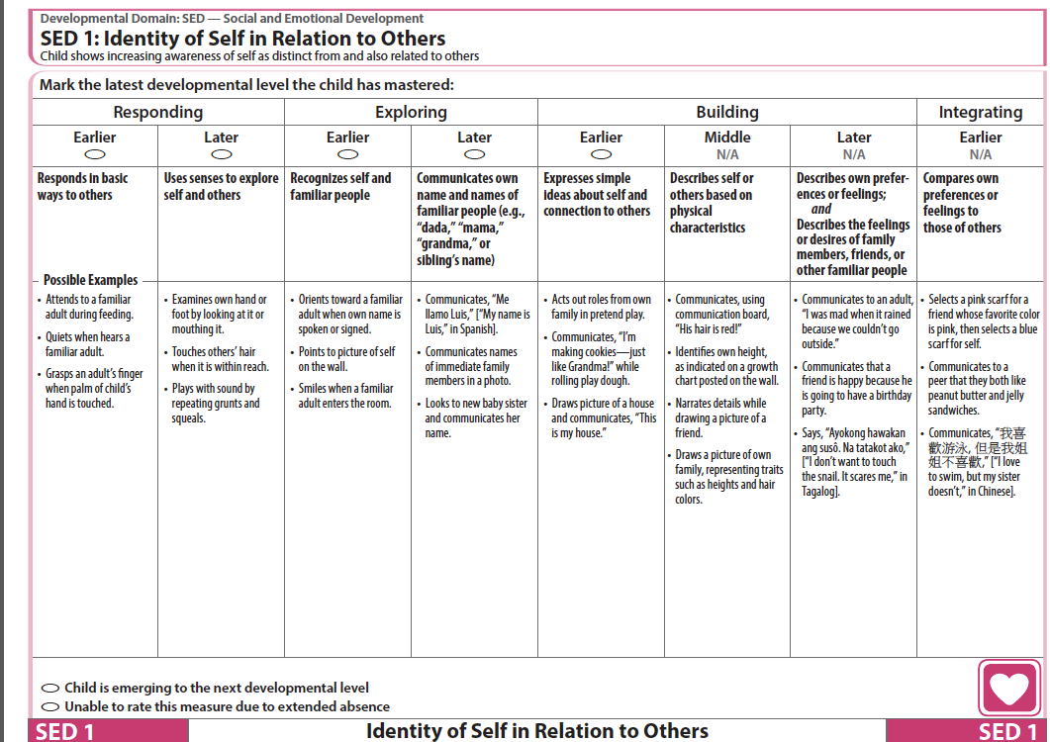
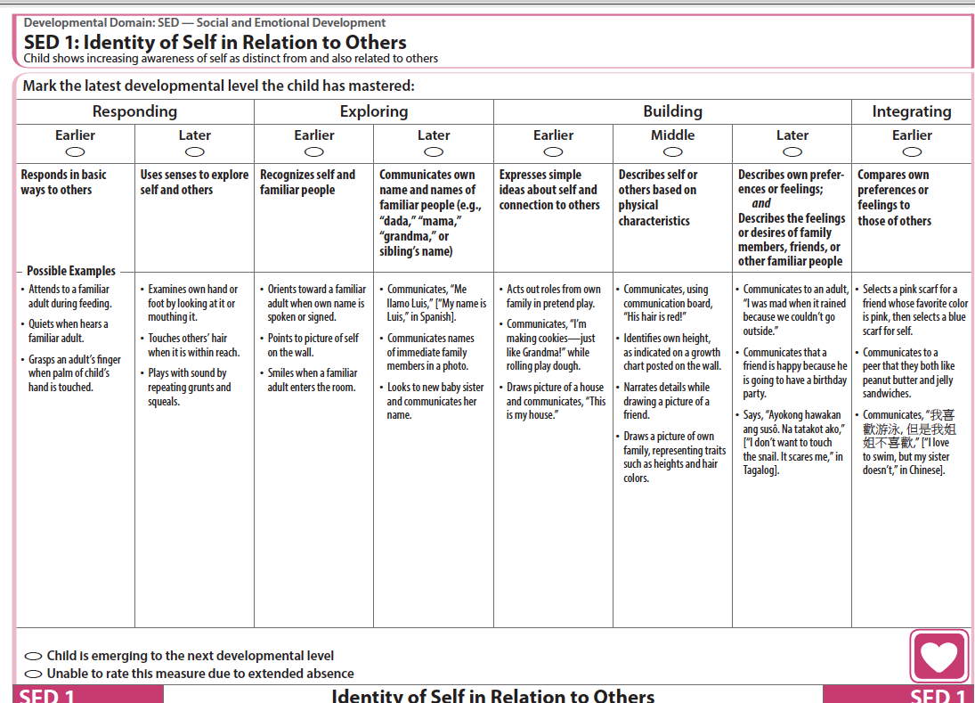
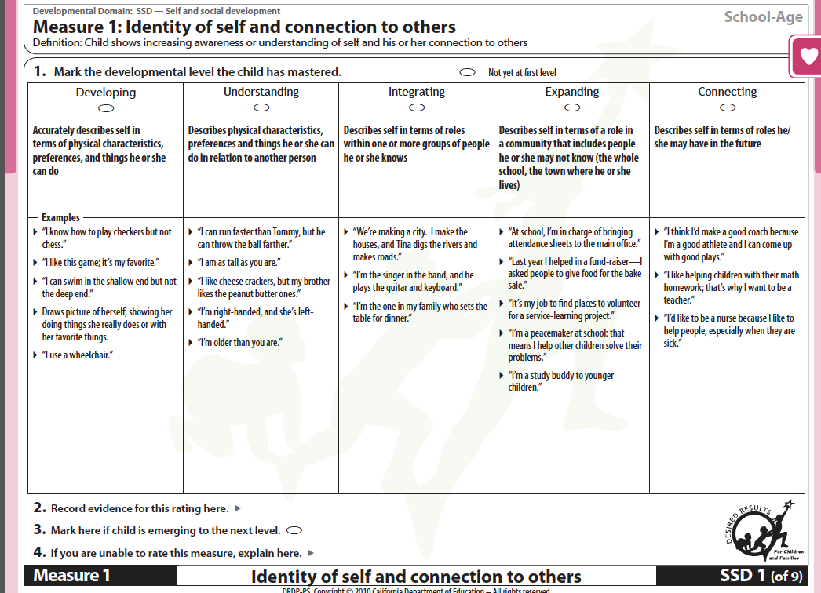
Compare and Contrast
Notes:
Activity: Compare and Contrast
Trainer Notes:
Point out the differences between the Infant/Toddler View and the Preschool View of the DRDP (2015).
Point out the difference in the School Age assessment (developmental levels, measures numbered consecutively).

Slide 26
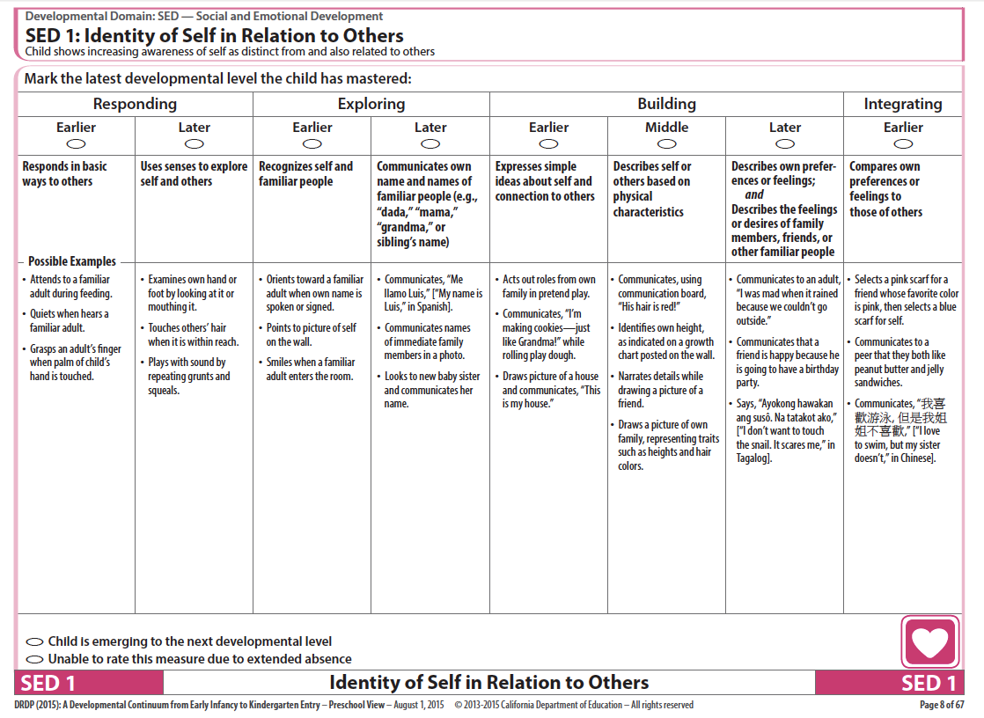
Navigation Map
Measure
Developmental Domain
Definition
Descriptor
Developmental Level
Example
Notes:
Script:
The back side provides the terms and definitions for the DRDP (2015).

Slide 27

Remember, the examples listed…
are only a few ways a child might demonstrate a particular developmental level.
Notes:
Script:
The purpose of the examples is to help teachers clarify where the skills could be demonstrated; e.g., “Some ways a teacher might see the behavior.”
Encourage staff to add examples of what they observe for the developmental levels.
The DRDP examples activity to do with staff is in the binder.

Slide 28
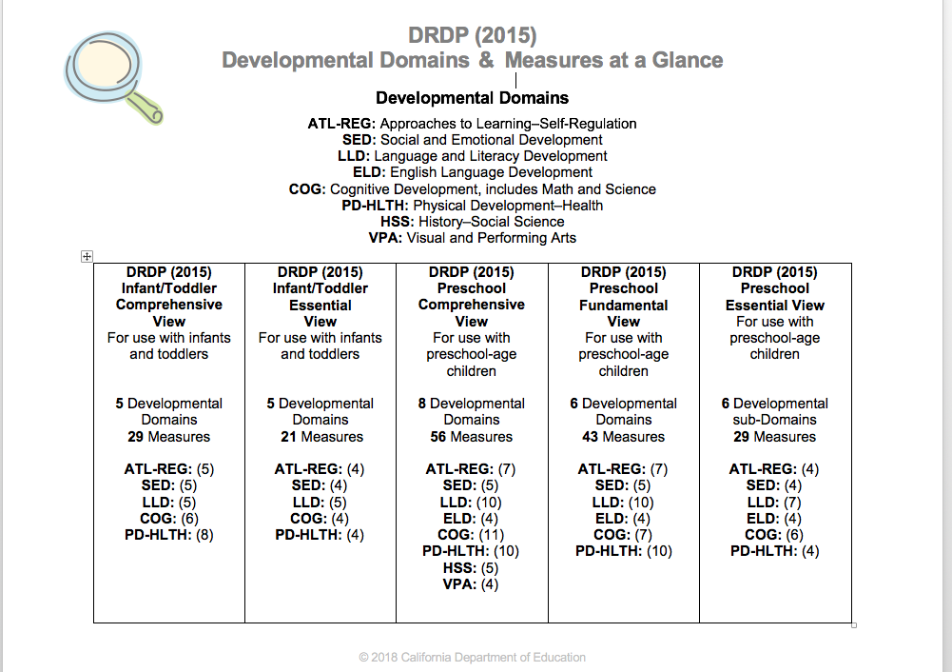
DRDP at a Glance
Notes:
Script:
The DRDP Domains and Measures at a Glance shows the developmental domains and number of measures in parenthesis for all age-level instruments:
There are 29 measures in the DRDP (2015) Infant/Toddler Comprehensive View.
There are 21 measures in the DRDP (2015) Infant/Toddler Essential View.
There are 56 measures in the DRDP (2015) Preschool Comprehensive View.
There are 43 measures in the DRDP (2015) Preschool Fundamental View.
There are 29 measures in the DRDP (2015) Preschool Essential View.
There are 55 measures in the DRDP-K (2015) Comprehensive View.
There are 37 measures in the DRDP-K (2015) Fundamental View.
There are 33 measures in the DRDP-K (2015) Essential View.
There are 25 measures in the DRDP-K (2015) Snapshot View.
The DRDP-SA (2011) Complete Version has 31 measures and the DRDP-SA (2010) Simplified Version has 13.

Slide 29
        Domains
The Four Ds
        Definitions
        Developmental levels
        Descriptors
LOOK to the 4 Ds:
Domains, Definitions, Developmental Levels, and
Descriptors to clarify the intent of each measure.
Notes:
Script:
These are the four components of the DRDP – the 4 Ds.
Trainer Note:
Review the 4 Ds and emphasize that reading these components can assist staff in knowing the intent, or purpose, of each measure.
The domain represents a crucial area of learning and development for children.
The definition specifies the aspect of development that is being observed.
The descriptor describes observable child behaviors associated with that developmental level.
The developmental levels for each measure represent a developmental continuum.

Slide 30
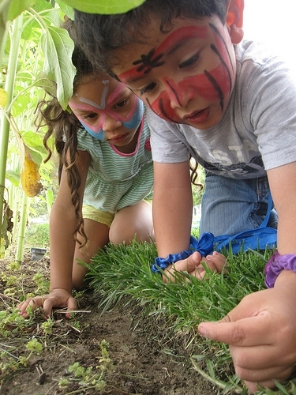
The DRDP is an
Observation Based Assessment Instrument
Notes:
Script:
We will focus on observation skills, rating the DRDP, collecting DRDP data, the Summary of Findings, and the Child’s Developmental Progress form.

Slide 31

“Getting to know children as people and as learners gives you the information you need to be an effective decision maker in the classroom.”
The Power of Observation
Notes:
Trainer note: Share the quote and show the book, The Power of Observation, if available.
Click to next slide.

Slide 32
“With the information you learn from observing, you can:
• select the right materials,
• plan appropriate activities,
• ask questions that guide children in learning to understand the world around them.”
The Power of Observation
Notes:
Script:
EESD requires programs to use the DRDP for assessment as a motivator. The real reason we use observation is to get to know children.
Through observation, we get to know how children learn best, as well as their strengths, need for support materials, and language. In addition, it helps teachers plan engaging activities to help children progress in their development.
Observation is a skill that can be learned and gets easier with practice. The observations we are making should provide good information that can inform our ratings on the DRDP.
The next activity will assist in writing meaningful anecdotal notes.

Slide 33


Develop Methods for Recording Observations and Collecting Evidence
Anecdotal records
Photographs
Audio and video records
Running records
Sketches
Work samples
Daily logs
Frequency counts
Notes:
Script:
Before teachers can rate the DRDP, they need to collect relevant information about the children.
Once teachers know the “what”, “when,” and “how,” they are ready to plan to observe, record, and collect evidence on children’s typical behaviors.
Teachers and staff can collect a wide variety of documentation, such as anecdotal notes, work samples, frequency count sheets, and photos to provide evidence of children’s mastered developmental levels across all of the measures.
Enlist all teachers, support staff, and parents to contribute documentation for the children’s portfolios. We know that teachers who are successful in implementing an observation-based assessment, plan for observations.
Trainer Note:
Remind participants to look at the gallery during breaks for samples.

Slide 34
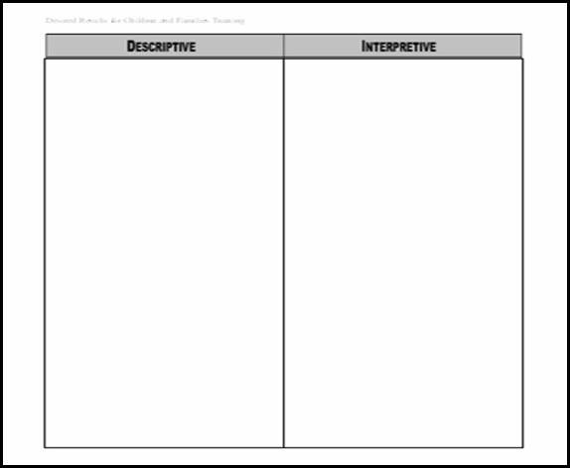
Noticing Descriptions and Interpretations
Notes:
Activity: Noticing Descriptions and Interpretations

Slide 35

Still Photo Observation
Adapted by permission, The Art of Awareness © 2000 Deb Curtis and Margie Carter, Redleaf Press. St. Paul, Minnesota, www.redleafpress.org.
Notes:
Trainer Note:
Keep this slide up during the activity.

Slide 36
Definitions: Descriptive and Interpretive
Descriptive
Interpretive
What are the specific details?
What you actually…
  Observed
  Read
  Heard
Example: He is holding shirt with one hand and pen in other hand.
What were your initial reactions?
How you felt about what you…
  Observed
  Read
  Heard
  Example: He looks worried.
Notes:
Script:
This is a reminder of what quality notes have.

Slide 37

Steps to Completing the DRDP
Notes:
Script:
The next section of the presentation provides the steps to completing the instrument. (There is a tutorial on the Desired Results website on completing the DRDP.)

Slide 38
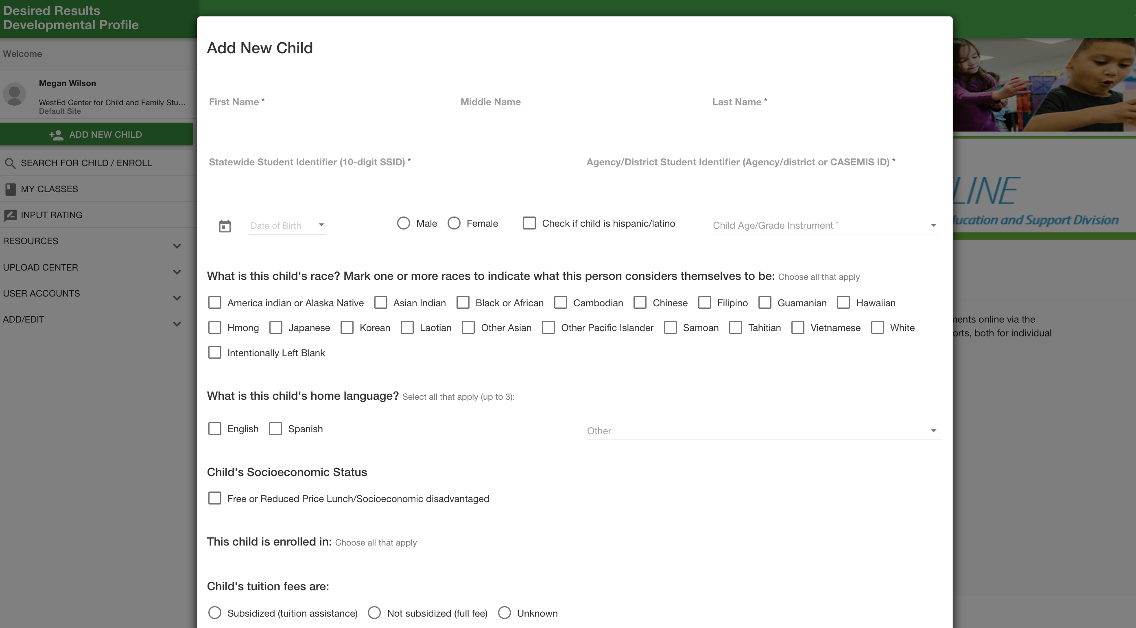
Complete the Information Page
Notes:
Script:
One of the first steps is to enter children into the DRDP Online system.
The Child Record will need to be completed for all children.
Ensure that the date of assessment at the top of the page is within 60 days of the child’s enrollment.
Teachers can edit the information page when necessary.
A tutorial, Steps to Completing the DRDP, is available on the Desired Results website.

Slide 39
        Domains
The Four Ds
        Definitions
        Developmental levels
        Descriptors
LOOK to the 4 Ds:
Domains, Definitions, Developmental Levels, and
Descriptors to clarify the intent of each measure.
Notes:
Script:
One of the first steps is to become familiar with the components of the assessment.
The 4 Ds of the DRDP assessment instrument are crucial to helping staff clarify the intent, or purpose, of each measure.
The domain represents a crucial area of learning.
The definition specifies the aspect of development that is being observed.
The developmental levels represent a developmental continuum. Each level specifies a point along the developmental continuum.
The descriptors provide the behaviors and/or skills you must see the child demonstrating with mastery to rate at that developmental level.

Slide 40

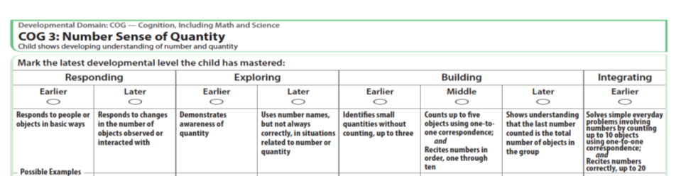
A Deeper Look at the
Descriptors
Descriptor
Each developmental level has a descriptor that defines the behaviors that would be observed if a child were at that developmental level.
Notes:
40
Script:
The descriptor can be found right under the developmental level, in every measure.

Slide 41

Using the Descriptor
If the descriptor has ; followed by and, the child must demonstrate all the behaviors, but not necessarily during the same observation.
Notes:
Script:
The language inside the descriptors is very important.
If the descriptor has a ; AND the child must demonstrate all the behaviors, but not necessarily during the same observation.
For example, if the descriptor says walk; and skips, the child needs to exhibit both behaviors. He could walk today and skip tomorrow.

Slide 42
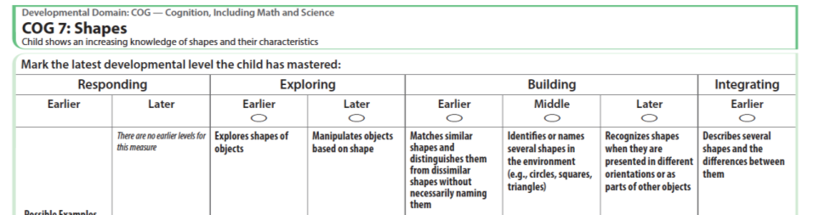
If the descriptor says and, then the child must be able to demonstrate all of the behaviors during the same observation.
Notes:
Script:
But if the descriptor says AND, then the child must demonstrate all the behaviors during the same observation.
For example, if the descriptor says, “walk AND skip,” the child needs to walk and skip in the same observation.

Slide 43
Using the Descriptor
If the descriptor says or, a child only needs to demonstrate the behavior in one of the listed ways.
Notes:
Script:
If the descriptor says or, a child only needs to demonstrate the behavior in one of the listed ways.

Slide 44

A Deeper Look at the
Descriptors
Look at COG 3 and COG 7.
Read each descriptor carefully:
  Circle the word or
  Highlight ; followed by AND
  Underline AND (when it connects two skills)
Did you get them all?
Notes:
Refer to Activity Sheet #6 – A Deeper Look at the Descriptors
Script:
Now we are going to practice.
It’s important to understand what the descriptors are asking you to observe. As you read the descriptor think about what skills you are looking for. Are they asking you to observe a specific skill? Are they asking you to observe the child displaying more than one skill? Read through each descriptor for each measure and circle the ORs, highlight the ;ANDs, and underline the AND in the descriptors.
Turn to COG 3 and COG 7 and circle the ORs, highlight the ;ANDs, and underline the AND in the descriptors (only in descriptors).
Now that we are done, turn to COG 3. How many ORs did you find? How many ;ANDs? How many ANDs?
Trainer note: Repeat this for COG 7.

Slide 45
Cognition Sample
Notes:
Script:
Administrators can show their own video and have staff analyze the descriptors. See activity sheet - Deeper Look at Descriptors.

Slide 46
A Deeper Look at the
Descriptors
What is the child able to do?
Look at COG 3 and COG 7 and their descriptors.
Which parts of the descriptors can the child do?
Notes:
Script:
Remember we are not rating. We are looking at the child’s behavior to see how those behaviors may be related to the descriptors.
What did you see the child do? What did the child demonstrated during the clip?

Slide 47

Developmental Level Activity
Where are you in your development…
as a cook?
Notes:
Script:
This practice model is a playful creation to assist staff in considering how circumstances may change behaviors - not just developmental progress.
Trainer Note:
Explain that now the training will move to learning more about developmental levels in the DRDP.
Read slide… “Where are you in your development…as a cook?”

Slide 48
Notes:
Script:
It does not matter where the participants are on the continuum, as each one is making continuous progress towards the desired result!
Trainer note:
Ask participants to raise hands or stand up to show pride for the level of “mastery” attained.

Slide 49
Developmental Level Activity
Prepare an activity to do with your staff
or…
Participate in the tutorial
on the Desired Results website
Notes:
Trainer note:
Hold up the developmental level activity and show.

Slide 50

Lunch Break
Notes:
Take a 15 minute break.
Trainer Note:
Remind participants to check out the gallery.

Slide 51
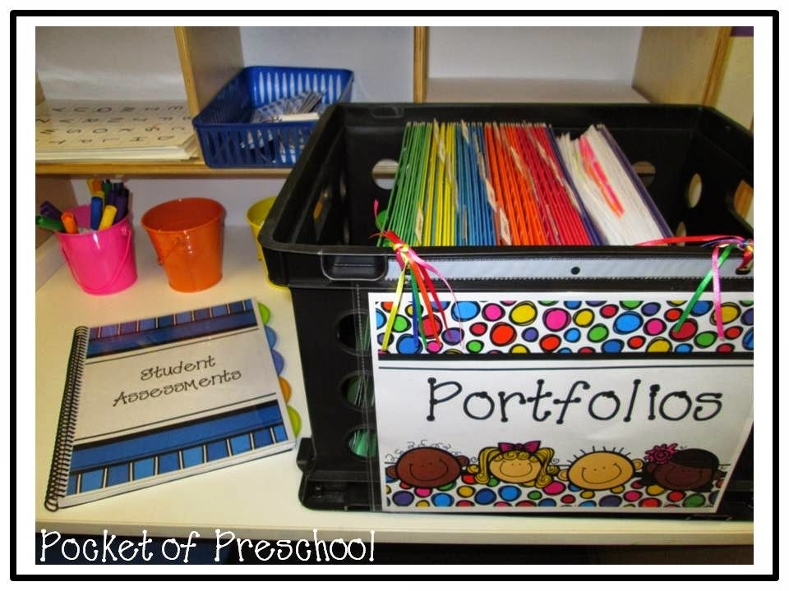

Review the collected evidence and reflect on the child’s development
Notes:
Script:
As the due date to complete the DRDP nears, review the collected evidence to ensure documentation exists to support the developmental level the child has mastered.

Slide 52
How do children demonstrate a developmental level is mastered?
A developmental level is mastered when the child typically demonstrates the behavior(s)
    Consistently over time
    In different situations or settings
Notes:
Trainer note:
Read the slide. Give pause to let participants think about the criteria for “mastered.” Suggest participants make a poster to put around the center to help staff learn this as a mantra.

Slide 53
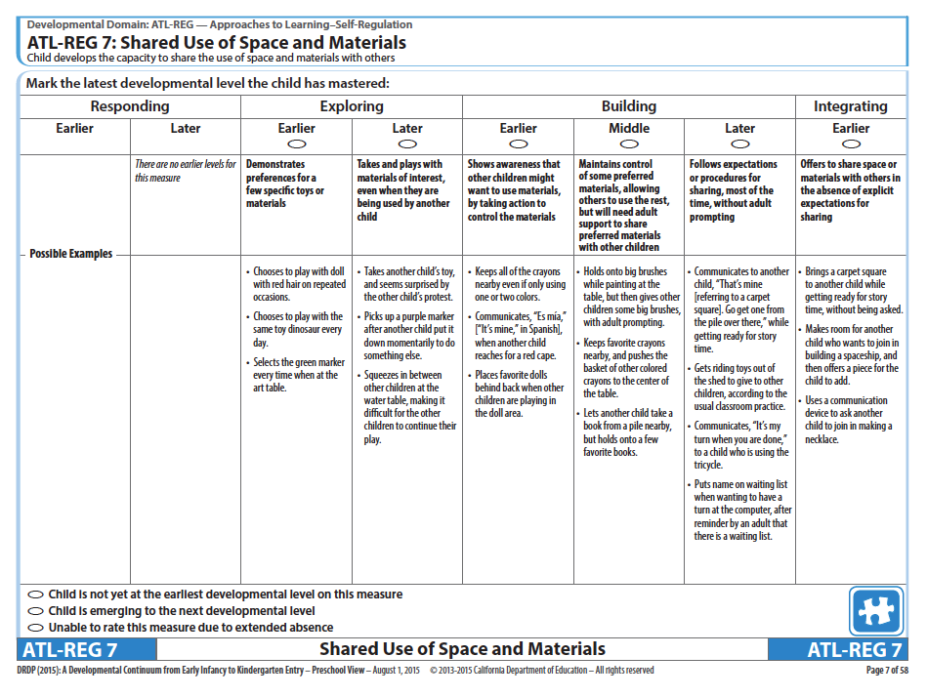
Based on observations, fill-in one bubble that best describes the child’s latest developmental level mastered
Notes:
Script:
Based on observations, fill-in one bubble that best describes the child’s latest developmental level mastered.

Slide 54
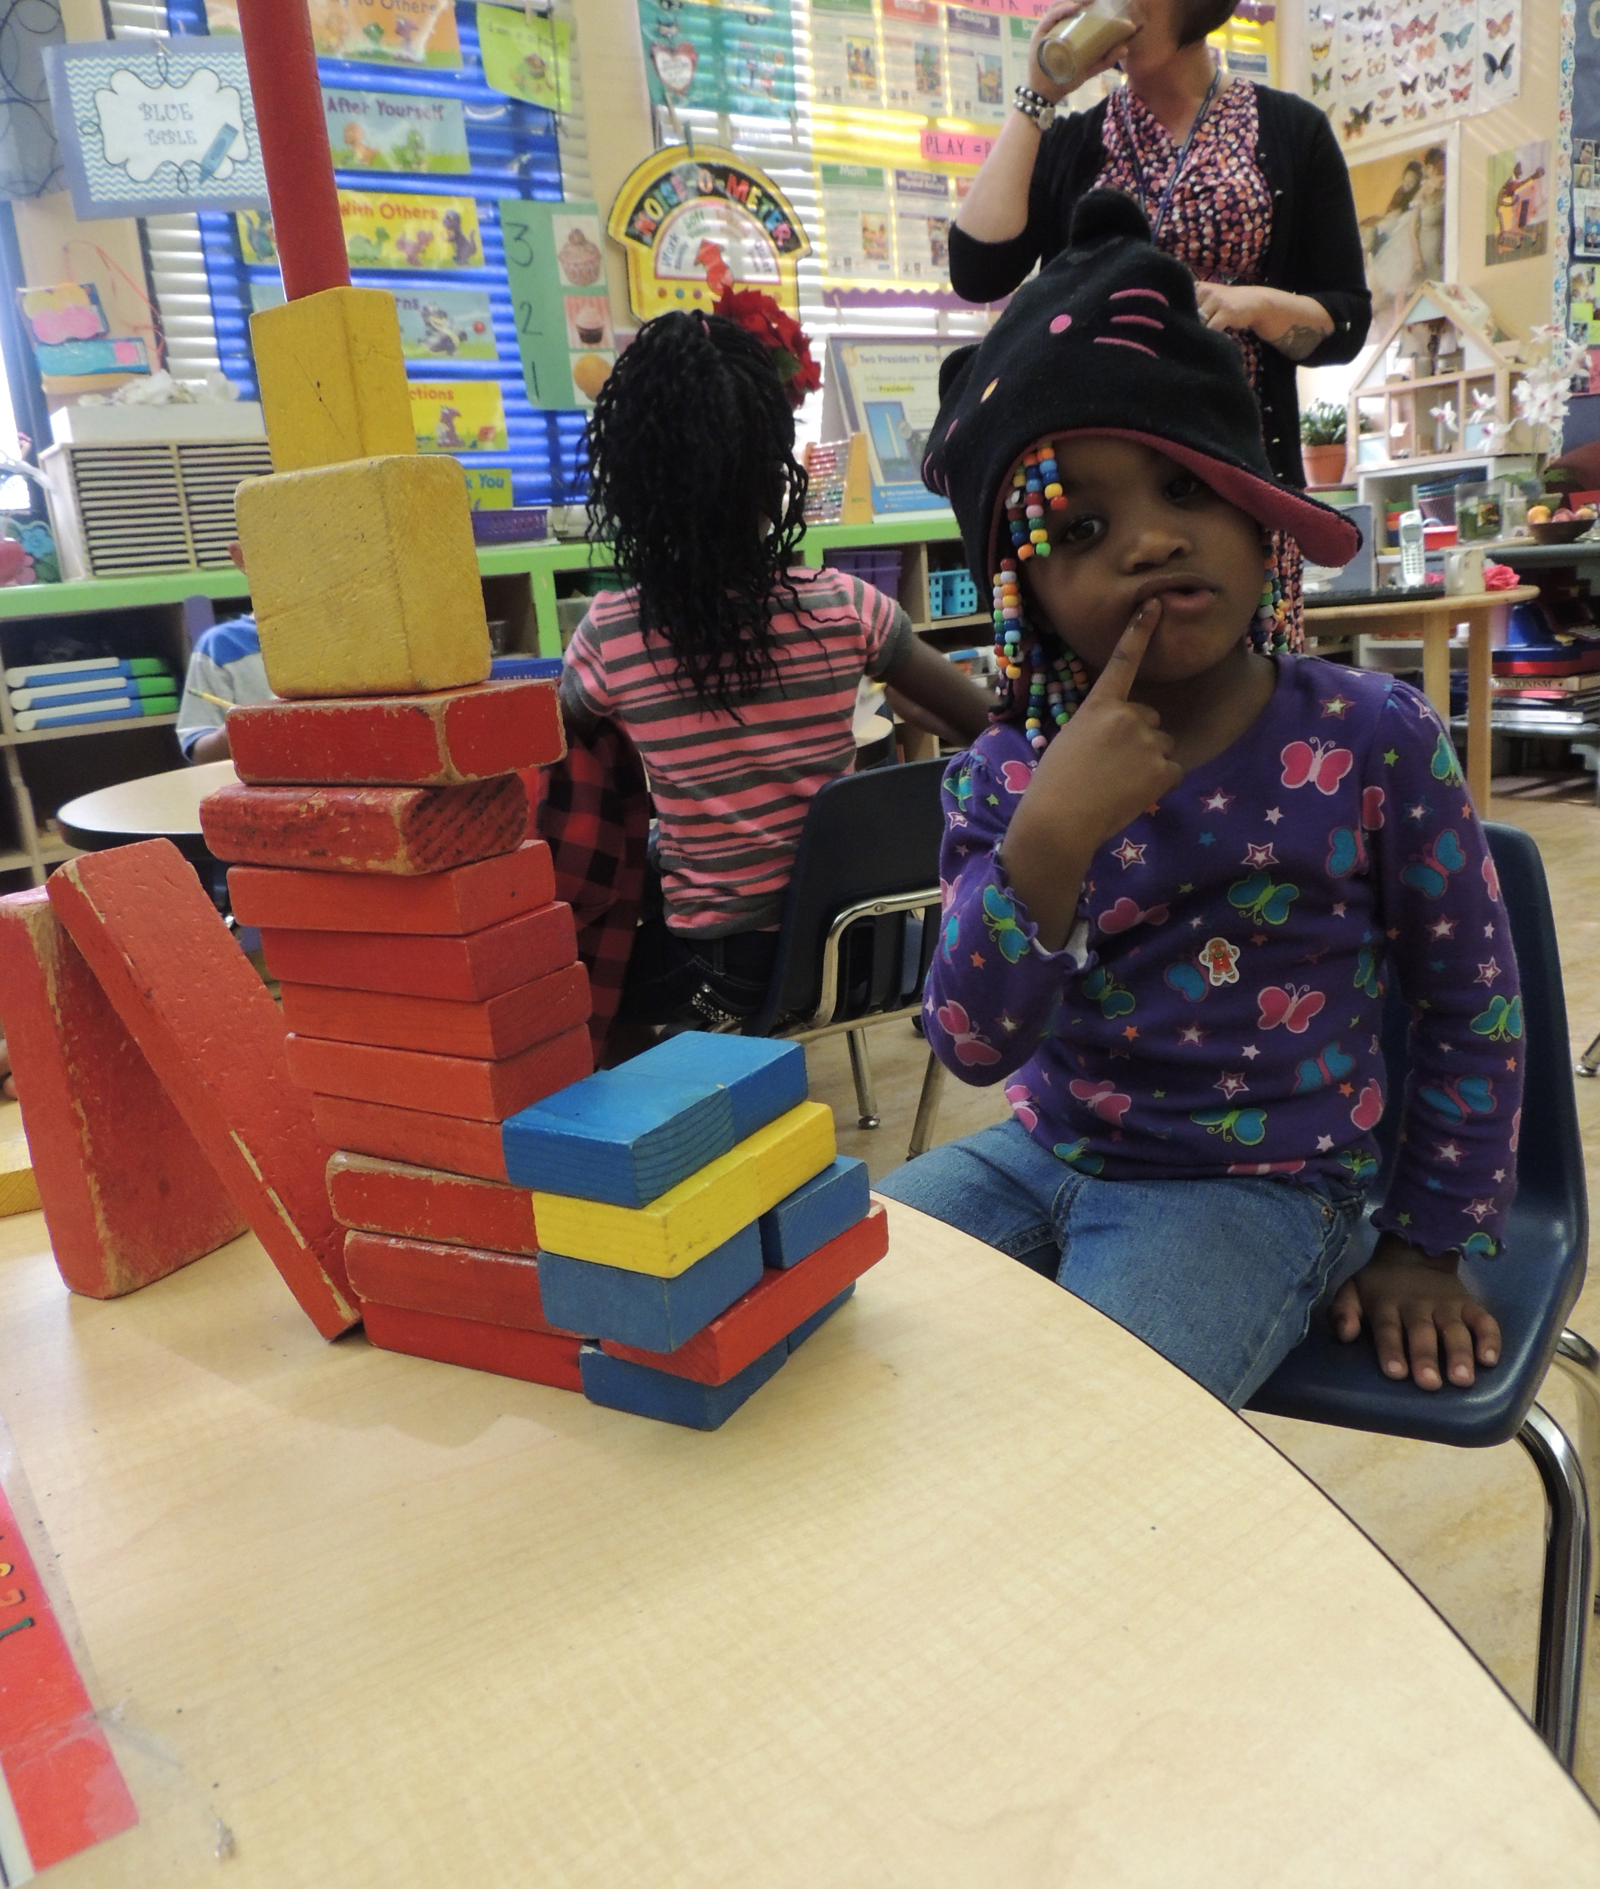
After marking the developmental level mastered, ask “Is the child emerging to the next level by demonstrating behaviors from the next developmental level, but not yet typically or consistently?” If so…
Notes:
Script:
After marking the developmental level mastered, ask “Is the child emerging to the next level by demonstrating behaviors from the next developmental level, but not yet typically or consistently?” If so…

Slide 55
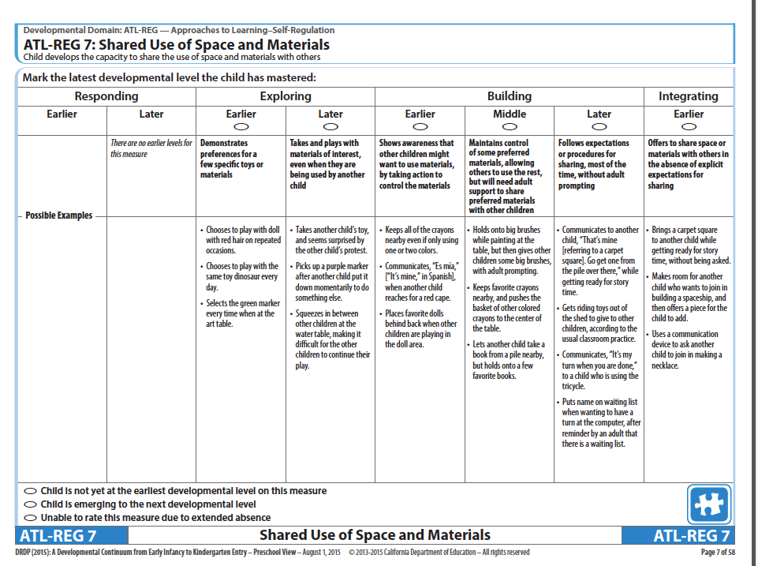
Emerging
Notes:
Script:
After marking the developmental level mastered, consider if the child is beginning to sometimes demonstrate behaviors from the next level. As compared to mastered behaviors which are consistent, emerging behaviors are not yet typical or consistent.
If you determine that the child is emerging to the next level, you may mark the bubble labeled, emerging.
Using the emerging bubble is optional and up to the individual teacher.
If the child is at the last developmental level, do not rate the child as emerging to the next level.

Slide 56
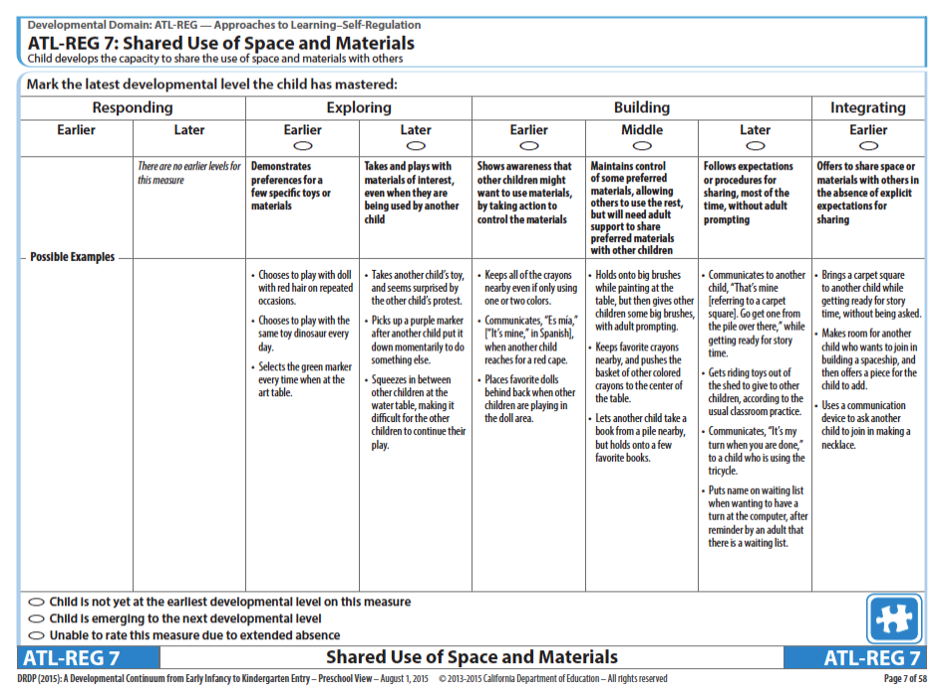
Not Yet at the Earliest
Developmental Level
Notes:
Script:
Not yet at the earliest developmental level means that you do not see mastered skills or behaviors that would allow you to mark the first developmental level.
Note that the not yet at earliest developmental level bubble is not available in the infant/toddler instrument because that instrument begins with the reflexive stage which children typically evidence at birth.

Slide 57

Unable to Rate
Notes:
Script:
In the rare circumstance that you are unable to rate a child on a specific measure, explain in detail the reason for a lack of rating in the box at the bottom of the page.
Unable to rate is only used for extended absences.

Slide 58
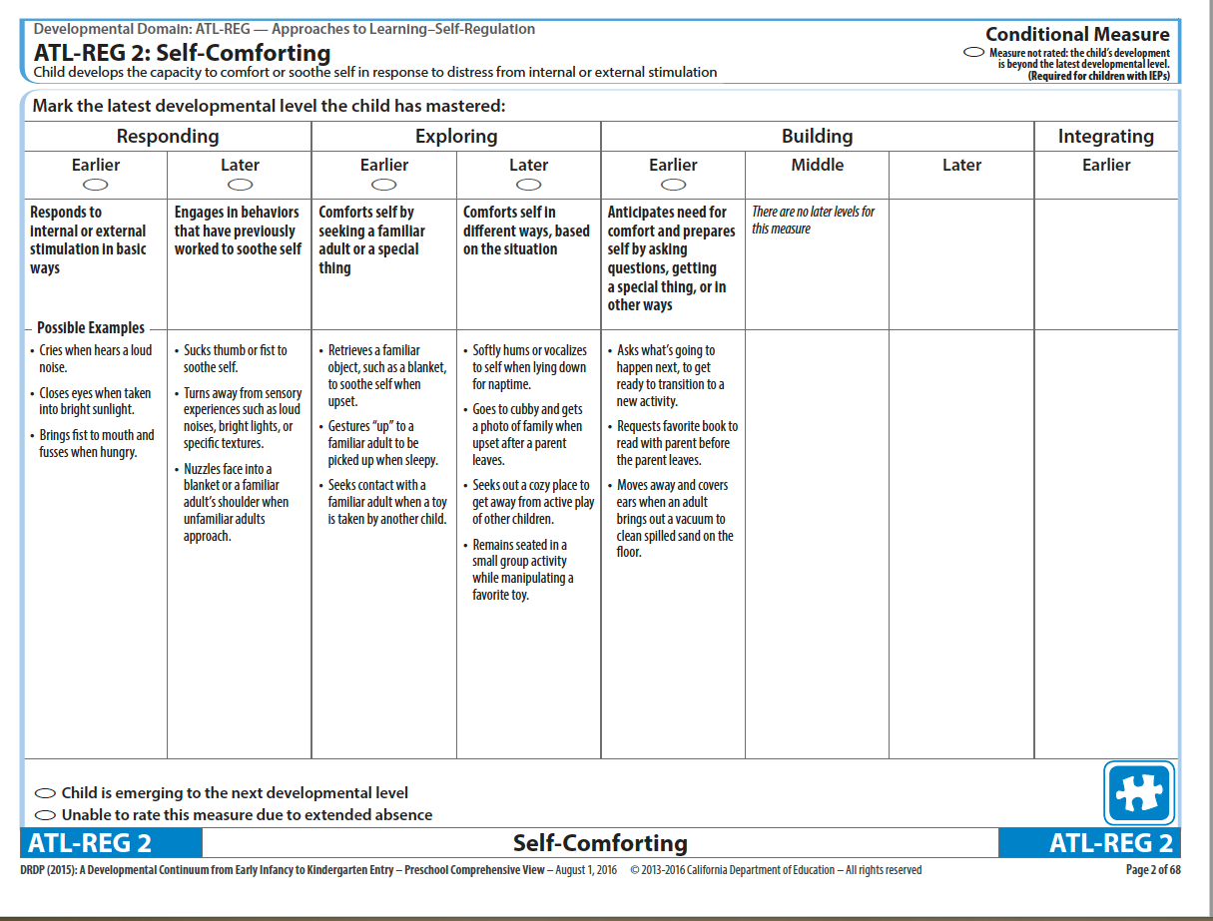
Conditional Measures
Notes:
Script:
Some measures in the DRDP are considered conditional measures that are only assessed when certain conditions are met.
Conditional measures should be used if they assist teachers and service providers in planning a child’s learning activities and supports, and documenting progress.

Slide 59
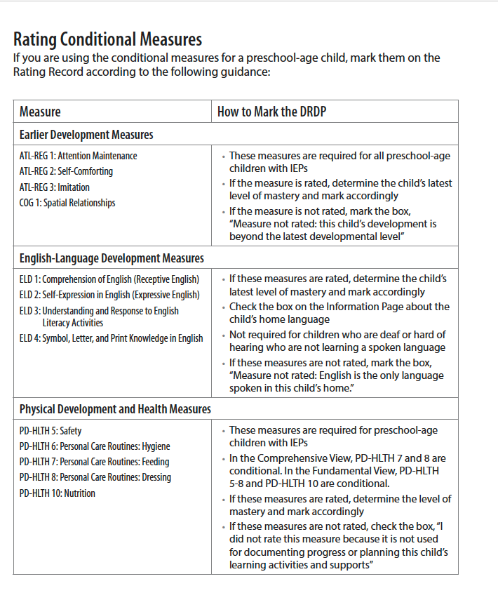
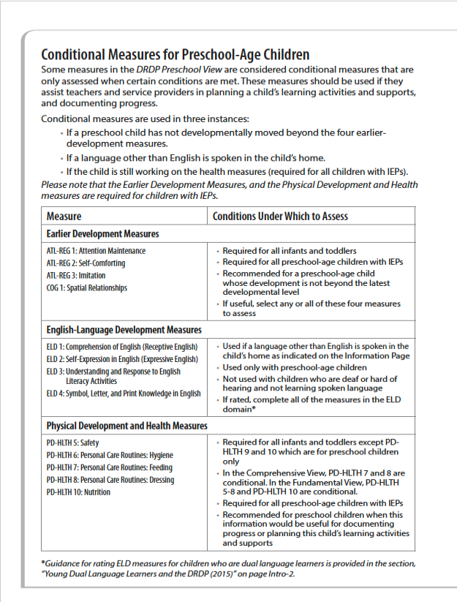
Conditional Measures
Notes:
Script:
Refer to the charts on Intro 4 and Intro 9 for more information.

Slide 60

Preschool English-Language Development Measures
Notes:
60
Script:
The DRDP (2015) Preschool View instruments contains four measures for English-language development.
(There are ELD tutorial on the Desired Results website.)

Slide 61
English-Language Development Measures
ELD 1: Comprehension of English (Receptive English)
ELD 2: Self-Expression in English (Expressive English)
ELD 3: Understanding and Response to English Literacy Activities
ELD 4: Symbol, Letter, and Print Knowledge in English
Notes:
Script:
The four English-Language Development measures used for children learning English are:
ELD 1: Comprehension of English (Receptive English)
ELD 2: Self Expression in English (Expressive English)
ELD 3: Understanding and Response to English Literacy Activities
ELD 4: Symbol, Letter, and Print Knowledge in English

Slide 62
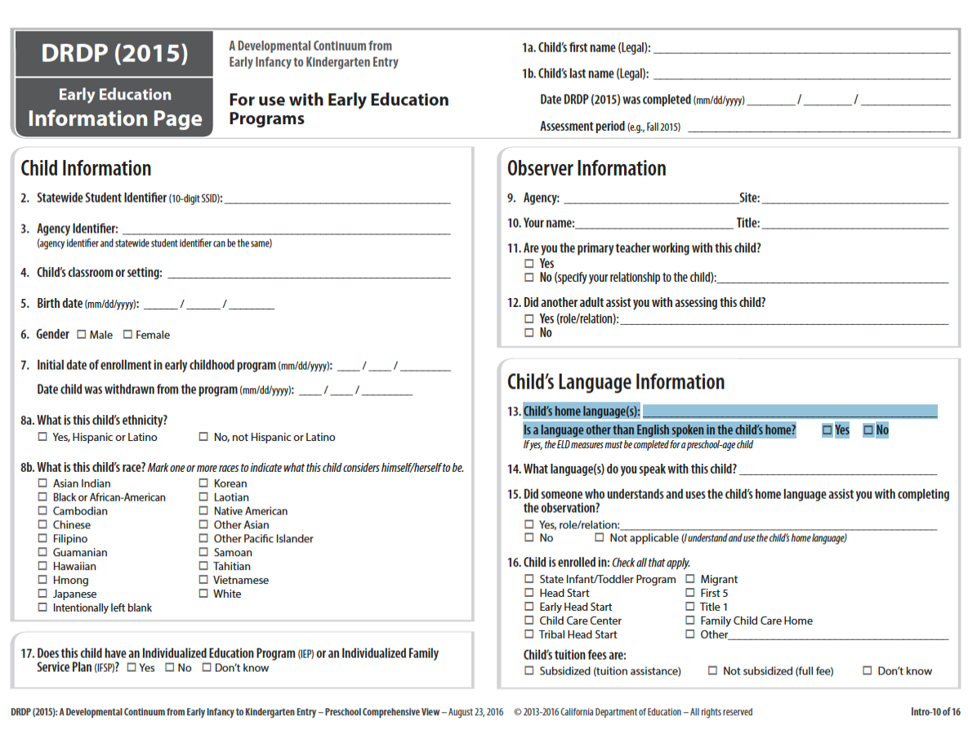
Child’s Language Information
Notes:
Script:
On Intro 10, question #13 gives directions on when to use the ELD measures.
If a language other than English is spoken in the child’s home, the ELD measures must be completed for preschool age children.

Slide 63
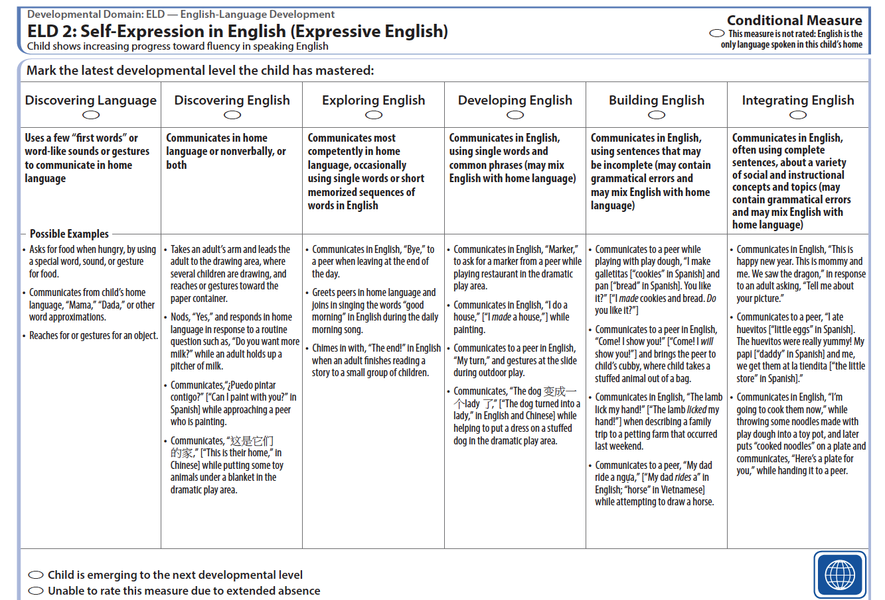
The New Developmental Levels for ELD
Notes:
Script:
The descriptors in the first two levels (Discovering Language and Discovering English) refer to the child's use of their home language.

Slide 64
Assessing Children Who Are Dual Language Learners
Notes:
Script:
In the folder is the handout Assessing Children Who are Dual Language Learners, which explores code switching.
Give teachers time to read the handout (8-10 minutes) and circle what is important to them.
Ask, “What are some things that stood out to you from the handout?”
Use chart paper to chart responses about code switching.

Slide 65
Code Switching
Typical of dual language development
Use of multiple languages in one conversation
Uses grammatical rules of each language (at the 3 and 4 year old level of course!)
Influenced by context and purpose
Notes:
Script:
What we observed the children doing is code switching. What is code switching?
Typical of dual language development
Use of multiple languages in one conversation
Uses grammatical rules of each language-of course at the three and four year old level!
Influenced by context and purpose

Slide 66

Key points for LLD & ELD
LLD is used with all children to measure progress in their home language.
ELD is used with any child where a language other than English is spoken in the home.
Notes:
Script:
The Language and Literacy Development measures are used to assess progress in developing foundational language and literacy skills. These measures are used with all children. Children who are dual language learners may demonstrate mastery in their home language, in English, or in both. This is true not only for Language and Literacy Development, but for all other domains as well, except for the English Language Development domain.
The four English-Language Development measures are used to document and assess progress in learning to communicate in English. These four measures are used if a language other than English is spoken in the child’s home.
Communication in all languages the child uses should be considered when collecting documentation and completing the measures in all domains.
Refer to Intro 6 and the appendices for more information on Assessing Dual Language Learners.

Slide 67
Completing a Developmental Profile
Desired Results Developmental Profile
Notes:
Activity: Completing a Developmental Profile

Slide 68

Into Practice
DIRECTIONS:
Review all evidence.
Reflect on what the evidence shows.
Complete the DRDP.

Slide 69
The Child’s Developmental Progress form is designed to…
Describe the child’s development to parents
Engage parents as partners in supporting curriculum objectives for the child
Assist in determining curriculum objectives to support the child’s development
Complete twice per year prior to the parent conference
Notes:
Script:
A progress form is used during parent conferences to describe children’s development and growth.
The progress form provides a review of the child’s strengths, areas that need improvement, and goals for developmental growth in the program and at home.
The information teachers write on the form is based on the DRDP, observations, work samples, and other evidence from the child’s portfolio, as well as information provided by parents.

Slide 70
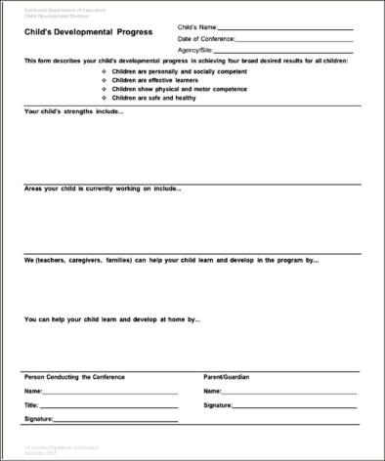
Child’s Developmental Progress Form
Notes:
Script:
This format may be used to encourage a conversation with parents about their role as the child’s first and most important teacher, as well as stressing the importance of the parents’ involvement and participation in the process of the child’s learning and growth.
Scheduled parent conferences are to occur at least two times each program year.

Slide 71
Completing the Child’s
Developmental Progress Form
DIRECTIONS:
1. Summarize DRDP findings
2. List:
  3 strengths
  1 area for improvement
  A way the program helps
71
Notes:
Activity: Completing a Child’s Developmental Progress Form

Slide 72
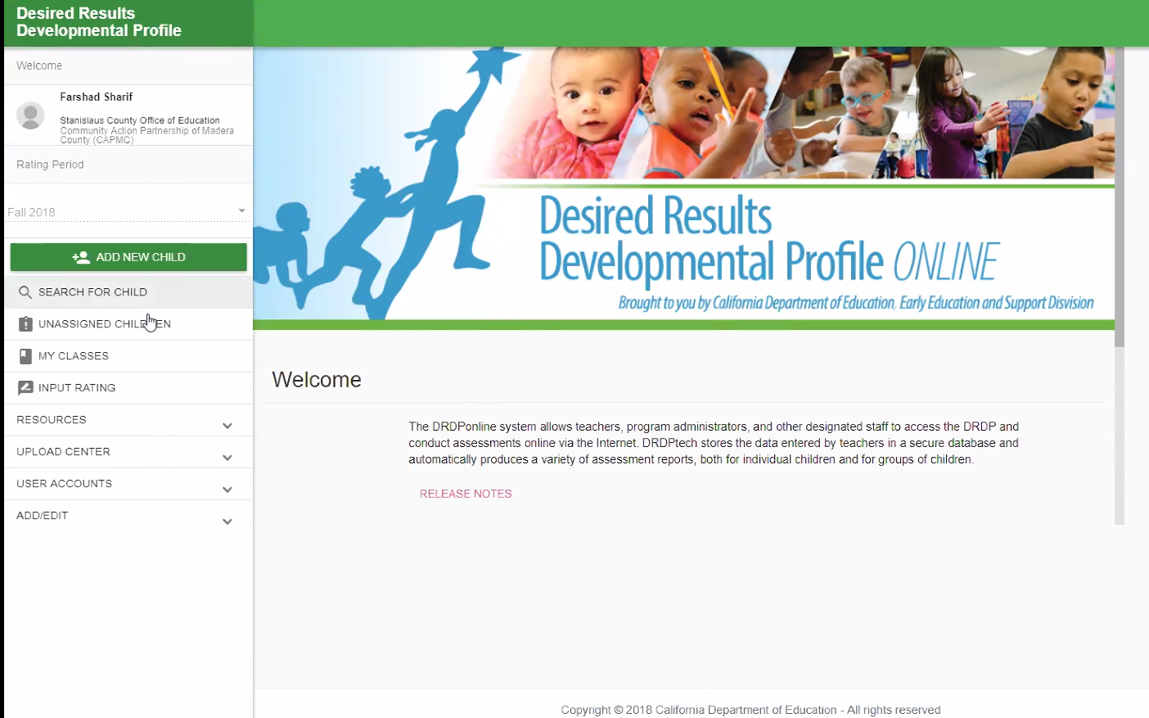
DRDP Online©
*Now required of all EESD programs*
Get information about DRDP Online on the Desired Results Website:
www.desiredresults.us
Notes:
Script:
DRDP Online CLOUD accounts are free for CDE funded programs, Head Start programs, California tribal CCDF, and for California K-12 school districts.

Slide 73
DRDP data is compiled by…
Individual child
Classroom
Contract
DRDP Online
Excel spreadsheets
Commercial software programs
Notes:
Script:
Data on the DRDP is collected first at the individual child level, then at the classroom level, and then compiled at the contract level.
DRDP Online provides an online system of tools for summarizing DRDP data.
Although the individual child and classroom data is kept on site and is not sent to EESD, it will be reviewed during your CPM/CMR. This data is also compiled and used to complete the Agency Program Action Plan.

Slide 74
What is DRDP Online©?
An online data entry system
An easy way to compile information about your students
Tool for printing out summary reports
Notes:
Script:
Teachers can complete the DRDP online, via the internet using a password and username. The system allows for automatic storage of DRDP data. The data entry system compiles all the data and provides multi level summary reports by student, or by group, and even sub group that can be shared with families and administrators.

Slide 75
DRDP Online© Reports
Notes:
Script:
All reports are designed in collaboration with EESD. They provide information about children’s competencies across developmental domains, and overtime progression. Three types of reports are featured here.
Group Report–provides psychometrically valid domain level information for a specified group. Teachers can use this information in their classroom to provide specific strategies to meet the needs of their groups. Administrators can use the Group Report to analyze data across the program and use the information to provide professional development or make changes for program improvement.
Child Report–provides psychometrically valid domain level information for individual children. Teachers can use this information to visually see where children are strong in their development and where they may need additional support.
Review Ratings–provides raw score information for individual children.

Slide 76
DRDP Summary of Findings
Notes:
Script:
Programs are required to summarize the data both at the classroom and contract level to determine key findings and action steps. These are trends or main points that require action.
Trainer note: After sharing, ask participants to view the sample DRDP Classroom Summary of Findings.
These findings will inform administrators and guide them in making continuous program improvements.
EESD field service consultants will be checking the DRDP Classroom Summary of Findings forms to make sure programs are using the data to inform the “continuous improvement” process.

Slide 77




What’s are the Curriculum Frameworks?
School-age frameworks available on CDE Website
Notes:
Script:
After compiling your data, action steps must be written to address the data.
The Curriculum Framework chapters provide information to support children's learning in the areas described in the California Learning and Development Foundations.
The icons and their colors are used to identify domain sections inside of the book. We will look at the sections of the book on the next slide.

Slide 78
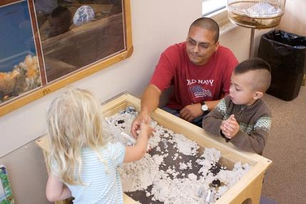
What does the framework do?
“Created as a companion to the California Preschool Learning Foundations, Volume 1, this framework presents strategies and information to enrich learning and development opportunities for all of California’s preschool children.” p. v
Notes:
Script:
There is a companion Curriculum Framework for each volume of the California Learning and Development Foundations.

Slide 79
Tips When Planning
Review current curriculum to find links with the DRDP.
Summarize children’s progress by reviewing, discussing, and consulting with others who know them.
Reflect on your collection of observations, including photos, notations, audio tapes, sketches, etc.
Consult other resources to support planning for the needs of children’s developmental levels.
Notes:
Script:
It’s important to plan to observe. When planning an activity for children, think about what to plan in relation to the DRDP. This does not mean setting up a testing situation, rather creating an invitation for children to have interactions with materials, their peers, or an adult that might provide an observation opportunity related to the DRDP.

Slide 80
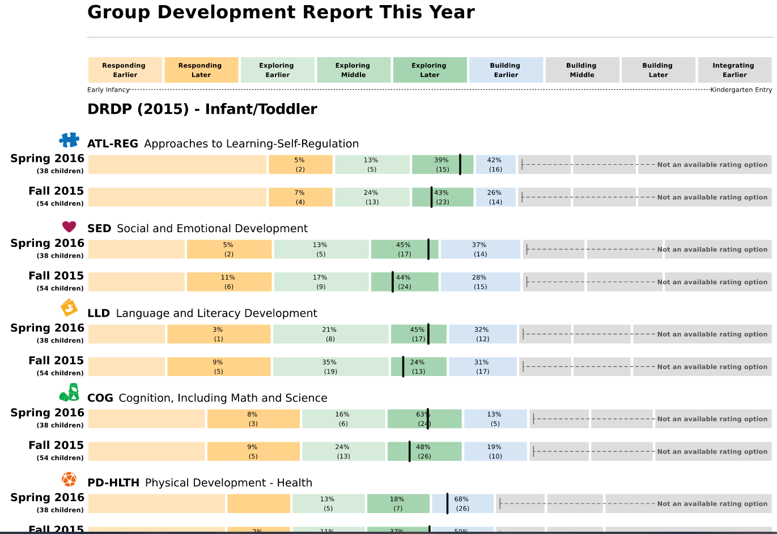
Small and Large Group Planning
Use the data provided from DRDPtech to plan for individual children, as well as for small and large group activities.
Notes:
Script:
This is one example of what the data may look like. This is a Progress this Year report. In your classroom or agency planning process, you would look at the DRDP data that is provided through your DRDP Online reports to support planning for the groups of children in your own classroom.

Slide 81

All teachers…
must use the results of assessments of children’s progress to support each child’s learning and development.
Notes:
Script:
All teachers, whether teaching in a Head Start or state preschool program, must use the results of the DRDP to support each child’s learning and development.

Slide 82
Writing a DRDP
Summary of Findings
DIRECTIONS:
1. Review narrative and DRDP Group Data Summary.
2. Identify key findings.
3. Draft action steps.
Notes:
Activity: Writing a Summary of Findings

Slide 83
Taking it
Back to the Agency
Notes:
Script:
Use calendar pages when planning to:
Train staff to complete the DRDP
Complete the first and second DRDP, complete each Child’s Developmental Progress Form, and schedule parent/teacher conferences
Group the DRDP data
Complete the DRDP Summary of Findings per classroom and agency

Slide 84
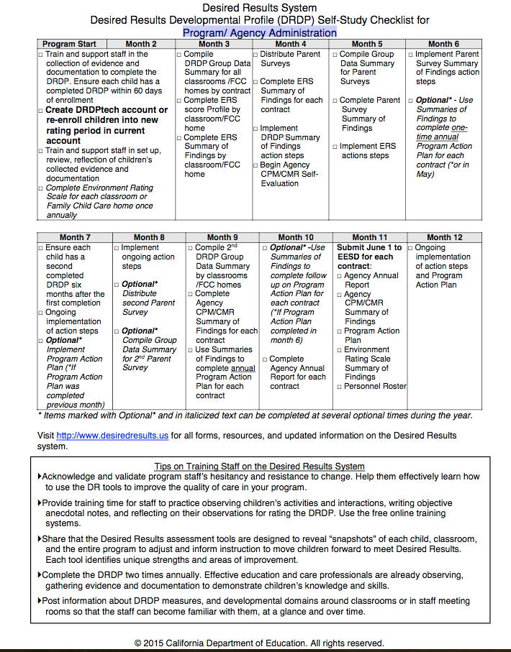
Use the Self-Study Checklist for Program/Agency
Administrators to plan agency/contract calendar
Notes:
Script:
To support participants in planning month to month training activities, direct participants to the DR system self-study checklist in their DR binder. In the Resources section at the back of the binder, participants will find calendar pages.
Requirements are listed on the checklist with suggested times (months) for completion.

Slide 85
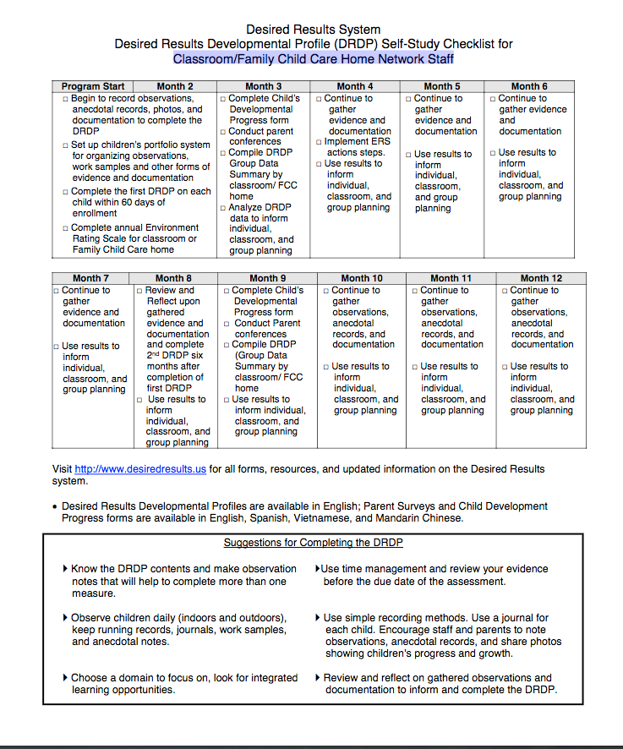
Use the
Self-Study Checklist for Classroom/Family
Childcare Home
Network Staff
to plan classroom/group
calendar
Notes:
Script:
Note that there are two sides to the checklist. One is for classroom/FCC home staff and the other side addresses the requirements of program/agency administrators.

