Slide 1



Program Guidelines
Notes:
There are three program guideline publications, from the California Department of Education
The Guidelines for Early Learning in Child Care Home Settings
Infant/Toddler Learning and Development Program Guidelines
California Preschool Program Guidelines
This section is for training site administrators, not teachers.

Slide 2
Program Guidelines
“The […] Program Guidelines provide information on how to provide high quality early care and education, including recommendations for program policies and day to day practices that will improve program services.”
-Infant/Toddler Learning and Development Program Guidelines, p. 2
Notes:
The guidelines address important issues and information about child development and program planning. The three publications take a specific look at a particular age group and the needs of that age group or setting. They all provide leadership to the early childhood field and ensure that the impact of early care is positive for all children.

Slide 3
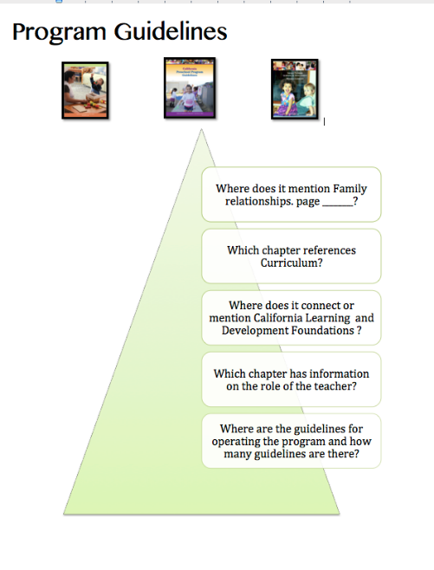
Five Questions
Choose a copy of the Program Guidelines.
Find the Program Guidelines handout.
Work as a table to answer the five questions.
Notes:
Choose one of the program guidelines and we will take a deeper look inside of the publication.
Find the Program Guidelines handout.
Complete the five questions as a table group.
Allow 15 minutes for this activity. When they are done, if they have used different age levels, have them share out the information they found.

Slide 4

Continuous Improvement
Choose one guideline.
Brainstorm as a team:
  What are we already doing to support this guideline?
  How can we make it better?
  What resources are available?

Slide 5


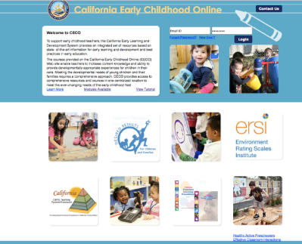


Resources/Additional Support
Resources
Appendices
Notes:
Don’t forget the appendices. Turn to the appendix and put a sticky on a resource you have not used yet.

Slide 6

CECO Module for Preschool Program Guidelines
Notes:
Become familiar with the guidelines for operating high-quality preschool programs. Encourage program leaders to take the online courses so that they can
Review the components and structure of the Preschool Program Guidelines.
Be informed with supported research and resources of key practices.
Explore an overview of the content chapter of the Preschool Program Guidelines.
Upon completion of this module, participants will be able to:
Utilize this publication in response to the need for a common understanding about what constitutes high-quality programming across a broad spectrum of curriculum and practice for preschools.
Understand what high-quality preschool programming means in the context of California’s move toward higher expectations for all students at the elementary and secondary school levels.

Slide 7
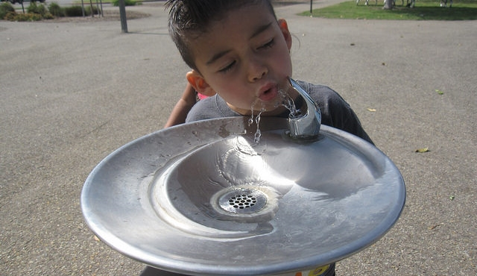
Break

