Slide 1
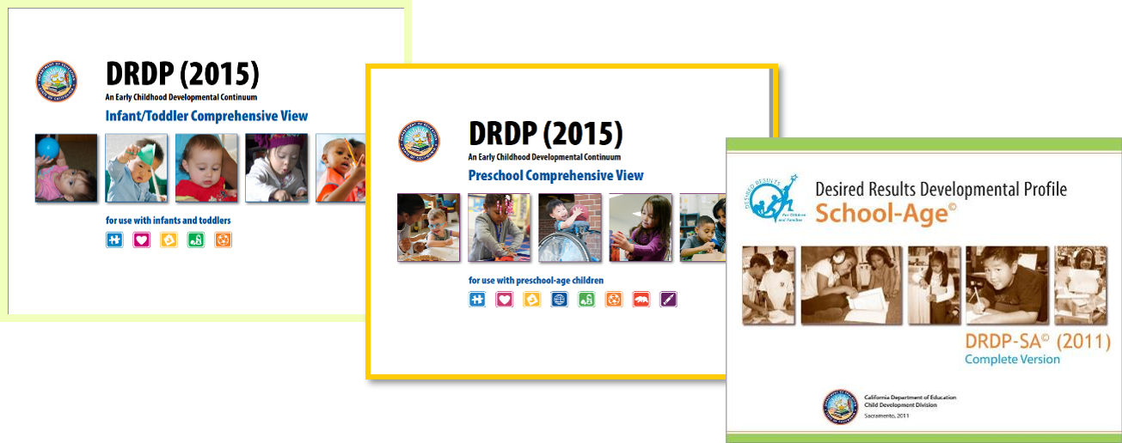
Desired Results Developmental Profile© (DRDP) Observation Assessment Instrument
Notes:
Script:
In this session, participants will learn about the Desired Results Developmental Profile (DRDP).
We will focus on observation skills, rating the DRDP, collecting the DRDP data, the Summary of Findings, and the Child’s Developmental Progress form.

Slide 2

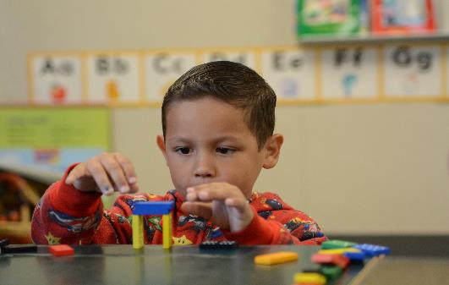
We observe…
As each child interacts with other children, adults, and environment
In the natural program setting
Notes:
Script:
Teachers observe children in their natural, daily activities. Agencies will be able to describe children’s achievements in learning and development to advocate the strengths and benefits of the program to families and the larger community.

Slide 3
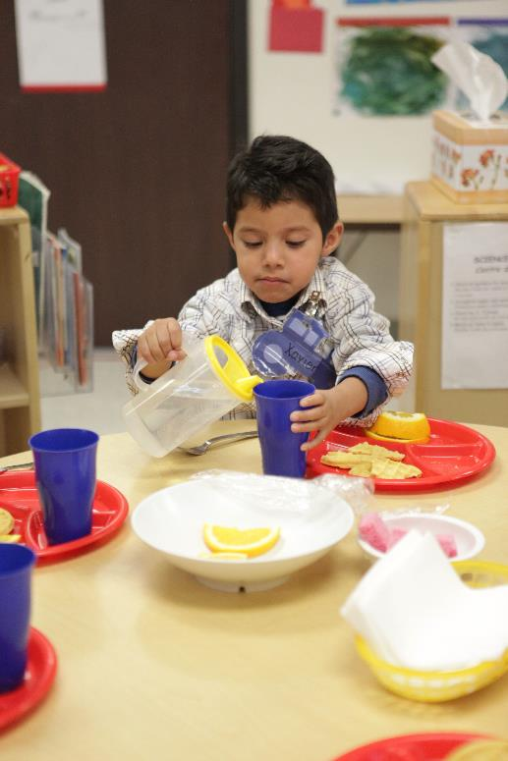
And we observe…
As children participate in the typical daily program
Notes:
Script:
Good observation and recording methods over time are the cornerstones for using the DRDP effectively. The DRDP is not a test, but an observation-based assessment for children.
The person who is the designated teacher should complete the DRDP. Assistants, parents, and other staff should contribute observations.
Note: Family Child Care Networks have a “teacher identified” person complete the DRDP. This person may be the case manager who oversees the network care providers. The case manager consults with care providers and parents in completing the DRDP.

Slide 4

Collected documentation includes:
Anecdotal notes
Photos
Work samples
Other evidence of knowledge and behaviors
Notes:
Script:
Teachers collect a substantial number of anecdotal notes, photos, work samples, and other pieces of documentation from family members and other staff, that demonstrate the children’s mastered developmental levels. The organization of collected documentation can be achieved through “portfolios.”

Slide 5
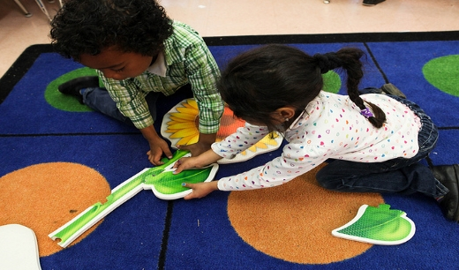
DRDP enables us to…
determine how children are benefiting from programs.
Notes:
Script:
The DRDP findings provide information for agencies to use to improve programs.
Information is shared with families during parent conferences to support parents in supporting the child’s progress.
Information can also be shared with the community to demonstrate how children benefit from involvement in the program.

Slide 6
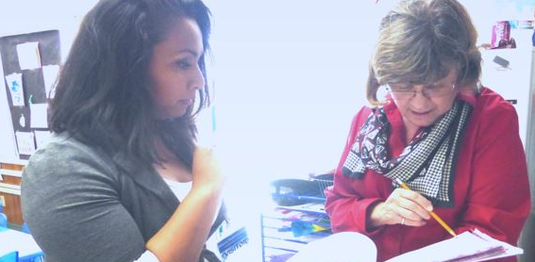
The DRDP Assists Providers
in meeting each child’s developmental needs in each classroom or family child care home.
Notes:
Script:
The DRDP documents the kind of work that quality programs are already doing every day.
As teachers learn more about the children in their care, the DRDP information assists them in adapting and modifying curriculum plans and activities for the individual child, as well as activities for small and large groups.

Slide 7

The DRDP provides…
a “snapshot” of the child’s development.
Notes:
Script:
Children grow and change quickly, so a completed DRDP is a “snapshot” (i.e., a representative moment in time) of a child’s development.
All succeeding observations will document changes that result from growth and progress.

Slide 8

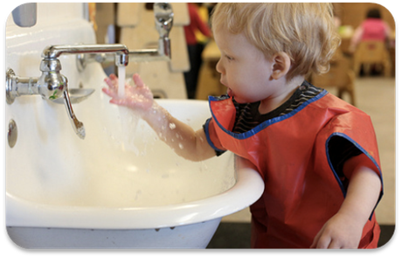

The DRDP provides a
framework for showing children’s progress over time
Notes:
Script:
Each age-level instrument provides a framework that serves in monitoring children’s progress throughout the program year.
There are a suite of DRDP instruments:
DRDP Infant/Toddler View
DRDP Preschool View
DRDP SA view and
DRDP K
Each profile provides guidance in documenting observations that reflect the developmental growth for each age group.

Slide 9
DSS Child Care Bulletins
In accordance with Senate Bill (SB) 98 (Chapter 24, Statutes of 2020), effective July 1, 2021, the following programs transferred to the California Department of Social Services (CDSS), Child Care and Development Division (CCDD)…
Notes:
Script:
General Child Care and Development Programs (CCTR) • California Family Child Care Home Education Networks (CFCC) • Programs for Children with Severe Disabilities (CHAN) • Migrant Child Care and Development Programs (CMIG) • Migrant Child Care Alternative Payment Programs (CMAP) • California Alternative Payment Programs (CAPP) • CalWORKs Stage 2 (C2AP) • CalWORKs Stage 3 (C3AP) • Resource and Referral Programs (CRRP) • Local Child Care and Development Planning Councils (CLPC) The California Department of Education (CDE), Early Education Division (EED) will continue to administer the CSPP, Inclusive Early Education Expansion Program (IEEEP), American Indian Early Childhood Education (AIECE) grant, and Early Head Start-Child Care Partnership grant awarded to the CDE by the United States Department of Health and Human Services, as well as other early education programs
https://www.cdss.ca.gov/Portals/9/Additional-Resources/Letters-and-Notices/CCBs/2021/CCB%2021-11.pdf?ver=2021-09-23-111708-210
If you are providing services to children with Individualized Education Programs (IEP) or Individualized Family Service Plans (IFSP), you are encouraged to visit the desired results access website to get additional information about training and specific requirements.

Slide 10
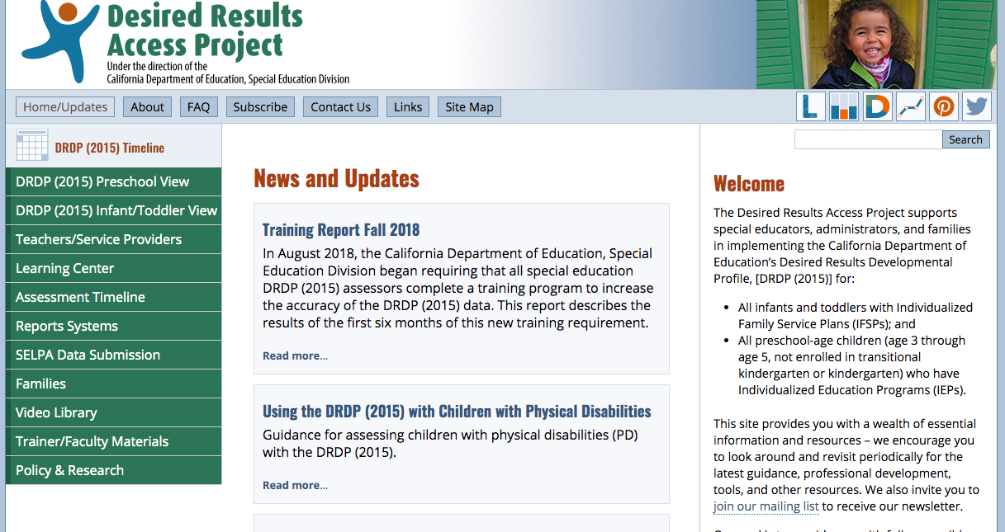
Desired Results Access Project
http://www.draccess.org
Notes:
Trainer note:
DR Access Project is a website to discover requirements specific to Special Education programs
Participants may have additional questions about DRDP Access. Encourage them to visit the website listed on the screen to get additional information.

Slide 11
DRDP Appendices
When children are served by both Early Education Division and Special Education Division programs, the teachers and specialists are to collaborate on one assessment following the more stringent timeline and handle DRDP data according to the requirements of each division.
Notes:
Script:
More details can be found in appendix A of the DRDP assessment.
Direct participants to appendix A and have them read and share about the two columns.

Slide 12

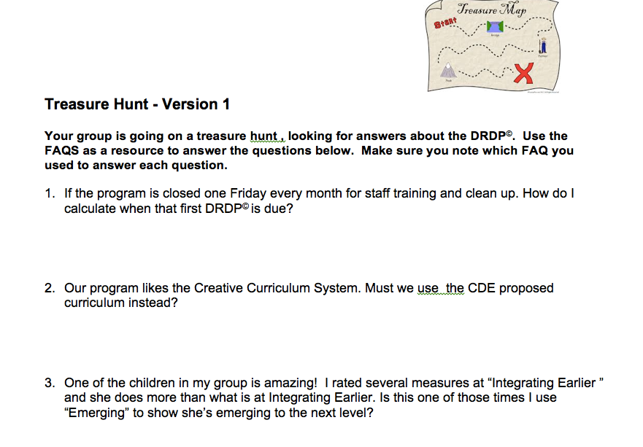
Treasure Hunt - Version 1
Notes:
Activity: Treasure Hunt

Slide 13

DRDP Guidelines
An age-appropriate version of the DRDP must be completed within 60 calendar days of the child’s enrollment and every six months thereafter.
60 calendar days and every 6 months thereafter
Notes:
Script:
An age-appropriate version of the DRDP must be completed for all children enrolled in a California state-funded center or family child care home network.
Trainer Note:
Clarify how often and when DRDPs are required to be completed. In CDSS programs Emphasize 60 calendar days from the enrollment date of children. Enrollment is typically determined to be the first date the child receives care.

Slide 14
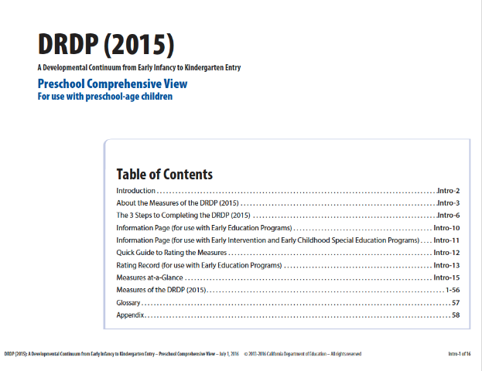
Teachers and staff need to be familiar with the DRDP
Notes:
Script:
Get to know the Desired Results, developmental domains, measures, definitions, developmental levels, and descriptors. Read through the introduction and appendices of the assessment for clarification.
The DRDP tool kit ideas, such as the mini-measures, are on the Desired Results website and are helpful in becoming familiar with the DRDP.

Slide 15
The DRDP was developed by the:
California Department of Education, Child Development Division (now Early Education Division)
WestEd Center for Child & Family Studies
University of California, BEAR Center
with valuable input from teachers and directors who participated in the research study
Notes:
Script:
WestEd and BEAR aligned the instruments and developed new measures.
BEAR provided overall direction for the study and summarized the data.
BEAR is the Berkeley Evaluation and Assessment Research Center.

Slide 16

DRDP Alignment
Notes:
Script:
The DRDP aligns with the:
Infant and Toddler Early Learning and Development Foundations
Preschool Learning Foundations, Volumes 1-3
Common Core Standards
Head Start Child Development and Early Learning Framework
Now let’s look at the instrument in more detail…

Slide 17
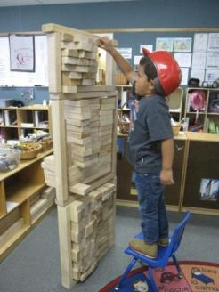
Build a Tower
Use the items on your table.
As a group, build a tower.
You have five minutes.
Notes:
Script:
Refer to DR-2015 Activity Sheet #3 – Build a Tower.
Have participants build a tower using any accessible material (cups, blocks, paper, etc.).

Slide 18
Key Points
What was your first step?
How did you know to start there?
What does this have to do with children’s learning?
Notes:
Script:
(This is the debrief slide.)
The purpose of the activity is to make a connection between having a foundation in order to support a structure. For us that structure is children’s learning. Our foundation is our California Preschool and Infant Toddler Learning and Development Foundations. These are important first steps in understanding child development and understanding the skills that children are capable of.

Slide 19

Why was it important to align the DRDP to the foundations?
To ensure we assess what we want children to learn and that it is aligned to what is appropriate for children of this age.
Notes:
Script:
The state has taken care to build a cohesive system.
The foundations describe children’s learning and development.
Thus it is important that we are assessing what we want children to learn, and that we align it to what is appropriate for children of this age.

Slide 20
What is the relationship between the DRDP and the foundations?
The foundations tell us how children, with adequate support, typically learn and develop.
The DRDP provides a structure and a tool for recording an individual child’s development and documenting progress.
All volumes of the California Learning and Development Foundations provide the research backing for the DRDP (2015).
Notes:
Script:
The developmental domains work in an integrated fashion to support all four Desired Results. Ways to use the foundations and DRDP together:
Read foundations at the beginning of the school year to understand development in a general way.
Complete the DRDP twice each year to see children’s progress.
Foundations provide the overall developmental landscape or backdrop. The DRDP helps determine where an individual child is on that backdrop.

Slide 21
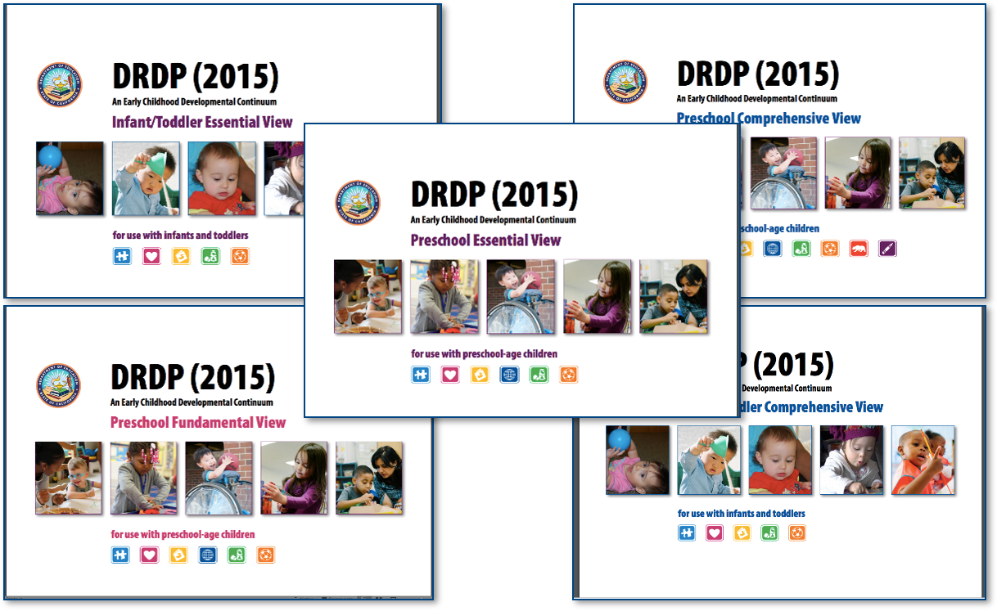
A Full Continuum Assessment
Notes:
Script:
The DRDP is a full continuum assessment. The same assessment is used for all children, including children with IFSPs and IEPs. There is one assessment and there are five views of this assessment. The measures, however, are the same. This means that ATL-REG 1 is the same measure in all views. The difference is the number of measures in the different views.
Infant/Toddler Comprehensive View has 5 domains and 29 measures.
Infant /Toddler Essential View 5 domains and 21 measures.
Preschool Comprehensive View has 8 domains and 56 measures, 10 of those measures are conditional.
Preschool Fundamental View has 6 domains with 43 measures, thirteen of those measures are conditional.
Preschool Essential View has 6 developmental sub domains and 29 measures
The fundamental view only pertains to preschool aged children. The essential views of the assessment do not meet special education requirements.. Agencies choose which view will be used to assess children.
To learn about what adaptations a child with an IFSP or IEP needs please collaborate with the child’s service providers.

Slide 22
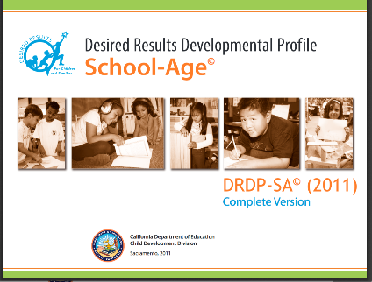

DRDP School-Age
6 domains
31 measures
2 domains
13 measures
Notes:
Script:
Programs may use either the DRDP-SA© (2010) Simplified Version or DRDP-SA© (2010) Complete Version.
Use the DRDP-SA© (2010) with school-age children from kindergarten through 12 years old, including those who have an individualized education program (IEP).
DRDP SA has two versions to choose from:
DRDP–SA complete version which has all 35 measures
DRDP-SA© (2010) simplified version, which has 2 domains with 13 measures.
The DRDP-SA©(2010) was simplified because the other areas were already being assessed during the school day (e.g., reading, math, etc.). The state of California felt it was still important to assess Self and Social Development as well as Heath and Safety.

Slide 23
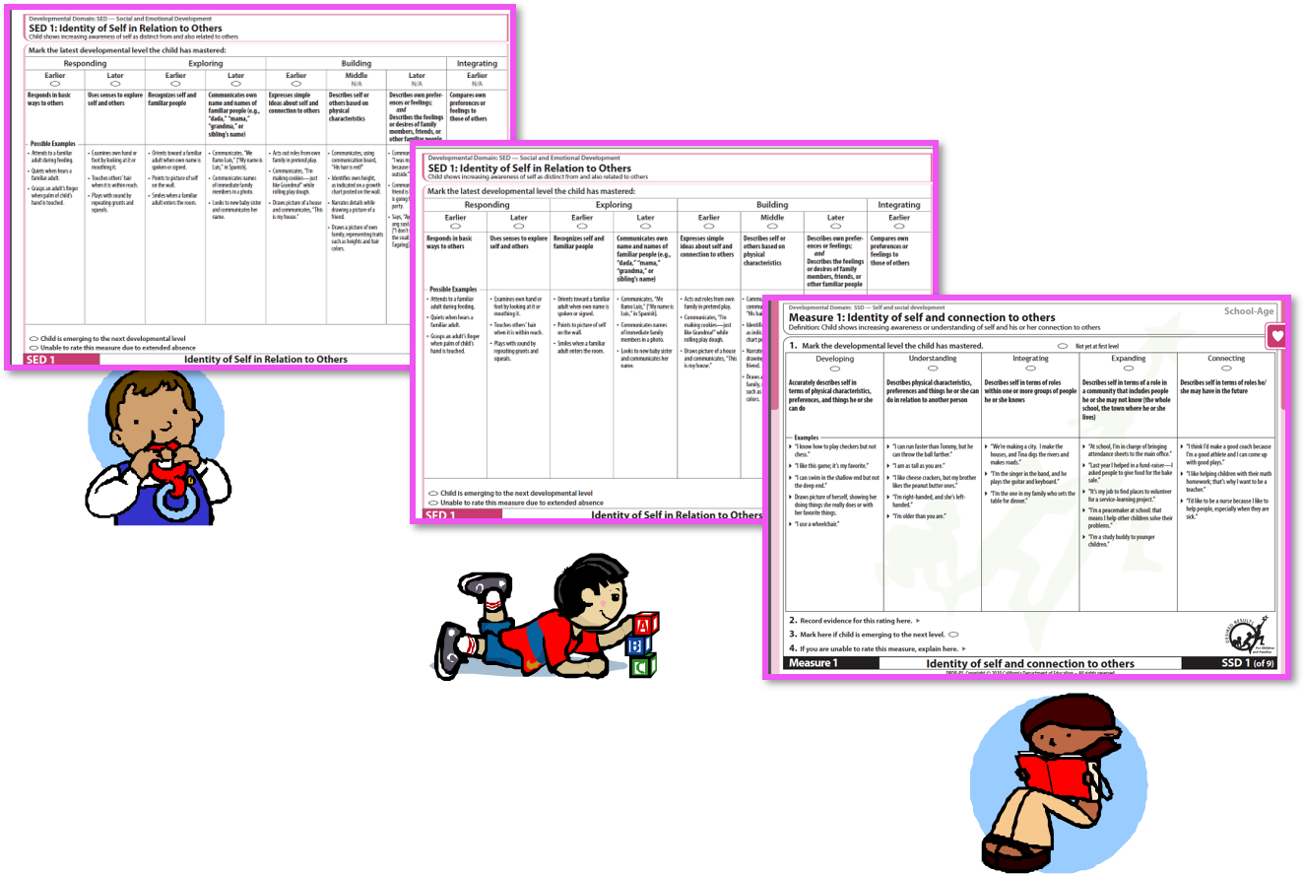
Compare and Contrast
Notes:
Activity: Compare and Contrast
Trainer Notes:
Point out the differences and similarities between the Infant/Toddler View and the Preschool View of the DRDP (2015).
Point out the difference in the School Age assessment (developmental levels, measures numbered consecutively).

Slide 24
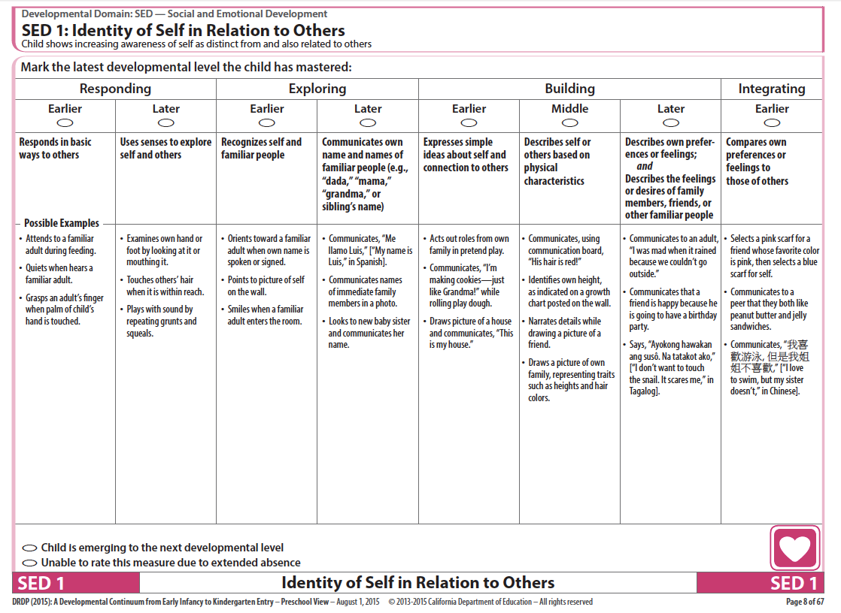
Navigation Map
Measure
Developmental Domain
Definition
Descriptor
Developmental Level
Example
Notes:
Script:
Let's look at all the elements of the DRDP measure page. Please fill in the empty boxes, as I click through the names. The back side provides the terms and definitions for the DRDP.

Slide 25

Remember, the examples listed…
are only a few ways a child might demonstrate a particular developmental level.
Notes:
Script:
The purpose of the examples is to help teachers clarify where the skills could be demonstrated, i.e., some ways a teacher might see the behavior.
Encourage staff to add examples of what they observe for the developmental levels.
The DRDP examples activity to do with staff is in the binder.

Slide 26
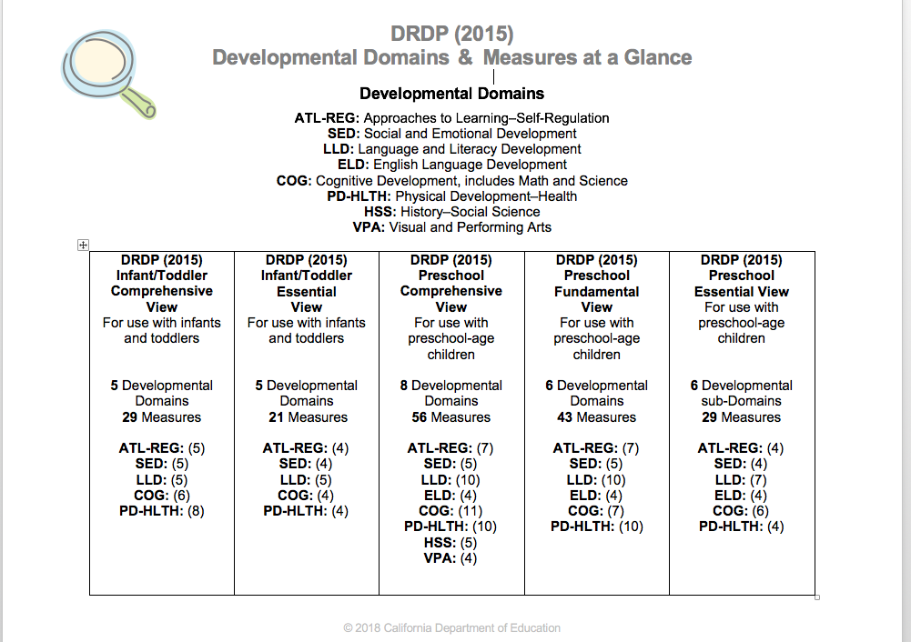
DRDP at a Glance
Notes:
Script:
The DRDP Domains and Measures at a Glance shows the developmental domains and number of measures in parenthesis for all age-level instruments:
29 measures in the DRDP I/T Comprehensive View
21 measures in the DRDP I/T Essential View
56 measures in the DRDP Preschool Comprehensive View
43 measures in the DRDP Preschool Fundamental View
29 measures in the DRDP Preschool Essential View
55 measures in the DRDP-K Comprehensive View
37 measures in the DRDP-K Fundamental View
33 measures in the DRDP-K Essential View
25 measures in the DRDP-K Snapshot View
DRDP-SA Complete Version has 31 measures and the DRDP-SA Simplified Version has 13 measures

Slide 27
The Four Ds
        Domains
The Four Ds
        Definitions
        Developmental levels
        Descriptors
LOOK to the 4 Ds:
Domains, definitions, developmental levels, and
descriptors to clarify the intent of each measure.
Notes:
Script:
These are the four components of the DRDP – the 4 Ds.
Trainer Note:
Review the 4 Ds and emphasize that reading these components can assist staff in knowing the intent, or purpose, of each measure.
The domain represents a crucial area of learning and development for children.
The definition specifies the aspect of development that is being observed.
The descriptor describes observable child behaviors associated with that developmental level.
The developmental levels for each measure represent a developmental continuum.

Slide 28
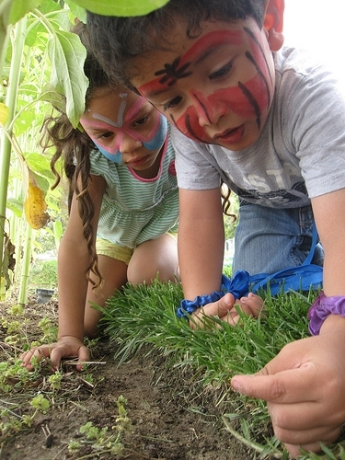
The DRDP is an
Observation-based assessment instrument
Notes:
Script:
We will focus on observation skills, rating the DRDP, collecting DRDP data, the Summary of Findings, and the Child’s Developmental Progress form.

Slide 29

The Power of Observation
“Getting to know children as people and as learners gives you the information you need to be an effective decision maker in the classroom.”
The Power of Observation
Notes:
Trainer note:
Share the quote and show the book, The Power of Observation, if available.
Click to next slide.

Slide 30
Motivation
“With the information you learn from observing, you can:
select the right materials,
plan appropriate activities, and
ask questions that guide children in learning to understand the world around them.”
The Power of Observation
Notes:
Script:
The state of California requires programs to use the DRDP for assessment as a motivator. The real reason we use observation is to get to know children.
Through observation, we get to know how children learn best, their strengths, need for support materials, and language. In addition, it helps teachers plan engaging activities to help children progress in their development.
Observation is a skill that can be learned and gets easier with practice. The observations we make should provide good information to inform our ratings on the DRDP.
The next activity will assist in writing meaningful anecdotal notes.

Slide 31

Develop Methods for Recording Observations and Collecting Evidence
Anecdotal records
Photographs
Audio and video records
Running records
Sketches
Work samples
Daily logs
Frequency counts
Notes:
Script:
Before teachers can rate the DRDP, they need to collect relevant information about the children.
Once teachers know the “what”, “when,” and “how,” they are ready to plan to observe, record, and collect evidence on children’s typical behaviors.
Teachers and staff can collect a wide variety of documentation, such as anecdotal notes, work samples, frequency count sheets, and photos to provide evidence of mastered developmental levels across all of the measures.
Enlist all teachers, support staff, and parents to contribute documentation for the children’s portfolios. We know that teachers who are successful in implementing an observation-based assessment, plan for observations.
Trainer Note:
Remind participants to look at the gallery during breaks for samples.

Slide 32
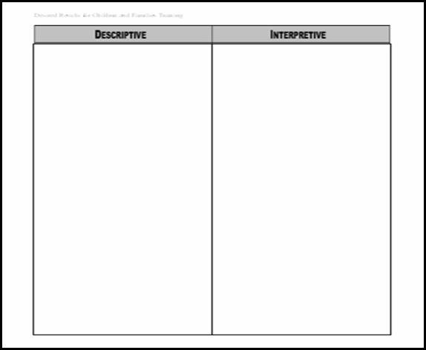
Noticing Descriptions and Interpretations
Notes:
Activity: Noticing Descriptions and Interpretations

Slide 33
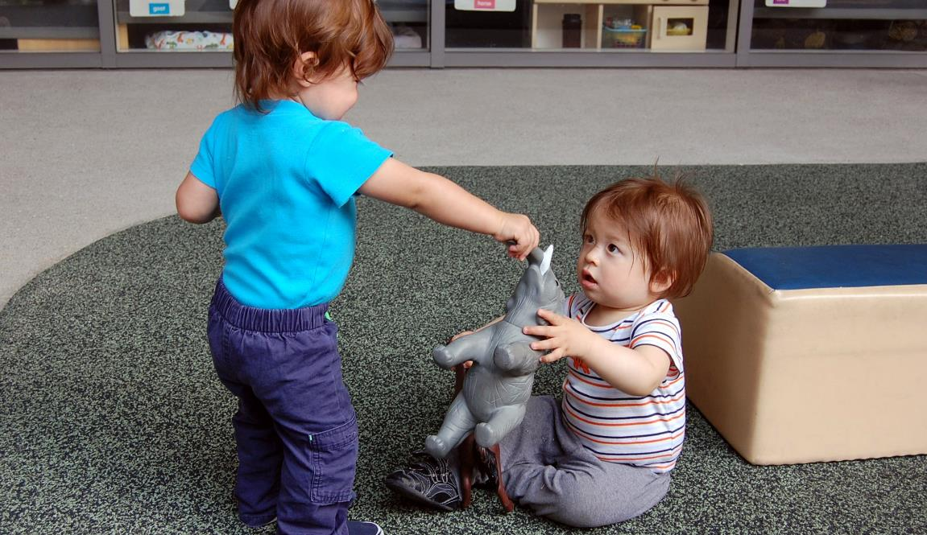
Still Photo Observation
Adapted by permission, The Art of Awareness © 2000 Deb Curtis and Margie Carter, Redleaf Press. St. Paul, Minnesota, www.redleafpress.org.
Notes:
Trainer Note:
Keep this slide up during the activity.

Slide 34
Definitions: Descriptive and Interpretive
Descriptive
Interpretive
What are the specific details?
What you actually…
  Observed
  Read
  Heard
Example: He is holding shirt with one hand and pen in other hand.
What were your initial reactions?
How you felt about what you…
  Observed
  Read
  Heard
  Example: He looks worried.
Notes:
Script:
This is a reminder of what quality notes have.

Slide 35

Steps to Completing the DRDP
Notes:
Script:
The next section of the presentation provides the steps to completing the instrument. (There is a tutorial on the Desired Results website on completing the DRDP.)

Slide 36
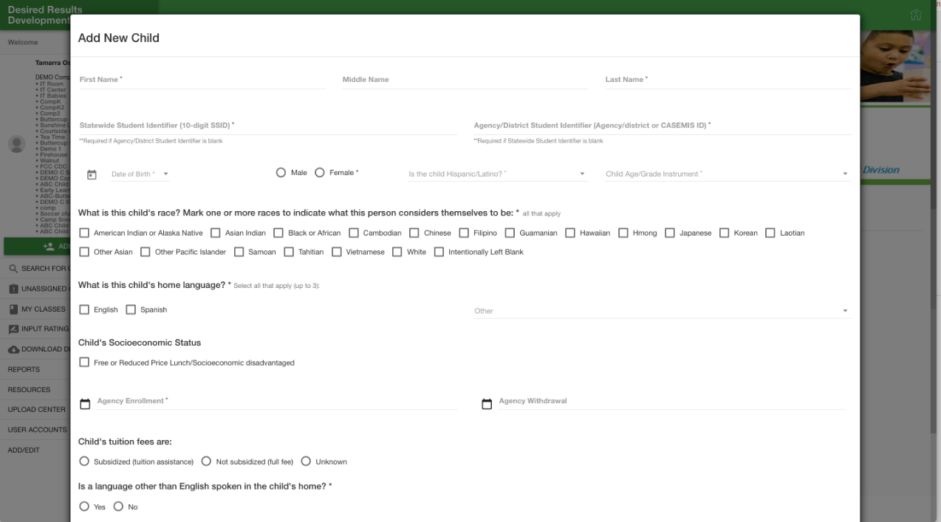
Complete the Information Page
Notes:
Script:
One of the first steps is to enter children into the DRDP Online system.
The Child Record will need to be completed for all children.
Ensure that the date of assessment is within 60 days of the child’s enrollment.
Administrators can edit the information page when necessary in DRDP Online.
A tutorial, Steps to Completing the DRDP, is available on the Desired Results website.
Micro learning videos are available on YouTube.

Slide 37
The Four Ds cont.
        Domains
The Four Ds
        Definitions
        Developmental levels
        Descriptors
LOOK to the 4 Ds:
Domains, definitions, developmental levels, and
descriptors to clarify the intent of each measure.
Notes:
Script:
One of the first steps is to become familiar with the components of the assessment.
The 4 Ds of the DRDP assessment instrument are crucial to helping staff clarify the intent, or purpose, of each measure.
The domain represents a crucial area of learning.
The definition specifies the aspect of development that is being observed.
The developmental levels represent a developmental continuum. Each level specifies a point along the developmental continuum.
The descriptors provide the behaviors and/or skills you must see the child demonstrating with mastery to rate at that developmental level.

Slide 38

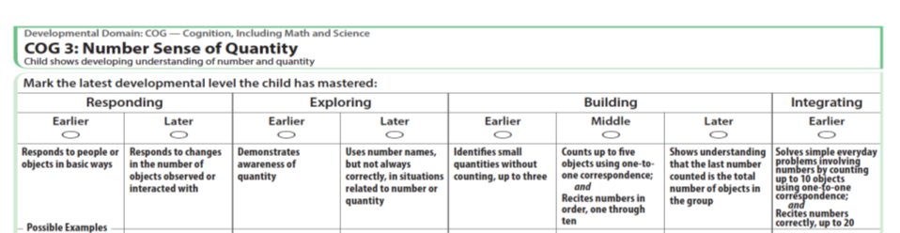
A Deeper Look at the Descriptors
Each developmental level has a descriptor that defines the behaviors that would be observed if a child were at that developmental level.
Descriptor
Notes:
Script:
The descriptor can be found right under the developmental level, in every measure.

Slide 39


Using the Descriptor
If the descriptor has ; followed by and, the child must demonstrate all the behaviors, but not necessarily during the same observation.
Notes:
Script:
The language inside the descriptors is very important.
If the descriptor has a ; AND the child must demonstrate all the behaviors, but not necessarily during the same observation.
For example, if the descriptor says walk; and skips, the child needs to exhibit both behaviors. He could walk today and skip tomorrow.

Slide 40
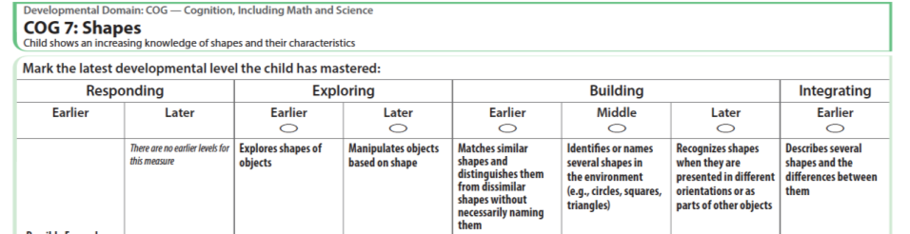
When the Descriptor Says AND
If the descriptor says and, then the child must be able to demonstrate all of the behaviors during the same observation.
Notes:
Script:
But if the descriptor says AND, then the child must demonstrate all the behaviors during the same observation.
For example, if the descriptor says, “walk AND skip,” the child needs to walk and skip in the same observation.

Slide 41
Using the Descriptor Cont.
If the descriptor says or, a child only needs to demonstrate the behavior in one of the listed ways.
Notes:
Script:
If the descriptor says or, a child only needs to demonstrate the behavior in one of the listed ways.

Slide 42

A Deeper Look at the Descriptors
Look at COG 3 and COG 7.
Read each descriptor carefully:
  Circle the word or
  Highlight ; followed by AND
  Underline AND (when it connects two skills)
Did you get them all?
Notes:
Refer to Activity Sheet #6 – A Deeper Look at the Descriptors
Script:
Now we are going to practice.
It’s important to understand what the descriptors are asking you to observe. As you read the descriptor think about what skills you are looking for. Are they asking you to observe a specific skill? Are they asking you to observe the child displaying more than one skill? Read through each descriptor for each measure and circle the ORs, highlight the ;ANDs, and underline the AND in the descriptors.
Turn to COG 3 and COG 7 and circle the ORs, highlight the ;ANDs, and underline the AND in the descriptors (only in descriptors).
Now that we are done, turn to COG 3. How many ORs did you find? How many ;ANDs? How many ANDs?
Trainer note: Repeat this for COG 7.

Slide 43
Cognition Sample
Notes:
Script:
Administrators can show their own video and have staff analyze the descriptors. See activity sheet - Deeper Look at Descriptors.

Slide 44
A Deeper Look at the Descriptors
What is the child able to do?
Look at COG 3 and COG 7 and their descriptors.
Which parts of the descriptors can the child do?
Notes:
Script:
Remember we are not rating. We are looking at the child’s behavior to see how those behaviors may be related to the descriptors.
What did you see the child do? What did the child demonstrate during the clip?

Slide 45

Developmental Level Activity
Where are you in your development…as a cook?
Notes:
Script:
This practice model is a playful creation to assist staff in considering how circumstances may change behaviors - not just developmental progress.
Trainer Note:
Explain that now the training will move to learning more about developmental levels in the DRDP.
Read slide… “Where are you in your development…as a cook?”

Slide 46
Mastery
Notes:
Trainer Note:
Ask participants to raise hands or stand up to show pride for the highest level of “mastery” attained. Think about their behaviors in the last 60 days and choose one level that describes mastery of their skills.
It does not matter where the participants are on the continuum, as each one is making continuous progress towards the desired result!

Slide 47

Lunch Break
Notes:
Take a 15-minute break.
Trainer Note:
Remind participants to check out the gallery.

Slide 48
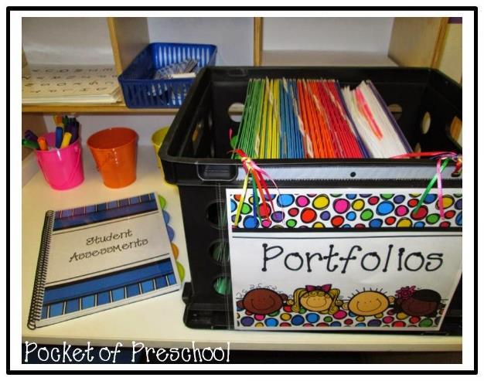

Review the collected evidence and reflect on the child’s development
Notes:
Script:
As the due date to complete the DRDP nears, review the collected evidence to ensure documentation exists to support the developmental level the child has mastered.

Slide 49
How do children demonstrate a developmental level is mastered?
A developmental level is mastered when the child typically demonstrates the behavior(s)
    Consistently over time
    In different situations or settings
Notes:
Trainer note:
Read the slide. Give pause to let participants think about the criteria for “mastered.” Suggest participants make a poster to put around the center to help staff learn this as a mantra.

Slide 50
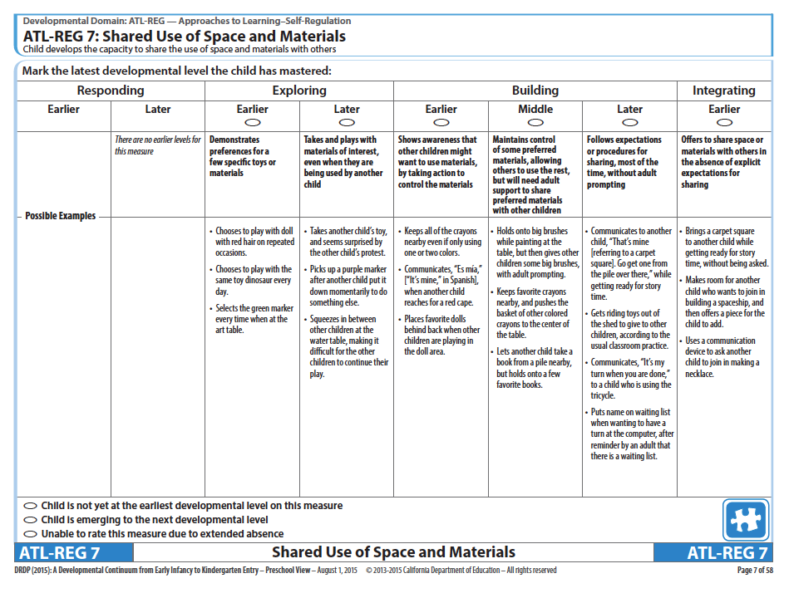
Based on observations, fill in one bubble that best describes the child’s latest developmental level mastered
Notes:
Script:
Based on observations, fill-in one bubble that best describes the child’s latest developmental level mastered.

Slide 51
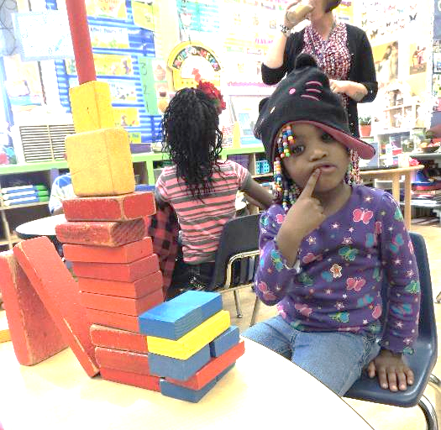
Is the child emerging?
After marking the developmental level mastered, ask “Is the child emerging to the next level by demonstrating behaviors from the next developmental level, but not yet typically or consistently?” If so…
Notes:
Script:
After marking the developmental level mastered, ask “Is the child emerging to the next level by demonstrating behaviors from the next developmental level, but not yet typically or consistently?” If so…

Slide 52
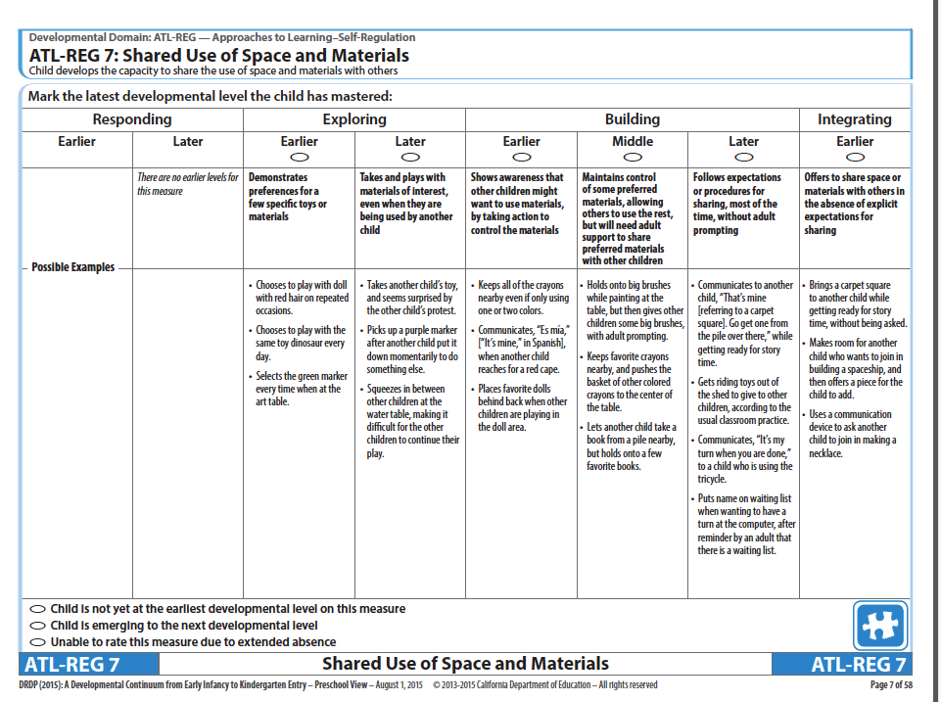
Emerging
Notes:
Script:
After marking the developmental level mastered, consider if the child is beginning to sometimes demonstrate behaviors from the next level. As compared to mastered behaviors which are consistent, emerging behaviors are not yet typical or consistent.
If you determine that the child is emerging to the next level, you may mark the bubble labeled, emerging.
Using the emerging bubble is optional and up to the individual teacher.
If the child is at the last developmental level, do not rate the child as emerging to the next level.

Slide 53
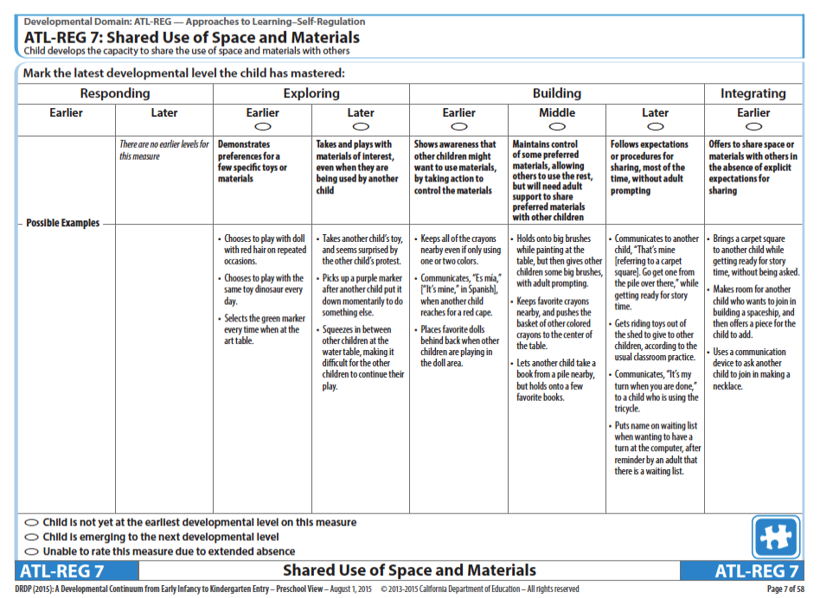
Not Yet at the Earliest Developmental Level
Notes:
Script:
Not yet at the earliest developmental level means that you do not see mastered skills or behaviors that would allow you to mark the first developmental level.
Note that the not yet at earliest developmental level bubble is not available in the infant/toddler instrument because that instrument begins with the reflexive stage which children typically evidence at birth.

Slide 54

Unable to Rate
Notes:
Script:
In the rare circumstance that you are unable to rate a child on a specific measure, explain in detail the reason for a lack of rating in the box at the bottom of the page.
Unable to rate is only used for extended absences.

Slide 55
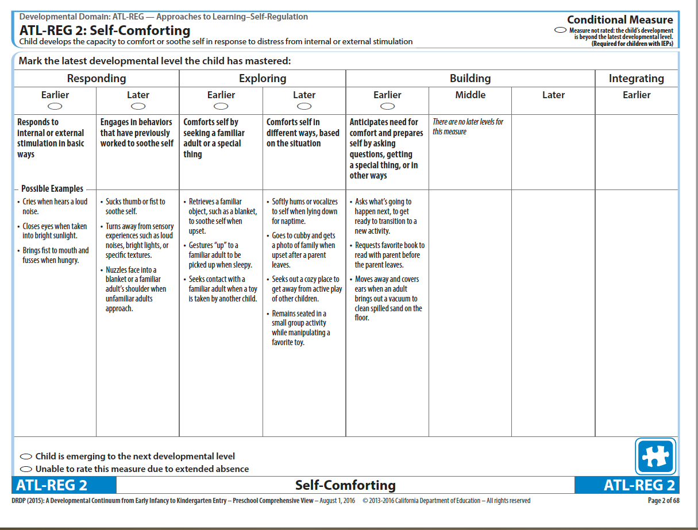
Conditional Measures
Notes:
Script:
Some measures in the DRDP are considered conditional measures that are only assessed when certain conditions are met.
Conditional measures should be used if they assist teachers and service providers in planning a child’s learning activities and supports, and documenting progress.
There is a short microlearning video on YouTube to explain conditional measures

Slide 56
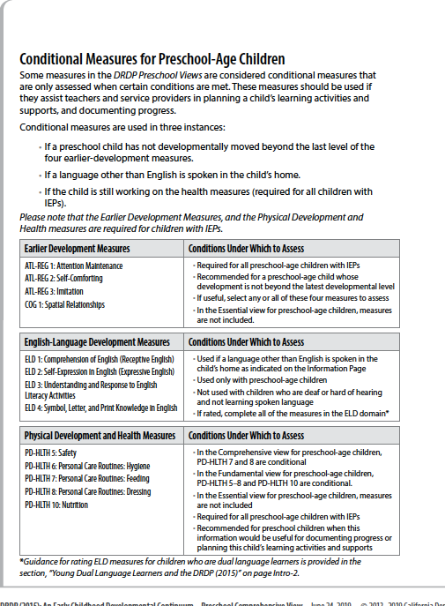
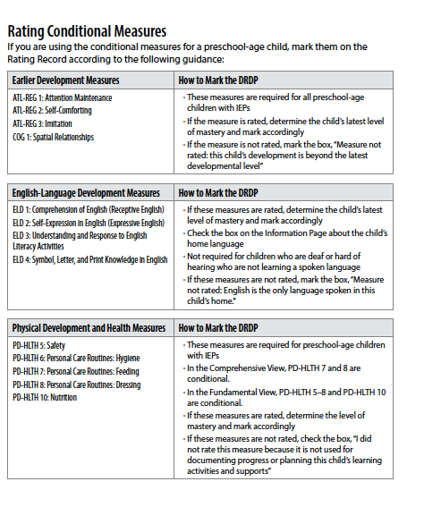
Conditional Measures
Notes:
Trainer Note:
Refer to the charts on Intro 4 and Intro 9 for more information.
Also refer to YouTube video.

Slide 57

Preschool English-Language Development Measures
Notes:
Script:
The DRDP (2015) Preschool View instruments contains four measures for English-language development.
(There are ELD tutorial on the Desired Results website.)

Slide 58
English-Language Development Measures
ELD 1: Comprehension of English (Receptive English)
ELD 2: Self-Expression in English (Expressive English)
ELD 3: Understanding and Response to English Literacy Activities
ELD 4: Symbol, Letter, and Print Knowledge in English
Notes:
Script:
The four English-Language Development measures used for children learning English are:
ELD 1: Comprehension of English (Receptive English)
ELD 2: Self Expression in English (Expressive English)
ELD 3: Understanding and Response to English Literacy Activities
ELD 4: Symbol, Letter, and Print Knowledge in English

Slide 59
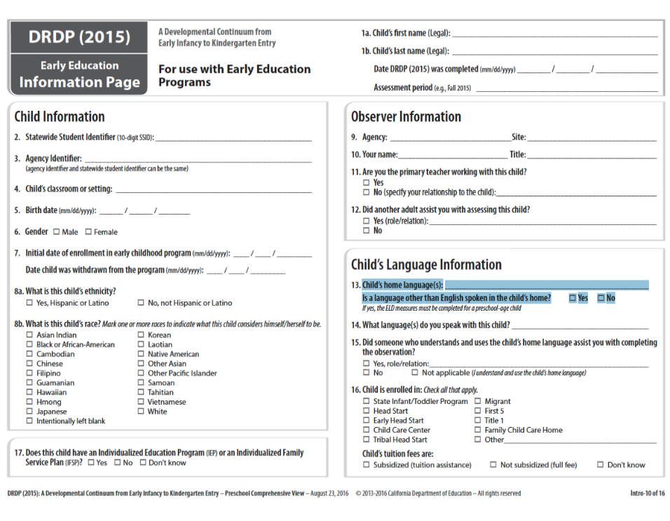
Child’s Language Information
Notes:
Script:
On Intro 10, question #13 gives directions on when to use the ELD measures.
If a language other than English is spoken in the child’s home, the ELD measures must be completed for preschool age children.

Slide 60
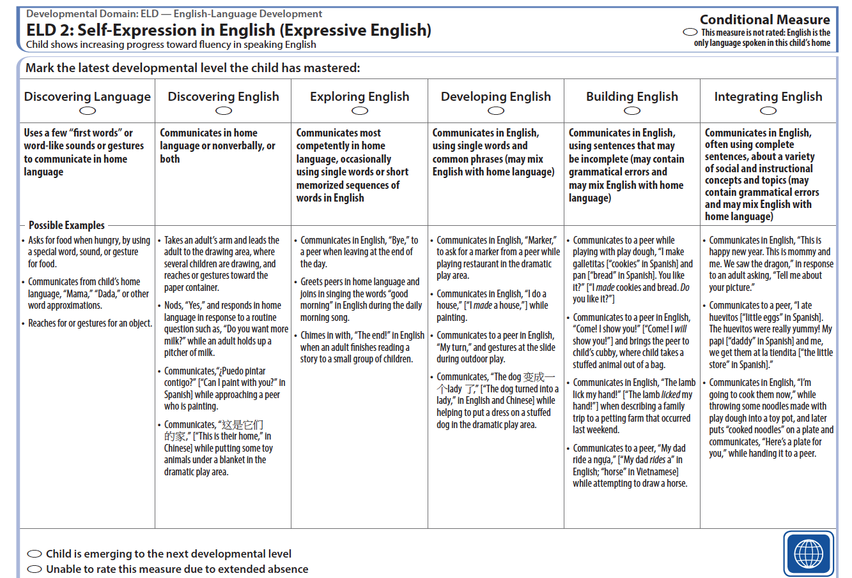
The Developmental Levels for ELD
Notes:
Script:
The descriptors in the first two levels (Discovering Language and Discovering English) refer to the child's use of their home language.

Slide 61
Assessing Children Who Are Dual Language Learners
Notes:
Script:
In the folder is the handout Assessing Children Who are Dual Language Learners, which explores code switching.
Give teachers time to read the handout (8-10 minutes) and circle what is important to them.
Ask, “What are some things that stood out to you from the handout?”
Use chart paper to chart responses about code switching.

Slide 62
Code Switching
Typical of dual language development
Use of multiple languages in one conversation
Uses grammatical rules of each language (at the 3 and 4-year-old level of course!)
Influenced by context and purpose
Notes:
Script:
What we observed the children doing is code switching. What is code switching?
Typical of dual language development
Use of multiple languages in one conversation
Uses grammatical rules of each language-of course at the three and four-year-old level!
Influenced by context and purpose

Slide 63

Key points for LLD & ELD
LLD is used with all children to measure progress in their home language.
ELD is used with any child where a language other than English is spoken in the home.
Notes:
Script:
The Language and Literacy Development measures are used to assess progress in developing foundational language and literacy skills. These measures are used with all children. Children who are dual language learners may demonstrate mastery in their home language, in English, or in both. This is true not only for Language and Literacy Development, but for all other domains as well, except for the English Language Development domain.
The four English-Language Development measures are used to document and assess progress in learning to communicate in English. These four measures are used if a language other than English is spoken in the child’s home.
Communication in all languages the child uses should be considered when collecting documentation and completing the measures in all domains.
Refer to Intro 6 and the appendices for more information on Assessing Dual Language Learners.

Slide 64
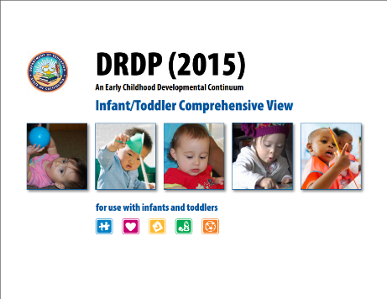


Completing a Developmental Profile
Notes:
Activity: Completing a Developmental Profile

Slide 65

Into Practice
DIRECTIONS:
Review all evidence.
Reflect on what the evidence shows.
Complete the DRDP.

Slide 66
The Child’s Developmental Progress form is designed to…
Describe the child’s development to parents
Engage parents as partners in supporting curriculum objectives for the child
Assist in determining curriculum objectives to support the child’s development
Complete twice per year prior to the parent conference
Notes:
Script:
A progress form is used during parent conferences to describe children’s development and growth.
The progress form provides a review of the child’s strengths, areas that need improvement, and goals for developmental growth in the program and at home.
The information teachers write on the form is based on the DRDP, observations, work samples, and other evidence from the child’s portfolio, as well as information provided by parents.

Slide 67
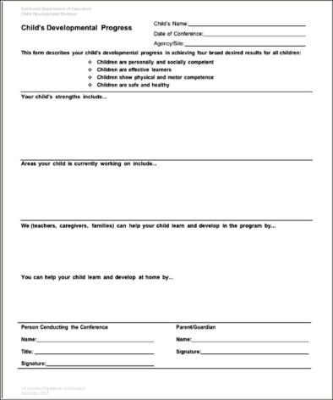
Child’s Developmental Progress Form
Notes:
Script:
This format may be used to encourage a conversation with parents about their role as the child’s first and most important teacher and stress the importance of the parents’ involvement and participation in the process of the child’s learning and growth.
Teachers are also encouraged to use the parent report from DRDP Online to supplement the Child Developmental Progress form.
Scheduled parent conferences are to occur at least two times each program year.

Slide 68
Completing the Child’s Developmental Progress Form
DIRECTIONS:
Summarize DRDP findings
List:
  3 strengths
  1 area for improvement
  A way the program helps
Notes:
Activity: Completing a Child’s Developmental Progress Form

Slide 69
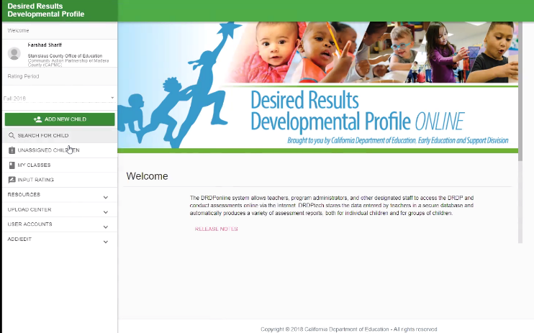
DRDP Online
*Now required of all California programs*
Get information about DRDP Online on the Desired Results website: www.desiredresults.us
Notes:
Script:
DRDP Online accounts are free for CDE/DSS funded programs, Head Start programs, California tribal CCDF, and for California K-12 school districts and all programs associated with California Quality Counts.
There are many free tutorials and webinars available to support implementation of DRDP Online.
Program staff may schedule an appointment for support or join free webinars: https://www.desiredresults.us/drdp-online-resources

Slide 70
DRDP data is compiled by…
Individual child
Classroom
Contract
DRDP Online
Commercial software programs
Notes:
Script:
Data on the DRDP is collected first at the individual child level, then at the classroom level, and then compiled at the contract level.
DRDP Online provides an online system of tools for summarizing DRDP data.
Although the individual child and classroom data is kept on site and is not sent to CDSS, it will be reviewed during your CPM/CMR. This data is also compiled and used to complete the Program Action Plan.

Slide 71
What is DRDP Online?
An online data entry system
An easy way to compile information about your students
Tool for printing out summary reports
Notes:
Script:
Teachers can complete the DRDP assessment using the DRDP Online system, via the internet using a password and username. The system allows for automatic storage of DRDP data. It also allows programs to be completely paperless when completing the assessment. The data entry system compiles all the data and provides multi level summary reports by student, or by group, and even subgroup that can be shared with families and administrators.

Slide 72
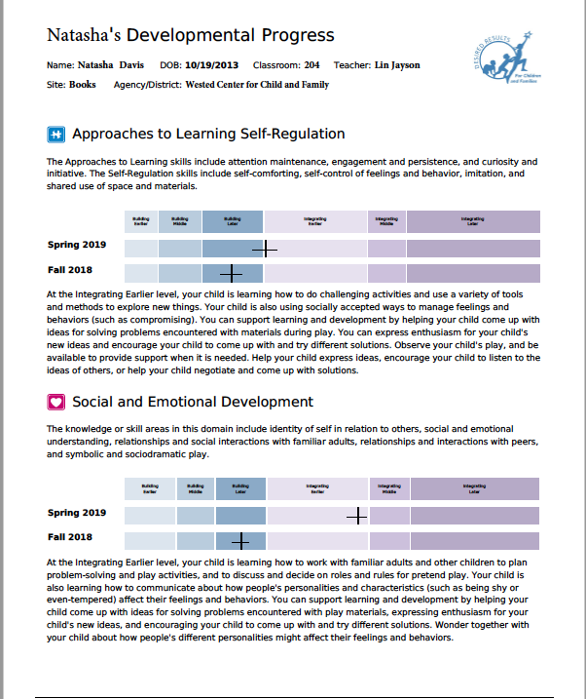
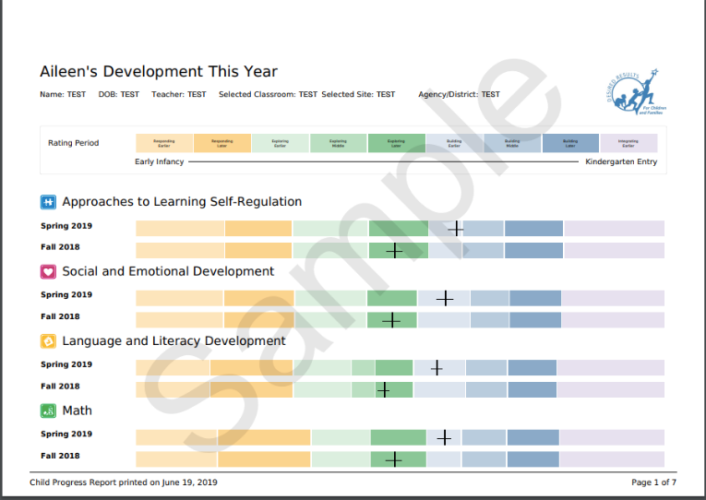
Child Reports
Notes:
Script:
The child development this year report, shows the child's overall developmental level in each separate domain. Child Report–provides psychometrically valid domain level information for individual children. Teachers can use this information to visually see where children are strong in their development and where they may need additional support.
Psychometric measurement is how the DRDP Online system calculates the correct distances of growth from one developmental level to the next.
“The Parent Report provides information from the DRDP assessment about your child’s knowledge, skills, and behaviors across a range of areas of development, called domains” (Parent Report Guidance for Teachers, California Department of Education).
The parent report does not specify the strengths or the areas of growth for children, it provides generic statements in the box that are helpful. But teachers must add to the boxes to individualize the information for that specific child.
Parent reports should be discussed with families, not just printed and handed out.

Slide 73
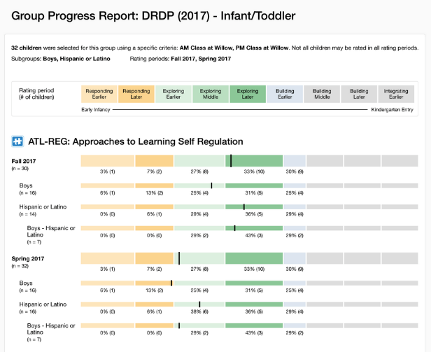
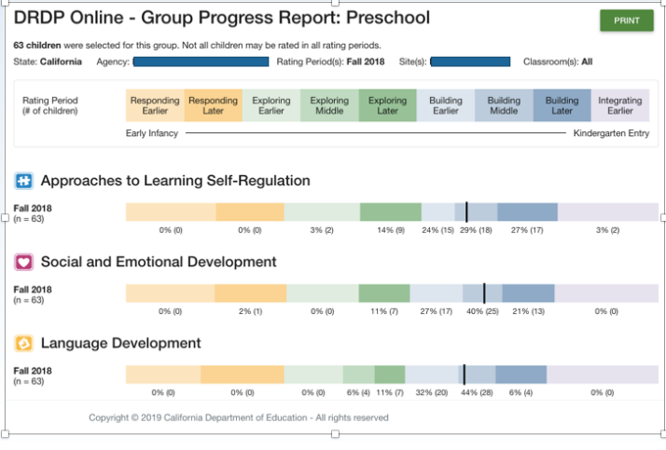
Group Report
Notes:
Script:
The Group Progress Report provides information on one rating period for an agency, program, site or classroom. The Group Cohort Report will show subgroup data along with the overall group data. The data will be available for all the domains completed by the program.
Teachers may use this information in their classroom to provide specific strategies to meet the needs of their groups. Administrators may use the Group Report to analyze data across the program and use the information to provide professional development or make changes for program improvement.

Slide 74
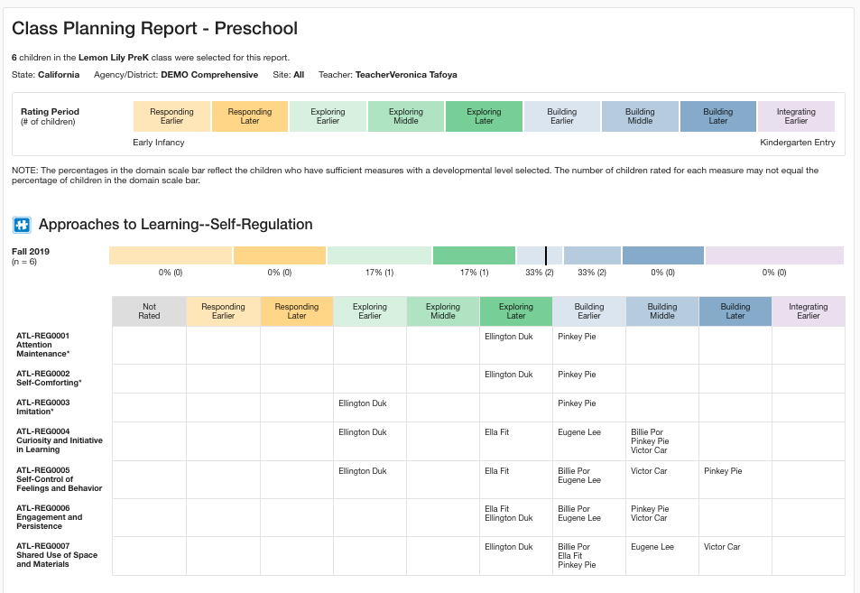
Class Planning Report
Notes:
Script:
The Class Planning Report helps teachers to modify instructional planning and meet individual needs.
Each report has the domain score of the specific domain at the top with numbers and percentages. Below that bar are all the measures within that domain and where each individual child was rated for each measure.

Slide 75

What are the Curriculum Frameworks?
School-age frameworks available on CDE Website
Notes:
Script:
After compiling your data, action steps must be written to address the data.
The Curriculum Framework chapters provide information to support children's learning in the areas described in the California Learning and Development Foundations.
The icons and their colors are used to identify domain sections inside of the book. We will look at the sections of the book on the next slide.

Slide 76
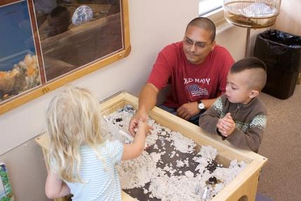
What does the framework do?
“Created as a companion to the California Preschool Learning Foundations, Volume 1, this framework presents strategies and information to enrich learning and development opportunities for all of California’s preschool children” (Preschool Curriculum Framework, p. v)
Notes:
Script:
There is a companion Curriculum Framework for each volume of the California Learning and Development Foundations.

Slide 77
Tips When Planning
Review current curriculum to find links with the DRDP.
Summarize children’s progress by reviewing, discussing, and consulting with others who know them.
Reflect on your collection of observations, including photos, notations, audio tapes, sketches, etc.
Consult other resources to support planning for the needs of children’s developmental levels.
Notes:
Script:
It’s important to plan to observe. When planning an activity for children, think about what to plan in relation to the DRDP. This does not mean setting up a testing situation, rather creating an invitation for children to have interactions with materials, their peers, or an adult that might provide an observation opportunity related to the DRDP.

Slide 78

All teachers…
must use the results of assessments of children’s progress to support each child’s learning and development.
Notes:
Script:
All teachers, whether teaching in a Head Start or state preschool program, must use the results of the DRDP to support each child’s learning and development.

Slide 79
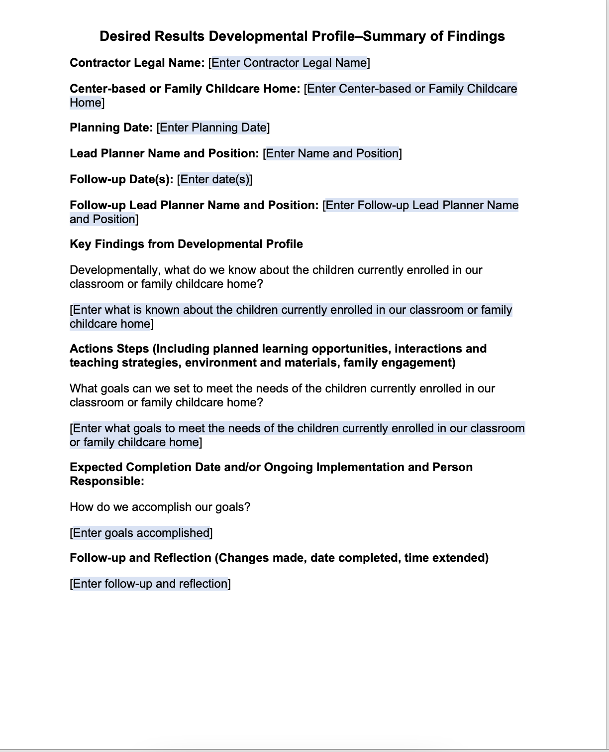
DRDP Classroom Summary of Findings
Notes:
Script:
Programs are required to summarize the data both at the classroom and contract level to determine key findings and action steps. These are trends or main points that require action. Think about where teachers want to see change or progress for the children in their class based on their data. Where will you put time, energy, and resources to see change?
Trainer note:
After sharing, ask participants to view the sample DRDP Classroom Summary of Findings.
These findings will inform administrators and guide them in making continuous program improvements.
California state consultants will be checking the DRDP Classroom Summary of Findings forms to make sure programs are using the data to inform the “continuous improvement” process.

Slide 80
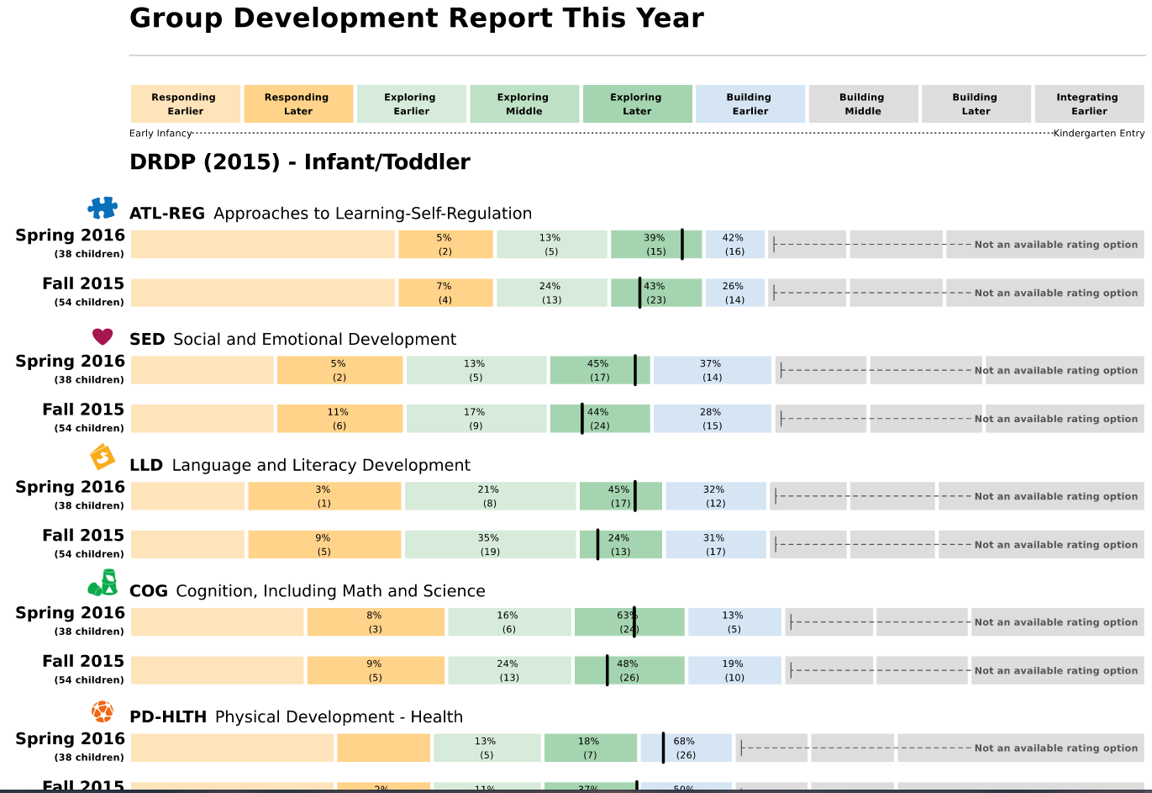
Small and Large Group Planning
Use the data provided from DRDP Online to plan for individual children, as well as for small and large group activities.
Notes:
Script:
This is one example of what the data may look like. This is a Progress this Year report. In your classroom or agency planning process, you would look at the DRDP data that is provided through your DRDP Online reports to support planning for the groups of children in your own classroom.

Slide 81
Writing a DRDP Summary of Findings
DIRECTIONS:
Review narrative and DRDP Group Data Summary.
Identify key findings.
Draft action steps.
Notes:
Activity: Writing a Summary of Findings

Slide 82
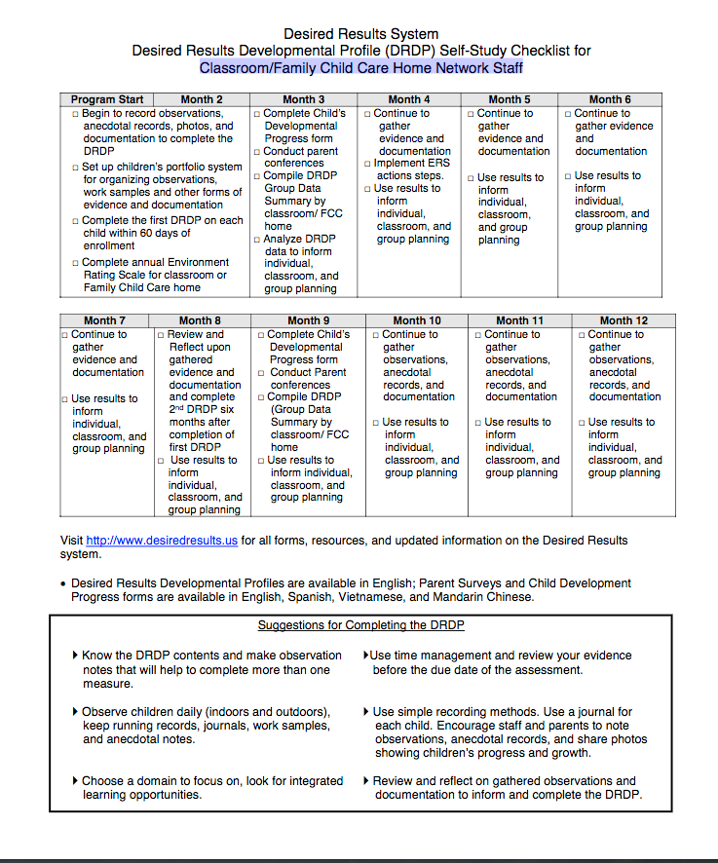
Self-Study Checklist
Use the
Self-Study Checklist for Classroom/Family
Childcare Home
Network Staff
to plan classroom/group
calendar
Notes:
Script:
Let's create a calendar of how we collect and organize documentation, when the first DRDPs are due, and when to complete the classroom summary of findings.

Slide 83
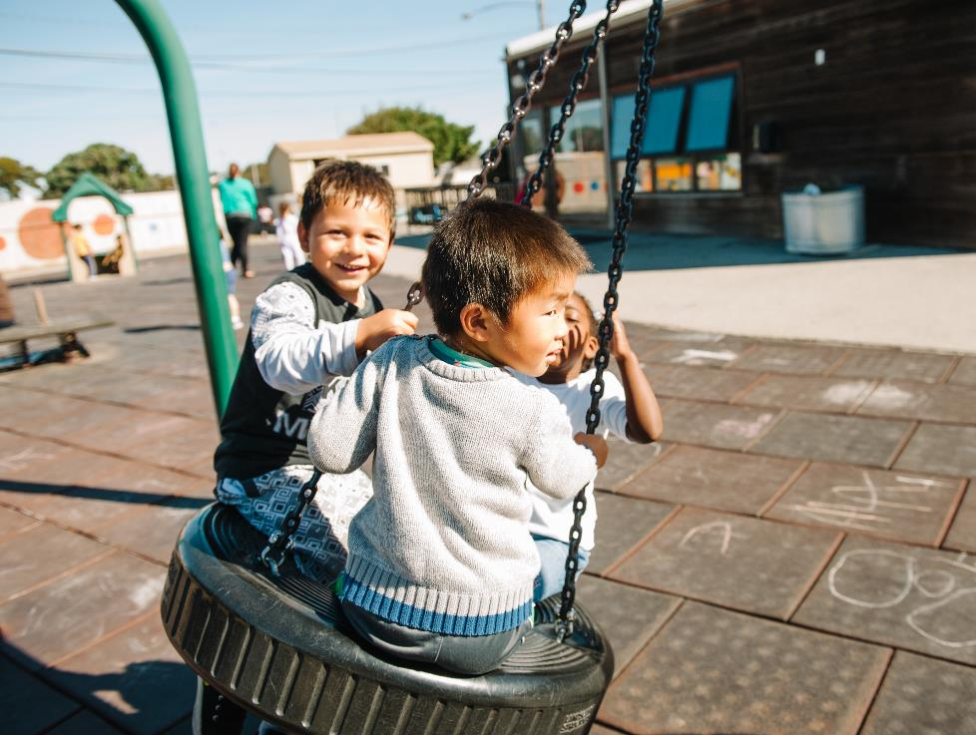
Thank you!

