Slide 1
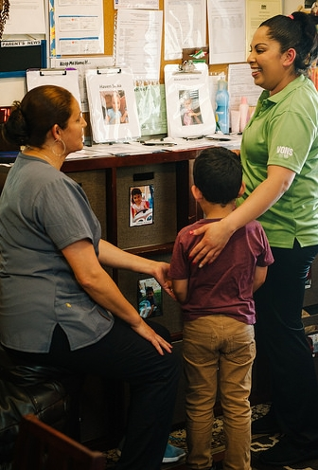
Session IV: Desired Results Parent Survey
Notes:
In this session, participants will learn about the Parent Survey form. They will also learn how to group the data from the surveys in a summary.

Slide 2
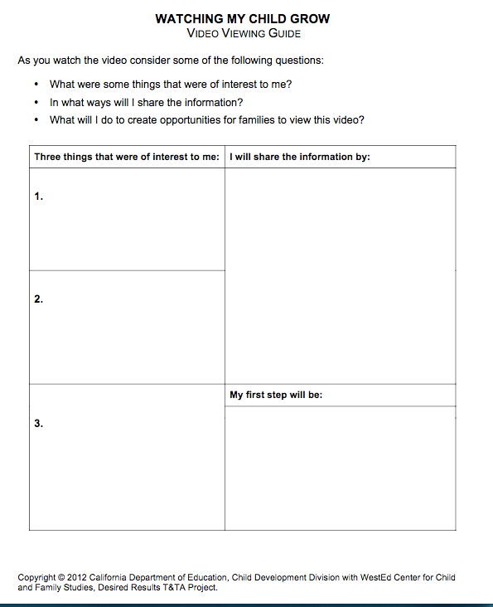
Watching My Child Grow
Complete the Video Viewing Guide.
Notes:
Activity: Watching My Child Grow

Slide 3
The Desired Results Parent Survey
Determines parent satisfaction with their child’s program
Provides information about how parents are achieving their goals
Gives programs access to information from parents to use to improve program quality
Is conducted at least once per year
Notes:
The Parent Survey was designed to collect information on how well each program supports the following two desired results for families:
Families support their children’s learning and development.
Families achieve their goals.
The Parent Survey provides a uniform procedure for getting information on the same set of issues from parents. It also gives programs new insights that can be used for improving program quality.

Slide 4
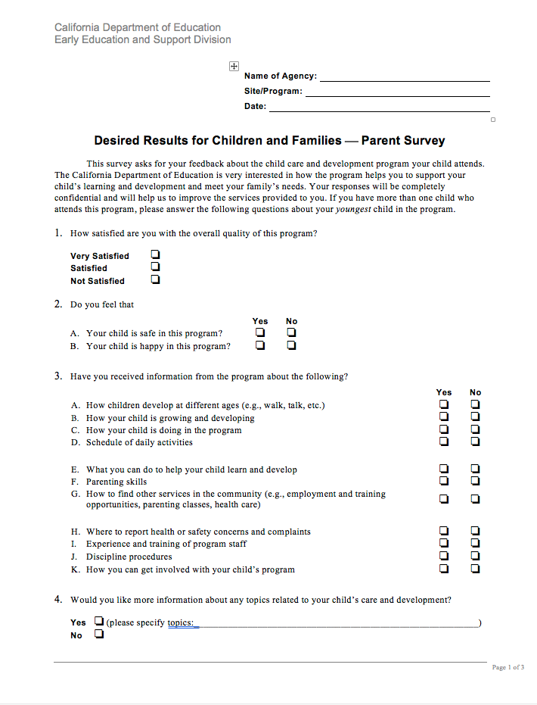
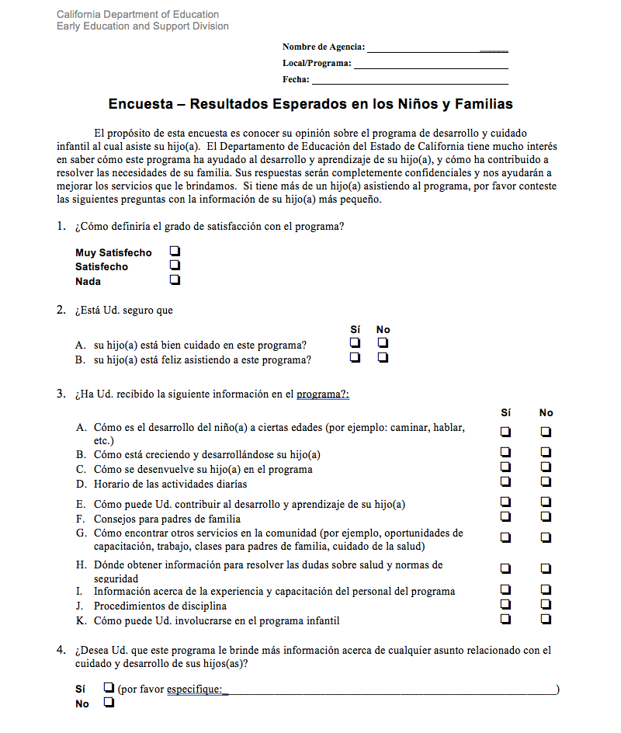
Desired Results Parent Survey
Notes:
The Parent Survey is available in English, Spanish, on the DR website. Copies in Vietnamese, and Mandarin Chinese languages by calling the DR T&TA Project office 800.770.6339.
Parent surveys are confidential.
It is distributed one time a year but can be done twice if desired.

Slide 5
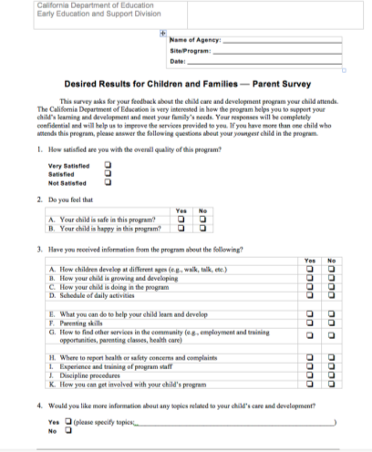
Becoming Familiar with the Parent Survey
Notes:
Activity: Option One (1) – Becoming Familiar with the Parent Survey

Slide 6
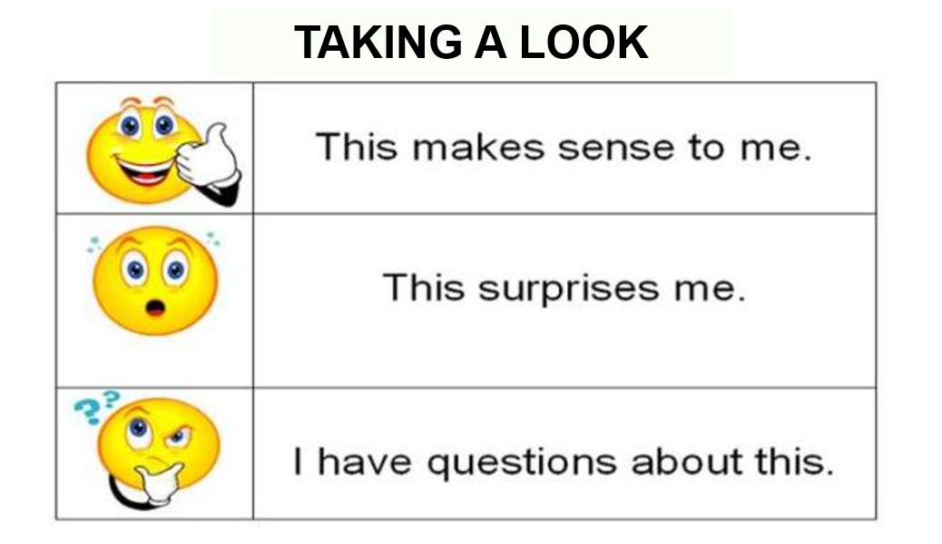
Becoming Familiar with the Parent Survey (2)
Notes:
Activity: Option Two (2) – Becoming Familiar with the Parent Survey

Slide 7
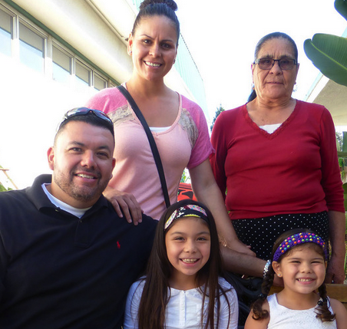
Data from Parent Surveys Is…
Compiled by contract
Analyzed to identify key findings
Used to write the Parent Survey Summary of Findings
Notes:
The data collected from the Parent Surveys is grouped and analyzed. Administrators then identify key findings and develop action steps to complete the Parent Survey Summary of Findings.

Slide 8
Find forms on the Desired Results Web site www.wested.org/desiredresults to assist in compiling data.
Notes:
The next three slides are intended to help new administrators know where to find resources to help them compile data.

Slide 9
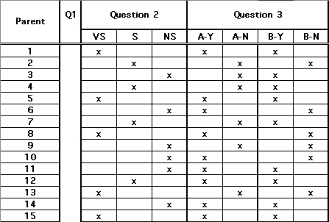
Parent Survey Group Data Summary Excel File
Notes:
Programs may download the Parent Survey Group Data Summary Excel file from the Desired Results Web site.

Slide 10
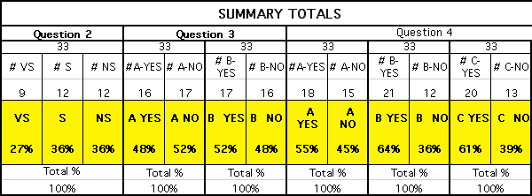
Parent Survey Group Data Summary Excel File Structure
Notes:
The Parent Survey Group Data Summary Excel file is structured much like the DRDP (2015) Group Data Summary file.
It provides numbers and percentages for the possible response options.
There are two (2) worksheets - the Input Data sheet and the Overview sheet.

Slide 11
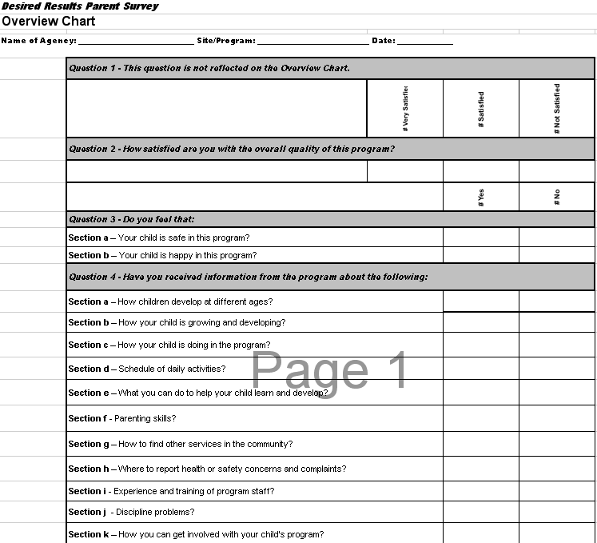
Parent Survey Group Data Summary Tally Sheet
Notes:
There is also a Parent Survey Group Data Summary Tally Sheet for calculating parents’ responses by hand.
After the Parent Survey Group Data Summary is complete, the next step is to analyze the data.

Slide 12
Desired Results Parent Survey Return
CDSS requires the Parent Survey to be distributed one time a year.
Getting parents to return surveys is important.
Good strategies for getting surveys back does NOT include punishing children for parents not returning the survey.
PAR 113-114
Notes:
See Activity Sheet - Parent Survey Returns
The Parent Survey is distributed to find out how they are feeling about our program. The data is then gathered to inform the Summary of Findings.
Trainer note: Before revealing bullet 3, tell participants there will be a contest and they should consider how this contest may pertain to collecting parent surveys. Tell participants to raise their hand if they have what you are looking for, and they will receive a reward. Give each person who raises their hand a piece of candy.
Who received a warm hug from a loved one this morning? Raise your hand.
Who has parents who always attended their school events? Raise your hand.
Who has had a surprise party thrown for them? Raise your hand.
Pause after the second question and ask a few of the participants that did not receive a piece of candy how they are feeling.
When you’ve completed the activity, ask participants what they think this activity may have to do with collecting Parent Surveys? Give everyone a piece of candy and reveal the last bullet. Share that children do not have control over their families and should not be punished for their actions.
Remind them that their strategies should NOT include punishing children, e.g., child gets a sticker if the survey is returned, child gets a prize if the survey is returned, etc.
Having a positive relationship with parents will increase the odds of your getting a survey back.

Slide 13

Provide this…and they will return!
With the participants at your table, assign a recorder and a reporter.
With your table group, write down your successful strategies for collecting parent surveys.
Be prepared to share your top three.
Notes:
Trainer note: Depending on the size of your group this can be a table or elbow partner activity.
Provide participants with 3 x 5 index cards. Write one idea per card.
Give time for participants to share out their top three.
Slide introduction: “Getting Parent Surveys returned can be tricky, but I also know the answer is typically in the room! Now we are going to work smarter, not harder, and take this opportunity to share some of our most successful strategies for collecting Parent Surveys.”
Introduce the activity (about 5 minutes for brainstorming and 5 minutes for sharing out).
Share with participants that the ideas will be collected, compiled, and posted on the Web site by the end of October.

Slide 14
Motivating Parents to Return the Survey
Review the Parent Survey with families at a parent meeting prior to giving it to families.
Host a Just for the Fun of It night periodically.
Provide a comfortable space to complete.
Share the Watching My Child Grow DVD with families so they understand Desired Results.
Provide a small reward such as a raffle ticket, prize, etc.
Notes:
Trainer note: Go through each bullet briefly that has not already been addressed by the group.
To ensure family members have a clear understanding of the Parent Survey’s purpose and contents, many sites review the survey during a parent meeting and have families fill them out during or after the review.
Just for the Fun of it Night might include movie, potluck dinner, game night. Families are more apt to come out if it involves fun, family and food!
See handout with other strategies.
Providing a comfortable space to fill out the survey could be a treat for busy families. Provide adult size chairs, soft music, and refreshments such as coffee, tea, and muffins, or a bowl of treats.
Watching My Child Grow gives families a great overview of the Desired Results System which may encourage more understanding and support from families.
Suggestion for gift: one program took a photo of each child and put it in a frame from the dollar store.
Raffle prize might be donated by local stores or other community organizations.

Slide 15
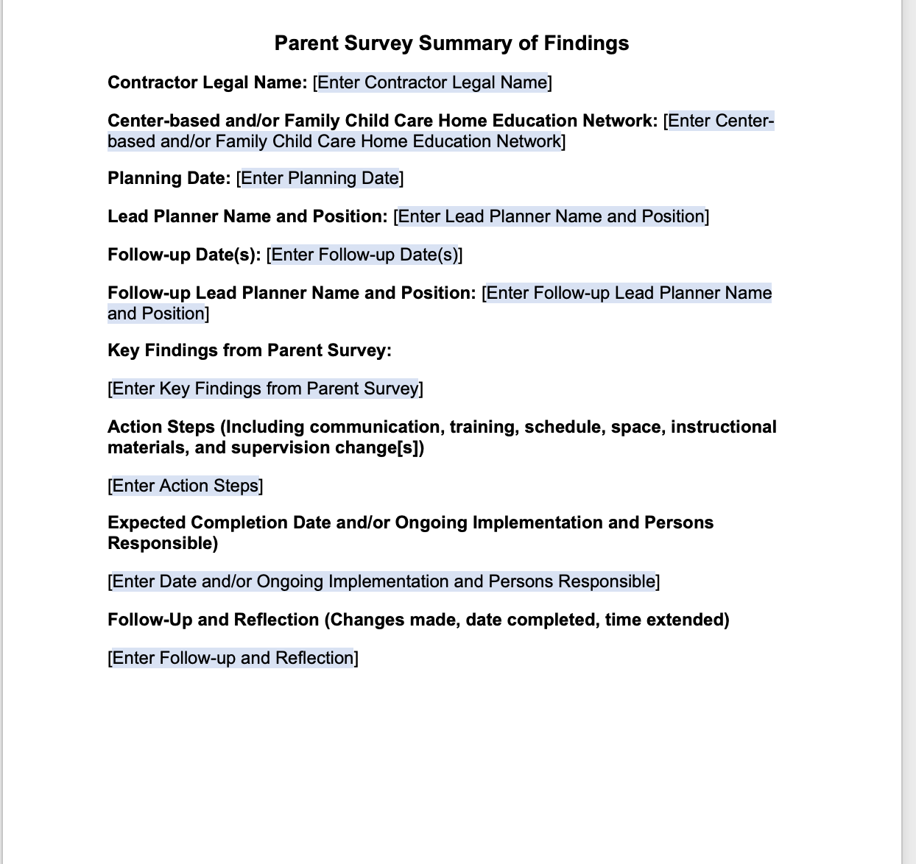
Completing the Parent Survey Summary of Findings
Notes:
Activity: Completing the Parent Survey Summary of Findings and Exploring the Action Step Further
Activity (30 minutes)
After collecting the Parent Surveys, compile the data and use that data to write a Summary of Findings.
Find the Summary of Findings in the handouts.
Walk through the handout.
The process is the same for each Summary of Findings completed, i.e., the DRDP and the ERS.

Slide 16
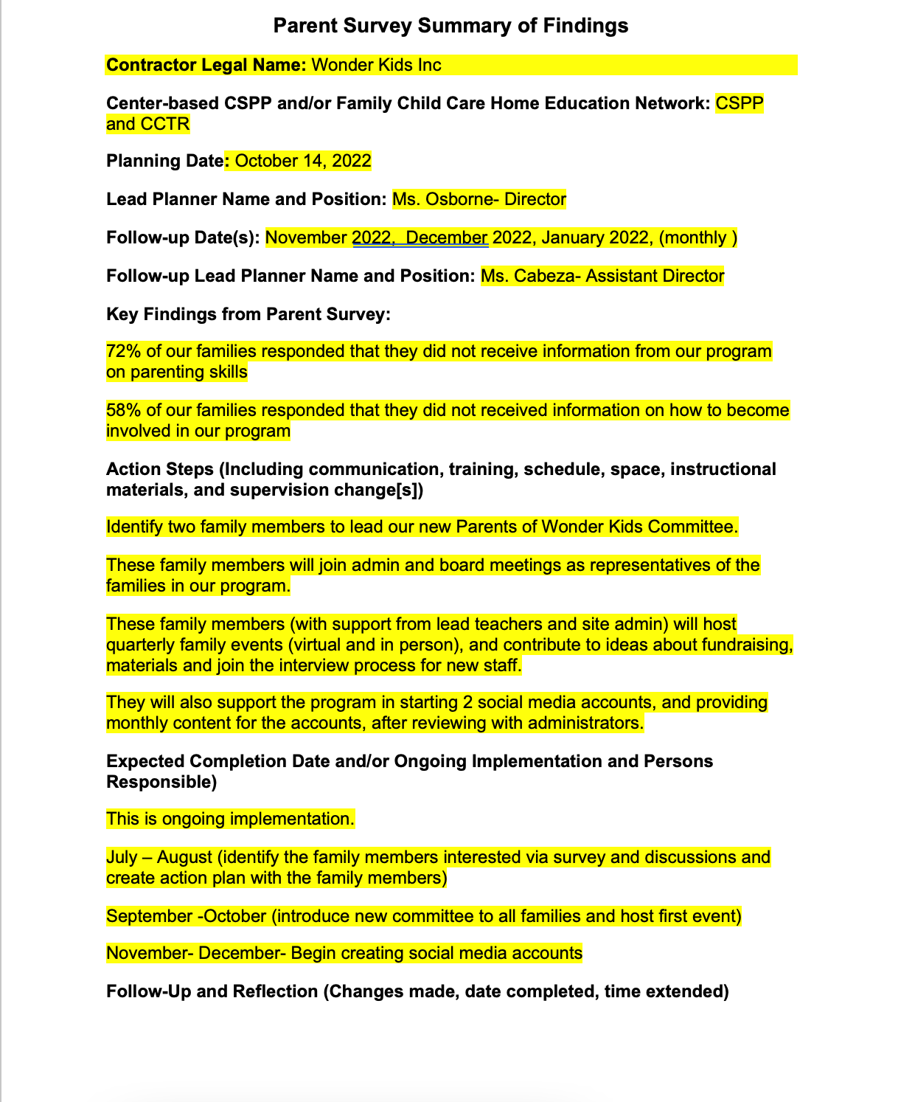
Parent Survey Summary of Findings‒Action Steps
Notes:
Be specific when writing action steps. For example, instead of sayings “Send home monthly newsletter,” try “Send home newsletter that includes a section, How to Support Children’s Growth and Development.” Using the language from the survey may be helpful.
Also consider if the information provided is written in parent’s home language?
Has the information been offered multiple ways, such as a parent night, follow up newsletter, personal note home, online video presentation, or PowerPoint with voice over?

Slide 17

Deep Thoughts and Reflections for Administrators
    How/when do you share key findings at the site and program level with teaching staff?
    How are action steps developed? Just administrators? Staff and administrators?
    Do you have an accountability plan? Who follows through with people responsible for items on the action steps?
Notes:
Give participants 10 minutes to discuss these questions at the table groups or with their elbow partner.

Slide 18
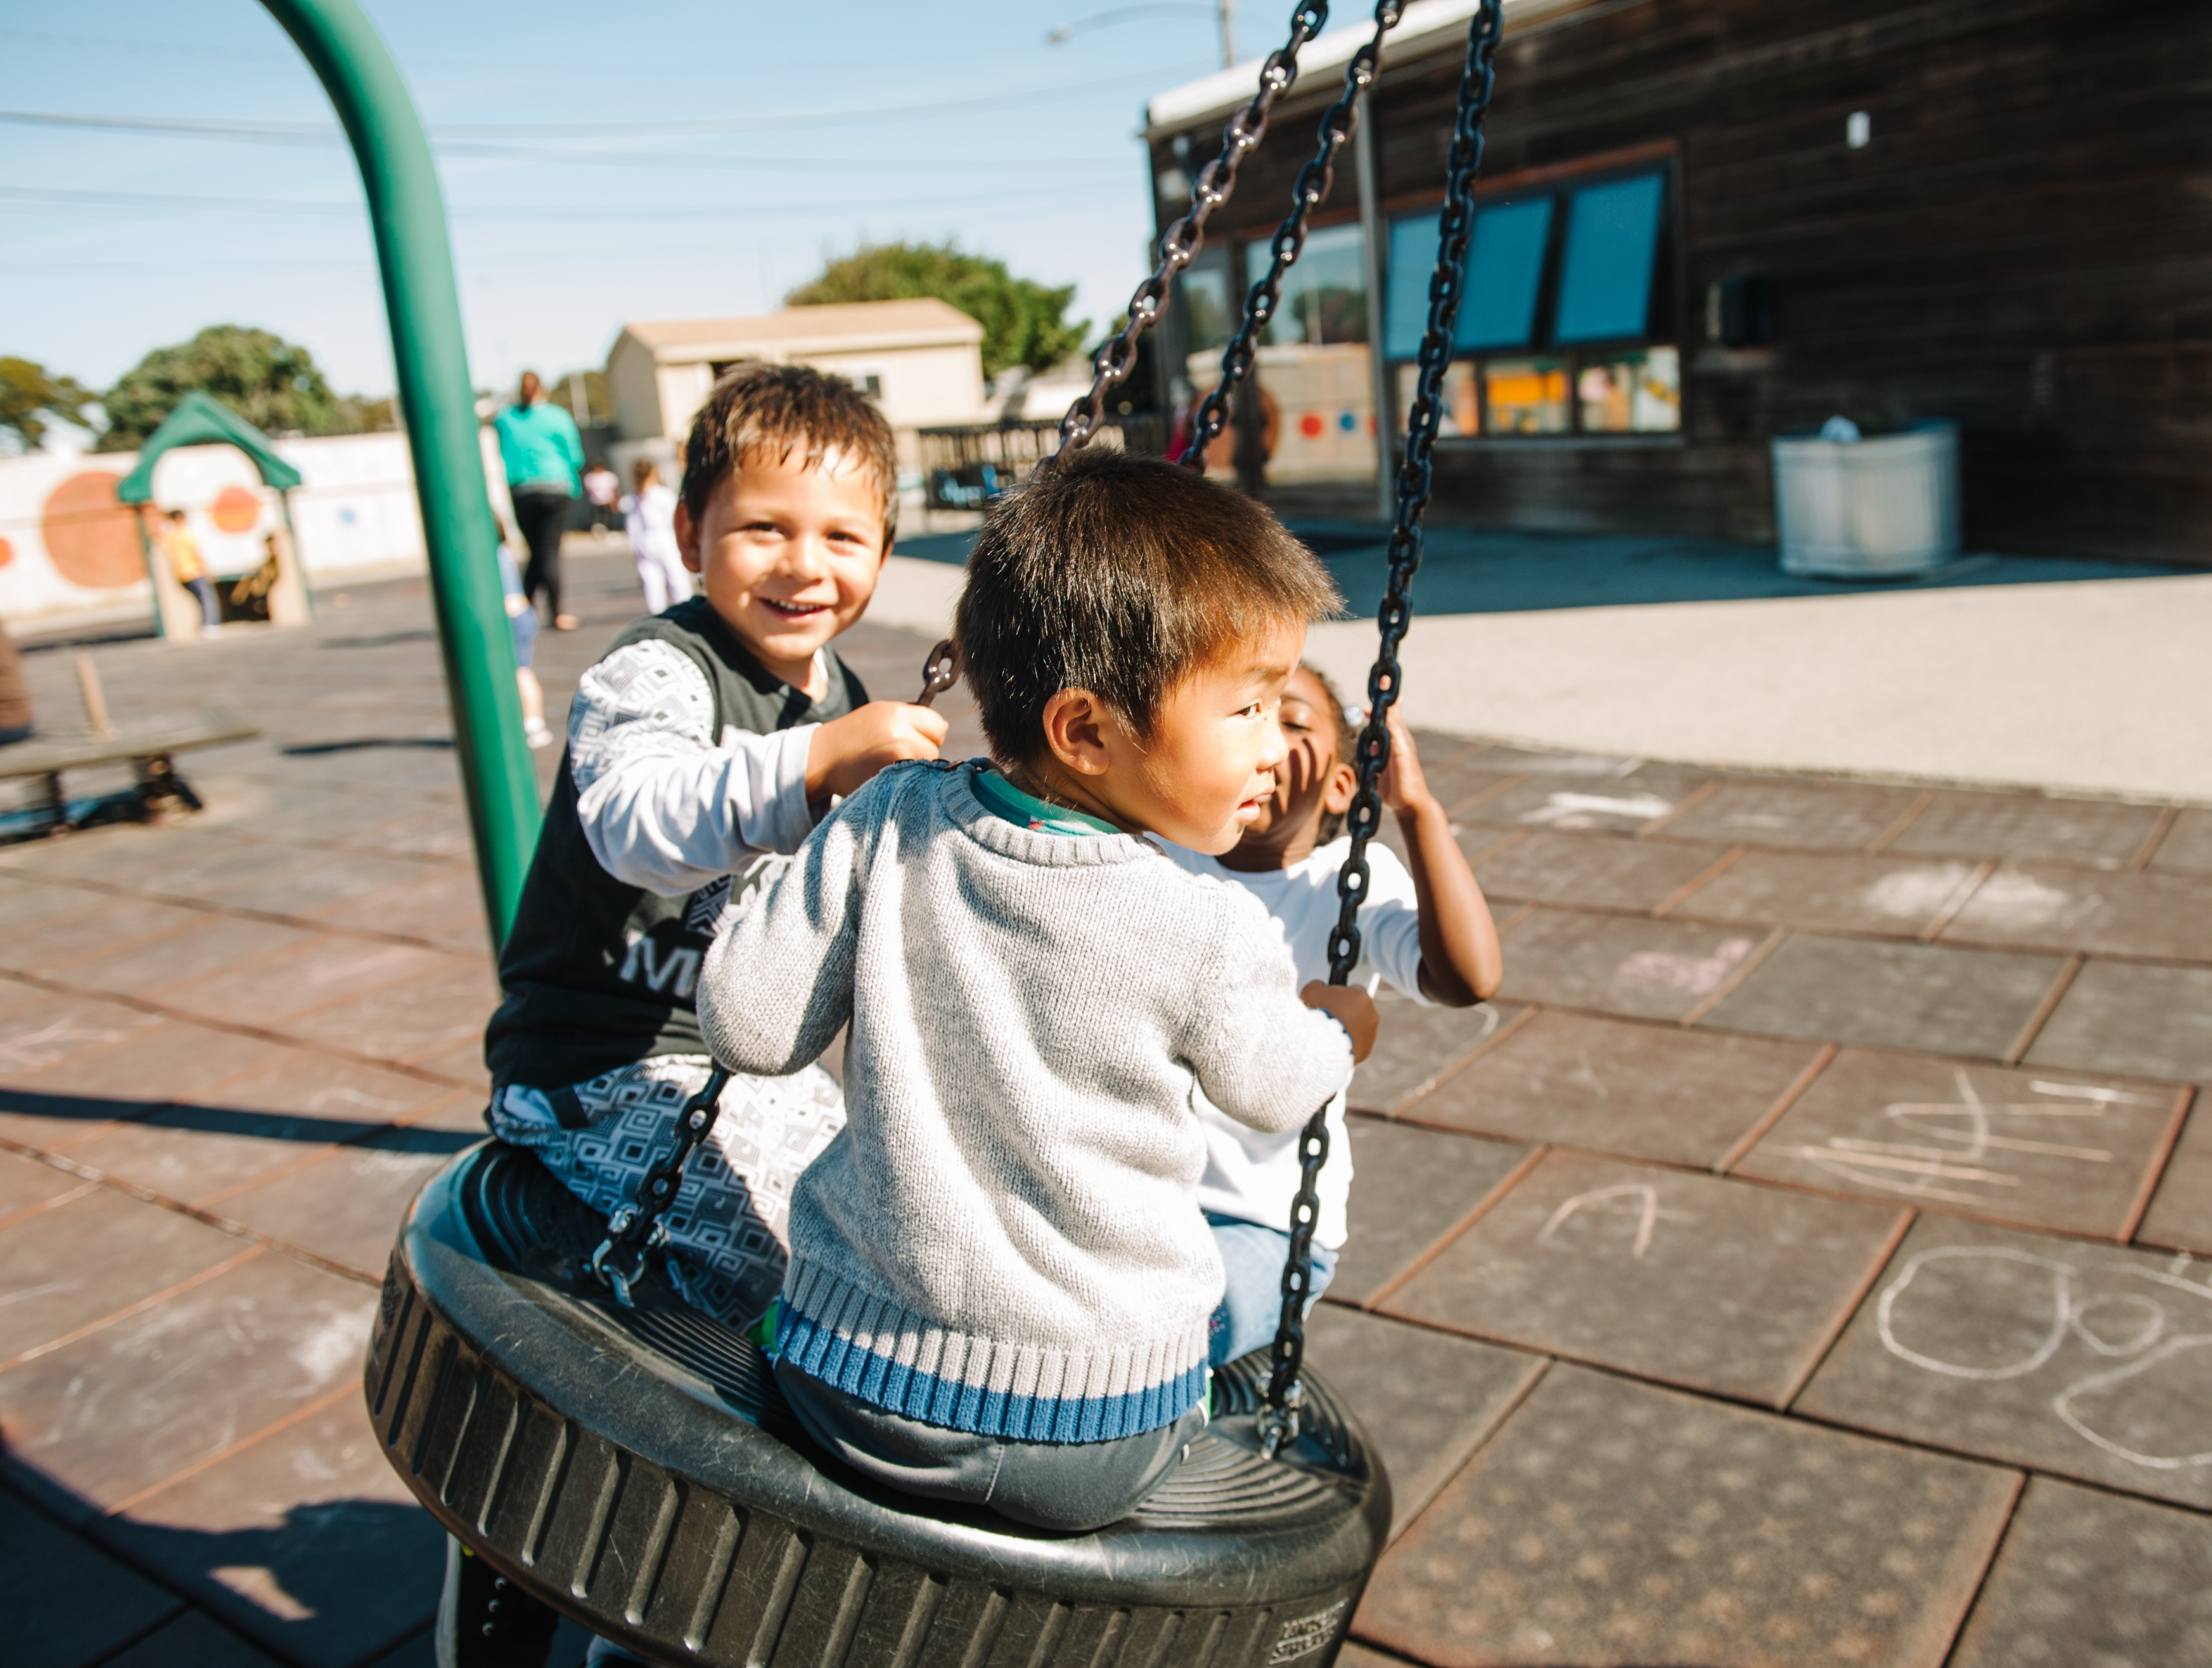
Break

Slide 19

Developing Partnerships with Families
Notes:
Now we will look at developing partnerships with families and how to effectively use the Parent Survey and the Child’s Developmental Progress form when conferencing with families.
We will also take a look into the Family Partnership and Culture publication from the California Department of Education. A big part of building long lasting family partnerships is tapping into the family as a primary resource.
“This publication promotes understanding of children’s cultural or multicultural experiences at home and helps teachers use those experiences as building blocks for teaching and learning in early education settings” (Family Partnership and Culture, p. v).

Slide 20

Making a Family Tree
Notes:
Activity: Make a Family Tree
Self examination and self awareness are powerful tools for forming meaningful relationships with others. This activity is adapted from the CDE publication, Family Partnerships and Culture. It allows teachers to appreciate the strength of their own cultural group and gives the opportunity to appreciate other cultures.

Slide 21
Making a Family Tree‒continued
What ethnic groups are reflected in your family?
What cultural traditions are represented?
What family practices have been passed down in your family?
Why are they important to you?
Notes:
As you finish your family tree, reflect on these questions for yourself. Now as a teacher, how are you bringing this information about the children and families you serve into your program?
Remember to take time and learn about the children in the program and their families. Become familiar with the cultural group with which the children's’ families identify, recognizing that each family creates its own “culture” by drawing from their members’ interpretations.
“Over time, gather information about things the families do, their customs, habits, routines, and preferences. Embrace and value others’ cultural perspectives” (Family Partnership and Culture, p. 7).
Pages 7- 9 of the Family Partnerships and Culture publication, provide several other strategies for self reflection on cultural background and perspectives.

Slide 22
Activity: Do You See What I See?
Look at the abstract piece of art with an elbow partner?
Discuss what you see for 3-5 minutes.
Be ready to share with the group.
Notes:
Note to trainer:
This activity is adapted from “Project Exceptional, Volume 2A Guide for Training and Recruiting Child Care Providers to serve Young Children with Disabilities.”

Slide 23

Do You See What I See?‒2

Slide 24
Do You See What I See?‒3
Perceptions are as unique and diverse as human beings.
Rarely will two individuals see or hear exactly the same thing.
It is often difficult to see things as others may see them.
Each person’s view or perception is of equal value.
- Project Exceptional, Volume 2: A Guide for Training and Recruiting Child Care Providers to Serve Young -Children with Disabilities, CDE Sacramento (1996), pp 96-97.

Slide 25
Do You See What I See?‒4
There is no right or wrong about individual perceptions.
We learn from each other when different perspectives are shared.
- Project Exceptional, Volume 2: A Guide for Training and Recruiting Child Care Providers to Serve Young -Children with Disabilities, CDE Sacramento (1996), pp 96-97.
Notes:
Abstract art lends itself to multiple interpretations by viewers. As in personal perceptions of life events, there is not a “right” or “wrong” to what one perceives.
When people share differing perspectives, they almost always learn something new.
What does this have to do with families? It is a reminder that we call from different perspectives and if we can keep this in mind it can help us in building positive relationships with our families.

Slide 26
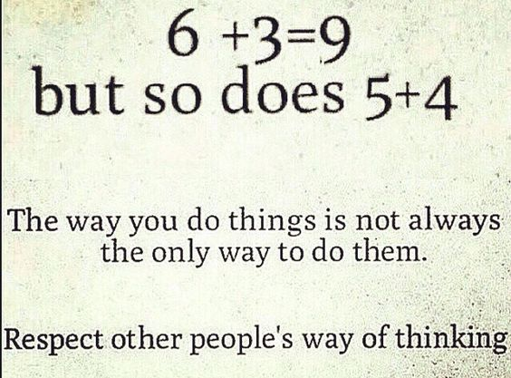
Expand Your Understanding of Families

Slide 27
Building Successful Relationships With Families
What does it take to build successful relationships?
Mutual trust and respect
Environments that give positive messages to families like, “You belong here.”
Supportive communication
Recognition of working with families as partners
What else does it take?
Notes:
Activity Sheet #2 –Building Successful Relationships with Families (15 minutes)
Mutual trust and respect– Families feel like they are heard and that their opinion matters.
Environments give the message that families are important by reflecting their culture and ethnicity; they are welcome in the classroom.
Communication happens on a regular basis that is supportive, such as contacting the family with positive information about their child before something negative happens.
Letting parents know that you want to work as a partner and that the parent is the child’s first teacher.

Slide 28
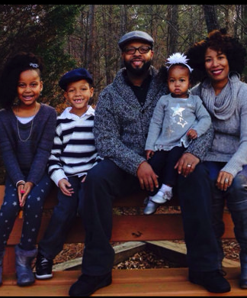
Strategies for Building Relationships
Learn first, teach second.
Participate in community cultural gatherings that are open to the public.
http://www.cde.ca.gov/sp/cd/re/documents/familypartnerships.pdf
Notes:
These are examples of strategies to start the lines of communication with families.
Participate in community cultural gatherings that are open to the public. If you are invited, your attendance at cultural celebrations may provide an opportunity to foster relationships with the children and families.
Take a moment and turn to Family Partnerships and Culture [CDE], pp 8-9 now to see more strategies you can use.
Debrief: Remind participants that “Mistakes will certainly be made and are part of the learning process. Although cultural responsiveness may be challenging, it can ultimately be a source of deep joy and meaningful relationships” (Family Partnerships and Culture [CDE], p. 98).

Slide 29

Family Values
How does our program…
Value families and their contribution to children’s learning?
Approach cultural diversity with an open mind?
Apply knowledge gained about families, including their values and beliefs, to teaching and learning?
Notes:
Families have valuable information necessary in understanding the children you serve. “To develop a partnership and to tap into the family as a primary resource, teachers and program staff must reach out to families, learn about, and develop strong partnerships with them. This process requires openness to learning and an effort to understand the individuality each family and the diversity of the families from which the children come.”( Family partnership and Culture p. x)
Trainer note:
Before this activity, have three chart papers posted with each of the questions written on them. Post them throughout the room.
Have teachers write a response to each of these questions on a sticky note and post their response on the appropriate chart paper.

Slide 30
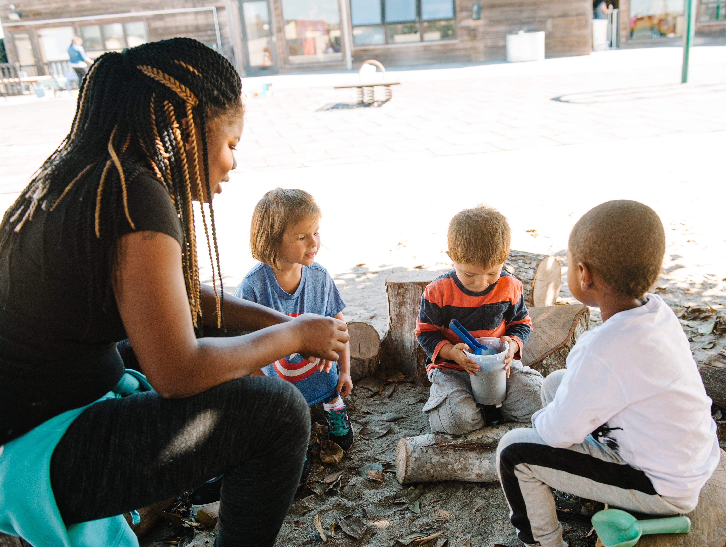
Family Values‒2
Review pages 100-105.
Number the sections 1-10.
Discuss in small groups the sections that are easy to discuss with families.
Discuss which sections are more difficult to discuss and why.
Notes:
Provide pages 100-105 from the Family Partnership and Culture publication.

Slide 31

Family Values‒3
It’s often easier to discuss aspects that families are comfortable sharing such as celebrations, goals for their child, etc.
It may take time for families to disclose more personal information such as child rearing, gender roles, etc.

Slide 32

Supporting Teachers to Identify Their Conference Strengths and Fears
Dream Card
List positive feelings you have about parent conferences.
Nightmare Card
List negative feelings or fears you have about parent conferences.
Notes:
See Activity Sheet #6 Conference Dream and Nightmare Activity (10 minutes).

Slide 33
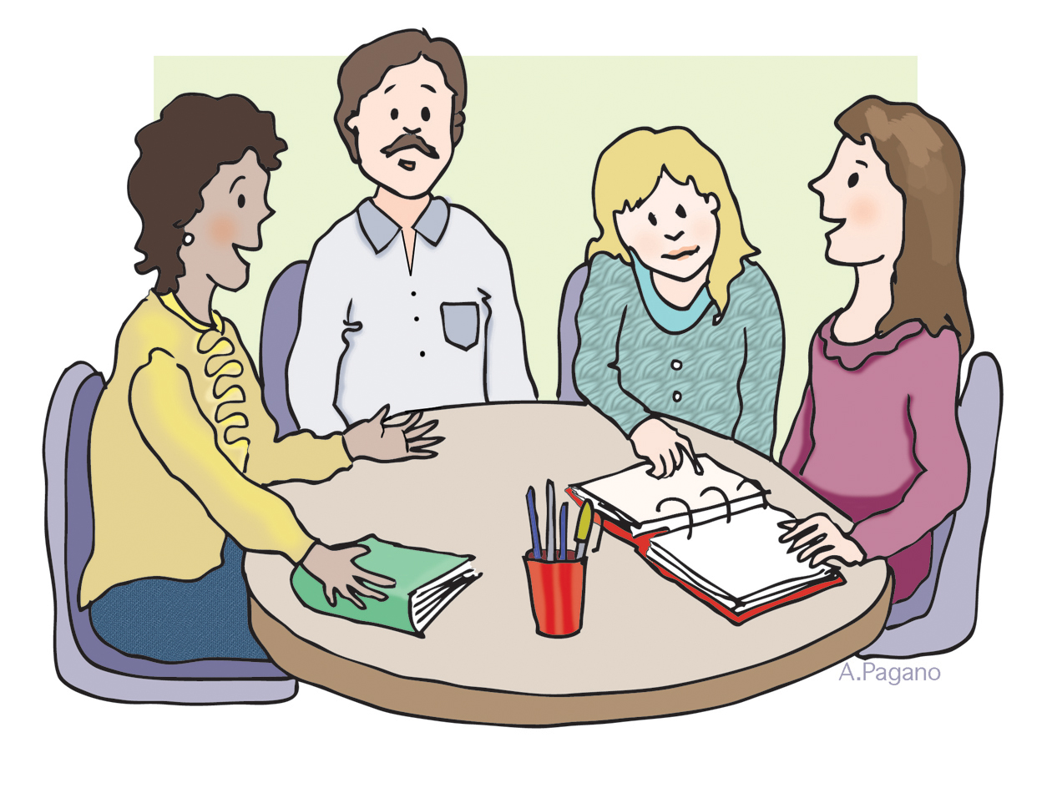
Purpose of the Parent Conference
Share the information on the Child’s Developmental Progress form.
Create a parent-teacher partnership that will help the child be successful.
Provide a two-way communication opportunity that updates each partner about the child’s growth and development.
Establish a relationship that makes it easier for the teacher and parents to initiate contact later.
Adapted from: Barry Sweeney, Preparing for Parent Conferences www.teachermentors.com
Notes:
The first bullet is what is required by C. The other bullets are considered good practice.
Are there other reasons to conference with parents?

Slide 34
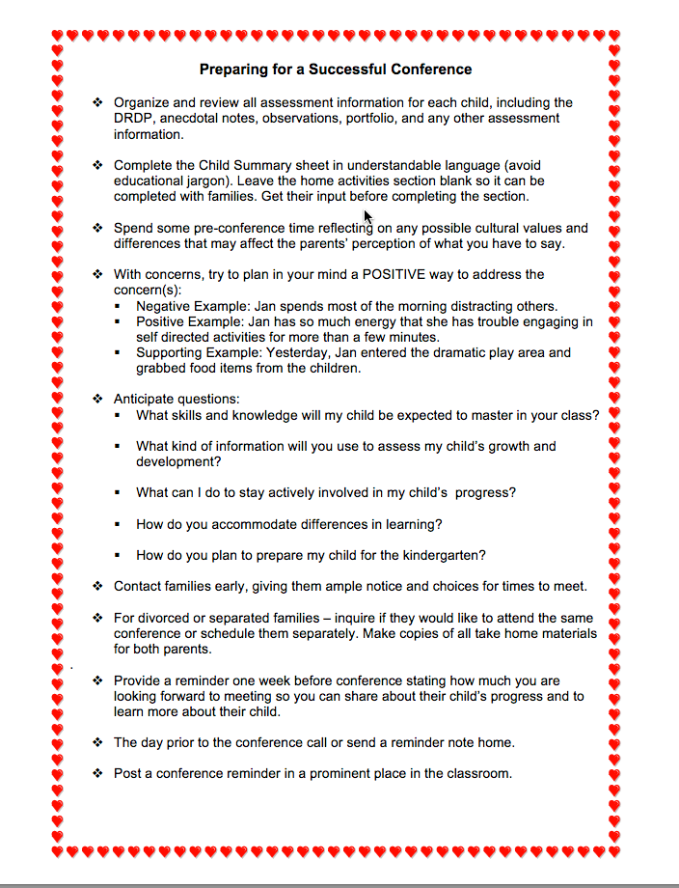
Preparing and Steps for a Successful Conference
Read both pages of the handout and highlight 2-3 things that are of interest on each page.
Share one thing that you have highlighted.
Notes:
Ask participants to find the handout.
Allow 7-8 minutes for reading and 10 minutes for discussion
Direct them to get a highlight and use it as they read.

Slide 35
Sorting it All Out
Each table will receive a set of cards for a specific area of the Child’s Developmental Progress Form.
Sort cards into two categories:
  Statements that should be included in the progress form
  Statements that should NOT be included
Notes:
See Activity #5- Sorting It All Out
This activity takes 20 minutes.

Slide 36
What is Really Being Communicated?
Only 7% of what is communicated is in words.
53% of what is communicated comes from body language.
40% of what is communicated comes from the tone and feeling reflected in our voice, and how we say the words.
Source: Sean Covey. The Seven Habits of Highly Effective Teens. A Fireside Book, Simon and Schuster, 1999. P.171.
Notes:
Review the slide.
Discuss the importance of non-verbal body language.
An example might be a parent whose compliments don’t seem complimentary because they are given with a gruff tone and a scowl on the face.

Slide 37
To Really Listen…
Listen with your eyes and your ears. Listen to the person’s words, but also to what they are not saying.
Stand in their shoes.
Practice mirroring. A mirror reflects. Repeat back in your own words what the other person is saying and feeling.
Source: Sean Covey. The Seven Habits of Highly Effective Teens. A Fireside Book, Simon and Schuster, 1999. P.171-173.
Notes:
Review the steps of really listening. Think back to the opening activity “Do You See What I See?”
This includes listening for words, but also noticing the other person’s body language, tone of voice, and enunciation.
Effective listening also includes trying to see the situation from the other person’s point of view, and mirroring back what you perceive that they are thinking, feeling, and saying.
When you understand where the other person in the conversation is coming from, then you can try to make yourself understood.

Slide 38

Mirroring Phrases
As I get it…
So, as I see it...
I can see that you are feeling…
So, what you’re saying is…
  Source: Sean Covey. The Seven Habits of Highly Effective Teens. A Fireside Book, Simon and Schuster, 1999. P.175.
Notes:
Share slide.
If time, ask group to share phrases similar to these. This activity could be done with teachers by:
Asking teachers to add to the list
Having them role play and use these phrases.

Slide 39
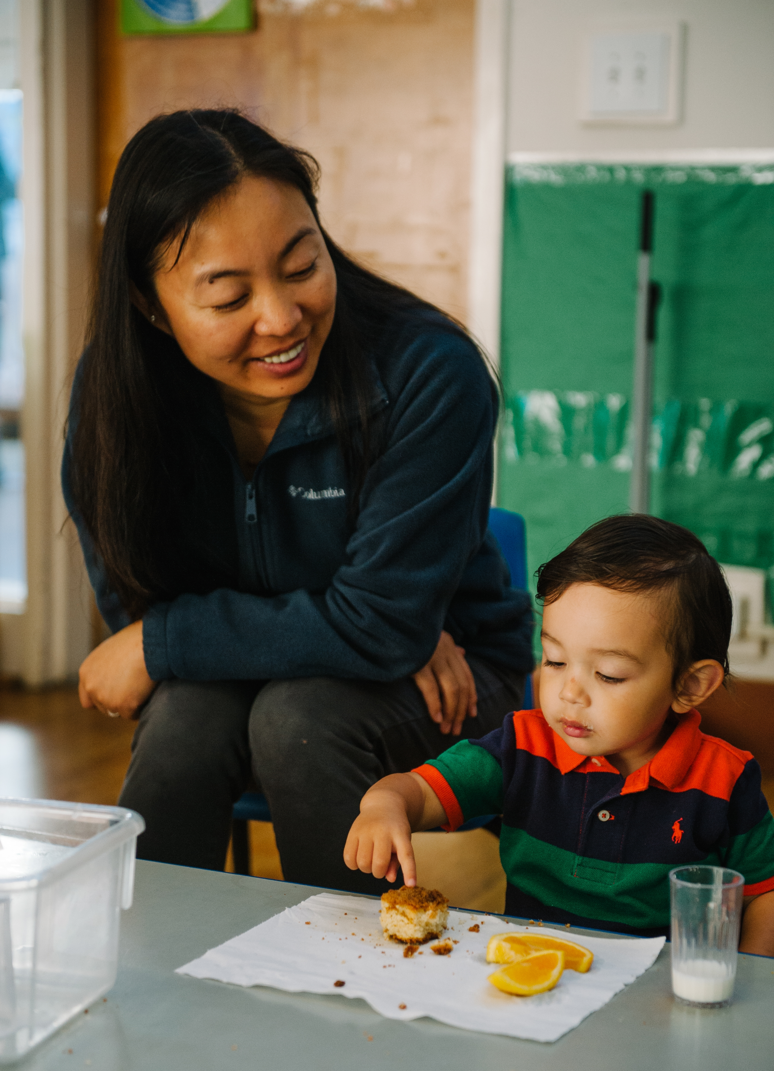
SLANT for Strength
Sit up straight
Lean slightly forward
Ask questions
Nod to show interest
Track the speaker
Source: Dr. Allen Mendler, “Working Successfully with Difficult Students: A Discipline with Dignity Approach.” Bureau of Education and Research.
Notes:
The SLANT process is an effective listening tool, both in a conference and in the classroom.
This slide could be printed out and given to staff. They could post this near desk or keep in parent conference folder as a reminder.

Slide 40
Communication Troubleshooting
Parent has no phone.
Mom works days, Dad works nights.
Parent complains about everything the school and teacher does.
The teacher and parent do not speak the same language.
Notes:
See Activity # 7 - Communication Troubleshooting (10 minutes).

Slide 41
Guidelines for Good Customer Service
Be professional—Always put the customer first.
Be polite—Parents and children deserve your respect and consideration, no matter what kind of day you are having.
Notes:
We often forget that we are in the customer service profession. This is a great reminder as we move through the day and our lives. Consider posting the message as a reminder to teachers before they start each day in adult bathroom, by mirror, in office, etc.

Slide 42
Guidelines for Good Customer Service‒continued
Be proud—Parents see you as experts, ready and able to deliver solutions
Be prompt—No one likes to be kept waiting.
Be personal—Parents and children want to be treated as individuals, not as the next person in line.
Notes:
We often forget that we are in the customer service profession. This is a great reminder as we move through the day and our lives. Consider posting the message as a reminder to teachers before they start each day: in adult bathroom, by mirror, in office, etc.

Slide 43

Bumper Sticker
Family Engagement = Shared Responsibility
Notes:
Activity – Family Engagement Bumper Sticker
Trainer Note:
As you close this section, encourage teachers to make a statement about your agencies philosophy about Family Partnerships. Post them around the center, or in the family room of your center.

Slide 44

Deep Thoughts and Reflections for Administrators‒continued
How do you train teachers to conduct effective conferences?
Does your program provide teaching staff with guidelines and support for conducting successful conferences?
Do you provide constructive feedback to your teaching staff regarding the content of the child summary forms?
Notes:
Activity: 10 minutes
Trainer Note:
Give participants time to discuss these questions with table groups or elbow partners.
Large group share out only if someone learned something they want to share.
If you are training your teachers on how to conduct effective conferences, are you willing to share with us, in the chat box.

Slide 45

Q and A

Slide 46

Thank You for Participating!

