Slide 1
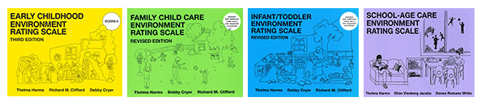
Session V: Environment Rating Scales
Notes:
In this part of the training, participants will receive an introduction to the Environment Rating Scales to measure program quality in classrooms, child care home, and centers.
The four environment rating scales are:
Infant/Toddler (ITERS-R)
Early Childhood (ECERS-R)
School-Age Care (SACERS)
Family Child Care (FCCERS)

Slide 2
Environment Rating Scales (ERS)
The Environment Rating Scales are designed to assess process quality in an early childhood or school-age care group.
  Interactions
  Space
  Schedule
  Materials
(Frank Porter Graham, Child Development Institute, 2008)
Notes:
The Environment Rating Scales have good inter-rater reliability and validity and have been part of many research studies.
Process quality is what children directly experience in their programs that has a direct effect on their development, including the various interactions that go on in a classroom between staff and children and among the children themselves, and the interactions children have with the many materials and activities in the environment, as well as those features, such as space, schedule and materials that support these interactions. Process quality is assessed primarily through observation and has been found to be more predictive of child outcomes than structural indicators such as staff to child ratio, group size, cost of care, and even type of care, for example child care center or family child care home (Whitebook, Howes & Phillips, 1995). https://www.ersi.info/scales.html

Slide 3
Quality Programs
Quality programs must provide for the three basic needs all children have:
Protection of their health and safety
Building positive relationships
Opportunities for stimulation and learning from experience
https://www.ersi.info/scales.html
Notes:
In order to provide care and education that will permit children to experience a high quality of life while helping them develop their abilities, a quality program must provide for the three basic needs of all children:
Protection of their health and safety
Supporting and guiding social/emotional development
Opportunities for intellectual and language stimulation and appropriate learning activities
No one component is more important than the others, nor can one substitute for another. It takes all three to create quality and education. Each of the three basic components or quality manifests itself in tangible forms in the program’s environment, curriculum, schedule, supervision and interaction, and can be observed. These are the key aspects of process quality that are included in our environment rating scales.
https://www.ersi.info/scales.html

Slide 4
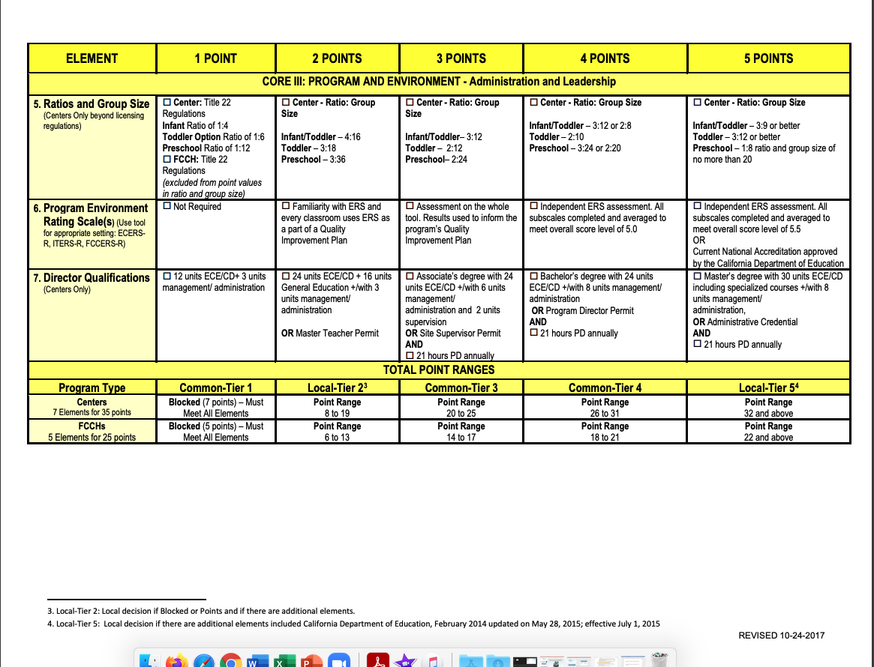
Matrix and DR System
Notes:
The Environment Ratings scales is also a part of the Quality Rating Matrix.

Slide 5
The Environment Rating Scales are...
a required tool for the Program Self-Evaluation and the ongoing continuous improvement process.
Notes:
California adopted the Environment Rating Scales in 2001 as part of the Desired Results system.

Slide 6

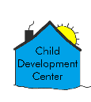


CDSS agencies are required to complete an ERS for each:
Classroom
Site
Contract
Notes:
No matter the size of a program or agency, data is compiled at the classroom level for the Environment Rating Scale. Each program is responsible for the ERS data to be grouped by:
1st – classroom/ FFCHEN home
2nd – site / FFCHEN home
3rd – program or agency compiled by age group and contract.
Compile all the ITERS, ECERS, FCCERS and SACERS. Write a Summary of Findings for each one or write it by type on one sheet of paper.)

Slide 7
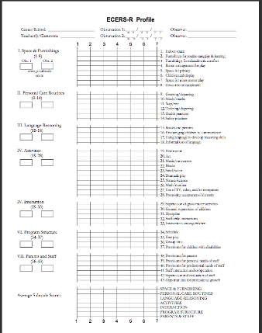
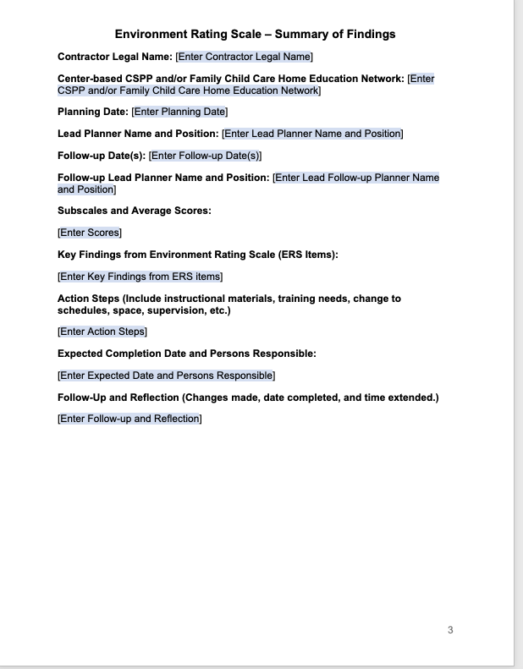
ERS Profile and Summary of Findings
Complete one per classroom
Complete one per classroom, site, and contract
Notes:
At the end of your age-appropriate ERS booklet, there is a profile sheet used to summarize scores across the assessment. After calculating the classroom score, classrooms will then complete an ERS Summary of Findings.

Slide 8
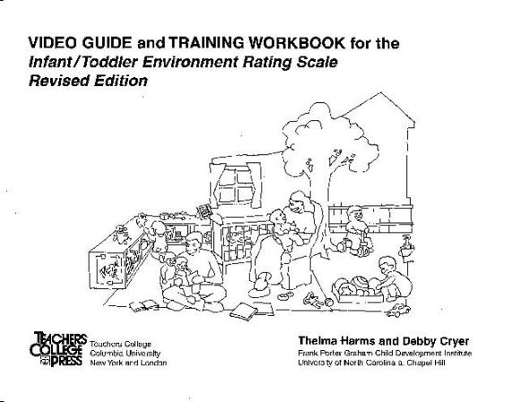
Introduction to the ERS
Notes:
Activity: Introduction to the ERS
The video for this activity training workbook can be found on https://vimeo.com/20883172

Slide 9
Items and Subscales
7 subscales and 43 items
7 subscales and 39 items

Slide 10
Items and Subscales (2)
7 subscales and 47 items
7 subscales and 38 items

Slide 11
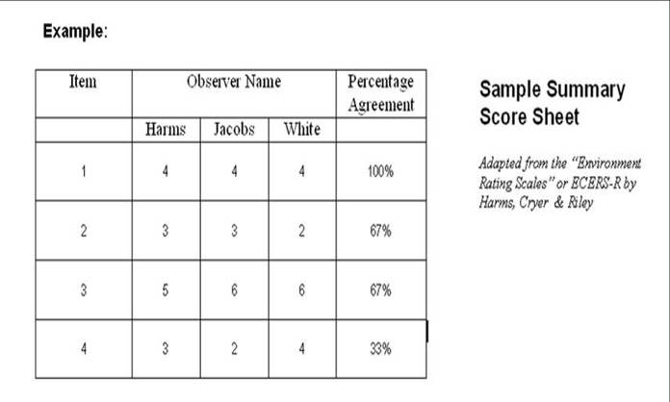
ERS Inter-Rater Reliability
Notes:
Activity: Inter-Rater Reliability

Slide 12
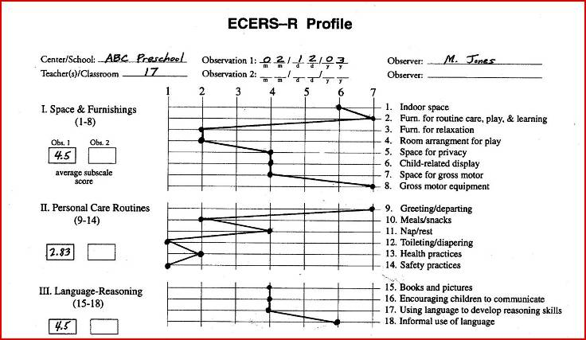
Early Childhood Environment Rating Scale-Profile Worksheet
Notes:
After teachers and administrators finish administering the ECERS, they plot the scores on this simple graph. This visual graph helps programs see which items and subscales fall below a score of “5.”
Any item score below a “5” in classrooms requires identification and action steps on the classroom ERS Summary of Findings.
Agency ERS Summary of Findings will identify sub-scale score averages (for all classrooms/FCC homes) below a “5” in the contract summary.
Trainer note: Ask participants to compute the average score for subscale II personal care routines. (Add the scores for each item and divide the sum by the number of items to compute the average subscale score.)

Slide 13
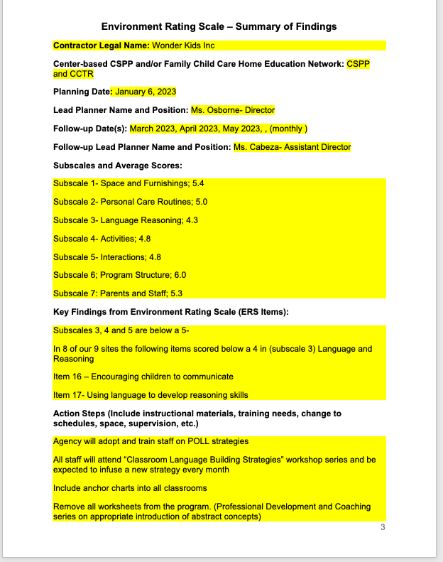
ERS Summary of Findings Sample
Notes:
Activity: ERS Summary of Findings
Make sure activities are at the classroom level.

Slide 14
ERS Summary of Findings
Notes:
Trainer note: Call for the group’s attention and ask volunteers to share key findings and action steps.
Each classroom will list items with a score below “5.” Agencies will list sub-scale averages (for all classrooms) with a score below “5.”

Slide 15
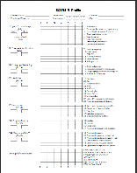
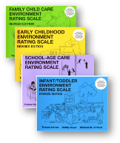
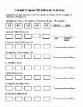
Steps to Completing the Agency Environment Rating Scale
Classroom
Completes Classroom/FCC Home Summary of Findings
Scores ER Scale
Completes Profile
Agency
Compiles ERS Profile Data by Contract
Completes Summary of Findings by Contract
Notes:
Trainer note: Click to display the steps in completing the ERS process.
Emphasize:
Agencies need to compile the classroom profiles data into one document and find the subscale average.
They then need to address all subscale averages that fall below a “5.”
One comprehensive ERS Summary of Findings per contract goes to CDE with the agency’s annual report.

Slide 16
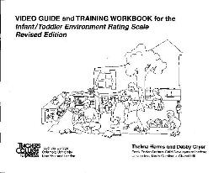
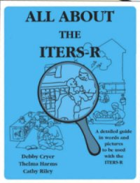
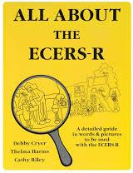
Staff Training Resources
Notes:
The video guide and training workbook are excellent resources for training staff. Many of the resource and referral agencies include them in their lending libraries. The books, All About the ECERS and All About the ITERS are also invaluable resources for staff. Many agencies provide training in California on the ERS.

Slide 17
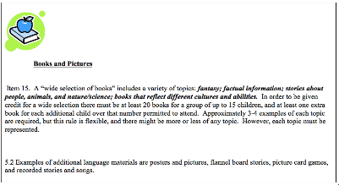
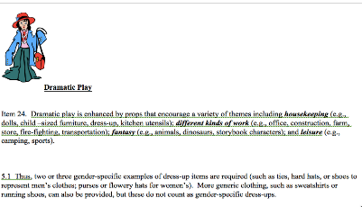
ERS Cards
Notes:
ERS cards are available on the Desired Results website to download and print for free.
Trainer note:
Take participants to the website and show them where to get the ERS cards.

Slide 18
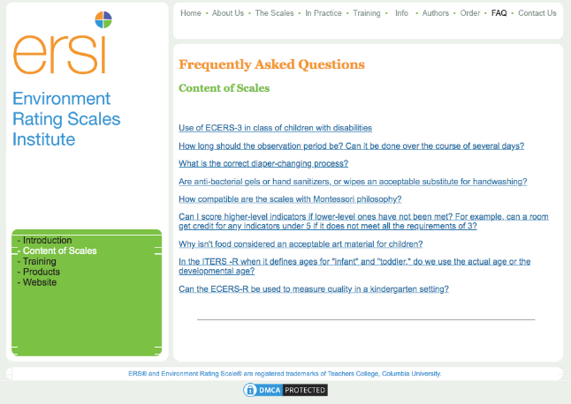
ERSI
Notes:
The ERSI site provides many more resources to support implementation of the Environment Rating Scales.
The Substantial Portion of the Day chart can be found in the booklet on the last page of the score sheet.

Slide 19
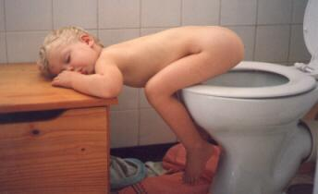
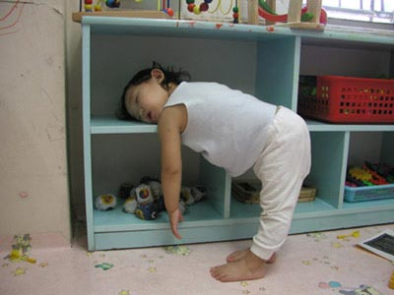
Break

Slide 20
Taking it
Back to the Agency
Notes:
Participants may now use the calendar pages to plan when they will:
Complete the ERS for the classroom
Group the ERS data
Complete the ERS Summary of Findings per classroom and agency

Slide 21
Website Resources
Desired Results T & TA Project
www.desiredresults.us
Program for Infant/Toddler Caregivers
www.pitc.org
California Preschool Instructional Network
https://cpin.us/`
California School-Age Consortium
https://www.calsac.org/
Family Child Care at Its Best
https://www.fccbtraining.org/
California Early Childhood Online
https://www.caearlychildhoodonline.org/
Notes:
Trainer note: If internet is available demonstrate the websites.
If age-level experts are available, ask him/her to share information about the projects specific to their age level.

