Slide 1

CDSS Attribution
This training is funded by the California Department of Social Services (CDSS). The materials included in this training are developed in part or wholly by the California Department of Education (CDE) and produced by CDSS.
Notes:
This training is funded by the California Department of Social Services (CDSS). The materials included in this training are developed in part or wholly by the California Department of Education (CDE) and produced by CDSS.

Slide 2
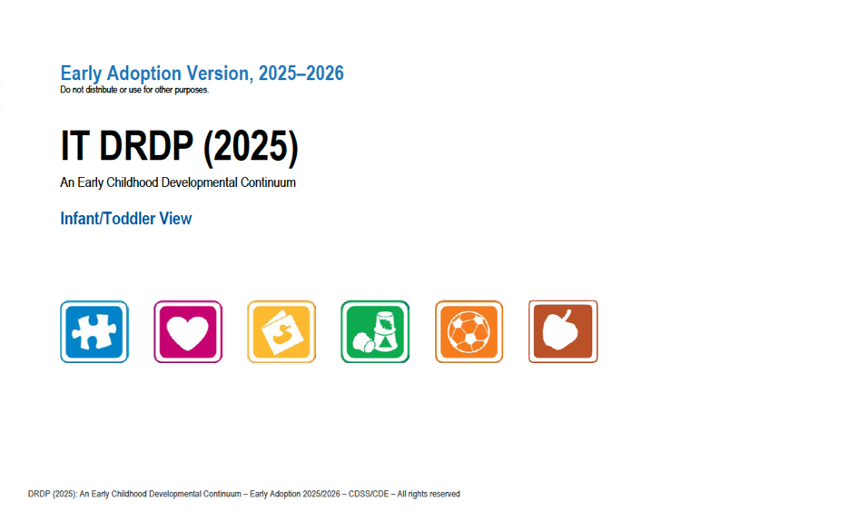
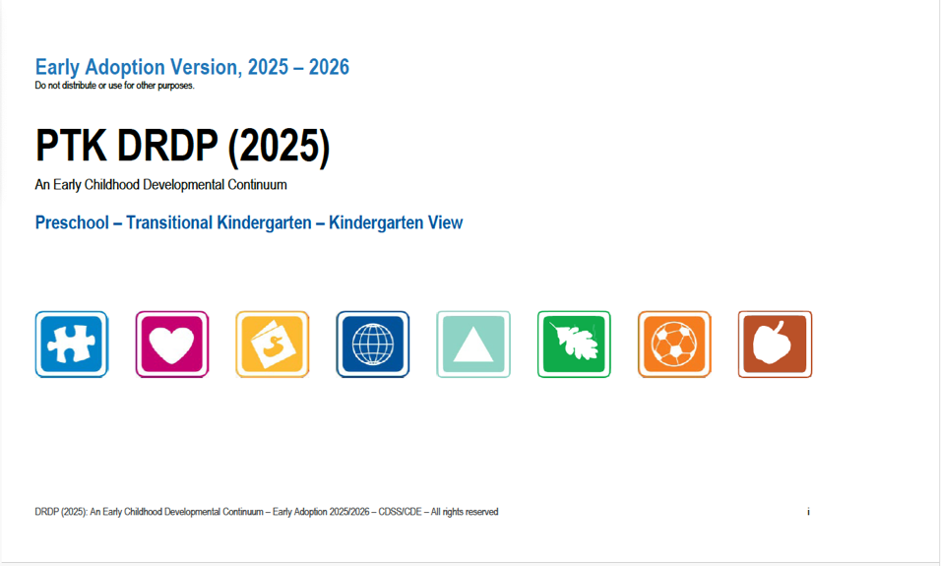
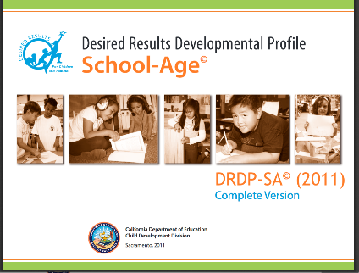
A Full Continuum Assessment
Notes:
Script:
In this session, participants will learn about the Desired Results Developmental Profile (DRDP).
We will focus on developing observation skills, rating the DRDP, collecting DRDP data, completing the Summary of Findings, and the Child’s Developmental Progress form.
DRDP 2025 has an updated view for IT and preschool, transitional kindergarten,
The school-age assessment remains the same.

Slide 3
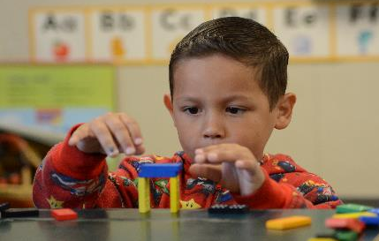

We observe…
As each child interacts with other children, adults, and the environment.
In the natural program setting.
Notes:
Script:
Teachers observe children in their natural, daily activities. Agencies will be able to describe children’s achievements in learning and development, advocating for the strengths and benefits of the program to families and the broader community.
Slide text:
We observe…
As each child interacts with other children, adults, and the environment
In the natural program setting

Slide 4
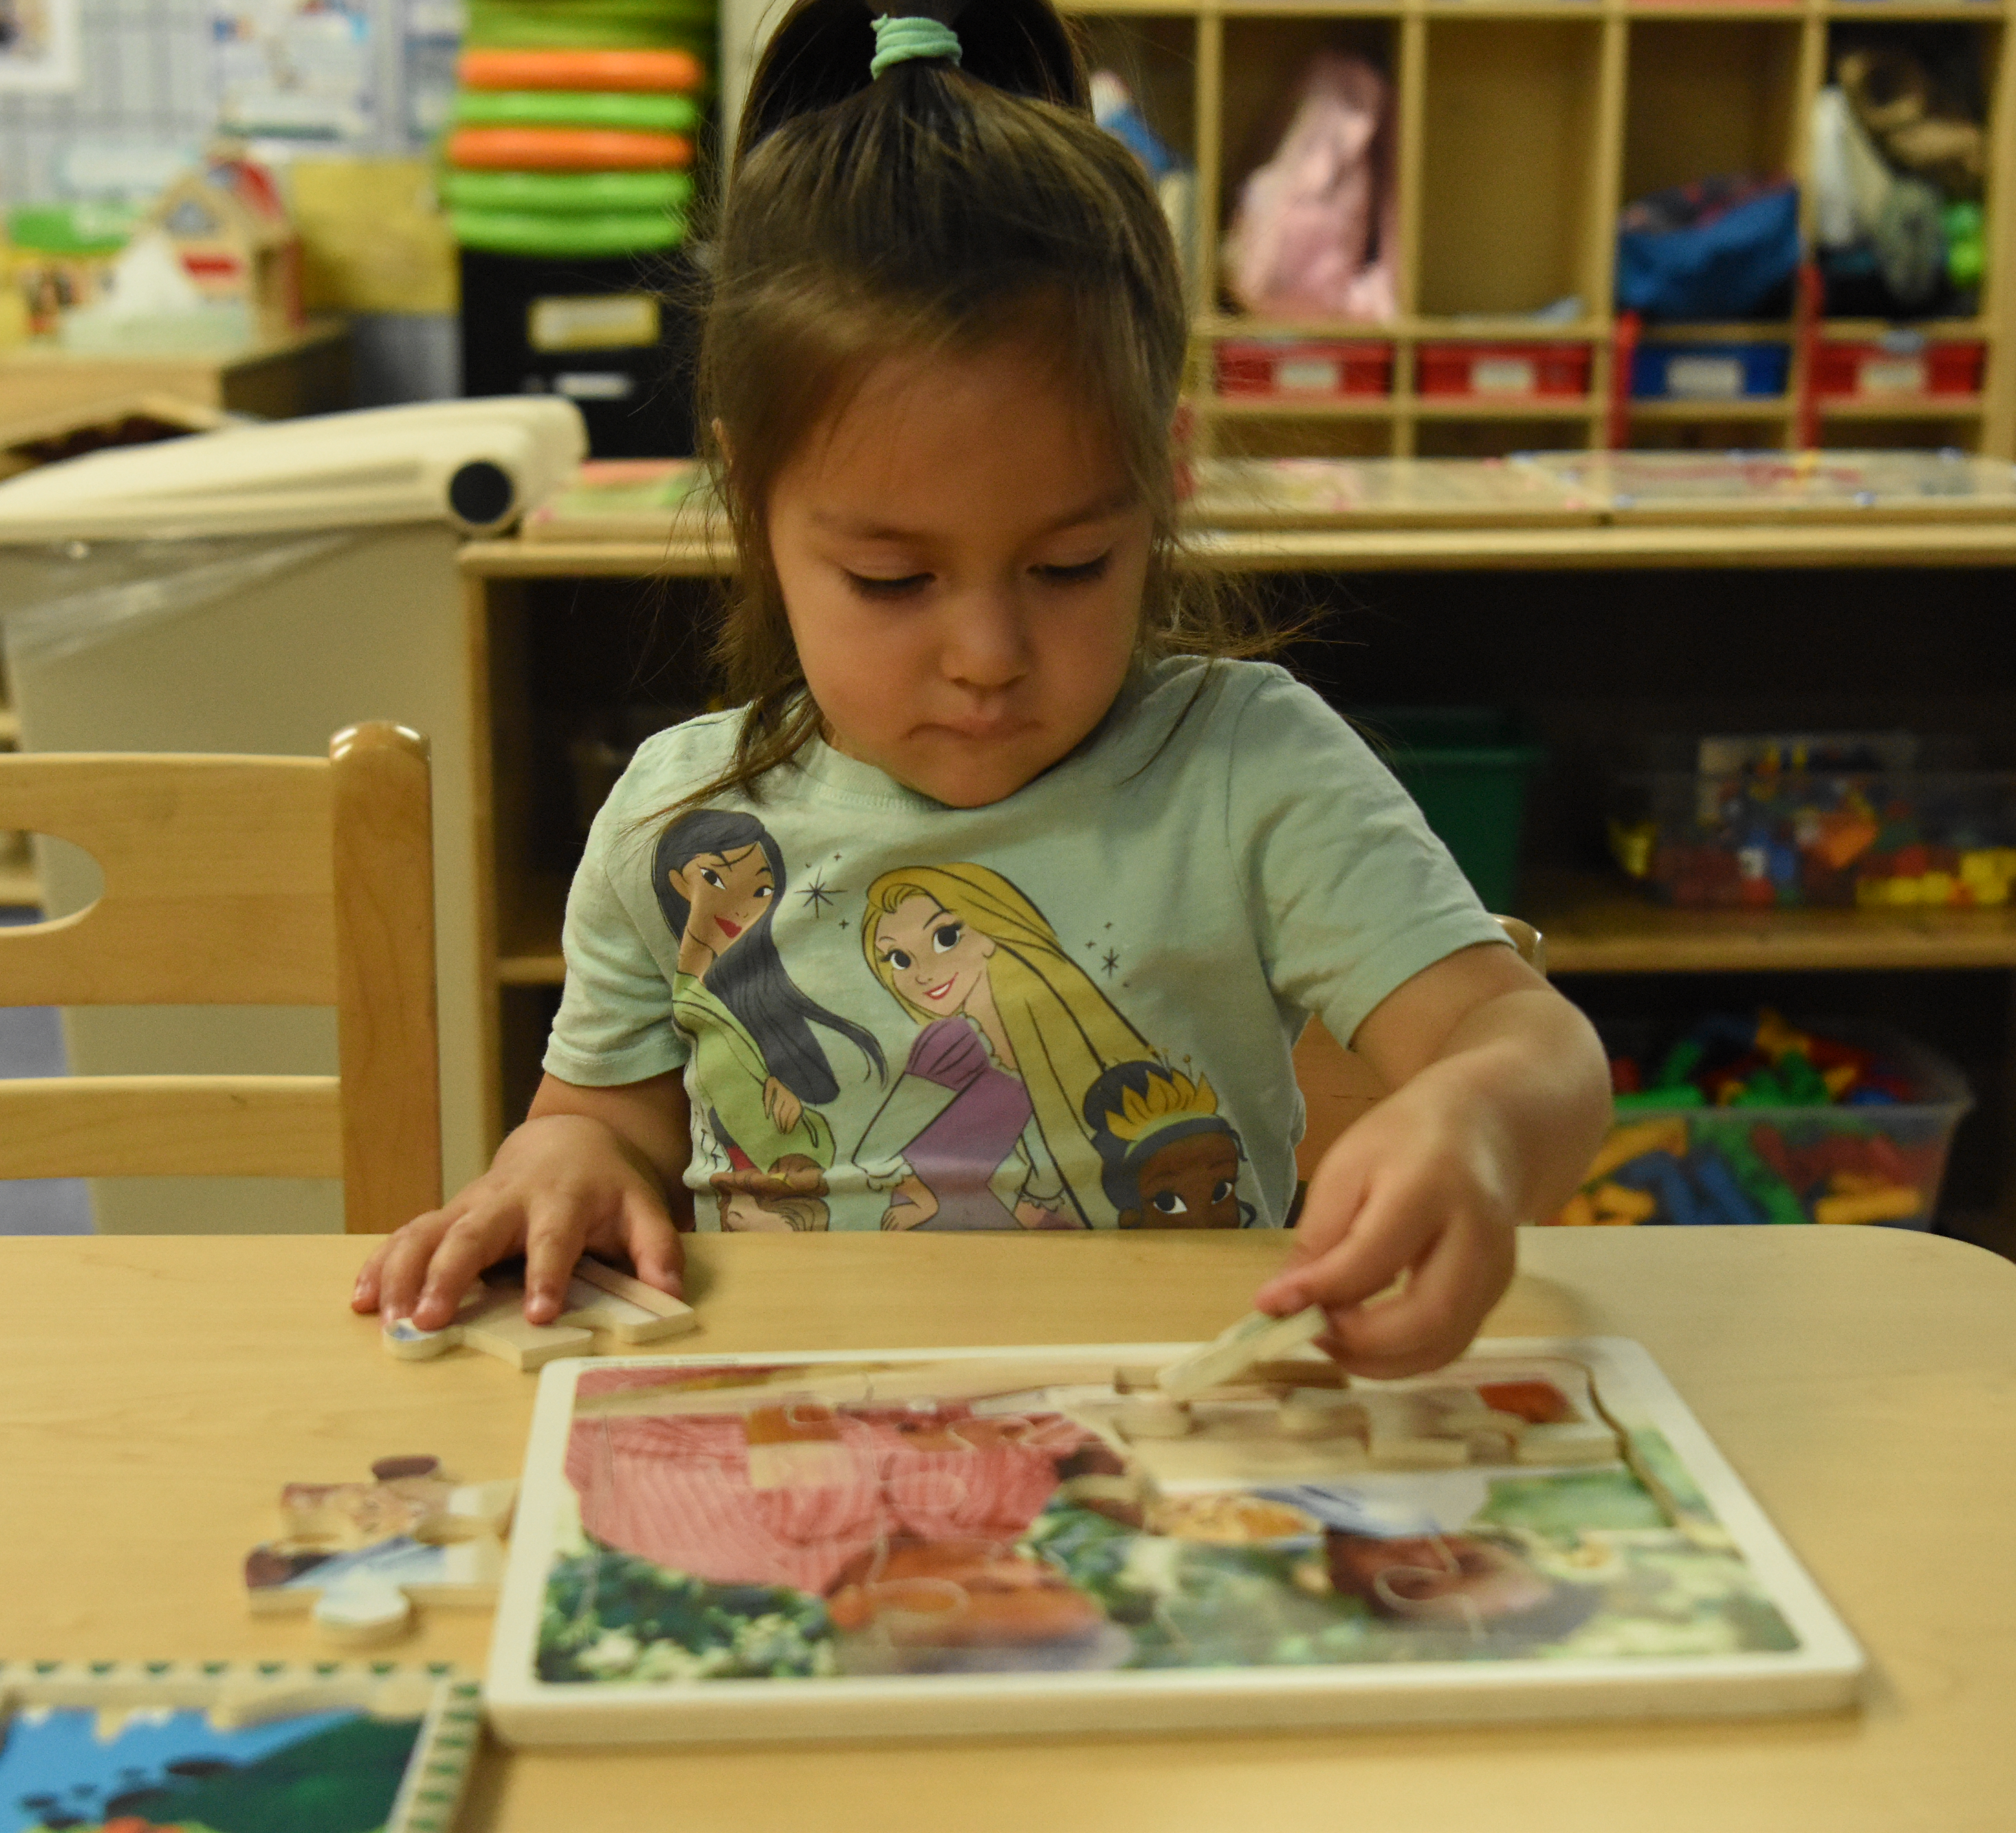
And we observe…
As children participate in the typical daily program.
Notes:
Script:
Good observation and recording methods over time are the cornerstones for using the DRDP effectively. The DRDP is not a test, but an observation-based assessment for children.
The designated teacher should complete the DRDP. Assistants, parents, and other staff should contribute observations.
Note: Family Child Care Networks have a “teacher identified” person complete the DRDP. This person may be the case manager who oversees the network care providers. The case manager consults with care providers and parents in completing the DRDP.
Slide text:
And we observe … As children participate in the typical daily program

Slide 5

Collected documentation includes:
Anecdotal notes
Photos
Work samples
Other evidence of knowledge and behaviors
Notes:
Script:
Teachers collect a substantial number of anecdotal notes, photos, work samples, and other pieces of documentation from family members and other staff that demonstrate the children’s mastered developmental levels. The organization of collected documentation can be achieved through “portfolios.”
Slide text:
Collected documentation includes:
Anecdotal notes
Photos
Work samples
Other evidence of knowledge and behaviors

Slide 6

DRDP enables us to…
determine how children are benefiting from programs.
Notes:
Script:
The DRDP findings provide agencies with information to improve their programs.
Information is shared with families during parent conferences to support parents in supporting the child’s progress.
Information can also be shared with the community to demonstrate how children benefit from involvement in the program.
Slide text:
DRDP enables us to…determine how children are benefiting from programs.

Slide 7

The DRDP Assists Providers
in meeting each child’s developmental needs in each classroom or family child care home.
Notes:
Script:
The DRDP documents the kind of work that quality programs are already doing every day.
As teachers learn more about the children in their care, the DRDP information helps them adapt and modify curriculum plans and activities for individual children, as well as for small and large groups.
Slide text: The DRDP Assists Providers … in meeting each child’s developmental needs in each classroom or family child care home.

Slide 8

The DRDP provides…
a “snapshot” of the child’s development.
Notes:
Script:
Children grow and change quickly, so a completed DRDP is a “snapshot” (i.e., a representative moment in time) of a child’s development.
All succeeding observations will document changes that result from growth and progress.

Slide 9


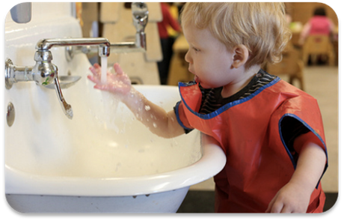
The DRDP provides a
framework for showing children’s progress over time.
Notes:
Script:
Each age-level instrument provides a framework that serves to monitor children’s progress throughout the program year.
There is a suite of DRDP instruments:
DRDP Infant/Toddler View
DRDP Preschool Transitional Kindergarten Kindergarten View
DRDP SA view
Each profile provides guidance in documenting observations that reflect the developmental growth for each age group.

Slide 10
CDSS Child Care Bulletins
In accordance with Senate Bill (SB) 98 (Chapter 24, Statutes of 2020), effective July 1, 2021, the following programs transferred to the California Department of Social Services (CDSS), Child Care and Development Division (CCDD)…
Notes:
Script:
General Child Care and Development Programs (CCTR) • California Family Child Care Home Education Networks (CFCC) • Programs for Children with Severe Disabilities (CHAN) • Migrant Child Care and Development Programs (CMIG) • Migrant Child Care Alternative Payment Programs (CMAP) • California Alternative Payment Programs (CAPP) • CalWORKs Stage 2 (C2AP) • CalWORKs Stage 3 (C3AP) • Resource and Referral Programs (CRRP) • Local Child Care and Development Planning Councils (CLPC) The California Department of Education (CDE), Early Education Division (EED) will continue to administer the CSPP, Inclusive Early Education Expansion Program (IEEEP), American Indian Early Childhood Education (AIECE) grant, and Early Head Start-Child Care Partnership grant awarded to the CDE by the United States Department of Health and Human Services, as well as other early education programs
https://www.cdss.ca.gov/Portals/9/Additional-Resources/Letters-and-Notices/CCBs/2021/CCB%2021-11.pdf?ver=2021-09-23-111708-210
If you are providing services to children with Individualized Education Programs (IEPs) or Individualized Family Service Plans (IFSPs), you are encouraged to visit the Desired Results Access website to obtain additional information about training and specific requirements.

Slide 11
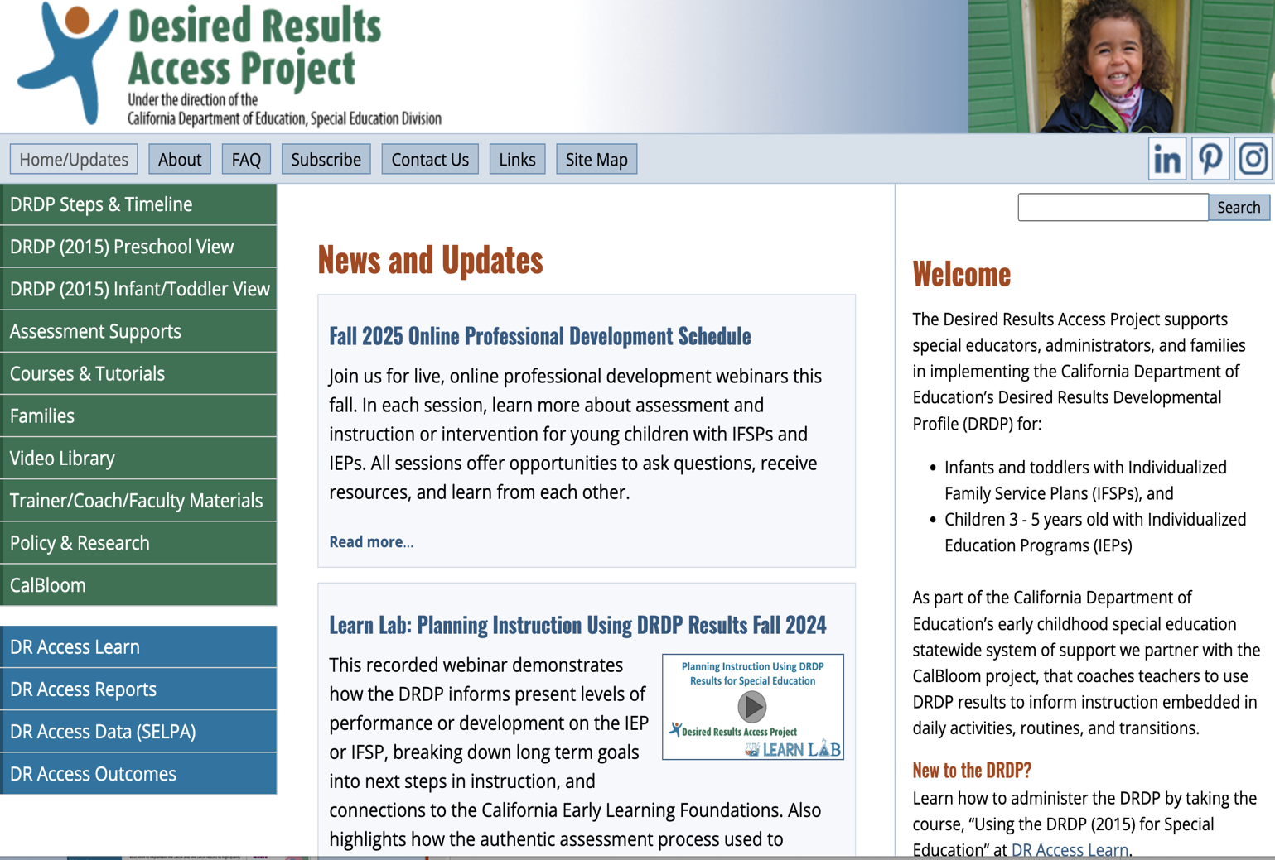
Desired Results Access Project
http://www.draccess.org
Notes:
Trainer note:
DR Access Project is a website to discover requirements specific to Special Education programs.
Participants may have additional questions about DRDP Access. Encourage them to visit the website listed on the screen to get additional information.

Slide 12
DRDP Appendices
When children are served by both Early Education Division and Special Education Division programs, the teachers and specialists are to collaborate on one assessment following the more stringent timeline and handle DRDP data according to the requirements of each division.
Notes:
Script:
More details can be found in Appendix A of the DRDP assessment.
Trainer Note:
Direct participants to Appendix A and have them read and share about the two columns.

Slide 13

Treasure Hunt - Version 1
Your group is going on a treasure hunt looking for answers about the DRDP. Use the FAQs as a resource to answer the questions below. Make sure you note which FAQ you used to answer each question.
If the program is closed one Friday every month for staff training and cleanup, how do I calculate when that first DRDP is due?
Our program likes the Creative Curriculum System. Must we use the CDE proposed curriculum instead?
One of the children in my group is amazing! I rated several measures at “Integrating Earlier,” and she does more than what is at Integrating Earlier. Is this one of those times I use “Emerging” to show she’s emerging to the next level?
Notes:
Activity: Treasure Hunt
Your group is going on a treasure hunt to find answers about the DRDP. Use the FAQs as a resource to answer the questions below. Make sure you note which FAQ you used to answer each question.
If the program is closed one Friday every month for staff training and cleanup, how do I calculate when that first DRDP is due?
Our program likes the Creative Curriculum System. Must we use the CDE proposed curriculum instead?
One of the children in my group is amazing! I rated several measures at “Integrating Earlier,” and she does more than what is at Integrating Earlier. Is this one of those times I use “Emerging” to show she’s emerging to the next level?

Slide 14

DRDP Guidelines
An age-appropriate version of the DRDP must be completed within 60 calendar days of the child’s enrollment and every six months thereafter.
60 calendar days and every 6 months thereafter
Notes:
Script:
In CDSS-funded programs, an age-appropriate version of the DRDP must be completed for all children enrolled in a California state-funded center or family child care home network.
In CDE-funded programs, a child's Desired Results Developmental Profile (DRDP) must be completed between 60 and 90 calendar days from their first day of attendance. This applies to children enrolled for at least 10 hours per week.
Trainer Note:
Clarify how often and when DRDPs are required to be completed. In CDSS programs, the emphasis is on 60 calendar days from the date of enrollment for children. Enrollment is typically determined to be the first date the child receives care.

Slide 15
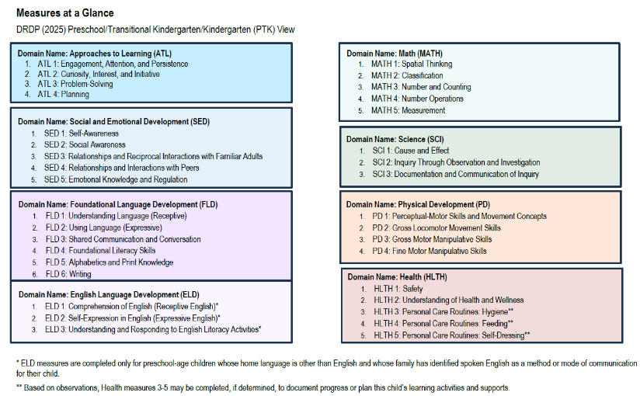
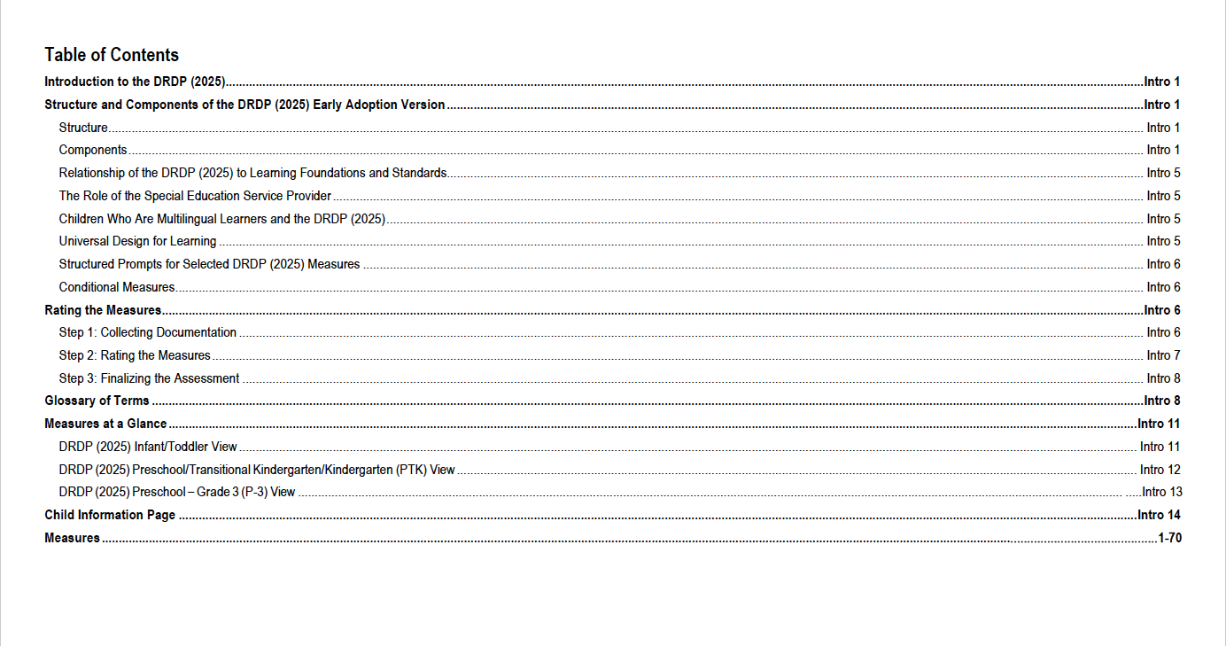
Teachers and staff need to be familiar with the DRDP
Notes:
Script:
Get to know the Desired Results, developmental domains, measures, definitions, developmental levels, and descriptors. Read through the introduction and appendices of the assessment for clarification.
The DRDP toolkit ideas, such as the mini-measures, are available on the Desired Results website and are helpful in becoming familiar with the DRDP.

Slide 16




Learning Foundations What Children Know and Are Able to Do
Notes:
Script:
The DRDP aligns with the:
Infant and Toddler Learning and Development Foundations
Preschool Transitional Kindergarten Learning Foundations
Common Core Standards
California’s foundations tell us what is age-appropriate for children.
Now let’s look at the instrument in more detail.
There will be more resources – such as videos and CECO modules released soon. Please keep an eye out for updates through the CDSS listserv and the DR listserv.

Slide 17
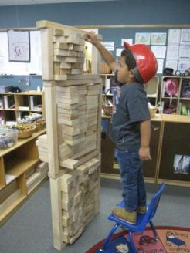
Build a Tower
Use the items on your table.
As a group, build a tower.
You have five minutes.
Notes:
Script:
Refer to DR Activity Sheet #3 – Build a Tower.
Have participants build a tower using any accessible material (cups, blocks, paper, etc.).
Slide Text: Use the items on your table.
As a group, build a tower.
You have five minutes.

Slide 18
Key Points
What was your first step?
How did you know to start there?
What does this have to do with children’s learning?
Notes:
Script:
(This is the debrief slide.)
The purpose of the activity is to establish a connection between having a foundation and supporting a structure. For us, that structure is children’s learning. Our foundation is our California Preschool and Infant Toddler Learning and Development Foundations. These are important first steps in understanding child development and the skills that children are capable of.
Slide Text:
Key Points
What was your first step?
How did you know to start there?
What does this have to do with children’s learning?

Slide 19

Why was it important to align the DRDP to the foundations?
To ensure we assess what we want children to learn and that it is aligned to what is appropriate for children of this age.
Notes:
Script:
The state has taken care to build a cohesive system.
The foundations describe children’s learning and development.
Thus, we must assess what we want children to learn and align it with what is appropriate for children of this age.

Slide 20
What is the relationship between the DRDP and the foundations?
The foundations tell us how children, with adequate support, typically learn and develop.
The DRDP provides a structure and a tool for recording an individual child’s development and documenting progress.
All volumes of the California Learning and Development Foundations provide the research backing for the DRDP (2015).
Notes:
Script:
The developmental domains work in an integrated fashion to support all four Desired Results. Ways to use the foundations and DRDP together:
Read the foundations at the beginning of the school year to understand development in a general way.
Complete the DRDP twice each year to see children’s progress.
Foundations provide the overall developmental landscape or backdrop. The DRDP helps determine where an individual child is on that backdrop.

Slide 21
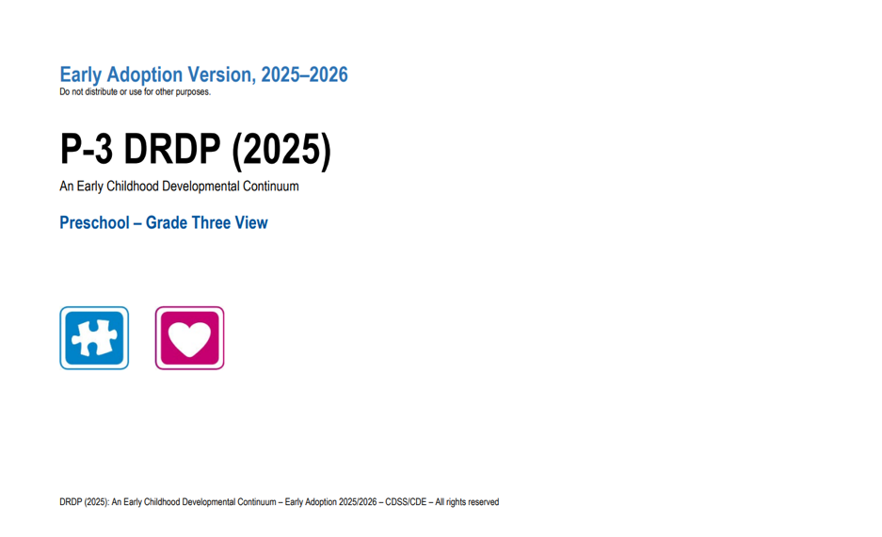
A Full Continuum Assessment (2)
Notes:
Script:
The DRDP is a full continuum assessment. The same assessment is used for all children, including children with IFSPs and IEPs.
The DRDP (2025) for infants and toddlers has six domains and 25 measures.
The DRDP (2025) for PTK has eight domains and 35 measures.

Slide 22
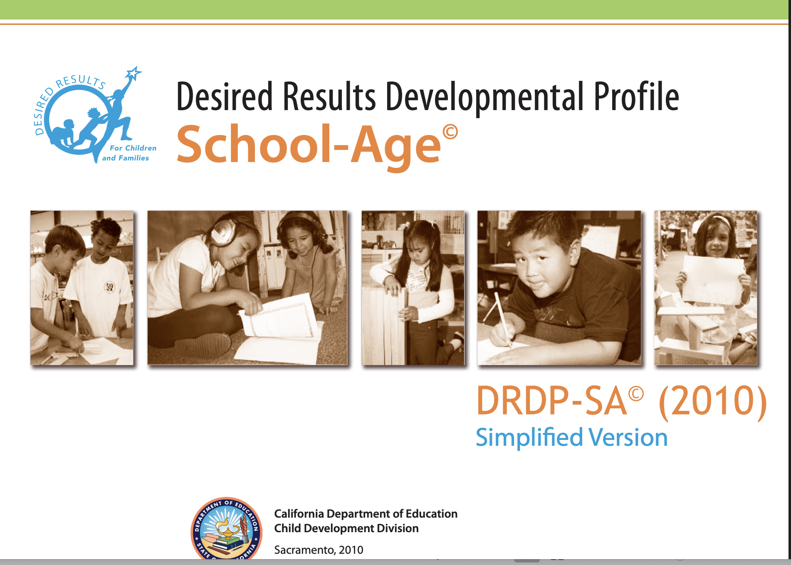
DRDP School-Age
6 domains
31 measures
2 domains
13 measures
Notes:
Script:
State-funded after-school programs may use either the DRDP-SA (2010) Simplified Version or the DRDP-SA (2010) Complete Version.
Use the DRDP-SA (2010) with school-age children from kindergarten through 12 years old, including those with an individualized education program (IEP).
DRDP SA has two versions to choose from:
DRDP–SA complete version has all 35 measures.
The DRDP-SA (2010) simplified version consists of two domains with 13 measures.
The DRDP-SA (2010) was simplified because other areas were already being assessed during the school day (e.g., reading, math). The state of California felt it was still important to assess Self and Social Development as well as Health and Safety.

Slide 23
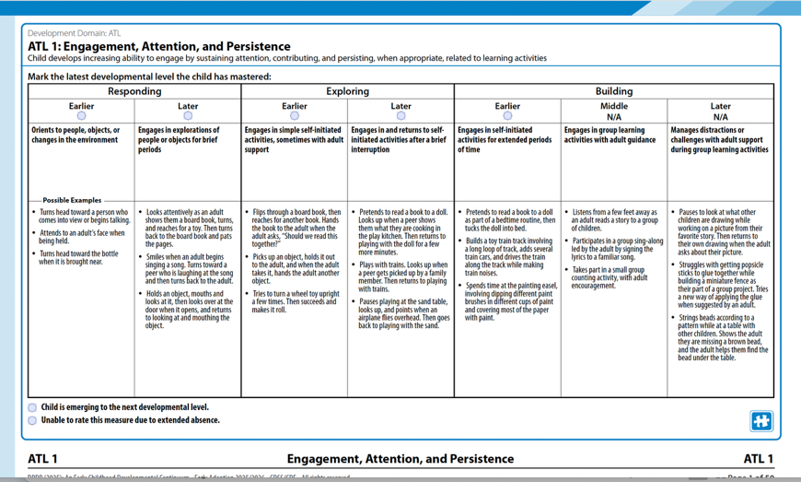
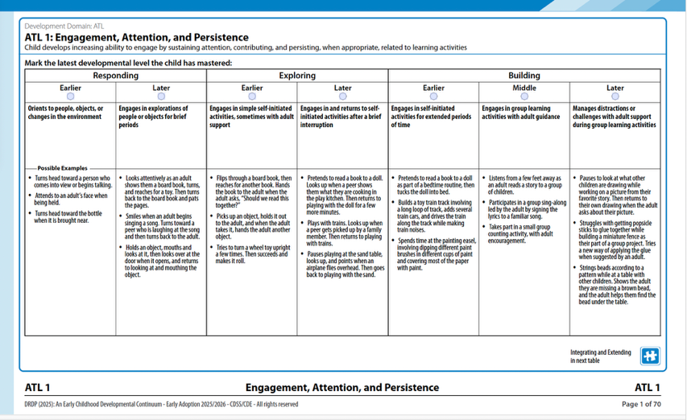
Compare and Contrast
Notes:
Activity: Compare and Contrast
Trainer Notes:
There is an activity in the Admin materials that encourages you to compare and contrast with your staff the differences between the views of the DRDP 2025. Point out how the measures are in the same domain, have the same name, and share the exact definition. Then have your staff look for the differences.
Which levels can be rated
Which levels can not be rated
Additional levels in PTK
If you are also supporting before- and after-school programs, do the same, looking for similarities and differences.
Point out the differences and similarities between the Infant/Toddler View, the PTK View, and the School Age assessment (developmental levels, measures numbered consecutively).

Slide 24
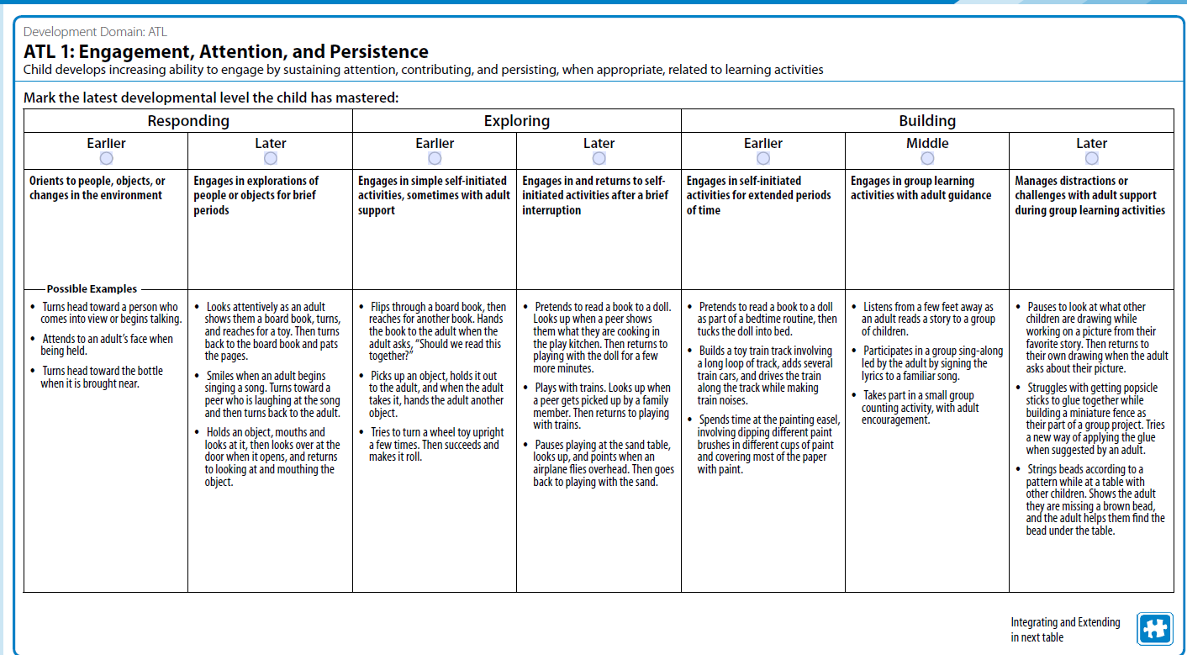
Navigation Map
Developmental Domain
Measure
Definition
Developmental Level
Descriptor
Example
Notes:
Script:
This navigation map describes domains, measures, definitions, descriptors, emerging, and examples. Follow along as we walk through the map.
The layout of the DRDP (2025) measures is similar to that of the DRDP (2015).
At the top of every DRDP measure are the developmental domains.
In the PTK view, the DRDP is made of eight developmental domains (the eight significant areas of learning).
Some of those include:
Approaches to Learning
Social Emotional Development
Foundational Language Development
Cognition, Math, Science
One notable difference in the DRDP (2025) is the inclusion of extended developmental levels, spread across two pages, to accommodate the additional detail.
Underneath the domain is the measure.
The measures are the individual skills that you need to rate for each child in the classroom.
Some domains may have four measures, some may have five, or even two measures.
It depends on the domain.
Something to remember is that the measures in any domain are interrelated, meaning they work together.
Underneath the measure is the definition. (Stop and highlight.)
The definition is critical. Please unmute and say, “The definition is very important.”
The definition is very important because it tells you exactly what you want. It’s helping you further understand what the measure is trying to assess.
Underneath the definition are the developmental levels.
The developmental levels are arranged on a continuum, progressing from left to right, from earlier to later skills.
When rating, you select one of these levels based on your observations.
Remember, you can only choose one of the levels; you are looking for the highest level mastered.
Under the developmental levels are what we like to call the heart of the measure—the descriptors.
The descriptors underneath each developmental level are in bold black and indicate the behavior or skill you need to see the child demonstrate with mastery, consistently, over time, and in different settings, to rate at that level.
Under the descriptor are examples.
Examples are just that, everybody, they are examples. They give us additional information to understand what the descriptor may look like.
Trainer Notes:
Ask participants to open the navigation map using the Padlet link above.

Slide 25
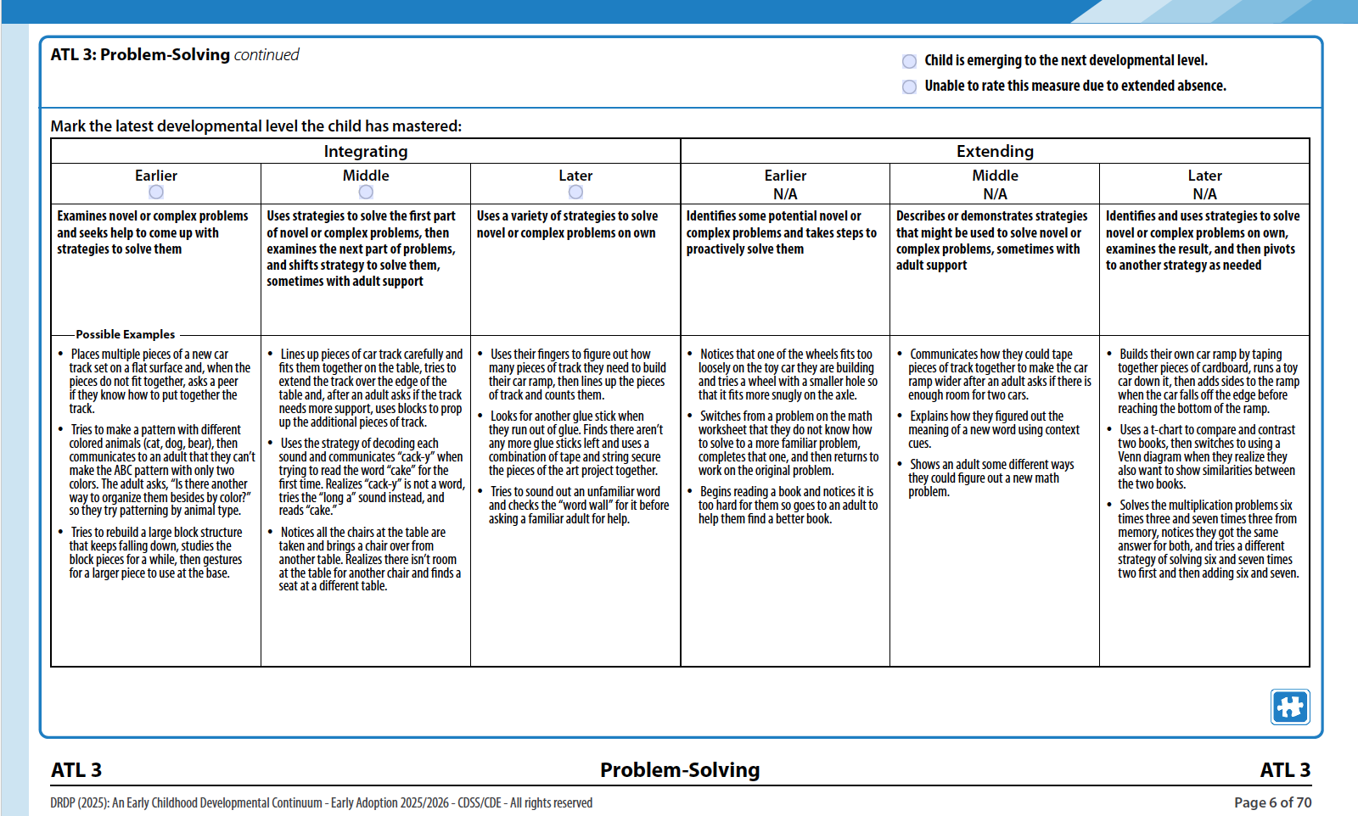
Navigation Map- continued
Emerging
Unable to rate
Notes:
Script:
You will find the additional rating options of emerging and not yet at the earliest levels on the second page of the ATL 1.
Emerging is used in conjunction with a level and cannot be used independently. Once you have rated the highest level as mastered, based on observations, determine if the child shows some skills (not yet mastered) of the very next level.

Slide 26

Remember, the examples listed…
Are only a few ways a child might demonstrate a particular developmental level.
Notes:
Script:
The purpose of the examples is to help teachers clarify where the skills could be demonstrated, i.e., some ways a teacher might see the behavior.
Encourage staff to add examples of their own observations for the developmental levels.
The DRDP examples activity for staff is located in the binder.

Slide 27
The Four Ds
Domains
The Four Ds
Definitions
Developmental levels
Descriptors
LOOK to the 4 Ds:
Domains, definitions, developmental levels, and
descriptors to clarify the intent of each measure.
Notes:
Script:
These are the four components of the DRDP – the 4 Ds.
Trainer Note:
Review the 4 Ds and emphasize that reading these components can help staff understand the intent or purpose of each measure.
The domain represents a crucial area of learning and development for children.
The definition specifies the aspect of development that is being observed.
The descriptor describes observable child behaviors associated with that developmental level.
The developmental levels for each measure represent a developmental continuum.

Slide 28
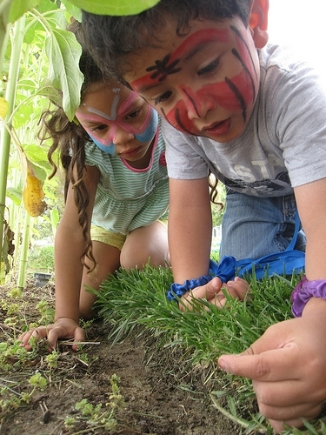
The DRDP is an
Observation-based assessment instrument.
Notes:
Script:
We will focus on observation skills, rating the DRDP, collecting DRDP data, the Summary of Findings, and the Child’s Developmental Progress form.

Slide 29

The Power of Observation
“Getting to know children as people and as learners gives you the information you need to be an effective decision-maker in the classroom.”
—The Power of Observation
Notes:
Trainer note:
Share the quote and display the book, "The Power of Observation," if available.
“Getting to know children as people and as learners gives you the information you need to be an effective decision-maker in the classroom.”
—The Power of Observation

Slide 30
Motivation
“With the information you learn from observing, you can:
select the right materials,
plan appropriate activities, and
ask questions that guide children in learning to understand the world around them.”
—The Power of Observation
Notes:
Script:
The state of California requires programs to use the DRDP for assessment as a motivator. The real reason we use observation is to get to know children.
Through observation, we gain insight into how children learn best, their strengths, their need for support materials, and their preferred language. Additionally, it enables teachers to plan engaging activities that support children's development.
Observation is a skill that can be learned and gets easier with practice. The observations we make should provide good information to inform our ratings on the DRDP.
The next activity will help you write meaningful anecdotal notes.

Slide 31

Develop Methods for Recording Observations and Collecting Evidence
Anecdotal records
Photographs
Audio and video records
Running records
Sketches
Work samples
Daily logs
Frequency counts
Notes:
Script:
Before teachers can rate the DRDP, they need to collect relevant information about the children.
Once teachers know the “what”, “when,” and “how,” they are ready to plan to observe, record, and collect evidence on children’s typical behaviors.
Teachers and staff can collect a wide variety of documentation, such as anecdotal notes, work samples, frequency count sheets, and photos, to provide evidence of mastered developmental levels across all the measures.
Enlist all teachers, support staff, and parents to contribute documentation for the children’s portfolios. We know that teachers who are successful in implementing an observation-based assessment plan for observations.
Trainer Note:
Remind participants to visit the gallery during breaks to view samples.

Slide 32
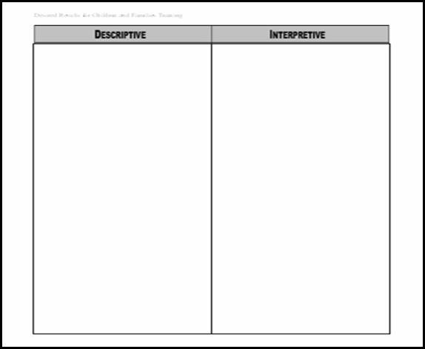
Noticing Descriptions and Interpretations
Notes:
Activity: Noticing Descriptions and Interpretations

Slide 33
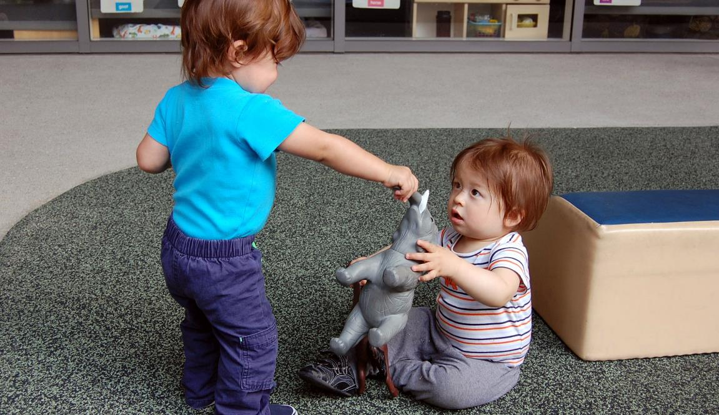
Still Photo Observation
Adapted by permission, The Art of Awareness © 2000 Deb Curtis and Margie Carter, Redleaf Press. St. Paul, Minnesota, www.redleafpress.org.
Notes:
Trainer Note:
Keep this slide up during the activity.

Slide 34
Definitions: Descriptive and Interpretive
Descriptive
Interpretive
What are the specific details?
What you actually…
Observed
Read
Heard
Example: He is holding a shirt with one hand and a pen in the other hand.
What were your initial reactions?
How you felt about what you…
Observed
Read
Heard
Example: He looks worried.
Notes:
Script:
This is a reminder of what quality notes have.
Slide text: Descriptive
What are the specific details?
What you actually…
Observed
Read
Heard
Example: He is standing in front of another child
Interpretive
What were your initial reactions?
How you felt about what you…
Observed
Read
Heard
Example: He took the toy away.

Slide 35

Steps to Completing the DRDP
Notes:
Script:
The next section of the presentation provides the steps to completing the instrument. (There is a tutorial on the Desired Results website on completing the DRDP.)

Slide 36
The Four Ds (2)
Domains
The Four Ds (2)
Definitions
Developmental levels
Descriptors
LOOK to the 4 Ds:
Domains, definitions, developmental levels, and
descriptors to clarify the intent of each measure.
Notes:
Script:
Let’s take a look at descriptors.
Trainer Note:
Review the 4 Ds and emphasize that reading these components can help staff understand the intent or purpose of each measure.
The domain represents a crucial area of learning and development for children.
The definition specifies the aspect of development that is being observed.
The descriptor describes observable child behaviors associated with that developmental level.
The developmental levels for each measure represent a developmental continuum.

Slide 37
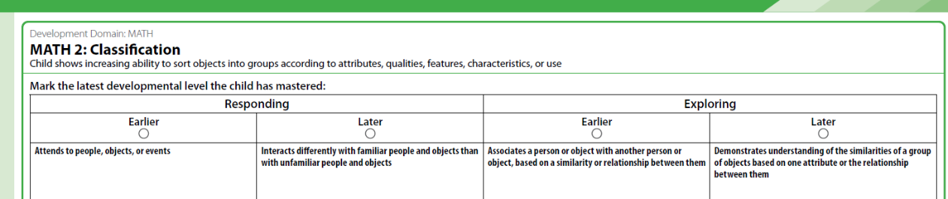
A Deeper Look at the Descriptors
Each developmental level has a descriptor that defines the behaviors that would be observed if a child were at that developmental level.
Descriptor
Notes:
Script:
The descriptor can be found directly below the developmental level in every measure.

Slide 38
When the Descriptor Says AND
If the descriptor says and, then the child must be able to demonstrate all of the behaviors during the same observation.
Notes:
Script:
But if the descriptor says AND, then the child must demonstrate all the behaviors during the same observation.
For example, if the descriptor says, “walk AND skip,” the child needs to walk and skip in the same observation.

Slide 39
Descriptor
If the descriptor says or, a child only needs to demonstrate the behavior in one of the listed ways.
Notes:
Script:
If the descriptor says or, a child only needs to demonstrate the behavior in one of the listed ways.

Slide 40
A Deeper Look at the Descriptor
Look at Math 2: Classification.
Read each descriptor carefully:
Circle the word or
Highlight and
Notes:
Script:
Now we are going to practice.
Turn to Math 2: Classification in the DRDP (2025) assessment.
Go through this measure, circle the Or and highlight the Ands in the descriptors (only in descriptors). I will give you a minute to find all the ORs and ANDs. Time starts now.
After completing this task:
Now that we are done, count the total number of "ORs" and “ANDs” you found.
Now that we know how many ANDs and ORs there are, let’s discuss the measure’s intent. What is this measure assessing?
What skills are you looking for?
(TRAINER: Chart the skills)
Background Information/Trainer Notes:
Allow up to three minutes to circle and highlight.
Go through the measure, circle, and highlight so you know how many ORs and ANDs are in the descriptors of the measure.
Check for understanding.
Examples of skills they may be looking for include understanding similarities, grouping objects based on an attribute, sorting objects by an attribute, accurately sorting more than two groups, and resorting.

Slide 41
Cognition Sample
Notes:
Script:
Administrators can show their own video and have staff analyze the descriptors. See the activity sheet: Deeper Look at Descriptors.

Slide 42
Deeper Look at Descriptors
What is the child able to do?
Look at Math 2 and the descriptors.
Which parts of the descriptors can the child do?
Notes:
Script:
Remember, we are not rating. We are looking at the child’s behavior to see how those behaviors may be related to the descriptors.
What did you see the child do? What did the child demonstrate during the clip?
Trainer Note:
Mention that evidence may be used for more than one measure.

Slide 43

Lunch Break
Notes:
Take a 15-minute break.
Trainer Note:
Remind participants to check out the gallery.

Slide 44

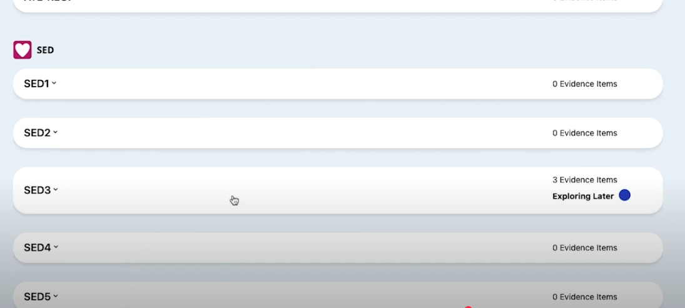
Review the collected evidence and reflect on the child’s development
Notes:
Script:
As the due date to complete the DRDP nears, review the collected evidence to ensure documentation exists to support the developmental level the child has mastered.
Use your electronic portfolio, like the DRDP Online Portfolio, to collect and review evidence.

Slide 45
How do children demonstrate a developmental level is mastered?
A developmental level is mastered when the child typically demonstrates the behavior(s)
Consistently over time
In different situations or settings
Notes:
Trainer note:
Read the slide. Give pause to let participants think about the criteria for “mastered.” Suggest that participants create a poster to display around the center, serving as a reminder for staff to adopt this as a mantra.

Slide 46
Based on observations, fill in one bubble that best describes the child’s latest developmental level mastered

Slide 47
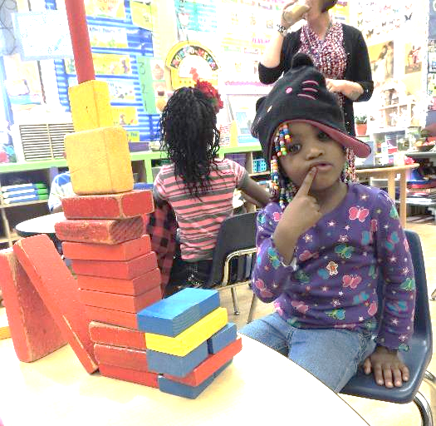
Is the child emerging?
After marking the developmental level mastered, ask, “Is the child emerging to the next level by demonstrating behaviors from the next developmental level, but not yet typically or consistently?” If so…
Notes:
Script:
After marking the developmental level mastered, ask, “Is the child emerging to the next level by demonstrating behaviors from the next developmental level, but not yet typically or consistently?” If so…

Slide 48
Emerging

Slide 49
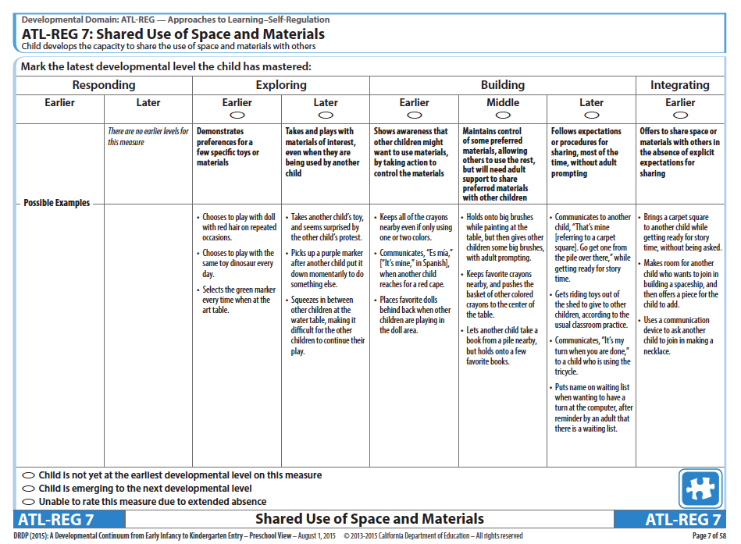
Unable to Rate
Notes:
Script:
In the rare circumstance that you are unable to rate a child on a specific measure, explain in detail the reason for a lack of rating in the box at the bottom of the page.
Unable to rate is only used for extended absences.

Slide 50
Unable to Rate (2)
Notes:
Script:
In the rare circumstance that you are unable to rate a specific measure, use unable to rate.
Unable to rate is only used for extended absences.

Slide 51
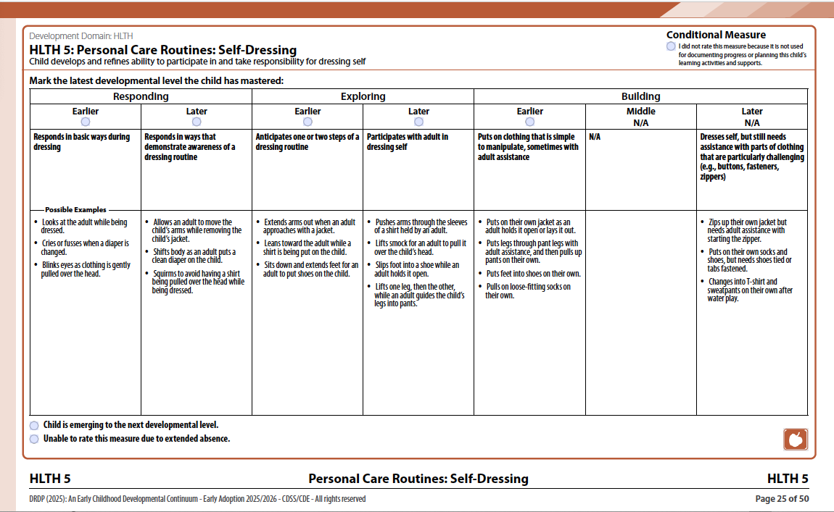
Conditional Measures
Notes:
Script:
Some measures in the DRDP are considered conditional measures, which are only assessed when certain conditions are met.
Conditional measures should be used when they assist teachers and service providers in planning a child’s learning activities and supports, as well as documenting progress.
There is a short microlearning video on YouTube to explain conditional measures.

Slide 52

Preschool English-Language Development Measures
Notes:
Script:
The DRDP PTK View includes three measures for English language development.
(There is an ELD tutorial on the Desired Results website.)

Slide 53
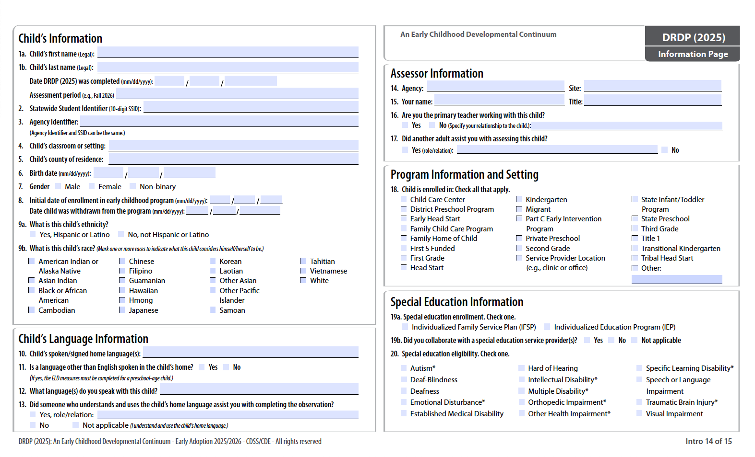
Child’s Language Information
Notes:
Script:
On Intro 14, question #11 gives directions on when to use the ELD measures.
If a language other than English is spoken in the child’s home, the ELD measures must be completed for preschool-age children.

Slide 54
Key Points for Assessing Multilingual Development
FLD is used with all children to measure progress in language and literacy development. Children may master levels in English, their home language, or through alternative communication.
ELD is used with multilingual learners learning to speak English to measure their progress in acquiring English.
Code switching is typical of multilingual development.
Notes:
Script:
Children can show progress in their home language, English, or through other forms of communication, such as gestures, sign language, or a picture communication system.
Teachers should speak the child’s home language in domains other than ELD or seek support.
Research shows that even when children mix their two languages, they tend to honor the grammatical rules of each. Code switching is influenced by the context or purpose of the child’s communication.

Slide 55

English Language Development Resources
Training on the California Preschool/Transitional Kindergarten Learning Foundations (PTKLF) is available through the California Preschool Instructional Network (CPIN).
Notes:
Script:
The domain of Language and Literacy Development includes two complementary subdomains: Foundational Language Development and English Language Development. (PTKLF p. 5)
CPIN provides training on this topic.
Go to www.cpin.us and select FIND YOUR REGIONAL LEAD in the left column. Select the appropriate region on the California map to find your Regional Lead.
Background:
The Foundational Language Development subdomain covers the foundations of language and literacy development in any language a child may be learning. It is designed for use with all monolingual and multilingual children.
The English Language Development subdomain is designed for use with multilingual children who are learning English as an additional language around the time of entry in an early education program

Slide 56
Completing a Developmental Profile
Notes:
Activity: Completing a Developmental Profile

Slide 57

Into Practice
DIRECTIONS:
Review all evidence.
Reflect on what the evidence shows.
Complete the DRDP.
Notes:
Slide text:
DIRECTIONS:
Review all evidence.
Reflect on what the evidence shows.
Complete the DRDP.

Slide 58
The Child’s Developmental Progress form is designed to…
Describe the child’s development to parents
Engage parents as partners in supporting curriculum objectives for the child
Assist in determining curriculum objectives to support the child’s development
Complete twice per year prior to the parent conference
Notes:
Script:
A progress form is used during parent conferences to describe children’s development and growth.
The progress form provides a review of the child’s strengths, areas that need improvement, and goals for developmental growth in the program and at home.
The information teachers write on the form is based on the DRDP, observations, work samples, and other evidence from the child’s portfolio, as well as information provided by parents.

Slide 59
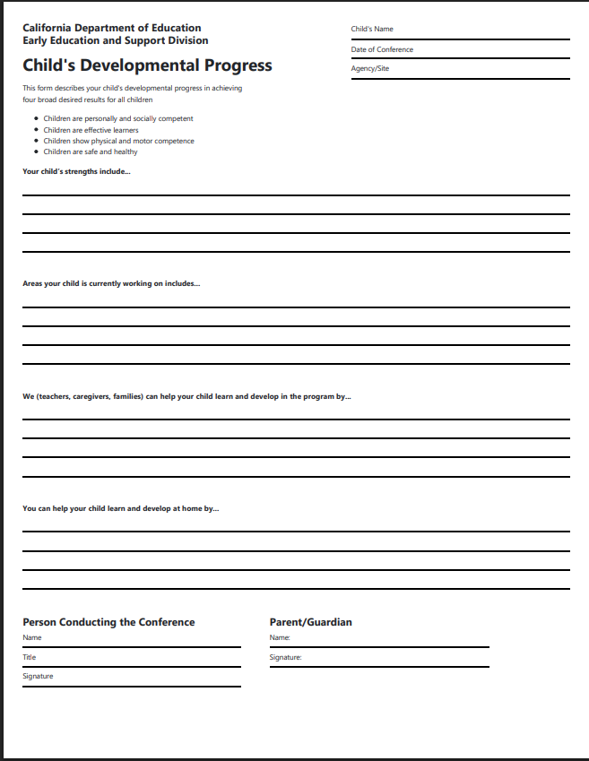
Completing the Child’s Developmental Progress Form
DIRECTIONS:
Summarize DRDP findings
List:
Three strengths
One area for improvement
A way the program helps
Notes:
Activity: Completing a Child’s Developmental Progress Form

Slide 60
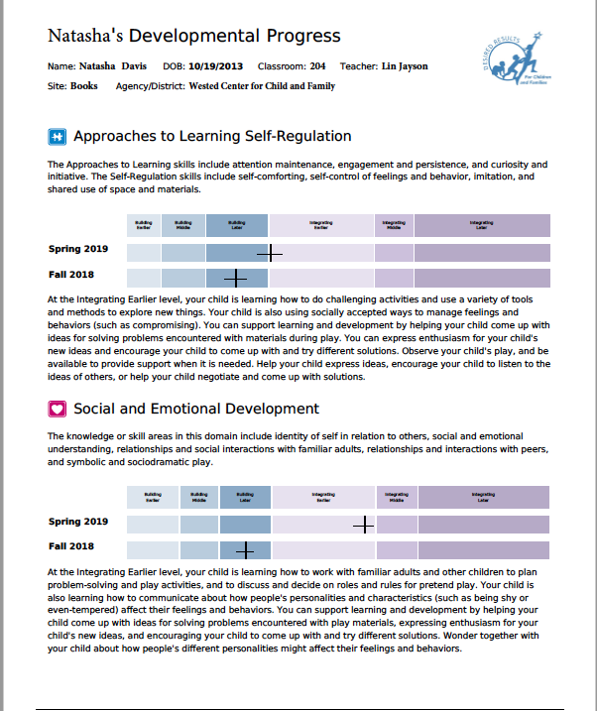
Parent Report
Notes:
Script:
“The Parent Report provides information from the DRDP assessment about your child’s knowledge, skills, and behaviors across a range of areas of development, called domains” (Parent Report Guidance for Teachers, California Department of Education).
The parent report does not specify the strengths or the areas of growth for children; it provides generic statements in the box that are helpful. But teachers must add to the boxes to individualize the information for that specific child.
Parent reports should be discussed with families, rather than being printed and handed out.

Slide 61

All About Young Children
Notes:
Script:
This website provides family-friendly information about child development in 8 different languages.
https://allaboutyoungchildren.org/english/

Slide 62
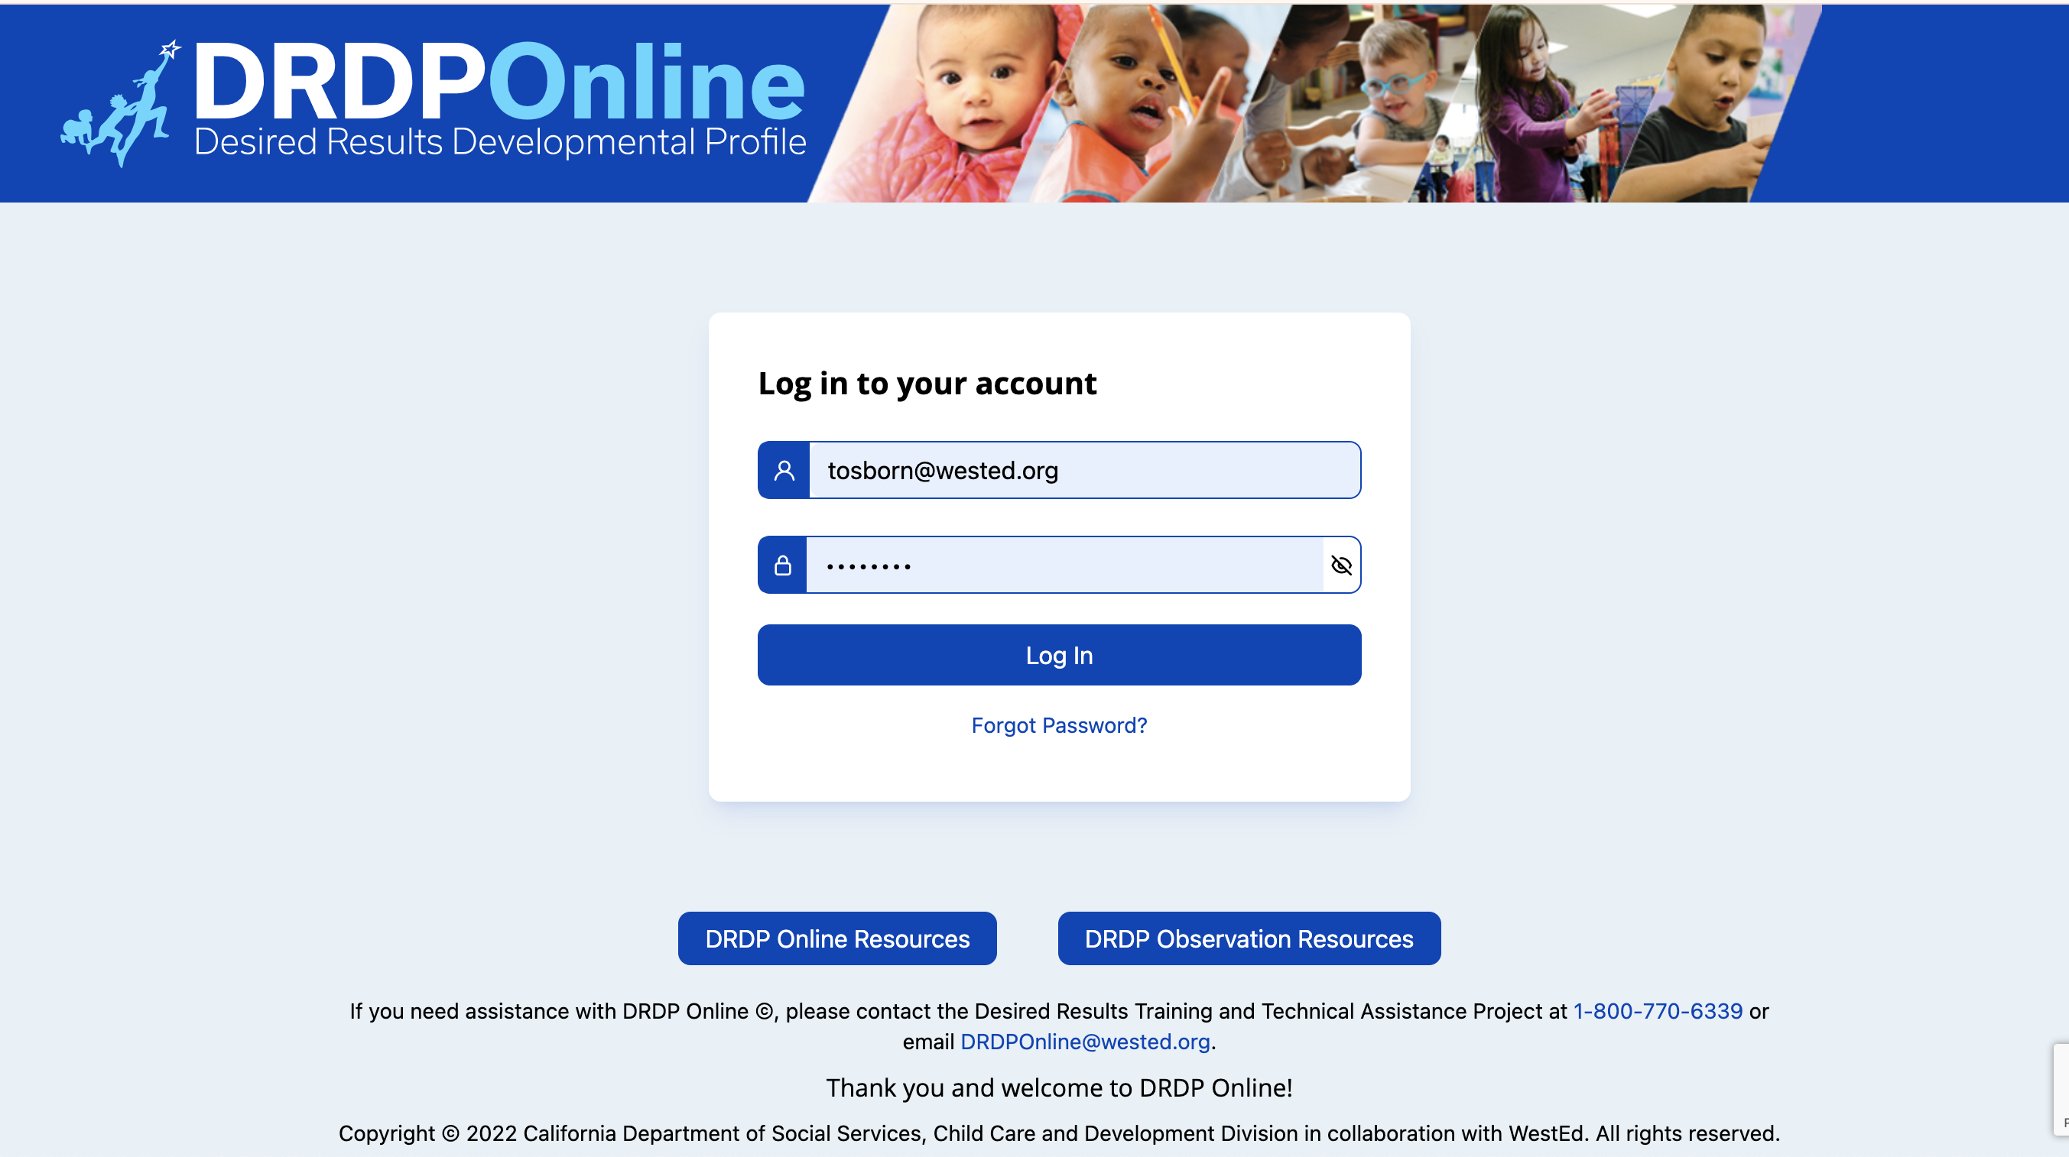
DRDP Online
*Required of all California programs*
Get information about DRDP Online on the Desired Results website: www.desiredresults.us
Notes:
Script:
DRDP Online accounts are free for CDE/CDSS-funded programs, Head Start programs, California tribal CCDF, and California K-12 school districts and all programs associated with California Quality Counts.
There are many free tutorials and webinars available to support the implementation of DRDP Online.
Program staff may schedule an appointment for support or join free webinars: https://www.desiredresults.us/drdp-online-resources

Slide 63
What is DRDP Online?
An online data entry system
An easy way to compile information about your students
Tool for printing out summary reports
Notes:
Script:
Teachers can complete the DRDP assessment using the DRDP Online system, via the internet, using a password and username. The system allows for automatic storage of DRDP data. It also allows programs to be completely paperless when completing the assessment. The data entry system compiles all the data and provides multi-level summary reports by student, by group, and even by subgroup, which can be shared with families and administrators.

Slide 64
DRDP data is compiled by…
Individual child
Classroom
Contract
DRDP Online
Commercial software programs
Notes:
Script:
Data on the DRDP is collected first at the individual child level, then at the classroom level, and then compiled at the contract level.
DRDP Online provides an online system of tools for summarizing DRDP data.
Although the individual child and classroom data are kept on site and are not sent to CDSS, they will be reviewed during your CPM/CMR. This data is also compiled and used to complete the Program Action Plan.

Slide 65
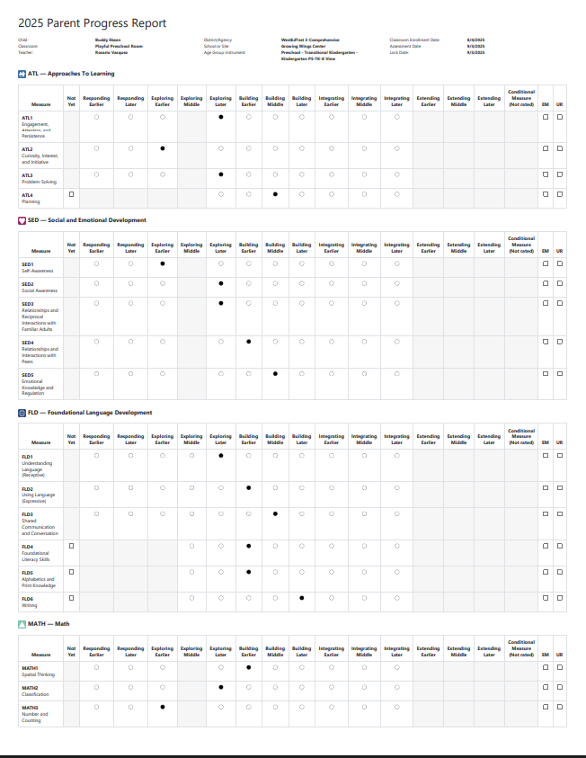
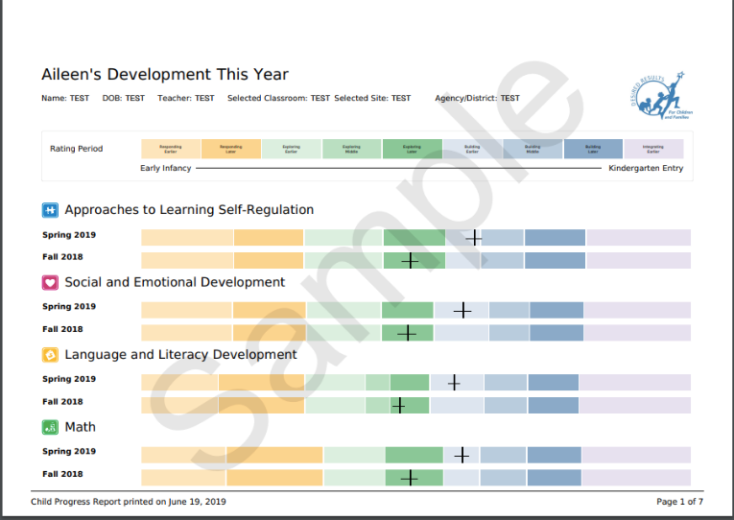
Child Reports
Notes:
Script:
After completing the DRDP, we need to use the data to share with families and to plan activities and lessons that support the child's development.
The Child Report on the left is available for the Fall 2025.
The report on the right will be available in the Spring of 2026.
The Child Development This Year report shows the child's overall developmental level in each separate domain. Child Report–provides psychometrically valid domain-level information for individual children. Teachers can use this information to visually see where children are strong in their development and where they may need additional support.

Slide 66
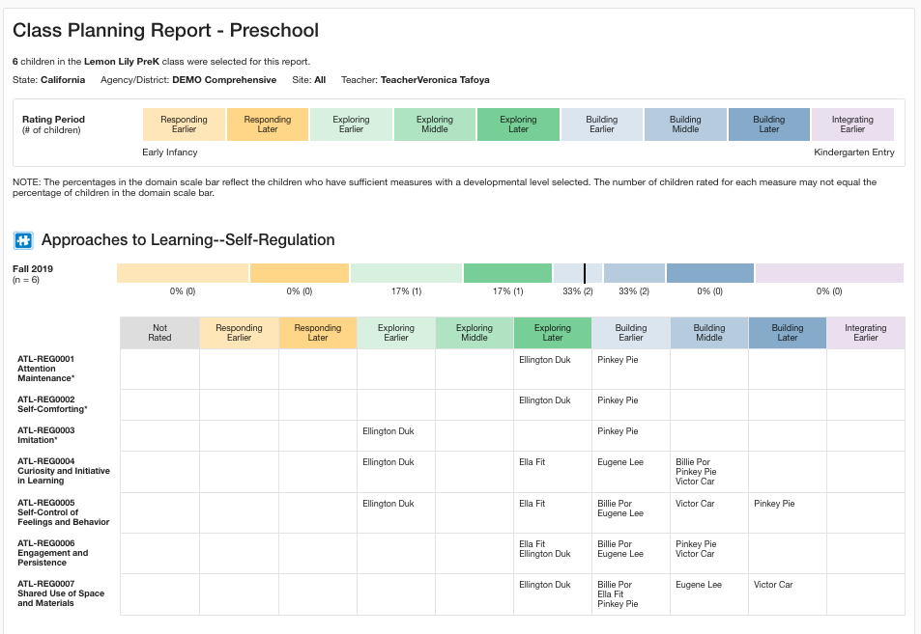
Class Planning Report
Helps to plan:
Large group
Small group
Individualize
Notes:
Script:
The Class Planning Report helps teachers modify instructional planning to meet individual needs (available in Spring 2026).
Each report features the domain score for the specific domain at the top, accompanied by numbers and percentages. Below that bar are all the measures within that domain, along with the rating for each child on each measure.
This report is most helpful when writing your classroom summary of findings.

Slide 67

What are the Curriculum Frameworks?
Notes:
Script:
After compiling your data, you must write action steps to address the data.
The Curriculum Framework chapters provide information to support children's learning in the areas described in the California Learning and Development Foundations.
The icons and their colors are used to identify domain sections inside the book. We will look at the sections of the book on the next slide.

Slide 68

What does the framework do?
“The California Preschool Framework, Volume 1 presents strategies and information to enrich learning and development opportunities for all of California’s preschool children” (Preschool Curriculum Framework, p. v).
Notes:
Script:
There is a companion Curriculum Framework for each volume of the California Learning and Development Foundations.
Slide text: “The California Preschool Framework, Volume 1 presents strategies and information to enrich learning and development opportunities for all of California’s preschool children” (Preschool Curriculum Framework, p. v).

Slide 69
Tips When Planning
Review the current curriculum to find links with the DRDP.
Summarize children’s progress by reviewing, discussing, and consulting with others who know them.
Reflect on your collection of observations, including photos, notations, audio tapes, sketches, etc.
Consult other resources to support planning for the needs of children’s developmental levels.
Notes:
Script:
It’s important to plan to observe. When planning an activity for children, consider what to include in relation to the DRDP. This does not mean setting up a testing situation; instead, it involves creating an invitation for children to interact with materials, their peers, or an adult who may provide an observation opportunity related to the DRDP.
Slide Text:
Review the current curriculum to find links with the DRDP.
Summarize children’s progress by reviewing, discussing, and consulting with others who know them.
Reflect on your collection of observations, including photos, notations, audio tapes, sketches, etc.
Consult other resources to support planning for the needs of children’s developmental levels.

Slide 70

All teachers…
must use the results of assessments of children’s progress to support each child’s learning and development.
Notes:
Script:
All teachers, whether teaching in a Head Start or state preschool program, must use the results of the DRDP to support each child’s learning and development.

Slide 71
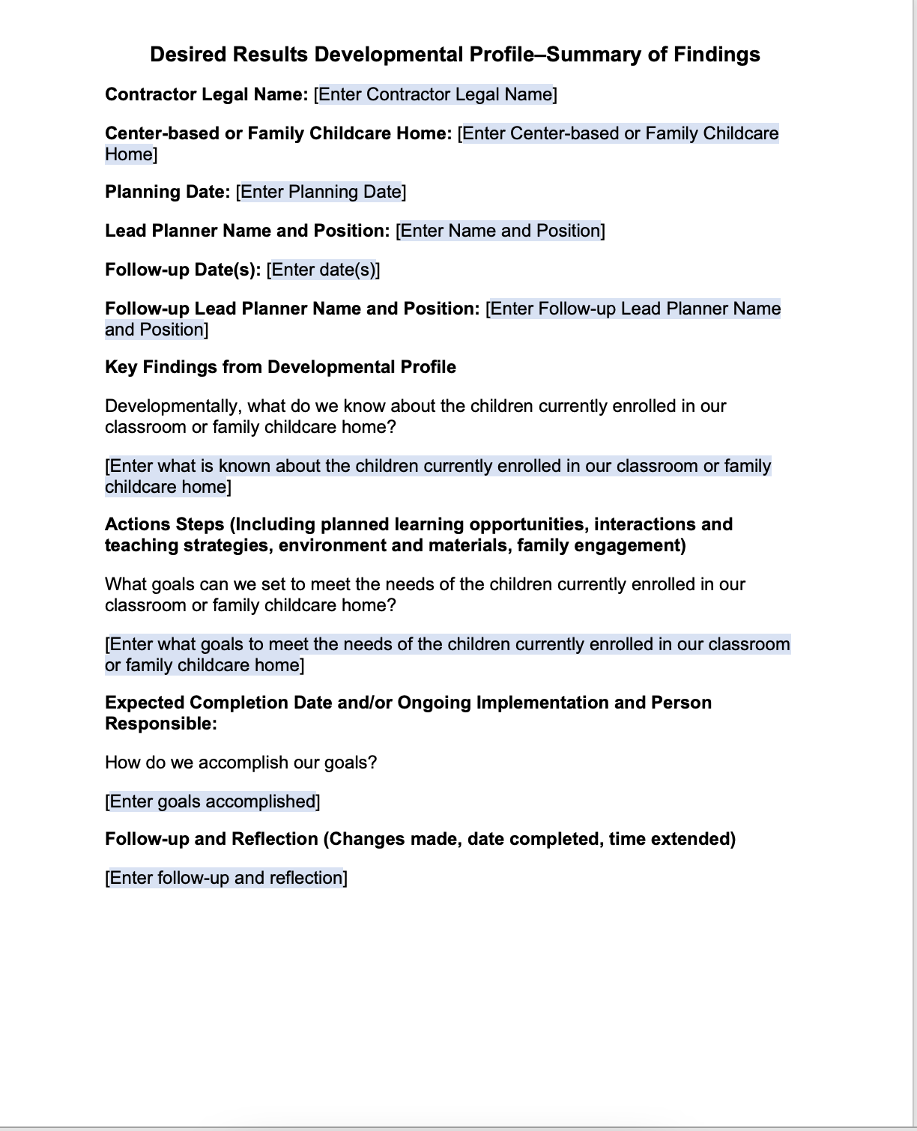
DRDP Classroom Summary of Findings
Notes:
Script:
Programs are required to summarize the data at both the classroom and contract levels to determine key findings and action steps. These are trends or main points that require action. Consider where teachers would like to see change or progress for the children in their class, based on their data. Where will you invest your time, energy, and resources to bring about change?
Trainer note:
After sharing, ask participants to view the sample DRDP Classroom Summary of Findings.
These findings will inform administrators and guide them in making continuous program improvements.
California state consultants will review the DRDP Classroom Summary of Findings forms to ensure that programs are utilizing the data to inform their “continuous improvement” process.

Slide 72
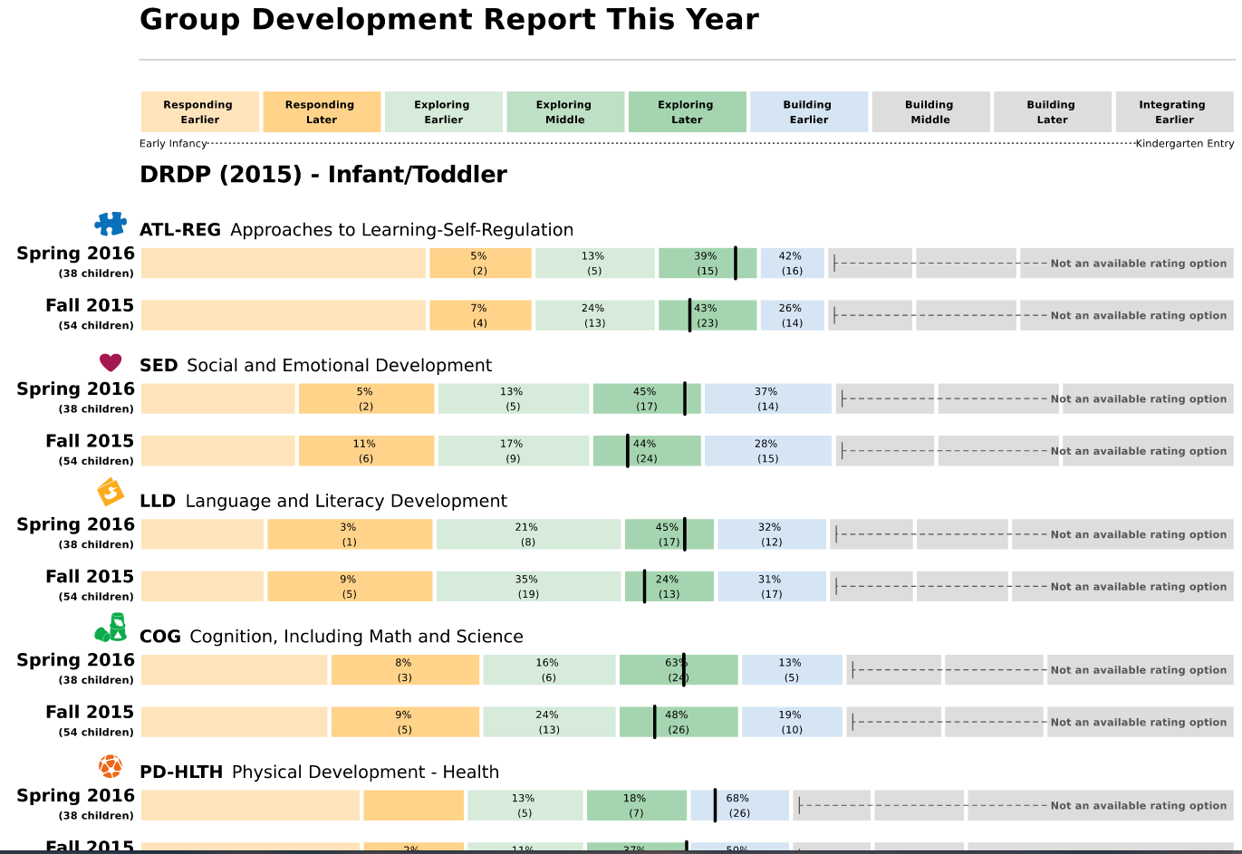
Small and Large Group Planning
Use the data provided from DRDP Online to plan for individual children, as well as for small and large group activities.
Notes:
Script:
This is one example of what the data may look like. This is a Progress this Year report. In your classroom or agency planning process, you would review the DRDP data provided through your DRDP Online reports to support planning for the groups of children in your own classroom.

Slide 73
Small and Large Group Planning (2)
Use the data provided from DRDP Online to plan for individual children, as well as for small and large group activities.

Slide 74
Writing a DRDP Summary of Findings
DIRECTIONS:
Review narrative and DRDP Group Data Summary.
Identify key findings.
Draft action steps.
Notes:
Activity: Writing a Summary of Findings
DIRECTIONS:
Review narrative and DRDP Group Data Summary.
Identify key findings.
Draft action steps.

Slide 75
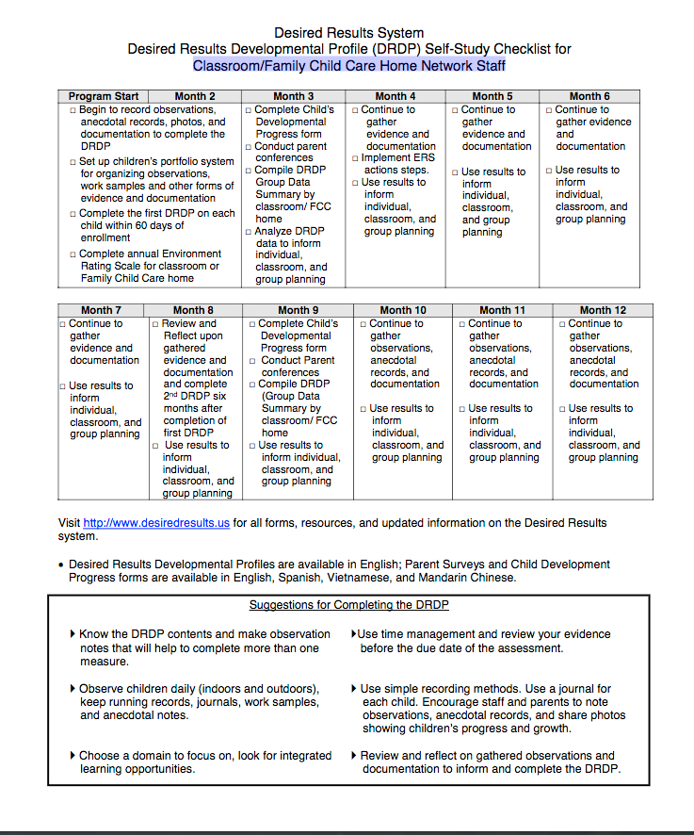
Self-Study Checklist
Use the
Self-Study Checklist for Classroom/Family Childcare Home
Network Staff
to plan the classroom/group
Calendar.
Notes:
Script:
Let's create a calendar of how we collect and organize documentation, when the first DRDPs are due, and when to complete the classroom summary of findings.
Use the Self-Study Checklist for Classroom/Family Child Care Home Network staff to plan the classroom/group calendar.

Slide 76
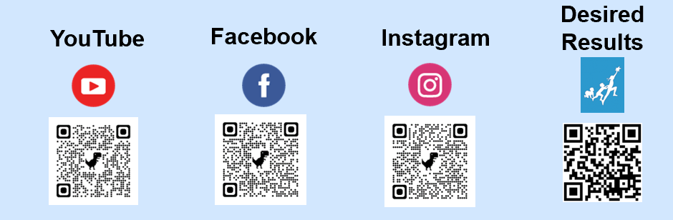
Contact Information
Desired Results
Phone: 800-770-6339
Web address: www.desiredresults.us
Notes:
Script:
Providers can contact the project if they have any questions regarding the training or the DRDP. If you cannot find something on the website or need help, give them a call.

Slide 77
Questions and Answers
Notes:
Questions and answers

Slide 78


Thank you!
Notes:
Thank you!

