Slide 1

CDSS Attribution
This training is funded by the California Department of Social Services (CDSS). The materials included in this training were developed in part or wholly by the California Department of Education (CDE) and produced by CDSS.
State of California Department of Social Services, Copyright (2025)
Notes:
This training is funded by the California Department of Social Services (CDSS). The materials included in this training were developed in part or wholly by the California Department of Education (CDE) and produced by CDSS. (State of California Department of Social Services, Copyright [2025])

Slide 2
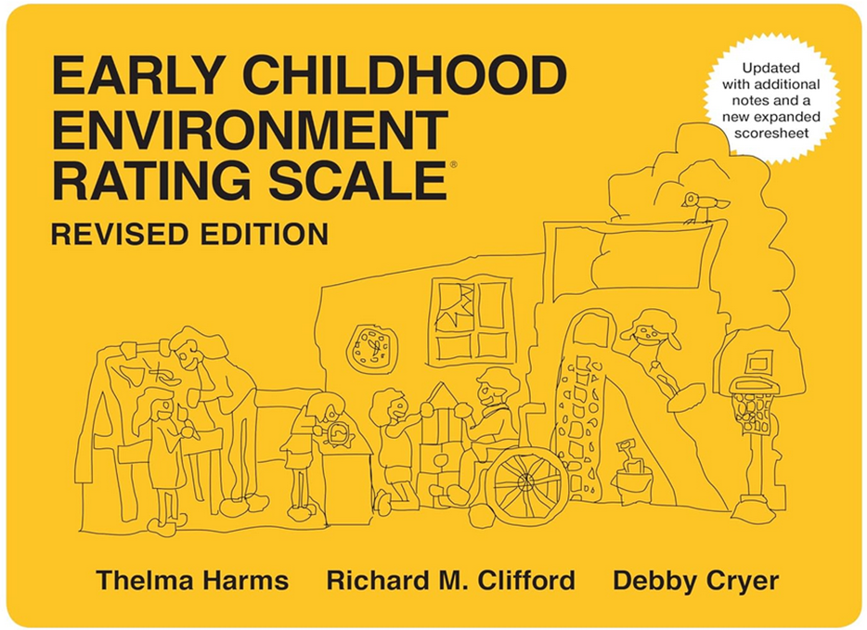
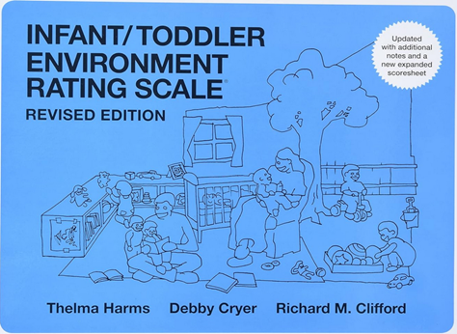
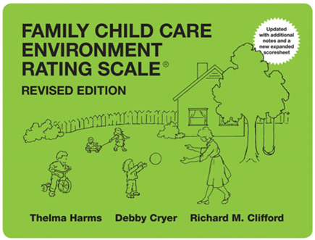
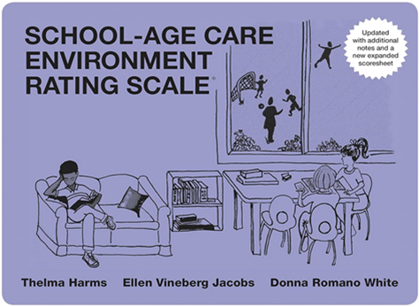
Desired Results for Children and Families
Session V: Environment Rating Scales
A Project of the California Department of Social Services with the Desired Results Training & Technical Assistance Project
Notes:
In this part of the training, participants will receive an introduction to the Environment Rating Scales to measure program quality in classrooms, child care homes, and centers.
There are four scales:
Infant/Toddler Environment Rating Scale (ITERS-R)
Early Childhood Environment Rating Scale (ECERS-R)
School-Age Care Environment Rating Scale (SACERS)
Family Child Care Environment Rating Scale (FCCERS)

Slide 3
The Environment Rating Scales
The Environment Rating Scales (ERS) are designed to assess process quality in an early childhood or school-age care group:
  Interactions
  Space
  Schedule
  Materials
Notes:
The Environment Rating Scales have good inter-rater reliability and validity and have been part of many research studies.
The Environment Rating Scales are designed to assess process quality in an early childhood or school-age care group. Process quality consists of the various interactions that go on in a classroom between staff and children, among the children themselves, and the interactions children have with the many materials and activities in the environment—as well as those features such as space, schedule, and materials that support these interactions.
Process quality is assessed primarily through observation and has been found to be more predictive of child outcomes than structural indicators, such as staff to child ratio, group size, cost of care, and even type of care (e.g., child care center or family child care home).
(See the Scales page of the Environment Rating Scales Institute [ERSI] website.)
Slide text: The Environment Rating Scales are designed to assess process quality in an early childhood or school-age care group.
Interactions
Space
Schedule
Materials

Slide 4
Quality Programs
Quality programs must provide for the three basic needs all children have:
Protection of their health and safety
Positive relationship building
Opportunities for stimulation and learning from experience
(See the Scales page of the Environment Rating Scales Institute [ERSI] website.)
Notes:
To provide care and education that will permit children to experience a high quality of life while helping them develop their abilities, a quality program must provide for the three basic needs of all children:
Protection of their health and safety
Positive relationship building
Opportunities for stimulation and learning from experience
No one component is more important than the others, nor can one substitute for another. It takes all three to create quality education.
Each of the three basic components or qualities manifests in tangible forms within a program’s environment, curriculum, schedule, supervision, and interactions; and the components can be observed. These are the key aspects of process quality that are included in our environment rating scales.
(See the Scales page of the Environment Rating Scales Institute [ERSI] website.)

Slide 5
Quality Matrix and the Desired Results System
The Quality Continuum Framework – Measured Quality Elements (QCF) (formerly called the Rating Matrix) includes elements that are research-based indicators of quality. It provides a recommended framework, or structure, for quality improvement.
Quality Counts California, Quality Continuum Framework – Measured Quality Elements document, July 2023
Notes:
The Environment Ratings scale is also a part of the Quality Continuum Framework. The Quality Continuum Framework – Measured Quality Elements (QCF) (formerly called the Rating Matrix) includes elements that are research-based indicators of quality. It provides a recommended framework, or structure, for quality improvement.
This year, there is no rating happening from the quality program; however, ERS observations are necessary to help us see what has happened to the quality of programs as they shift priorities. If programs are open and serving children, we cannot stop completing ERS observations: this would make us blind to what is happening to children in programs.
It is still relevant to examine how well the range of children’s developmental needs are being met.

Slide 6
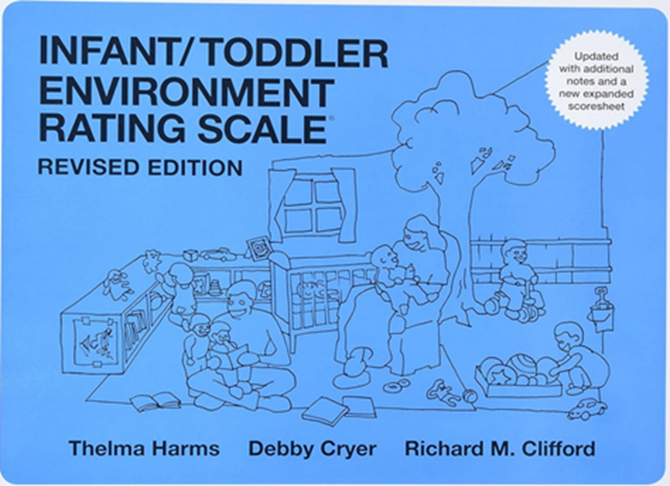
Environment Rating Scales
The Environment Rating Scales are required tools for the Program Self-Evaluation and the ongoing continuous improvement process.
Notes:
California adopted the Environment Rating Scales in 2001 as part of the Desired Results system.
The Environment Rating Scales are required tools for the Program Self-Evaluation and the ongoing continuous improvement process.
Circle the age-level instrument you are using in your program.

Slide 7
Items and Subscales for Early Childhood and Infant/Toddler
7 subscales and 43 items
7 subscales and 39 items
Notes:
The Early Childhood Environment Rating Scale has seven subscales and 43 items; the Infant/Toddler Environment Rating Scale has seven subscales and 39 items.

Slide 8
Items and Subscales for School-Age and Family Child Care (FCC)
7 subscales and 43 items
7 subscales and 38 items
Notes:
The School-Age Environment Rating Scale has seven subscales and 43 items; the Family Child Care Environment Rating Scale has seven subscales and 38 items.

Slide 9
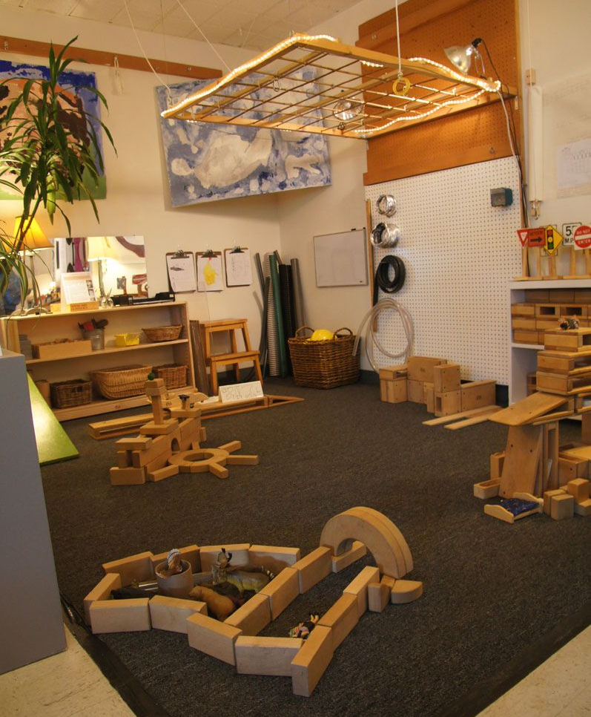
Requirements
Agencies are required to complete an ERS for each of the following:
Classroom
Site
Contract
Notes:
No matter the size of a program or agency, data is compiled at the classroom level for the Environment Rating Scale. Each program is responsible for the ERS data to be grouped by the following:
1st—Classroom/FFCHEN home
2nd—Site/FFCHEN home
3rd—Program or agency compiled by age group and contract
Compile all the ITERS, ECERS, FCCERS, and SACERS. Fill out the Summary of Findings form or write/type it on one sheet of paper.
Slide text:
Agencies are required to complete an ERS for each of the following:
Classroom
Site
Contract

Slide 10
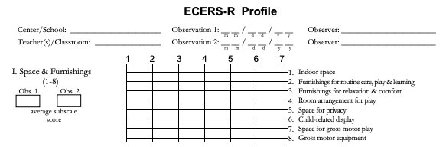
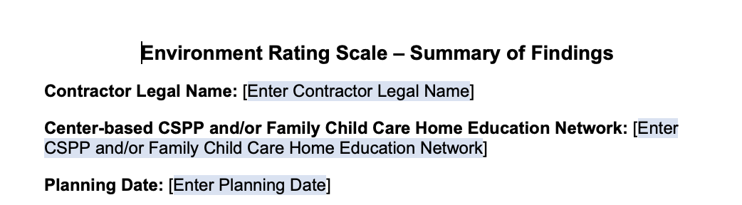
ERS Profile and Summary of Findings
Complete one per classroom
Complete one per classroom, site, and contract
Notes:
At the end of your age-appropriate ERS booklet, there is a profile sheet used to summarize scores across the assessment. (Complete one per classroom.)
After calculating the classroom score, classrooms will then complete an ERS Summary of Findings. (Complete on per classroom, site, and contract.)

Slide 11
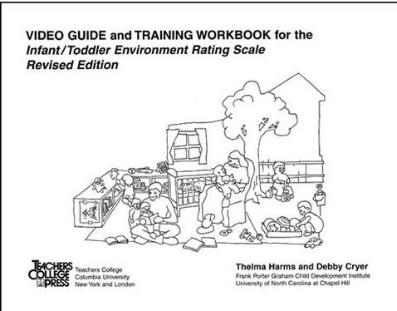
Introduction to the ERS
Notes:
Activity: Introduction to the ERS
The video for this activity training workbook can be found on the Vimeo website under the Early Childhood Environment Rating Scale title.
Bring up the Video Guide and explain the scoring. (Show page 3 and the scoring rules.) Provide 8 minutes to read through the guide.
Turn to page 7 of the Video Guide and do a sample of scoring using item 2.

Slide 12
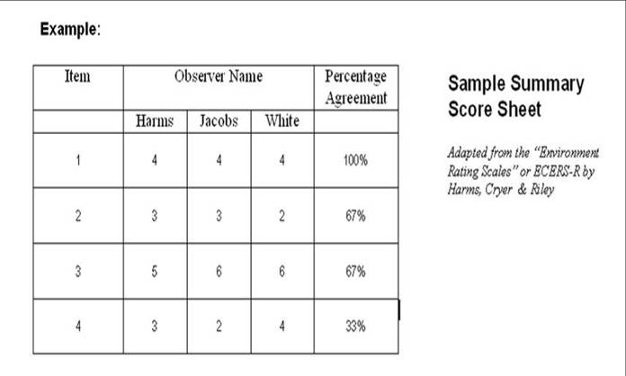
ERS Inter-Rater Reliability
Notes:
Inter-Rater Reliability is an activity found in the binder that you can do with your staff.
Have each teacher score an item and discuss how they scored it.

Slide 13
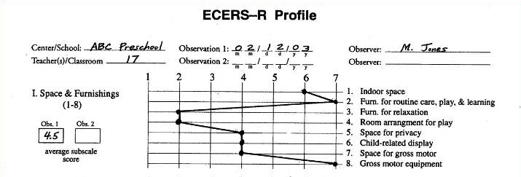
Early Childhood Environment Rating Scale-Profile Worksheet
Notes:
After teachers and administrators finish administering the ECERS, they plot the scores on this simple graph. This visual graph helps programs see which items and subscales fall below a score of “5.”
Any item score below a “5” in classrooms requires identification and action steps on the classroom ERS Summary of Findings.
Agency ERS Summary of Findings will identify subscale score averages (for all classrooms/Family Child Care [FCC] homes) below a “5” in the contract summary.
Trainer note: Ask participants to compute the average score for subscale II personal care routines. (Add the scores for each item and divide the sum by the number of items to compute the average subscale score.)

Slide 14
ERS Summary of Findings Sample
List the items that score below a 5.0.
Subscales and Average Scores:
Item 22—Blocks (1)
Item 24—Dramatic Play (4)
Key Findings from Environment Rating Scale (ERS Items):
The blocks in the classroom are not accessible to children. The classroom has an insufficient number of blocks for two children to build a structure.
Notes:
Activity: ERS Summary of Findings
Make sure activities are at the classroom level.
Slide Text:
List items that score below a 5.0.
Subscales and Average Scores:
Item 22—Blocks (1)
Item 24—Dramatic Play (4)
Key Findings from Environment Rating Scale (ERS Items): The blocks in the classroom are not accessible to children. The classroom has an insufficient number of blocks for two children to build a structure.

Slide 15
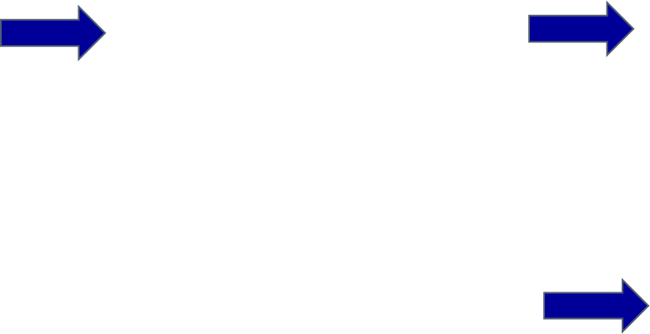
Steps to Completing the Agency Environment Rating Scale
Classroom
Complete Classroom/FCC Home Summary of Findings
Score ER Scale
Complete Profile
Compile ERS Profile Data by Contract
Complete Summary of Findings by Contract
Agency
Notes:
Trainer note: Review the steps to complete the ERS process.
Classroom: Score ER Scale; Complete Profile; Complete Classroom/FCC Home Summary of Findings
Agency: Compile ERS Profile Data by Contract; Complete Summary of Findings by Contract
Emphasize the following:
Agencies need to compile the classroom profiles data into one document and find the subscale average.
They then need to address all subscale averages that fall below a “5.”
One comprehensive ERS Summary of Findings per contract goes to CDE with the agency’s annual report.

Slide 16
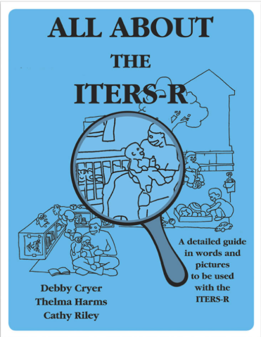
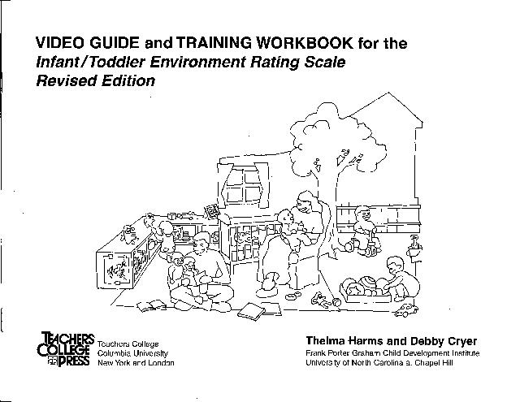
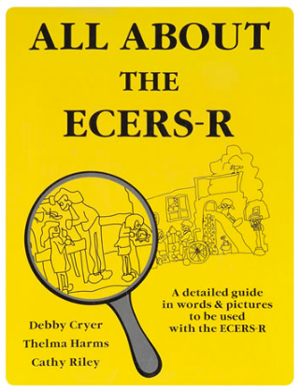
Staff Training Resources
Notes:
The VIDEO GUIDE and TRAINING WORKBOOK resources are excellent for are training staff. Many of the Resource and Referral agencies (R&R) include them in their lending libraries.
The All About the ECERS-R and All About the ITERS-R books are also invaluable resources for staff. Many agencies provide training in California on the ERS.
The All About resource guides interpret each item and indicator on the scale and provide photographs of real-world settings. It helps users use the ERS to accurately assess their early learning environment in the areas of cognitive, social-emotional, and physical development—as well as health and safety standards.

Slide 17
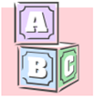
ERS Cards
Blocks
Item 22. Blocks are materials suitable for building sizable structures. Types of blocks are unit blocks (wooden or plastic, including shapes such as rectangles, squares, triangles, and cylinders); large hollow blocks (wooden, plastic, or cardboard; homemade blocks (materials such as food boxes and plastic containers). At least 2 types of blocks and a variety of accessories are accessible daily for 3 or more children at the same time.
3.1 Accessories enrich block play. Examples are toy people, animals, vehicles, and road signs.
Notes:
ERS cards are available on the Desired Results website to download and print for free. This is an example of the Blocks card:
Item 22. Blocks are materials suitable for building sizable structures. Types of blocks are unit blocks (wooden or plastic, including shapes such as rectangles, squares, triangles, and cylinders); large hollow blocks (wooden, plastic or cardboard; homemade blocks (materials such as food boxes and plastic containers). At least 2 types of blocks and a variety of accessories are accessible daily for 3 or more children at the same time.
3.1 Accessories enrich block play. Examples are toey people, animals, vehicles, and road signs.
Trainer note:
Take participants to the website and show them where to get the ERS cards.

Slide 18
Math
Desired Results Development Profile (DRDP) Measures
MATH 1–5
Curriculum Framework,
Environment and Materials Section
ERS Item #26
Notes:
Script:
When making connections to the DRDP and ERS, don’t forget that the Curriculum Framework is a companion document; it has an Environment and Materials section for every domain that offers ideas to support environment modifications and changing your ERS score.
Also, the Curriculum Framework includes vignettes that provide concrete classroom scenarios. These scenarios help to guide teaching strategies that support learning and development.
For example, DRDP Math Measures (1–5); ERS Item #26; and the Curriculum Farmwork, Environment and Materials Section are connected.

Slide 19

Questions for Reflection
How do you, or could you, organize your classroom environment to facilitate classification skills?
How could you integrate sorting and patterning experiences into children’s current topic of study?
What sorting or patterning activities would you, or do you, offer children who are just beginning to grasp these concepts?
How do you engage children in exploring and describing patterns?
How do you, or could you, use classification and patterning experiences to develop?
Source: California Department of Education. (2010). California Preschool Curriculum Framework, Volume 1, p. 171.
How would you use the Questions for Reflection from the Curriculum Framework to change, or justify, your ERS scores?
Notes:
How would you use the Questions for Reflection from the Curriculum Framework to change, or justify, your ERS scores?
Questions for Reflection
How do you, or could you, organize your classroom environment to facilitate classification skills?
How could you integrate sorting and patterning experiences into children’s current topic of study?
What sorting or patterning activities would you, or do you, offer children who are just beginning to grasp these concepts?
How do you engage children in exploring and describing patterns?
How do you, or could you, use classification and patterning experiences to develop?
Source: California Department of Education. (2010). California Preschool Curriculum Framework, Volume 1, p. 171.

Slide 20

Environment Rating Scale Institute (ERSI)
Notes:
The Environment Rating Scale Institute (ERSI) website provides many more resources to support implementation of the Environment Rating Scales.
The “Substantial Portion of the Day” chart can be found in the booklet on the last page of the score sheet.

Slide 21
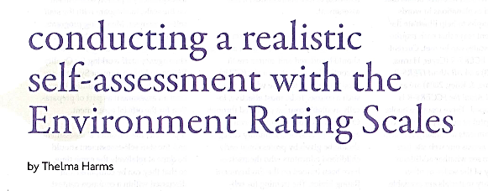
“Conducting a Realistic Self-Assessment with the Environment Rating Scale”
Thelma Harris, Exchange Magazine, September/October 2009
Notes:
The “Conducting a Realistic Self-Assessment with the Environment Rating Scale” article by Thelma Harris is from the September/October 2009 issue of Exchange Magazine.

Slide 22
Taking It
Back to the Agency
Notes:
Participants may now use the calendar pages to plan when they will do the following:
Complete the ERS for the classroom
Group the ERS data
Complete the ERS Summary of Findings per classroom and agency

