Slide 1
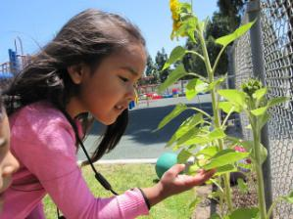
Desired Results
for Children and Families
A Project of the California Department of Education,
Early Education & Support Division
with the
Desired Results Training &Technical Assistance Project
Notes:
Script:
In this training, we will explore why the Desired Results system was developed and how it can be used to improve quality services to children and families.
Please write ONLY on the colored pages in the binders. The white pages can be used as handout masters when they return to your agencies to train others.
Trainer Note:
Introduce yourself, co-trainers, and special guests.

Slide 2

Welcome to
New Administrators Regional Training

Slide 3
Agreements
Start and end on time
Silence cell phones
Take care of personal needs
Active listening
Share expertise
Questions are welcome
Materials are confidential
Keep table top materials in training room
Notes:
Trainer Notes:
Slide optional: Chart the agreements even if this slide is used as a reminder to participants during the training.

Slide 4

Parking Lot
Write questions on post-its and place on “Parking Lot” chart paper.
Notes:
Script:
Please post questions in the Parking Lot. We will try to answer as many questions as possible during the training.
Questions that we do not have answers will be researched for the next training.
Trainer Notes:
Slide optional: Place two Parking Lot posters in the room.
Call the Desired Results Project during a session break or lunch for answers to unanswered questions (800-770-6339).

Slide 5
Agenda
Introduction/Overview of the Desired Results System
Desired Results Developmental Profile© (DRDP©)
BREAK
DRDP(cont.)
Continuous Improvement Process
LUNCH
Follow Up Webinars
  Parent Survey
  Environmental Rating Scale
  Dual Language Learners
BREAK
Resources
Closing

Slide 6
Training Overview
The Desired Results System
Desired Results Implementation
Desired Results as Part of a Continuous Cycle of Improvement
Training Program Staff
Notes:
4
Script:
This training will provide models and suggestions for training others at your agency or program. Training goals include:
Provide information about the Desired Results system
Facilitate Desired Results implementation in programs
Understand how the Desired Results system can improve programs and services for children and families in order to help them achieve desired results
Assist participants to train program staff
Trainer Notes:
Share the training goals below and explain what participants can expect to learn over the two days of training.

Slide 7
Training Outcomes
Participants will learn:
To focus on achieving desired results for children and families
About program improvement through the use of the Desired Results system
Notes:
Script:
This training focuses on methods within the Desired Results system that will improve services to children resulting in overall program improvement.
The secondary focus is to provide training for using the tools that will support program improvement.
Trainer Notes:
Share the training outcomes.

Slide 8
Session I: Overview
Notes:
Script:
Desired Results training is the result of a desire on the part of the California Department of Education, Early Education and Support Division to improve and standardize program quality across the state.
In Session I, an overview of the system’s components will provide preliminary information on the Desired Results for Children and Families system’s goals and structure.
Later, additional details and information will be provided to give participants knowledge about each element of the Desired Results system.

Slide 9
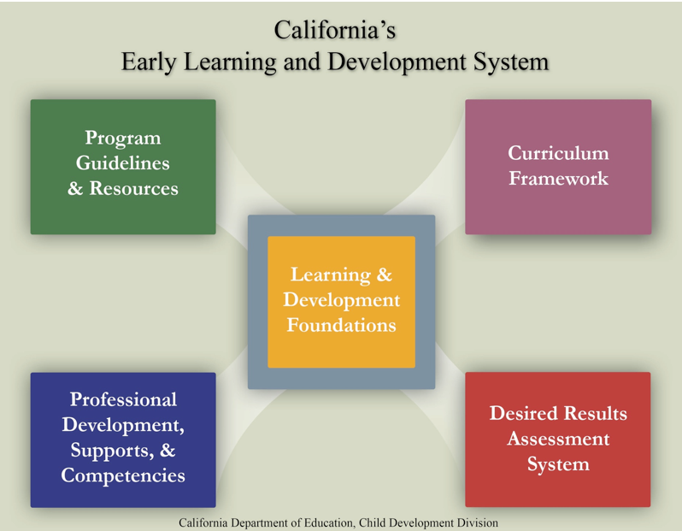
Notes:
Script:
This information is included in the online overview of the system. Today we are focusing on the Desired Results assessment system. This handout is in the binder and contains information for each of the elements on the back side. You will be able to write in the resources available for each component.
Trainer Notes:
Direct participants to use a highlighter to highlight key words as the elements are discussed. Instruct participants to keep this handout available.

Slide 10




Learning Foundations
What Children Know and Are Able to Do
CPIN
offers training
CECO modules
Notes:
Script:
At the center of the system are the Learning and Development Foundations which describe the learning and development that preschool children typically demonstrate with appropriate support.
The Infant/Toddler Learning & Development Foundations describe what children know and are able to do at around 8 months, 18 months, and 36 months.
The Preschool Learning Foundations describe what children know and are able to do at around 48 months and 60 months when in a high quality program.
Early learning foundations are also known by the terms “early learning standards” in other states.

Slide 11






Program Guidelines
CPIN
DLL link
New version now available
Notes:
Script:
We have provided everyone with copies of the appropriate guidelines. The guidelines bring together information that program administrators and teaching staff can use to prepare appropriate learning environments for children.

Slide 12
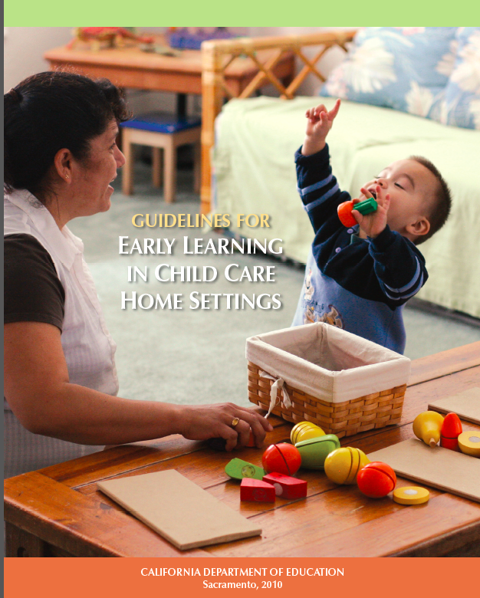


Program Guidelines
Notes:
Script:
There are three program guideline publications from the California Department of Education:
The Guidelines for Early Learning in Child Care Home Settings
Infant /Toddler Learning and Development Program Guidelines
California Preschool Program Guidelines
Trainer Notes:
This section is for training your site administrators, not teachers.

Slide 13
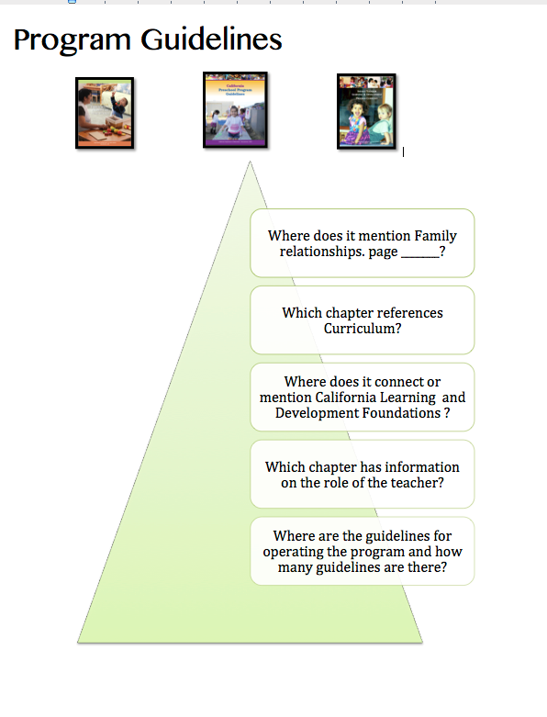
Program Guidelines
Choose a Program Guideline Book
Find the handout labeled Program Guidelines
Work as a table to answer the five questions
Notes:
Script:
Choose one of the program guidelines and we will take a deeper look inside of the publication.
Use the handout titled, Program Guidelines.
Complete the five questions as a table group.
Trainer Notes:
Allow 15 minutes for this activity.
When finished, if they have used different age levels, have them share out the information they found.

Slide 14
Where does it mention family relationships?
Answers
(IT) Chapter 1, p. 9-11, (PS) Chapter 3, p. 40, (HS) Chapter 1, p. 26
Which chapter references curriculum?
(IT) Chapter 6, p.100, (PS) Chapter 5, (HS) Chapter 3

Slide 15
Where does it connect or mention California
Learning and Development Foundations?
(IT) p.5 and p.129, (PS) p. 23, (HS) p.139
Which chapter has information on the role of the teacher?
(IT) Chapter 3, (PS) Chapter 3, (HS) Chapter 1
Where are the guidelines for operating the program and how many guidelines are there?
(IT) Chapter 5, (PS) Chapter 8, (HS) Chapter 4

Slide 16




Curriculum Frameworks
CPIN
offers training
CECO modules
16
Notes:
Script:
Another element of the system includes the Curriculum Framework. The framework offers guidance on how programs and teachers can support the learning and development that are described in the foundations through environments and experiences that are linguistically and developmentally appropriate, as well as individually and culturally meaningful and connected.

Slide 17







Professional Development Supports & Competencies

Slide 18
Professional Development, Supports & Competencies
California Early Childhood Online
Program for English Learner Training
Family Child Care at Its Best
Mentor Program
All About Young Children
The Child Development Training Consortium
Notes:
Refer to Handout - California Department of Education Early Education & Support Division (CDE/EESD) Professional Development Resources
The Program for Infant Toddler Care (PITC) seeks to ensure that America's infants get a safe, healthy, emotionally secure and intellectually rich start in life. http://www.pitc.org/
California Preschool Instructional Network (CPIN) provides professional development and technical assistance to preschool teachers and administrators to ensure preschool children are ready for school. http://www.cpin.us/
The Preschool English Learner Training provides teaching strategies, materials, and trainings to individuals interested in achieving optimal educational outcomes for children who attend public preschool programs and speak a language other than English. http://www.cpin.us/p/pel/
California School-Age Consortium (CalSAC) - CalSAC’s mission is to enhance the performance of California out-of-school program providers by building connections, competence, and community. http://www.calsac.org/
Family Child Care at Its Best provides high-quality, university-based child development education to thousands of licensed and license-exempt family childcare providers throughout California. http://humanservices.ucdavis.edu/ChildDev/Programs/FamilyChildCare.aspx?unit=CHLDEV
Desired Results Training and Technical Assistance Project provides training and technical assistance in the implementation of the Desired Results system, including assessing children with the Desired Results Developmental Profile©. http://www.desiredresults.us
The California Early Childhood Mentor Program provides resources and support to aspiring and experienced teachers and administrators in programs serving children birth to five and before- and after-school programs. http://www.ecementor.org/
CDE/ECE Faculty Initiative Project aligns and integrates essential content and competencies of key CDE/EESD materials and initiatives with core early childhood education curriculum of the California Community College (CCC) and the California State University (CSU) systems. http://www.wested.org/facultyinitiative/
The Child Development Training Consortium promotes high quality early education to California’s children and families by providing financial and technical assistance to child development students and professionals. http://www.childdevelopment.org

Slide 19
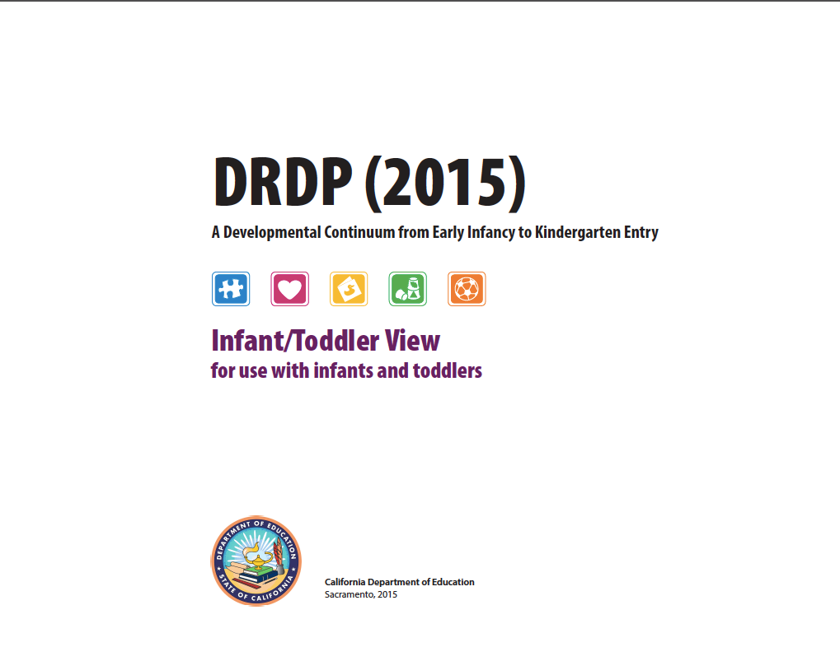

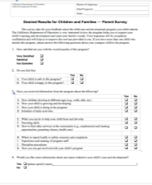


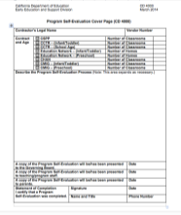


Desired Results Assessment System
Notes:
Script:
The system includes the assessment, the ERS, parent surveys and Program Self Evaluation.

Slide 20

What are your desired results?
DIRECTIONS:
Introduce yourself to others.
Reflect on meaning of desired results.
Discuss your desired results.
Take out three sticky notes.
Notes:
Activity: KWL
Script:
Take three sticky notes on the table. On the first note, write what you already know about the Desired Results system.
On the second sticky note, write what you want to know about the desired results system.
On the third sticky note write the letter “L” at the top.

Slide 21

What are your desired results?
On the first note, write down what you already know about the Desired Results system.
On the second note, write what you want to know about the desired results system.
On the third note, write the letter “L” at the top.
Notes:
Activity: Opening Activity- KWL
Script:
When you are done please take your sticky to the appropriate charts.
The K chart is for what you know. Place the first sticky note there.
The W chart is what you want to know. Place second sticky there.
Please keep your third sticky for the end of the day.
Trainer Notes:
Participants will use this note at the end of the day to write two things they learned and how they will take it back to their programs.

Slide 22

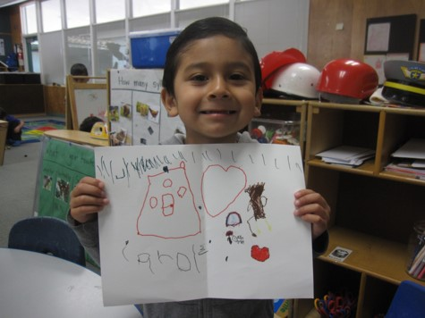
Desired Results for Children
Children are personally and socially competent.
Children are effective learners.
Children show physical and motor competence.
Children are safe and healthy.
Notes:
Script: (Review the four desired results for children.)
These are the overarching goals for children.

Slide 23
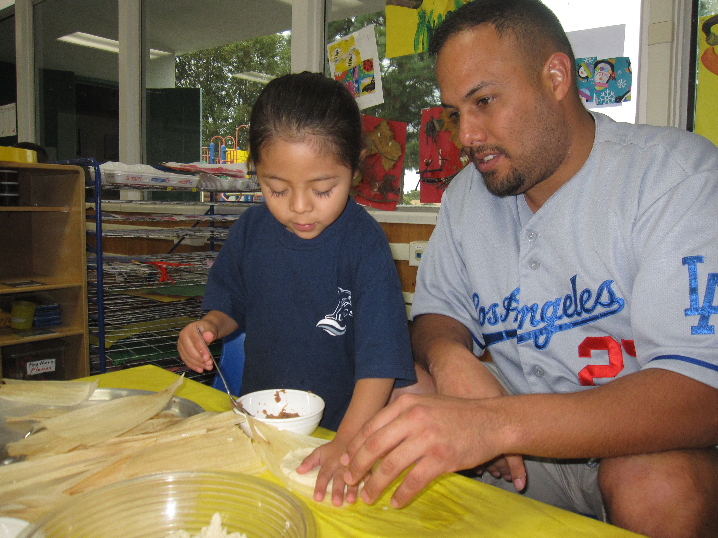
Desired Results for Families
Families achieve their goals.
Families support their children’s learning and development.
Notes:
Script:
The Parent Survey will help determine the achievement of these results. Parents will be supported in their role as their child’s first and most important teacher.
Trainer Notes:
Introduce the two desired results for families.

Slide 24
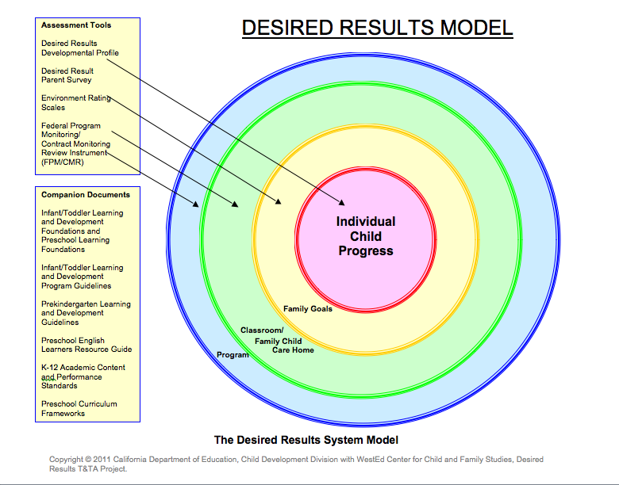
Notes:
Script:
This model is a graphic organizer of the DR.

Slide 25
Foundations and the DRDP
Foundations
A guide and teaching tool
At around 8, 18 & 36 months for I/T
At around 48 months and 60 months for PS
For all children, including English language learners and children with disabilities
DRDP
An observational assessment tool
Developmental continuum
For all children, including English language learners and children with disabilities
Notes:
Script:
It is important to understand that the foundations describe the knowledge and skills that all young children typically exhibit:
at about 8, 18, and 36 months for infants and toddlers
at about 48 months and about 60 months of age for preschool children
as they complete their first or second year of preschool;
with appropriate support; and
when attending a high-quality preschool program.
The DRDP is the child observational assessment tool that is used by teachers to record a child’s progress on a developmental continuum.

Slide 26
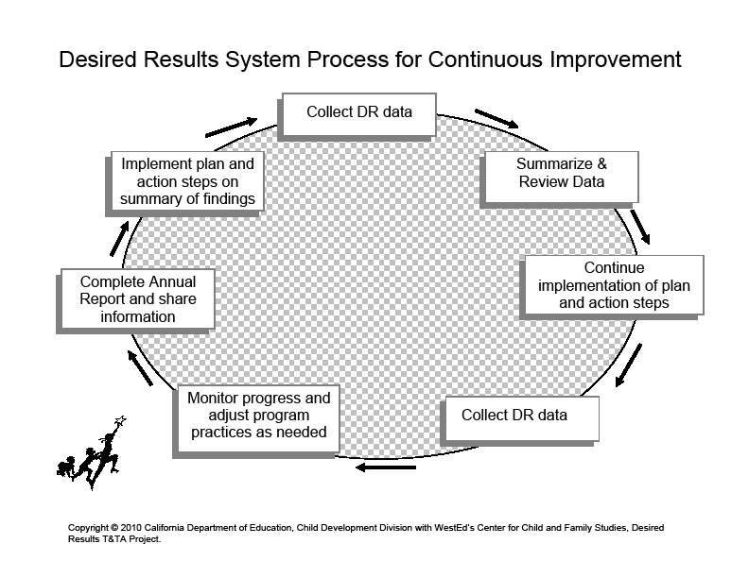
Desired Results System Process for Continuous Improvement
Notes:
Script:
In this diagram, programs begin at the top left box of the cycle, with implementing the Program Quality Dimensions and moving clock-wise around the cycle each program year. After adjustments have been made, administrators analyze and evaluate the progress to determine what subsequent actions should be taken to ensure continued progress.
Trainer Notes:
Ask participants to follow along on the DR System Process for Continuous Improvement handout.

Slide 27
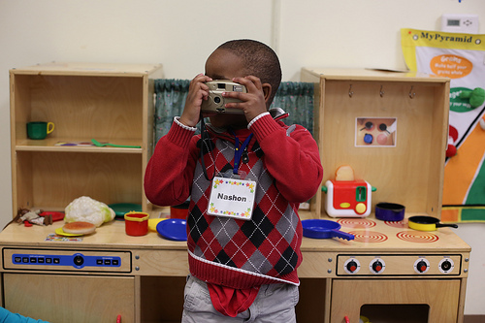
Desired Results Developmental Profile (2015)
Notes:
Script:
The DRDP serves as a framework for documenting the progress children demonstrate over time.
It provides teachers with concrete information that will help them tailor their curriculum to meet the needs of the children.
Trainer Notes:
Briefly ask how many people have used the DRDP to assess children.

Slide 28

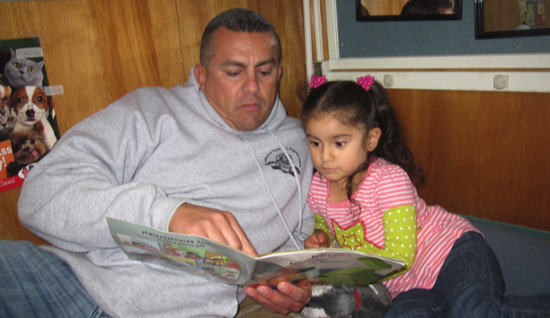


Parent Survey
All About Young Children
Notes:
Script:
The Parent Survey is the questionnaire to evaluate parents’ satisfaction with programs.
The Parent Survey:
Gives programs access to information from parents to improve program quality
Determines parent satisfaction with their child’s program
Is conducted at least once per year

Slide 29




Environment Rating Scales
Notes:
Script:
The Environment Rating Scales allow programs to assess their learning environments.
Research projects have discovered a meaningful relationship between ERS scores and child outcome measures, as well as between ERS scores and teacher characteristics, teacher behaviors, and compensation.
The Environment Rating Scale is used to measure implementation of Program Quality Dimensions.
Each classroom, family childcare home, and school age facility must be assessed at least once per program year.

Slide 30
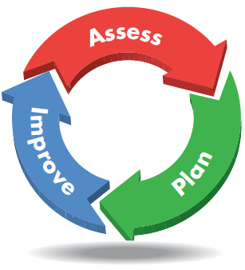

Program Self-Evaluation
Notes:
Script:
The program self-evaluation process gives agencies an opportunity to recognize their strengths and areas that require improvements.

Slide 31
Program Self-evaluation requirements by contract are based upon…
DRDP Summary of Findings and Program Action Plan
Agency FPM/CMR Summary of Findings
Agency Annual Report
Notes:
Script: (Review slide)
These forms will be described in more detail during online webinars.

Slide 32
Program Self-Evaluation and
Compliance Review
Review materials and procedures
Implement Desired Results System
Review and complete Agency Annual Report
Send Annual Report to EESD by June 1
Notes:
Script:
The Desired Results system documents the progress made by children and families in achieving desired results. It also provides information to help practitioners improve their child care and development services.

Slide 33
To summarize, the Desired Results system is used to:
Increase program quality for children and families
Measure the developmental progress of children and families in achieving desired results
Identify program strengths, as well as areas that may need improvement
Provide a results-based accountability system that is measurable

Slide 34


Break

Slide 35
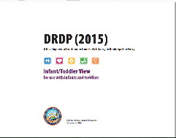


Session III
Desired Results Developmental Profile©
Observation Assessment Instrument
Notes:
Script:
In this session, participants will learn about the Desired Results Developmental Profile. There are three views for the DRDP (2015) and two views of the DRDP SA 2010
We will focus on observation skills, rating the DRDP, collecting the DRDP data, the Summary of Findings, and the Child’s Developmental Progress form.

Slide 36


We observe…
As each child interacts with other children, adults, and environment
In the natural program setting
Notes:
Script:
Teachers observe children in their natural, daily activities. Agencies are able to describe children’s achievements in learning and development to advocate the strengths and benefits of the program to families and the larger community.

Slide 37
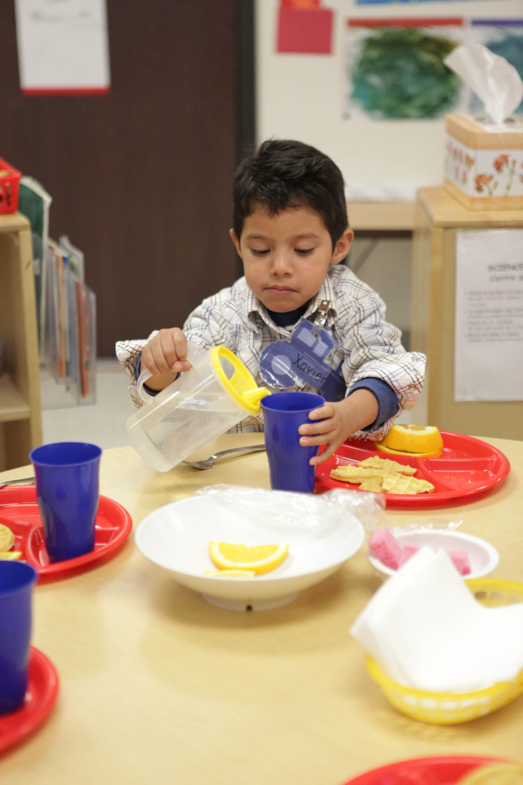
As children participate in the typical daily program
Notes:
Script:
Good observation and recording methods over time are the cornerstones for using the DRDP effectively.
The DRDP is not a test, but an observation based assessment for children.
The person who is the designated teacher should complete the DRDP. Assistants, parents, and other staff should contribute observations. For children with IEPs, be sure and collaborate with their service providers.
Trainer Notes:
Family Child Care Networks have a “teacher identified” person complete the DRDP. This person may be the case manager who oversees the network care providers. The case manager consults with care providers and parents in completing the DRDP.

Slide 38


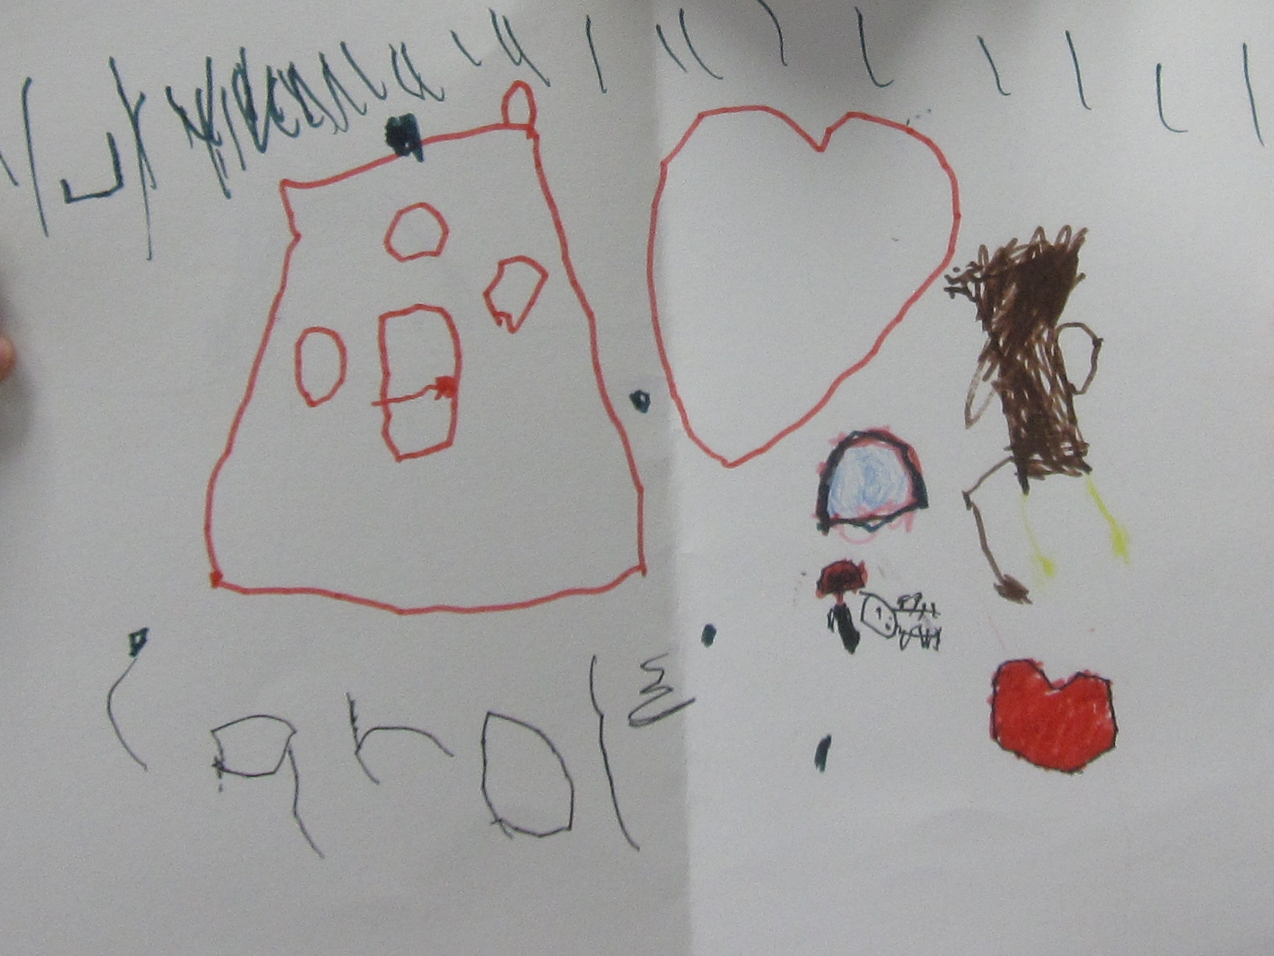

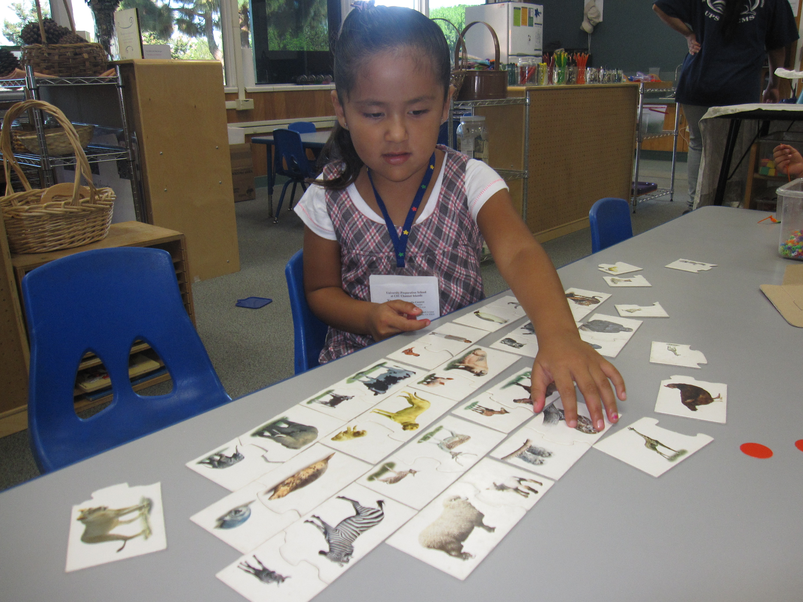
Collected documentation includes:
Anecdotal notes
Photos
Work samples
Other evidence of knowledge and behaviors
Notes:
Script:
Teachers collect a substantial number of anecdotal notes, photos, work samples, and other pieces of documentation from family members and other staff, that demonstrate the children’s mastered developmental levels. The organization of collected documentation can be achieved through “portfolios.”

Slide 39
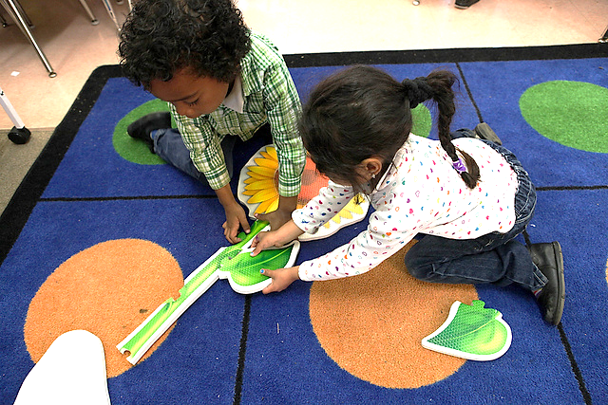
DRDP serves as a way to…
determine how children are benefiting from programs
Notes:
Script:
The DRDP findings provide information for agencies to use to improve programs.
Information is shared with families during parent conferences to support parents in supporting the child’s progress.
Information can also be shared with the community to demonstrate how children benefit from involvement in the program.

Slide 40
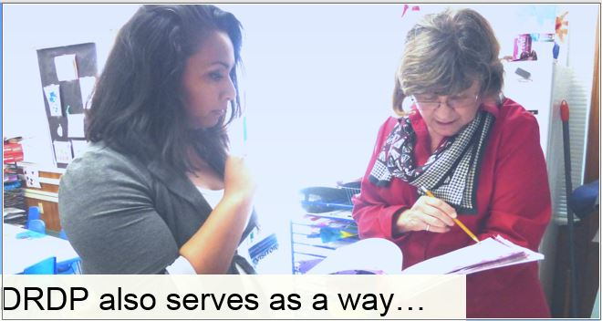
DRDP also serves as a way…
to assist providers in meeting each child’s developmental needs in each classroom or family child care home
Notes:
Script:
The DRDP documents the kind of work that quality programs are already doing every day.
As teachers learn more about the children in their care, the DRDP information assists them in adapting and modifying curriculum plans and activities for the individual child, as well as activities for small and large groups.

Slide 41

DRDP provides…
a “snapshot” of the child’s development
Notes:
Script:
Children grow and change quickly, so a completed DRDP is a “snapshot” (i.e., a representative moment in time) of a child’s development.
All succeeding observations will document changes that result from growth and progress.

Slide 42
The DRDP provides a
framework for showing children’s progress over time.
Notes:
Script:
Each age-level instrument provides a framework that serves in monitoring children’s progress throughout the program year. There is a suite of DRDP instruments:
The DRDP (2015) is one instrument with three views.
The DRDP (2015) is a full continuum instrument used for all children infancy through kindergarten entry including children with special needs.
The Infant/Toddler View for use with children infancy to 36 months and there are two views for use with preschool age children. The Comprehensive View and the Fundamental View of the assessment are used to assess preschool age children until kindergarten entry.
DRDP School-Age is available in two versions.
DRDP–SA Complete version which has all 35 measures
DRDP-SA© (2010) Simplified version, which has 2 domains with 13 measures.
The DRDP-SA©(2010) was simplified because the other areas were already being assessed during the school day (e.g., reading, math, etc.). EESD felt it was still important to assess Self and Social Development as well as Heath and Safety.
Each profile provides guidance in documenting observations that reflect the developmental growth for each age group.

Slide 43
CDE Guidance
Management Bulletin June 2015
Effective Fall 2015, the DRDP (2015) is required for all EESD programs that provide early education and care for children ages early infancy to kindergarten entry. It is also required for all preschool children with IEPs and for all infants and toddlers with IFSPs.
Notes:
Script: (Reference management Bulletin 15-03)
If providing services to children with an IEP or IFSP, you are encouraged to visit the draccess website to get additional information about training and specific requirements.

Slide 44
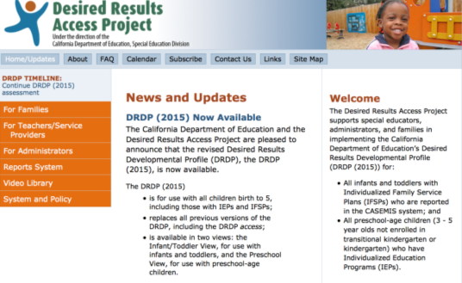
Desired Results Access Project:
For more information:
http://www.draccess.org
:
Notes:
Trainer note:
Participants may have additional questions about DRDP Access. They are encouraged to visit the website listed on the screen to get additional information.

Slide 45
CDE Guidance
Management Bulletin June 2015
When children are served by both EESD and SED programs, the teachers and specialists are to collaborate on one assessment following the more stringent timeline, and handle DRDP data according to the requirements of each Division.
Notes:
Script:
More details can be found in Management Bulletin 15-03.

Slide 46
CDE Guidance
Management Bulletin June 2015
The management bulletin can be downloaded from the EESD website at:
http:www.cde.ca.gov/sp/cd/ci/mb1004.asp
http://www.cde.ca.gov/sp/cd/ci/progspeclist.asp
Take 5 minutes to read the bulletin and use the highlighter as you read.
DRDP 115-117
Notes:
Script:
The entire bulletin provides information on collaboration between ECE staff and the special education provider. It also gives the requirement of using DRDPtech for all EESD programs. Take five minutes to read the bulletin. We recommend providing this bulletin to your staff or share it at a staff meeting.
Trainer note:
Direct participants to read the bulletin and use a highlighter as they read it.

Slide 47

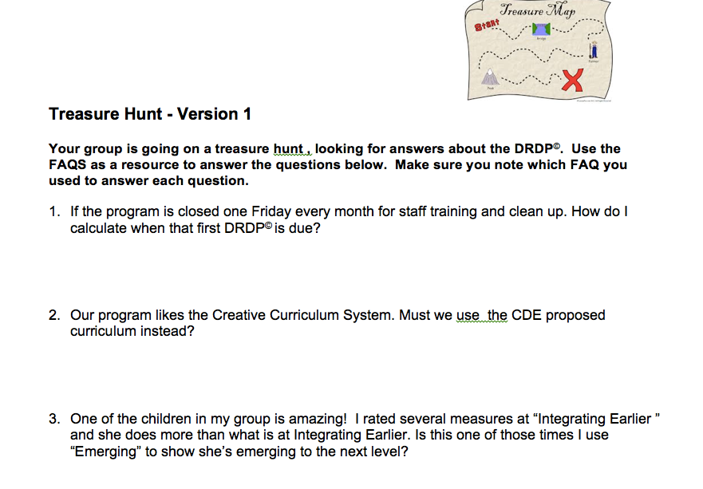
Treasure Hunt - Version 1”
DRDP 118-125
Notes:
Activity: Treasure Hunt

Slide 48

DRDP Guidelines
An age-appropriate version of the DRDP must be completed within 60 calendar days of the child’s enrollment and every six months thereafter.
60 calendar days and every 6 months thereafter
60 days
Notes:
Script:
An age-appropriate version of the DRDP must be completed for all children enrolled in a CDE/EESD funded center or family child care home network.
Trainer note:
Clarify how often and when DRDPs are required to be completed. Emphasize 60 calendar days from the enrollment date of children. Enrollment is typically determined to be the first date the child receives care.

Slide 49
Answers to Treasure Hunt
1. If the program is closed one Friday every month for staff training and clean up, how do I calculate when the first DRDP is due?
FAQ #1 and #2
2. Our program likes the Creative Curriculum system. Must we use the CDE proposed curriculum instead?
FAQ #27

Slide 50
3. One of the children in my group is amazing! I rated several measures at integrating earlier and she does more than what is at integrating earlier. Is this one of those times I use “emerging to the next level?
FAQ #16
4. We are part of a FCCHEN, and I supervise 6 family childcare homes, the providers tell me they are not allowed to complete DRDP’s. Is this true? Who is responsible for completing DRDP’s
FAQ #31 and #32
5. We have an inclusive preschool program. Do I still
complete the DRDP on children in the program that
have an IEP?
FAQ #21

Slide 51
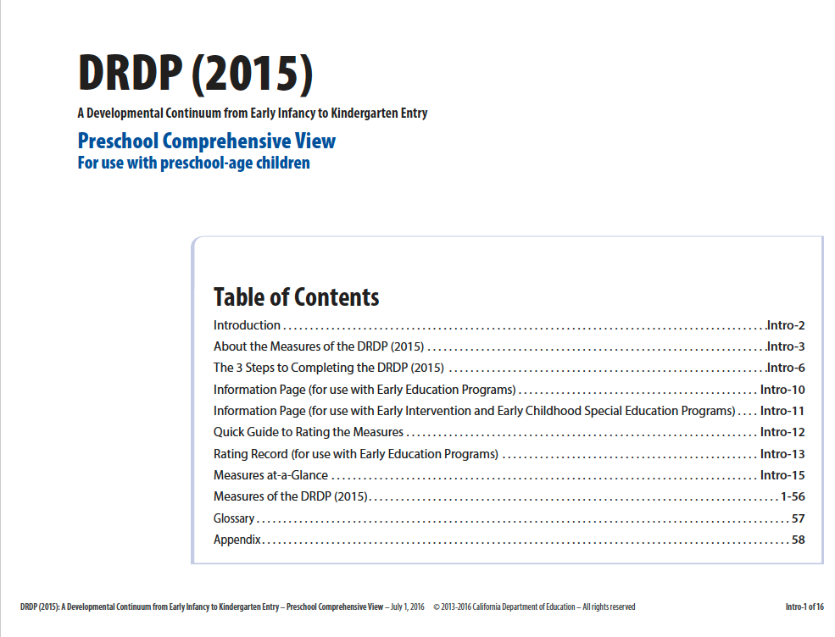
Teachers and staff need to become familiar with the DRDP.
Notes:
Script:
Get to know the Desired Results, developmental domains, measures, definitions, developmental levels, and descriptors. Read through the introduction and appendices of the assessment for clarification.
The DRDP Tool Kit ideas, such as the mini-measures, are on the DR website and helpful in becoming familiar with the DRDP.
Each age level assessment has front matter or introduction that provides direction and support.

Slide 52
The DRDP was developed by the:
California Department of Education, Child Development Division- (now Early Education and Support Division)
WestEd Center for Child and Family Studies
University of California, BEAR Center
With valuable input from teachers and directors who participated in the research study
Notes:
Script:
WestEd and BEAR aligned the instruments and developed new measures.
BEAR provided overall direction for the study and summarized the data.
BEAR is the Berkeley Evaluation and Assessment Research Center.

Slide 53

Notes:
Script:
The DRDP aligns with the:
Infant and Toddler Early Learning and Development Foundations
Preschool Learning Foundations, Volumes 1-3
Common Core Standards
Head Start Child Development and Early Learning Framework
Now let’s look at the instrument in more detail…

Slide 54
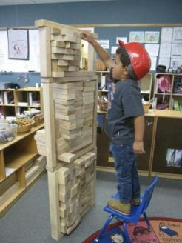
Build A Tower
Use the items on your table.
As a group, build a tower.
You have 5 minutes.
Notes:
Refer to DR-2015 Activity Sheet #3 – Build a Tower
Have participants build a tower using (cups, blocks, paper) any accessible material.

Slide 55
Key Points
What was your first step?
How did you know to start there?
What does this have to do with children’s learning?
Notes:
Script:
The purpose of the activity is to make a connection between having a foundation in order to support a structure. For us that structure is children’s learning. Our foundation is our California Preschool and Infant toddler Learning and development Foundations. These are important first steps in understanding child development and understanding the skills that children are capable of.
Trainer Note:
This is the debrief slide.

Slide 56

Why was it important to align the DRDP to the foundations?
To ensure we assess what we want
children to learn and that it is aligned to
what is appropriate for children of this age
Notes:
Script:
The state has taken care to build a cohesive system.
The foundations describe children’s learning and development.
Thus it is important that we are assessing what we want children to learn, and that we align it to what is appropriate for children of this age.

Slide 57
What is the relationship between the DRDP and the foundations?
The foundations tell us what children, with adequate support, typically learn and develop.
The DRDP provides a structure and a tool for recording an individual child’s development and documenting progress.
All volumes of the California Learning and Development Foundations provide the research backing for the DRDP (2015).
Notes:
Script:
The developmental domains work in an integrated fashion to support all four Desired Results. Ways to use the foundations and DRDP together:
Read foundations at the beginning of the school year to understand development in a general way.
Complete the DRDP twice each year to see children’s progress.
Foundations provide the overall developmental landscape or backdrop. The DRDP helps determine where an individual child is on that backdrop.

Slide 58

DRDP–School-Age
2 domains
13 measures
6 domains
31 measures
Notes:
Script:
Teachers may use either the DRDP-SA© (2010) Simplified Version or DRDP-SA© (2010) Complete Version.
Use the DRDP-SA© (2010) with school-age children from kindergarten through 12 years old, including those who have an individualized education program (IEP).

Slide 59

5 Domains
29 Measures
8 Domains
56 Measures
10 Conditional Measures
6 Domains
43 Measures
Notes:
Presenter Remarks:
The DRDP (2015) is a full continuum assessment. The same assessment is used for all children, including children with IFSP’s and IEP’s. There is one assessment and there are three views of this assessment. The measures however, are the same. This means that ATL-REG 1 is the same measure in all views. The difference is the number of measures in the different views.
The Infant/Toddler View has 5 domains and 29 measures.
The Preschool Comprehensive View has 8 domains and 56 measures, 10 of those measures are conditional
the Preschool Fundamental View has 6 domains with 43 measures, thirteen of those measures are conditional.
The fundamental view only pertains to preschool aged children. The infant toddler assessment remains the same. To learn about what adaptations a child with an IFSP or IEP needs please collaborate with the child’s service providers.

Slide 60

Why a Fundamental View?
Notes:
Script:
The requirement for all EESD programs is to complete the fundamental measures for all children. Programs may then choose to complete COG: SCI, HLTH, HSS, and/or VPA domains
Teachers should complete any conditional measures as needed. For preschool age children with IEPS the early development and physical development conditional measures must be completed.

Slide 61
Early Education and Support Division
Management Bulletin (MB) 16-06 from the Early Education and Support Division (EESD) was released in May 2016 detailing the two preschool views of the DRDP (2015).
http://www.cde.ca.gov/sp/cd/ci/progspeclist.asp

Slide 62
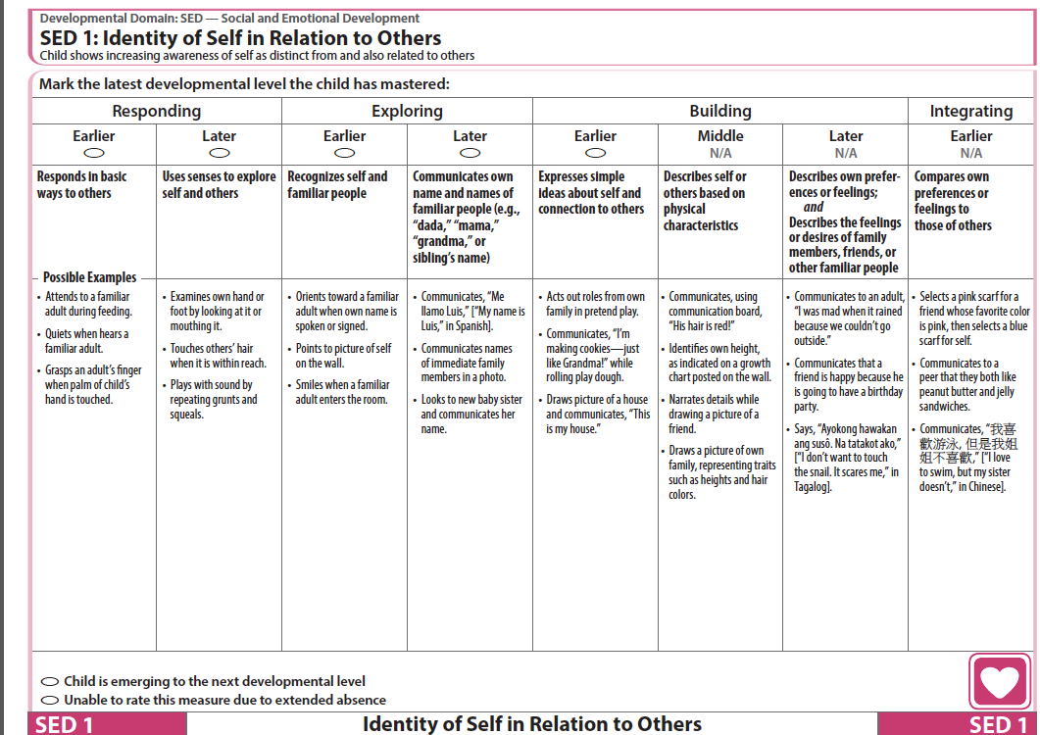
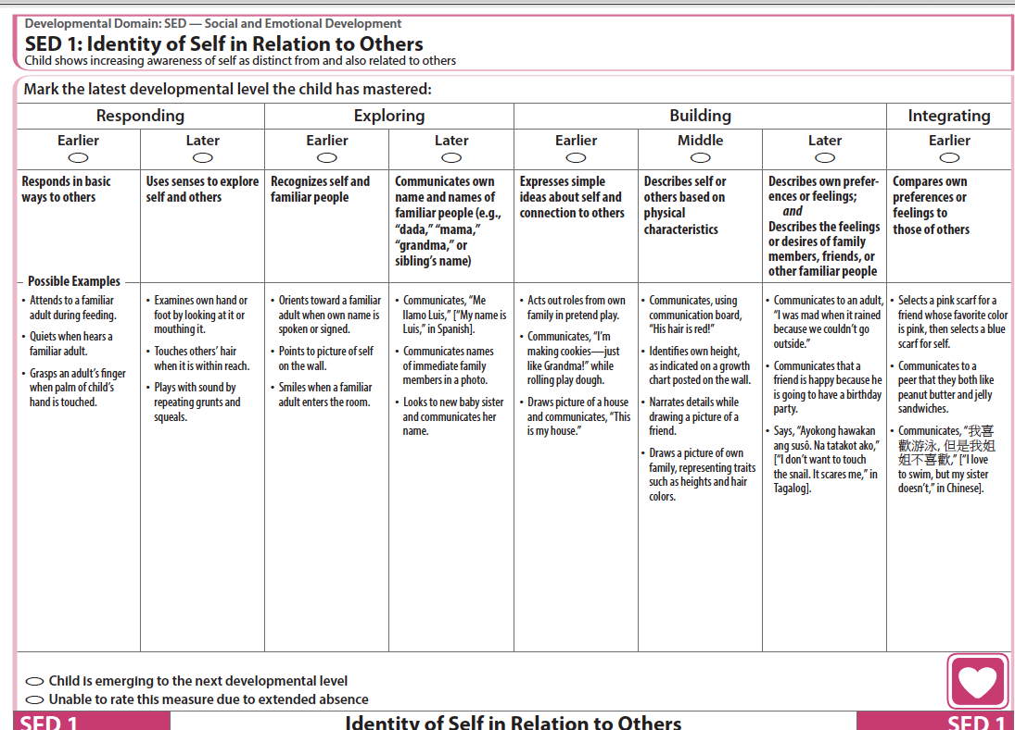
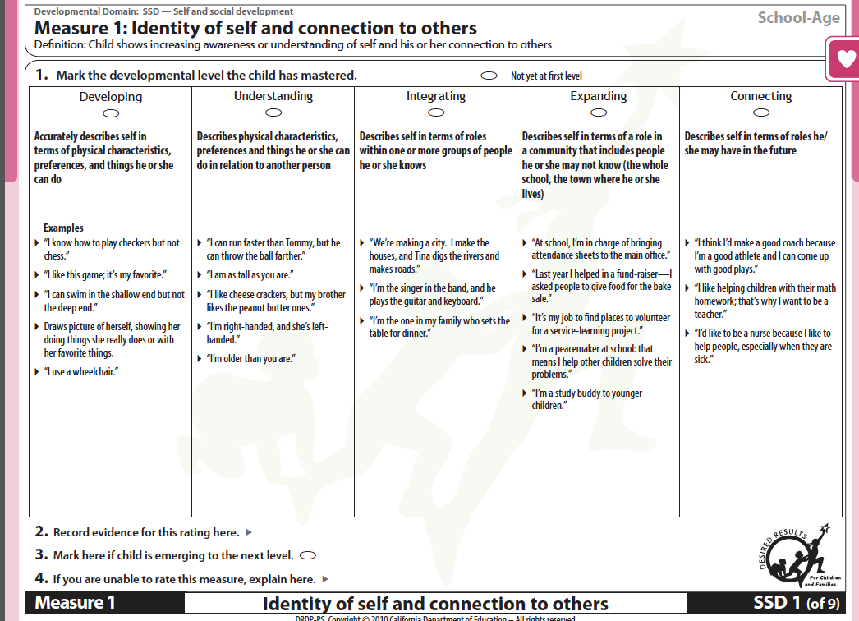
Compare and Contrast
DRDP 127-134
Notes:
Activity: Compare and Contrast
Trainer Notes:
Point out the differences between the Infant Toddler View and the Preschool View of the DRDP (2015).
Point out the difference in the School-Age assessment (developmental levels, measures numbered consecutively).

Slide 63
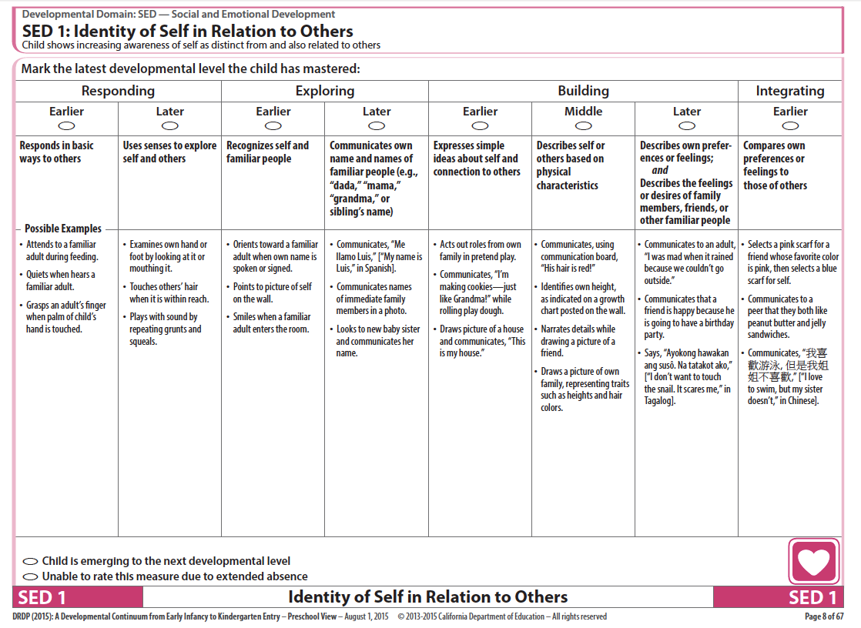
Navigation Map
Developmental Domain
Measure
Definition
Descriptor
Developmental Level
Example
Notes:
Script:
The back side provides the terms and definitions.

Slide 64

Remember, the examples listed…
are only a few ways a child might demonstrate a particular developmental level.
DRDP 135-138
Notes:
Script:
The purpose of the examples is to help teachers clarify where the skills could be demonstrated; e.g., “Some ways a teacher might see the behavior.”
Encourage staff to add examples of what they observe for the developmental levels.
DRDP examples activity to do with staff is in the binder.

Slide 65
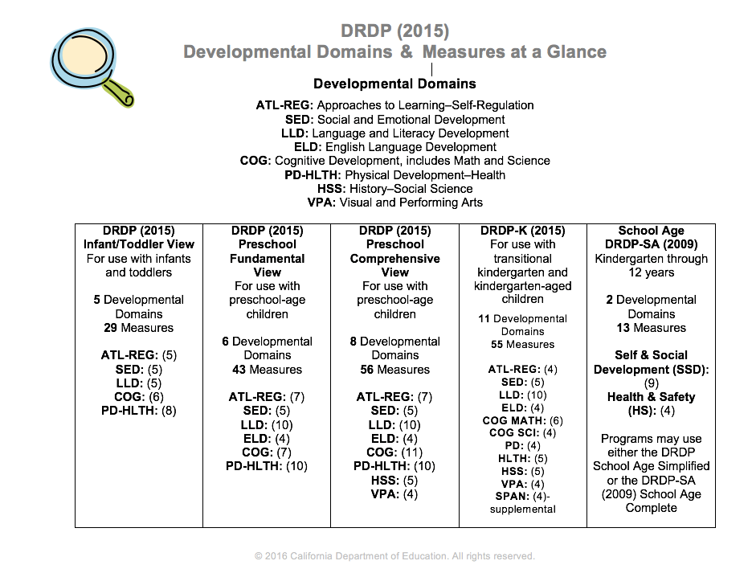
DRDP at a Glance
DRDP 139
Notes:
Script:
The DRDP at a Glance shows the developmental domains and number of measures in parenthesis for all age-level instruments.
There are:
29 measures in the DRDP (2015) IT View
56 measures in the DRDP (2015) Preschool Comprehensive View
43 measures in the DRDP (2015) Preschool Fundamental View
55 measures in the DRDP-K
31 measures in the DRDP-SA Complete Version and 13 in the DRDP-SA Simplified Version (2010).

Slide 66
        Domains
The Four Ds
        Definitions
        Developmental levels
        Descriptors
LOOK to the 4 Ds:
Domains, Definitions, Developmental Levels, and
Descriptors to clarify the intent of each measure
Notes:
Script:
These are the four components of the DRDP – the 4 Ds.
Trainer note:
Review them and emphasize that reading these components can assist staff in knowing the intent or purpose of the measure.
The Domain represents a crucial area of learning and development for children.
The Definition specifies the aspect of development that is being observed.
The Descriptor describes observable child behaviors associated with that developmental level.
The Developmental Levels for each measure represent a developmental continuum.

Slide 67
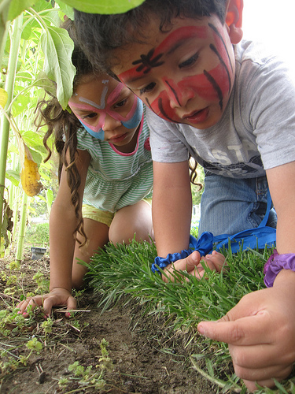
The DRDP is an
Observation Based Assessment Instrument
Notes:
Script:
We will focus on observation skills, rating the DRDP, collecting the DRDP data, the Summary of Findings, and the Child’s Developmental Progress form.

Slide 68

“Getting to know children as people and as learners gives you the information you need to be an effective decision maker in the classroom.”
The Power of Observation
Notes:
Trainer note:
Share quote and show book, The Power of Observation, if available.
Click to next slide.

Slide 69
“With the information you learn from observing, you can select the:
• right materials
• plan appropriate activities
• ask questions that guide
children in learning to understand the world around them.”
The Power of Observation
Notes:
Script:
EESD requires programs to use the DRDP for assessment as a motivator. The real reason we use observation is to get to know children.
Through observation, we get to know how children learn best, as well as their strengths, need for support materials, and language. In addition, it helps teachers plan engaging activities to help them progress in their development.
Observation is a skill that can be learned and gets easier with practice. The observations we are making should provide good information that can inform our ratings on the DRDP.
The next activity will assist in writing meaningful anecdotal notes.

Slide 70


Develop Methods for Recording Observations and Collecting Evidence
Anecdotal records
Photography
Audio and video records
Running records
Sketches
Work samples
Daily log
Frequency countfiles
Notes:
Script:
Before teachers can rate the DRDP, they need to collect relevant information about the children.
Once teachers know the “what”, “when” and “how,” they are ready to plan to observe, record, and collect evidence on children’s typical behaviors.
Teachers and staff can collect a wide variety of documentation to provide evidence of children’s mastered developmental levels across all of the measures, such as anecdotal notes, work samples, use frequency count sheets, take photos, and other forms of evidence.
Enlist all classroom staff, support staff, and parents to contribute documentation to the child’s portfolio. We know that teachers who are successful in implementing an observation-based assessment, plan for observations.
Trainer Note:
Remind participants to look at the gallery during breaks for samples.

Slide 71
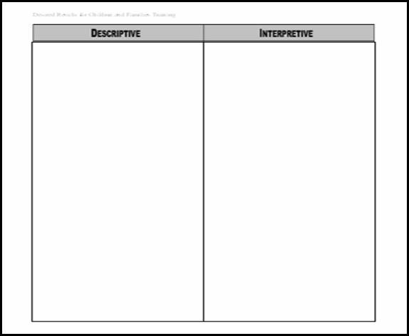
Noticing Descriptions and Interpretations
DRDP 140-143
Notes:
Activity: Noticing Descriptions and Interpretations

Slide 72
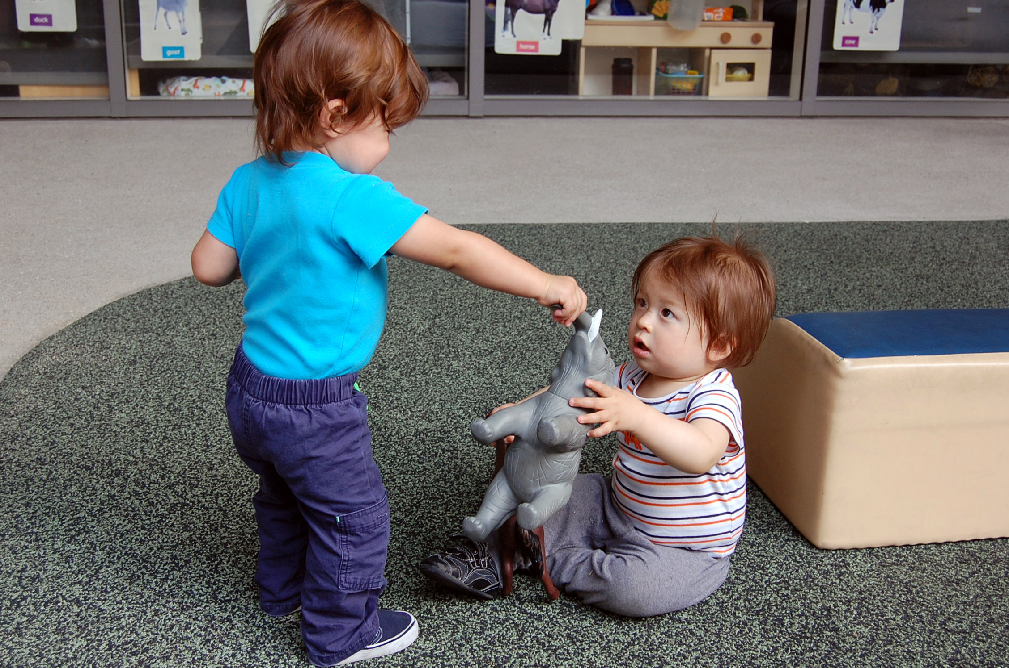
Still Photo Observation
Adapted by permission, The Art of Awareness © 2000 Deb Curtis and Margie Carter, Redleaf Press. St. Paul, Minnesota, www.redleafpress.org.
Notes:
Trainer note:
Keep this slide up during the activity.

Slide 73
Definitions: Descriptive and Interpretive
Descriptive
Interpretive
What are the specific details?
What you actually…
  Observed
  Read
  Heard
Example: He is holding shirt with one hand and pen in other hand.
What were your initial reactions?
How you felt about what you…
  Observed
  Read
  Heard
  Example: He looks worried
Notes:
Script:
This is a reminder of what quality notes have.

Slide 74

Lunch Break
Notes:
Take a 15 minute break.
Trainer note:
Remind participants to check out the gallery.

Slide 75

Welcome
to
DRDP
Jeopardy!
Notes:
See Activity Sheet 2 - Jeopardy
PURPOSE: This activity is an energizer and a way to check what the audience already knows about the DRDP and Desired Results.
Participants have a whiteboard paddle with a dry erase marker attached on the back of the paddle. The Velcro on the marker acts as an eraser. The paddle and marker are located in the briefcase. Optionally, participants may use plain paper.
Each table group works as a team to come up with answers. Have the team select one person to write on the white board and one person to be the team’s banker.
Tell participants to write big enough to see. Also remind them to write answer in the form of a question.
If correctly answered, participants receive DR Dollars play money. One table member must serve as the banker for the table team.
If training alone, ask a participant or two to help hand out the money.

Slide 76


These are aligned with the DRDP (2015) and serve as the research backing for the assessment.
$100
2010 © California Department of Education
Desired Results T & TA Project
76
Notes:
Trainer Note:
Play the Jeopardy tune or sing/hum the music as the answer/question is quietly discussed and written on the white board.
Allow sufficient time to complete writing before advancing to the next slide.

Slide 77
What are…
California Early Learning and Development Foundations
$100
Winner!
77
Notes:
Trainer Note:
Award $100 for the correct response.

Slide 78
To be completed within 60 calendar days of children’s enrollment in the program
$200
Notes:
Trainer Note:
Play the Jeopardy tune or sing/hum the music as the answer/question is quietly discussed and written on the white board.
Allow sufficient time to complete writing before advancing to the next slide.

Slide 79
When must…
the first DRDP to be
completed for each child?
$200
Winner!
Notes:
Trainer Note:
Award $200 for the correct response.

Slide 80
Teachers, caregivers, aides, parents and family may provide this.
$300
Notes:
Trainer Note:
Play the Jeopardy tune or sing/hum the music as the answer/question is quietly discussed and written on the white board.
Allow sufficient time to complete writing before advancing to the next slide.

Slide 81
What is…
evidence and documentation on children to support completing the DRDP?
$300
Winner!
Notes:
Trainer Note:
Award $500 for the correct response.
Let participants know that there will be another round after lunch. Remind them that as they go through the training there may be things shared in the presentation that will be useful in Round 2.
Trainer should be familiar with Round 2 Jeopardy because it can be fun to say “You may want to highlight that slide in your ppt notes. It could be in the Jeopardy game after lunch.”

Slide 82
Learning and Development Foundations
Curriculum Framework
Program Guidelines and Resources
Desired Results Assessment System
Professional Development
$300
Notes:
Trainer Note:
Play the Jeopardy tune or sing/hum the music as the answer/question is quietly discussed and written on the white board.
Allow sufficient time to complete writing before advancing to the next slide.

Slide 83
What is…
California’s Early Learning & Development System?
$300
Winner!
Notes:
Trainer Note:
Award $300 for the correct response.

Slide 84

This is conducted at least once a year to determine satisfaction with child’s program.
$400
Notes:
Trainer Note:
Play the Jeopardy tune or sing/hum the music as the answer/question is quietly discussed and written on the white board.
Allow sufficient time to complete writing before advancing to the next slide.

Slide 85
What is…
the Parent Survey?
$400
Winner!
Notes:
Trainer Note:
Award $400 for the correct response.

Slide 86

Steps to Completing the DRDP
Notes:
Script:
The next section of the presentation provides the steps to completing the instrument.

Slide 87
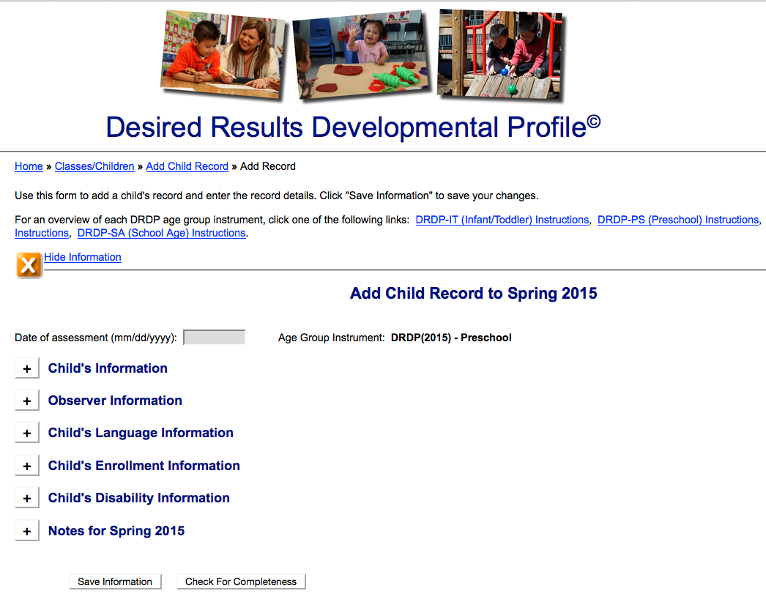
Complete the Information Page
Notes:
Script:
One of the first steps, is to enter children into the DRDPtech system.
The Child Record will need to be completed for all children.
Ensure that the date of assessment at the top of the page is within 60 days of the child’s enrollment.
The Information Page will already be completed for each rating period inside of DRDPtech. Teachers can edit the information page when necessary
A tutorial on on Steps to Completing the DRDP is available on the website.

Slide 88
        Domains
The Four Ds
        Definitions
        Developmental levels
        Descriptors
LOOK to the 4 Ds:
Domains, Definitions, Developmental Levels, and
Descriptors to clarify the intent of each measure
Notes:
Script:
One of the first steps, is to become familiar with the components of he assessment.
The 4Ds of the DRDP assessment instrument are crucial to helping staff clarify the intent or purpose of each measure.
The domain represents a crucial area of learning.
The definition specifies the aspect of development that is being observed.
The developmental levels represent a developmental continuum. Each level specifies a point along the developmental continuum.
The descriptors give you the behaviors and or skills you must see with mastery to rate at that developmental level

Slide 89

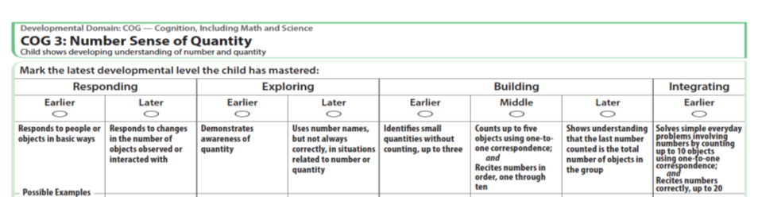
A Deeper Look at the
Descriptors
Descriptor
Each developmental level has a descriptor that defines the behaviors that would be observed if a child were at that developmental level.
Notes:
89
89
Script:
The descriptor can be found right under the developmental level, in every measure.

Slide 90

Using the Descriptor
If the descriptor has ; followed by and the child must do all the behaviors but not necessarily in the same observation.
Notes:
Script:
The language inside the descriptors is very important.
If the descriptor has a ; AND the child must do all the behaviors but not necessarily in the same observation.
For example if the descriptor says walk ;and skips, the child needs to exhibit both behaviors. He could walk today and skip tomorrow.

Slide 91
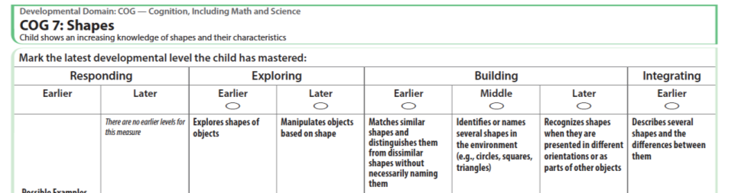
If the descriptor says and, then the child MUST be able to do all of the behaviors and they need to be observed together.
Notes:
Script:
BUT if the descriptor says AND then the child must do all the behaviors and they need to be observed together.
For example, if the descriptor says “walk AND skip” the child needs to walk and skip in the same observation.

Slide 92
Using the Descriptor
If the descriptor says or, a child only needs to demonstrate the behavior in one of the listed ways.
Notes:
Script:
If the descriptor says or, a child only needs to demonstrate the behavior in one of the listed ways.

Slide 93

A Deeper Look at the
Descriptors
Look at COG 3 and COG 7.
Read each descriptor carefully:
  circle the word or ,
  highlight ; followed by AND
  underline AND (when it connects two skills)
Did you get them all?
Notes:
Refer Activity Sheet #6 – A Deeper Look at the Descriptors
Script:
Now we are going to practice. It’s important to understand what the descriptors are asking you to observe. As you read the descriptor think about what skills you are looking for. Are they asking you to observe a specific skill? Are they asking you to observe the child displaying more than one skill? Read through each descriptor for each measure and circle the word or and highlight the word and.
Turn to COG 3 and COG 7 and circle the ORs, highlight the ;AND and underline the AND in the descriptors (only in descriptors).
Now that we are done turn to COG 3. How many ORs did you find? How many ;AND? How many ANDs? (TRAINER: Repeat this for COG 7.)

Slide 94
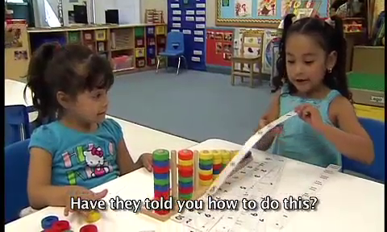
Cognition Sample
Notes:
Script:
Administrators can show there own video and have staff analyze the descriptors. See Activity Sheet Deeper Look at Descriptors.

Slide 95
A Deeper Look at the
Descriptors
What is the child able to do?
Look at COG 3 and COG 7 and their descriptors.
Which parts of the descriptors can the child do?
Notes:
Script:
Remember we are not rating. We are looking at the child’s behavior to see how those behaviors may be related to the descriptors.
What did you see the child do? What did the child demonstrated during the clip?

Slide 96

Developmental Level Activity
Where are you in your development…
as a cook?
Notes:
Script:
Read slide… “Where are you in your development…as a cook?”
This practice model is a playful creation to assist staff consider how circumstances may change behaviors - not just developmental progress.
Trainer Note:
Explain that now the training will move to learning more about developmental levels in the DRDP.

Slide 97
Notes:
Script:
It does not matter where you are on the continuum, each one is making continuous progress towards the desired result!
Trainer Note:
Ask participants to raise hands or stand up to show pride for the level of “mastery” attained.

Slide 98
Developmental Level Activity
Prepare an activity to do with your staff
or …
Participate in the tutorial
on the Desired Results website
Notes:
Trainer Note:
Hold up the developmental level activity and show.

Slide 99
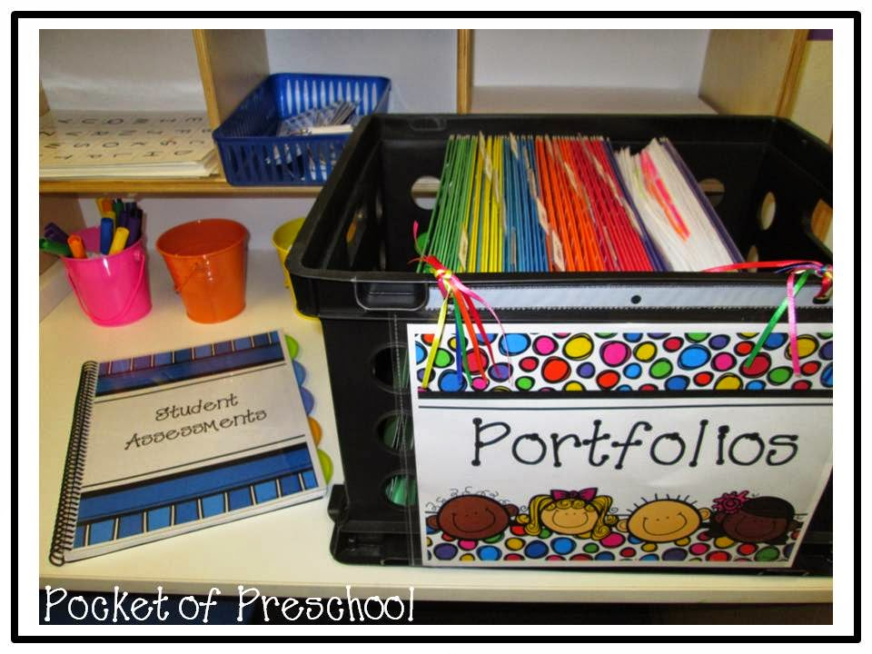

Review the collected evidence and reflect on the child’s development
Notes:
Script:
As the due date to complete the DRDP nears, review the collected evidence to ensure documentation exists to support the developmental level the child has mastered.

Slide 100
How do children demonstrate a developmental level is mastered?
A developmental level is mastered when the child typically demonstrates the behavior(s)
Consistently over time
In different situations or settings
Notes:
Trainer Note:
Read slide. Give pause to let participants think about the criteria for “mastered.” Suggest participants make poster to put around center to help staff learn this as a mantra.

Slide 101
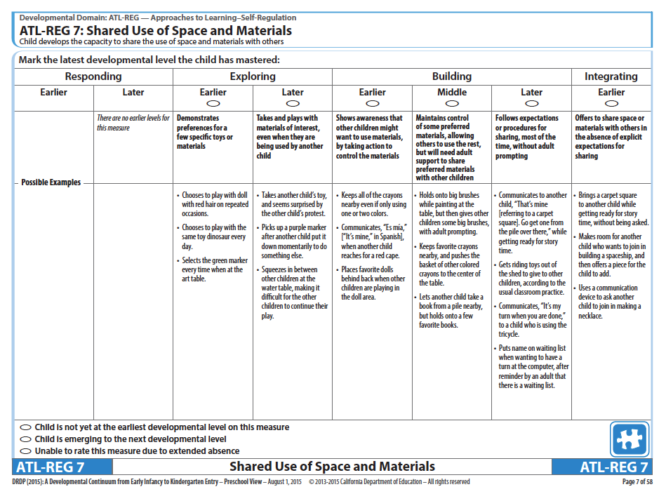
Based on observations, fill-in one bubble that best describes the child’s highest developmental level mastered
Notes:
Script:
Based on observations, fill-in one bubble that best describes the child’s highest developmental level mastered.

Slide 102
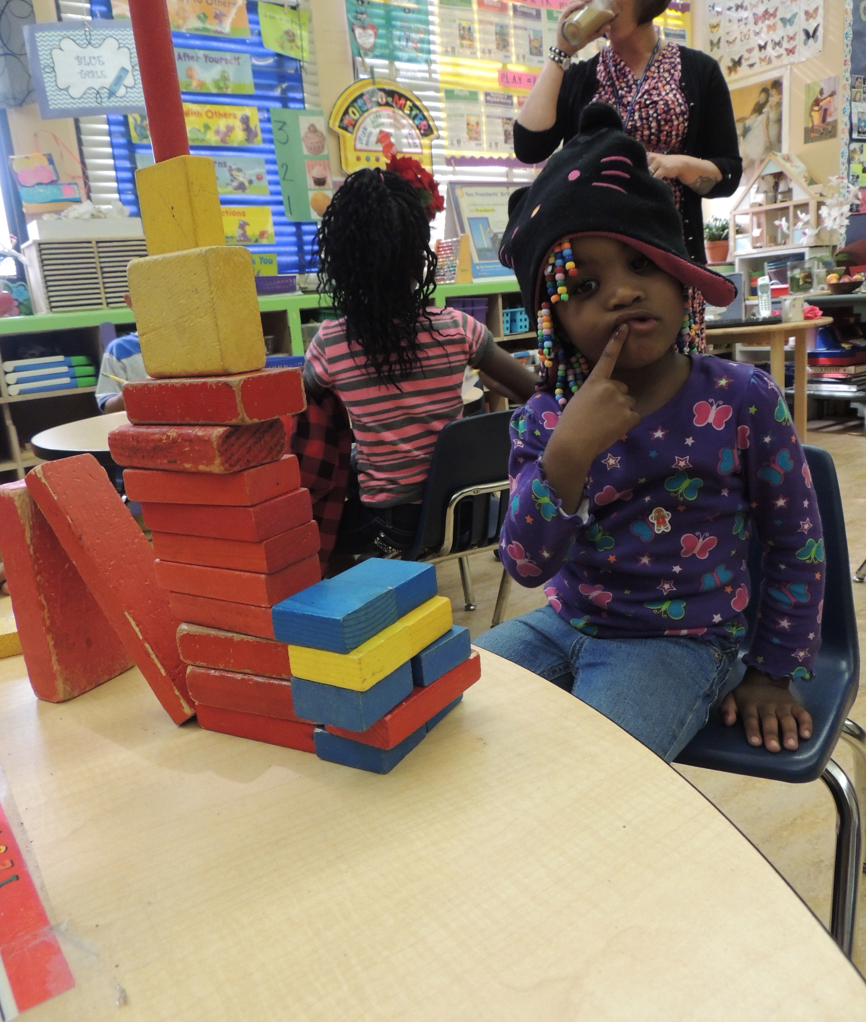
After marking the developmental level mastered, ask “Is the child emerging to the next level by demonstrating behaviors from the next developmental level, but are not yet typical or consistent? If so…

Slide 103
Emerging
Notes:
Script:
After marking the developmental level mastered, consider if the child is beginning to sometimes demonstrate behaviors from the next level. As compared to mastered behaviors which are consistent, emerging behaviors are not yet typical or consistent.
If you determine that the child is emerging to the next level, you may mark the bubble labeled, emerging.
Using the emerging bubble is optional and up to the individual teacher.
If the child is at the last developmental level do not rate the child as emerging to the next level.

Slide 104
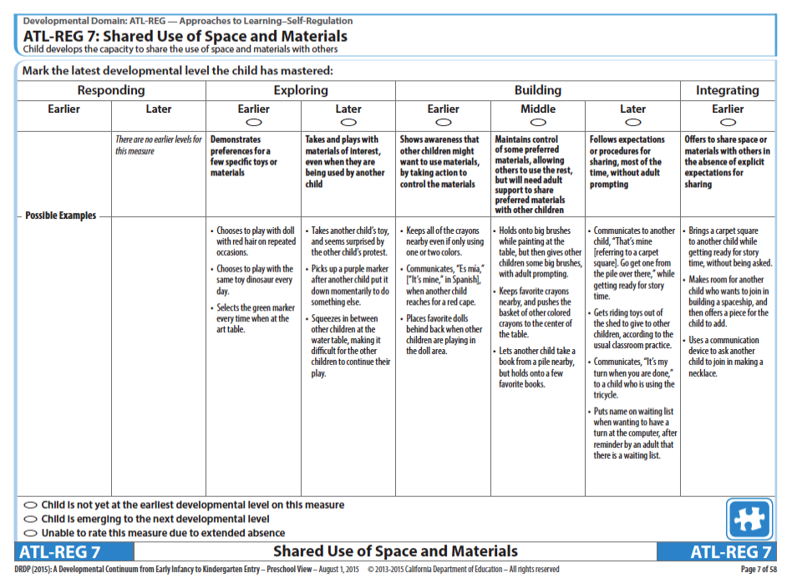
Not Yet at the Earliest
Developmental Level
Notes:
Script:
Not yet at the earliest developmental level means that you do not see mastered skills or behaviors that would allow you to mark the first developmental level.
Note that the not yet at earliest developmental level bubble is not available in the infant/toddler instrument because that instrument begins with the reflexive stage which children typically evidence at birth.

Slide 105

Unable to Rate
Notes:
105
Script:
In the rare circumstance that a you are unable to rate a child on a specific measure, explain in detail the reason for a lack of rating in the box at the bottom of the page.
Unable to rate is only used or extended absences.

Slide 106
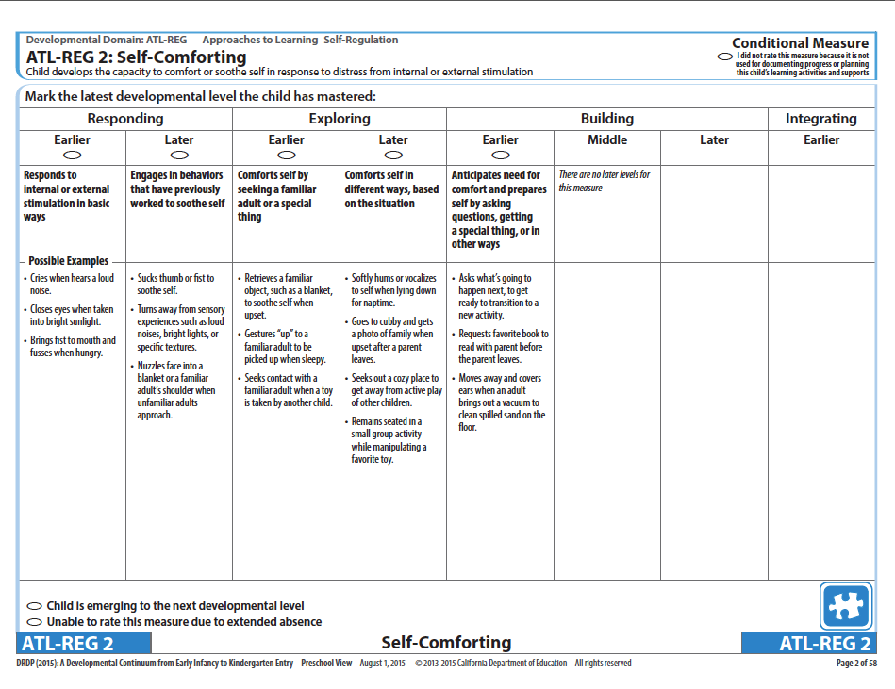
Conditional Measures
Notes:
Script:
If you determine that a conditional measure is not used for documenting progress or planning for this child’s learning activities and supports there is an option in the top right corner for Conditional Measures.
If the conditions are met the measures are required.

Slide 107
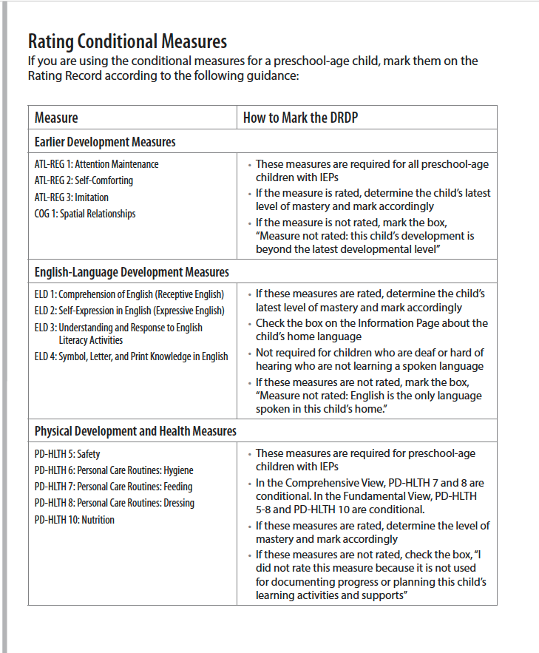
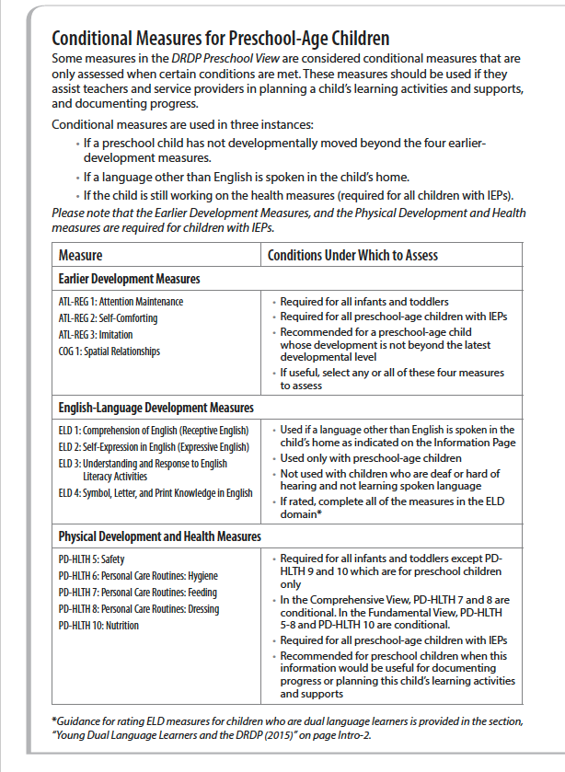
Conditional Measures
Notes:
Script:
Refer to the charts on Intro 4 and Intro 6 for more information.

Slide 108

Preschool English Language Development Measures
Notes:
108
Script:
The DRDP (2015) Preschool View instrument contains four measures for English Language Development.

Slide 109
English Language Development Measures
ELD 1: Comprehension of English (Receptive English)
ELD 2: Self expression in English (Expressive English)
ELD 3: Understanding and response to English Literacy Activities
ELD 4: Symbol, Letter, and Print Knowledge in English
Notes:
109
109
Script:
The four English Language Development measures used for children learning English are:
ELD 1 :Comprehension of English (Receptive English),
ELD 2: Self expression in English (Expressive English),
ELD 3: Understanding and response to English literacy activities, and
ELD 4: Symbol, letter, and print knowledge in English

Slide 110
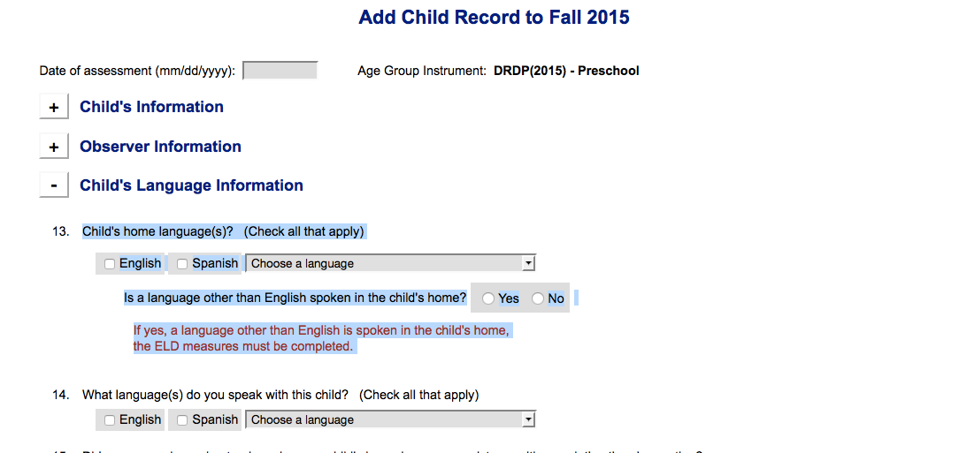
Child’s Language Information
Notes:
Script:
When completing the child record sheet inside of DRDPtech. It is important to answer question number 13 correctly. If you answer Yes, another language other than English is spoken in the child’s home, the ELD measures will be available. If you select NO, the ELD measures will be marked NA.

Slide 111
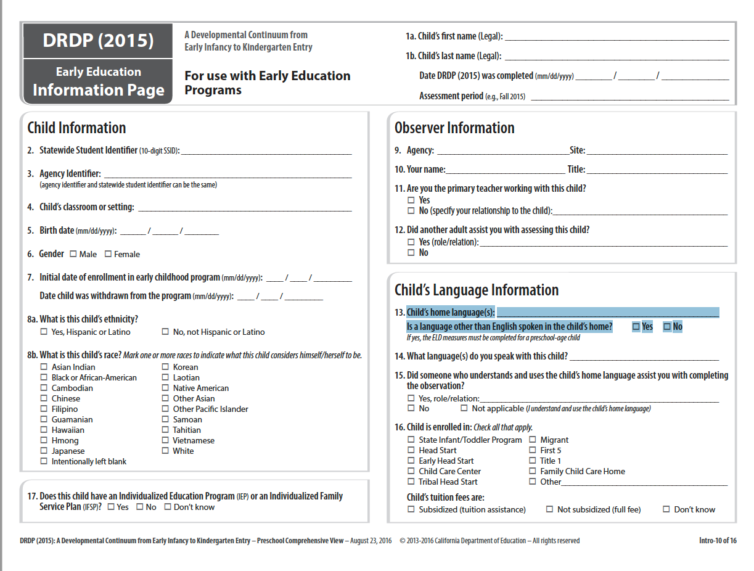
Child’s Language Information
Notes:
Script:
On Intro 10. Question #12 gives directions on when to use the ELD measures.
If another language other than English is spoken in the child’s home, the ELD measures must be completed for preschool age children.

Slide 112
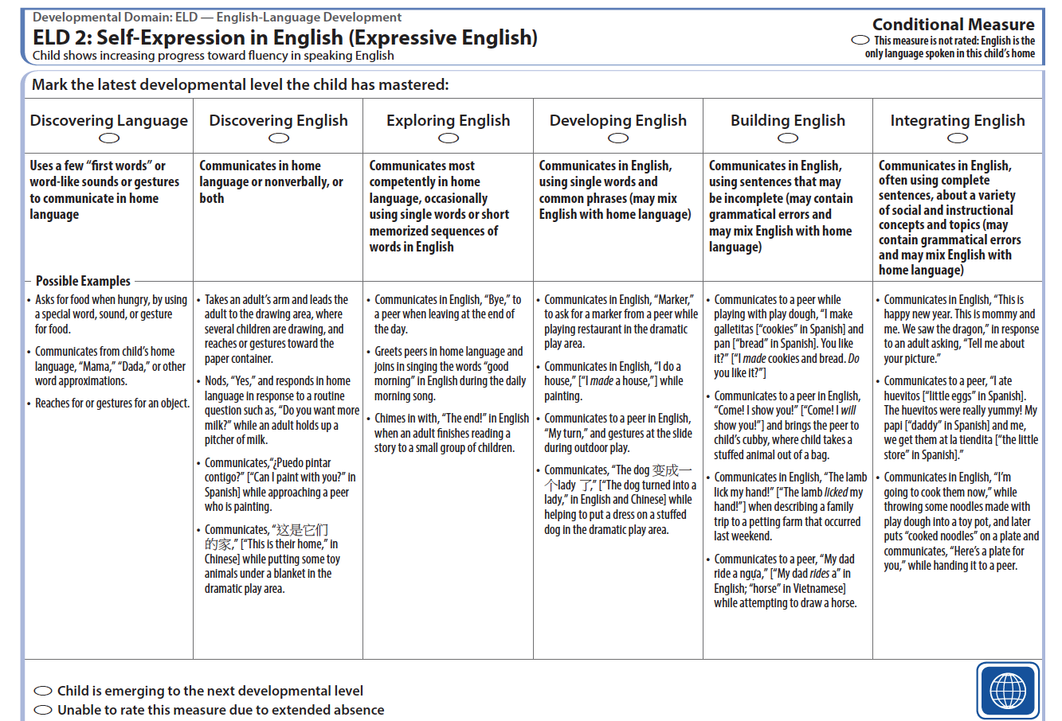
The New Developmental Levels for ELD
Notes:
Script:
There are two new developmental levels for all of the ELD measures. The descriptors in the first two levels (Discovering language and Discovering English) refers to the child's use of their home language.

Slide 113
Assessing Children Who Are Dual Language Learners
DRDP 145-147
Notes:
Script:
In your folder is a handout, Assessing Children Who are Dual Language Learners, which explores code switching.
Give teachers time to read the handout (8-10) minutes and circle what is important to them.
What are some things that stood out to you from the handout?
Trainer Note:
Use chart paper to chart responses about Code Switching.

Slide 114
Code Switching
Typical of dual language development
Use of multiple languages in one conversation
Uses grammatical rules of each language (at the 3 and 4 year old level of course!)
Influenced by context and purpose
Notes:
Script:
What we observed the children doing is code switching. What is code switching?
Typical of dual language development
Use of multiple languages in one conversation
Uses grammatical rules of each language-of course at the three and four year old level!
Influenced by context and purpose

Slide 115

Key Points for LLD & ELD
LLD is used with all children to measure progress in their home language.
ELD is used with any child where a language other than English is spoken in the home.
Notes:
Script:
The Language and Literacy Development measures are used to assess progress in developing foundational language and literacy skills. These measures are used with all children. Children who are dual language learners may demonstrate mastery in their home language, in English, or in both. This is true not only for Language and Literacy Development, but for all other domains as well, except for the English Language Development domain.
The four English Language Development measures are used to document and assess progress in learning to communicate in English. These four measures are used if another language other than English is spoken in the child’s home.
Communication in all languages the child uses should be considered when collecting documentation and completing the measures in all domains.
Refer to Intro 6 and the appendices for more information on Assessing Dual Language Learners

Slide 116
November Webinar
Dual Language Learner
9:00 am or 3:00 pm
November 15, 2016
HOMEWORK: Complete the LLD and ELD Foundations and Frameworks Modules inside of CECO.
Read the Assessing Dual Language Learner handout.

Slide 117

Completing a Developmental Profile
Desired Results Developmental Profile©
Notes:
Activity: Completing a Developmental Profile

Slide 118

Into Practice
DRDP 148-168
DIRECTIONS:
Review all evidence.
Reflect on what the evidence tells.
Complete the DRDP.

Slide 119
The Child’s Developmental Progress form is designed to…
Describe the child’s development to parents
Engage parents as partners in supporting curriculum objectives for the child
Assist in determining curriculum objectives to support the child’s development
Complete twice per year prior to the parent conference
Notes:
Script:
A progress form is used during parent conferences to describe children’s development and growth.
The progress form provides a review of the child’s strengths, areas that need improvement, and goals for developmental growth in the program and at home.
The information teachers write on the form is based on the DRDP, observations, work samples, and other evidence from the child’s portfolio, as well as information provided by parents.

Slide 120
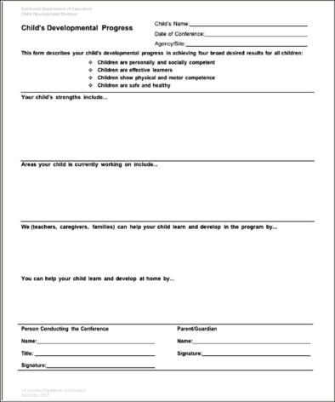
Child’s Developmental Progress Form
Notes:
Script:
This format may be used to encourage a conversation with parents about their role as the child’s first and most important teacher, as well as stressing the importance of the parents’ involvement and participation in the process of the child’s learning and growth.
Scheduled parent conferences are to occur at least two times each program year.

Slide 121
Completing the Child’s
Developmental Progress Form
DIRECTIONS:
1.Summarize DRDP findings
2.List:
  3 strengths
  1 area for improvement
  A way the program helps
DRDP 169-170
121
Notes:
Activity: Completing a Child’s Developmental Progress Form

Slide 122
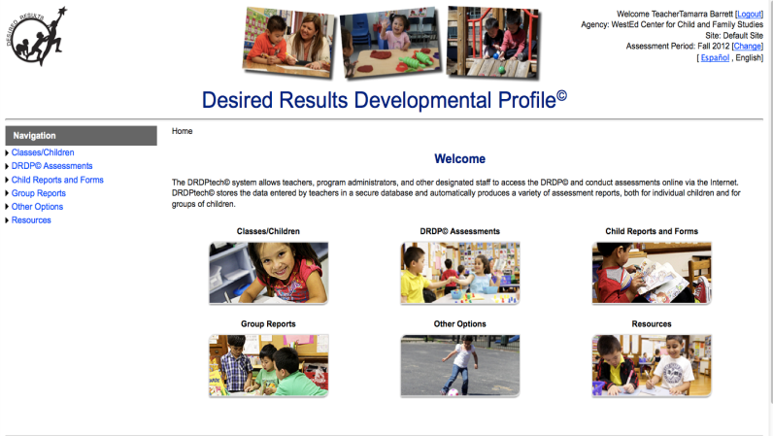
DRDPtech©
Now required of all EESD programs
Get information about DRDPtech on the Desired Results Web Site:
www.desiredresults.us
Notes:
Script:
DRDPtech CLOUD accounts are free for CDE funded programs, head start programs, California tribal CCDF, and for California K-12 school districts.

Slide 123

Break Time–10 min

Slide 124
DRDP data is compiled by…
Individual child
Classroom
Contract
DRDPtech
Excel spreadsheet
Commercial software programs
Notes:
Script:
Data on the DRDP is collected first at the individual child level, then at the classroom level, and then compiled at the contract level.
DRDPtech, provides an online system of tools for summarizing DRDP data.
Although the individual child and classroom data is kept on site and is not sent to EESD, it will be reviewed during your CPM/CMR. This data is also compiled and used to complete the Agency Program Action Plan.

Slide 125
What is DRDPtech©?
An online data entry system
An easy way to compile information about your students
Tool for printing out summary reports
Notes:
Script:
Teachers can complete the DRDPtech online, via the internet using a password and username. The system allows for automatic storage of DRDP data. The data entry system compiles all the data and provides multi level summary reports by student, or by group, and even sub group that can be shared with families and administrators.

Slide 126
DRDPtech© Reports
Notes:
Script:
All reports are designed in collaboration with EESD. They provide information about children’s competencies across developmental domains, and overtime progression. Three types of reports are featured in this slide.
Group repot – provides psychometrically valid domain level information for a specified group. Teachers can use this information in their classroom to provide specific strategies to meet the needs of their groups. Administrators can use the group report to analyze data across the program, and use the information to provide professional development or make changes for program improvement.
Child Report- provides psychometrically valid domain level information for individual children. Teacher can use this information to visually see where children are strong in their development and where they may need some support.
Review ratings –provides raw score information for individual children

Slide 127
DRDP Summary of Findings
Notes:
Script:
Programs are required to summarize the data both at the classroom and the contract level to determine key findings and action steps. These are trends or main points that require action.
Trainer Note:
After sharing, ask participants to view the sample DRDP Classroom Summary of Findings.
These findings will inform administrators and guide them in making continuous program improvements.
EESD field service consultants will be checking the DRDP Classroom Summary of Findings forms to make sure programs are using the data to inform the “continuous improvement” process.

Slide 128




What’s in the Curriculum Frameworks?
School-age frameworks available on CDE Web site
Notes:
Script:
After compiling data, action steps must be written to address the data.
The Curriculum Framework chapters provide information to support children's learning in the areas described in the California Learning and Development Foundations.
The icons and their colors are used to identify domain sections inside of the book. We will look at the sections of the book on the next slide.

Slide 129
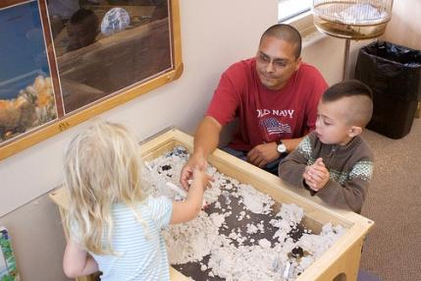
What does the framework do?
“Created as a companion to the California Preschool Learning Foundations, Volume 1, this framework presents strategies and information to enrich learning and development opportunities for all of California’s preschool children” (PCF, Vol. 1, p. v).
Notes:
Script:
There is a companion Curriculum Framework for each volume of the California Learning and Development Foundations.

Slide 130
Tips When Planning
Review current curriculum to find links with the DRDP.
Summarize children’s progress by reviewing, discussing, and consulting with others who know them.
Reflect on your collection of observations, including photos, notations, audio tapes, sketches, etc.
Consult other resources to support planning for the needs of children’s developmental levels.
Notes:
Script:
It’s important to plan to observe. When planning an activity for children, think about what to plan in relation to the DRDP. This does not mean setting up a testing situation, rather creating an invitation for children to have interactions with materials, their peers, or an adult that might provide an observation opportunity related to the DRDP.

Slide 131
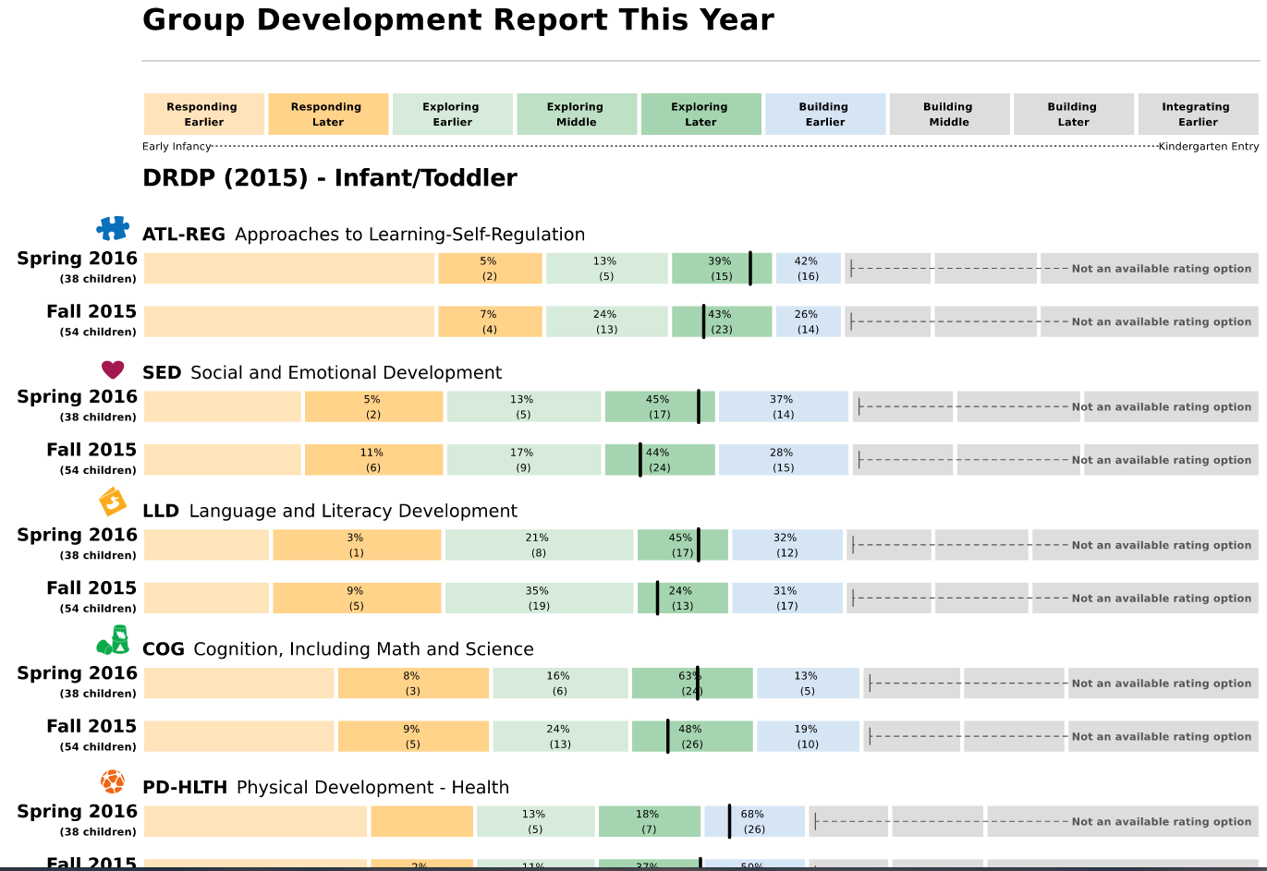
Small and Large Group Planning
Use the data provided from DRDPtech to plan for individual children, as well as for small and large group activities.
Notes:
Script:
This is one example of the data can look like. This is a Progress this Year Report. In your classroom or agency planning process, you would look at the DRDP data that is provided through your DRDPtech reports to support planning for the groups of children in your own classroom.

Slide 132

All teachers…
Must use results of assessments of children’s progress and teaching practices to support each child’s learning and development.
Notes:
Script:
All teachers, whether teaching in a Head Start or state preschool program, must use the results of the DRDP to support each child’s learning and development.
132

Slide 133
Writing a DRDP
Summary of Findings
DIRECTIONS:
1.Review narrative and DRDP Group Data Summary.
2.Identify key findings.
3.Draft action steps.
Notes:
Activity: Writing a Summary of Findings

Slide 134
Taking it
Back to the Agency
RES 13-18
Notes:
Script:
Participants may use calendar pages to plan when they will:
Train staff to complete the DRDP
Complete the first and second DRDP, complete each Child’s Developmental Progress Form, and schedule parent/teacher conferences
Group the DRDP data
Complete the DRDP Summary of Findings per classroom and agency

Slide 135

Self Study Checklist for Program/Agency
Use the Self-Study Checklist for Program/Agency
Administrators to plan agency/contract calendar
Notes:
Script:
To support participants in planning month to month training activities, direct participants to the DR system self-study checklist in their DR binder. In the Resources section, at the back of the binder, participants will find calendar pages.
Requirements are listed on the checklist with suggested times (months) for completion.

Slide 136

Self Study Checklist for Classroom/FCCHN
Use the
Self-Study Checklist for Classroom/Family
Childcare Home
Network Staff
to plan classroom/group
calendar
Notes:
Script:
Note that there are two sides to the checklist. One is for classroom/FCC home staff and the other side addresses the requirements of program/agency administrators.

Slide 137

DRDP Resources

Slide 138




Check out the Desired Results www.desiredresults.us
Resources
Tools
Forms
Samples

Slide 139



DRDP Portfolio App
Notes:
Script:
The DRDP (2015) Portfolio App is another way to collect and organize documentation electronically. The app allows teachers to upload pictures, videos, and or voice recordings and assign the documentation to specific measures. This information can be shared with families and with other teachers.

Slide 140



DRDP (2015) Tutorials
Notes:
Script:
There are DRDP tutorials coming soon in both Spanish and English available on the website.
You can learn more about the DRDP (2015) by using the simple-to-use online tutorials.
They are very short PowerPoints with a voice narration.

Slide 141



Support Materials for Implementation of DRDP
Getting to Know You Through Observation DVD, Training and Guided Practice on Observation Skills
Getting to Know you Through Observation Trainer’s Guide and Workbook
Getting to Know you Through Observation Trainer’s Guide and Workbook
Getting to Know You Through Observation Trainer Guide and Workbook, 12 training activities
www.desiredresults.us
Notes:
Script:
These are other support materials. Order forms are available on the Resources page of the DR website.

Slide 142

All About Young Children
Notes:
Script:
This Web site provides resources for families based on the California Infant/Toddler Learning & Development Foundations and the California Preschool Learning Foundations.
Parents and family members can find out what skills help children from birth to five learn; how they learn language, how they learn about feelings and relationships, how they learn about numbers, and how they become skillful at moving their bodies.
The name of the Web site is All About Young Children, and includes video clips of children's activities followed by parents' discussion, print materials of five domains in five age groups, audio files, and downloadable materials.
This Web site provides resources in eight different languages and for different age levels.

Slide 143
All About Young Children
Notes:
Script:
There are downloadable PDF documents available for multiple ages and domains in eight different languages.

Slide 144

CompSAT
Notes:
Script:
This is another helpful Web site for your professional growth.
CompSAT helps early childhood professionals reflect on their everyday practice and examine what they know and are able to do. There are 12 competencies that are considered.
Users are able to learn and grow at your own pace.
The website has interactive, multimedia tools, that enhance learning, and identify strengths and needs.
CompSAT is the companion guide to the ECE Competencies.

Slide 145

California Early Childhood Online (CECO)
Notes:
Script:
The courses provided on the California Early Childhood Online (CECO) website are FREE and enable teachers to increase content knowledge and ability to provide developmentally appropriate experiences for children in their care.
CECO provides access to comprehensive resources and courses in one centralized location to meet the ever-changing needs of the early childhood field.
When you complete a module, you receive a certificate that is good for professional growth hours.

Slide 146
Questions and Answers

Slide 147
Final
Jeopardy
Notes:
Final Jeopardy
Script:
Table teams can wager some or all of your winnings up to this point on this final question. Write the amount of the wager on the white board.
Trainer Notes:
Ensure that all teams have followed the instructions.
Play the Jeopardy tune or sing/hum the music as the answer/question is quietly discussed and written on the white board.
Allow sufficient time to complete writing before advancing to the next slide.
NOTE: This activity can get a bit rowdy and competitive. Make sure the wagering rules are followed and ask people to hold up paddles for others to see. Sometimes it helps to know what the total is for those who got PERFECT scores.

Slide 148
Final Jeopardy
These components help to understand the true intent of each measure
2010 © California Department of Education
Desired Results T & TA Project
148
Notes:
148

Slide 149
Final Jeopardy
What are…
the 4 D’s ?
Winner!
2010 © California Department of Education
Desired Results T & TA Project
149
Notes:
149

Slide 150

Please take a few minutes to complete the training evaluation form
or
Complete using the link below:
https://www.surveymonkey.com/r/sac10062015

Slide 151
November Webinar
Dual Language Learner
9:00 am or 3:00 pm
November 15, 2016
HOMEWORK: Complete the LLD and ELD Foundations and Frameworks Modules inside of CECO.
Read the Assessing Dual Language Learner handout.

Slide 152

Thank You!!!

